Slide 1

Unit 6: Entertainment
Overview
Pages 102 & 103

Slide 2
Lesson Outline
Warm-up
Vocabulary
Speaking
Consolidation
Wrap-up

Slide 3
Objectives
By the end of this lesson, students will be able to…
- revise vocabulary about fun activities.
- practise asking and answering questions about weekends.

Slide 4

WARM-UP

Slide 5
What activities do you usually do to relax?

Slide 6

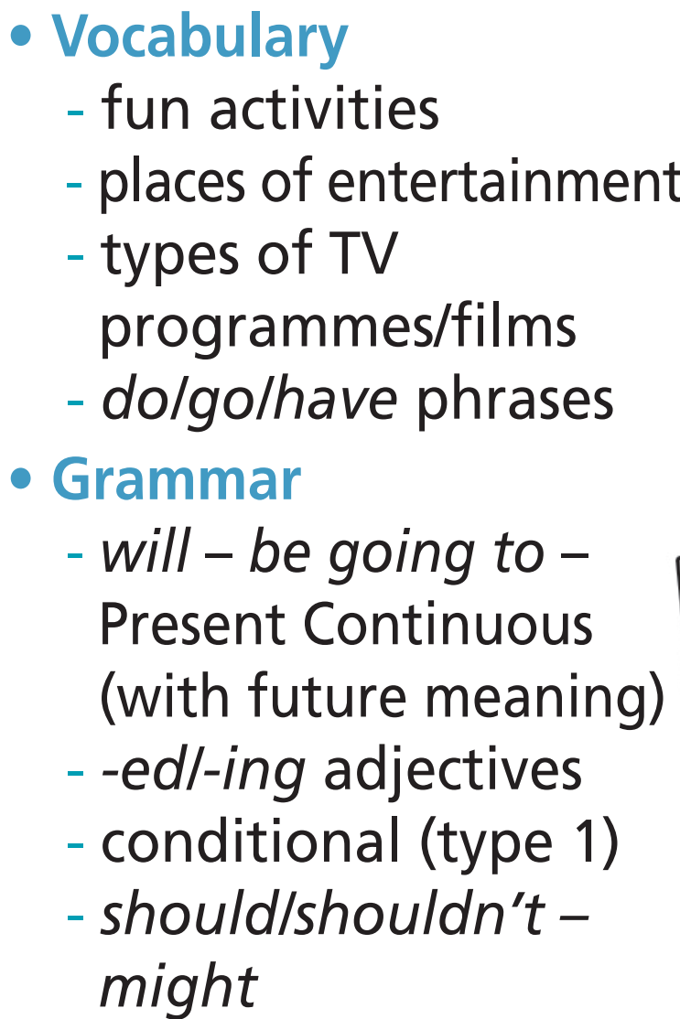
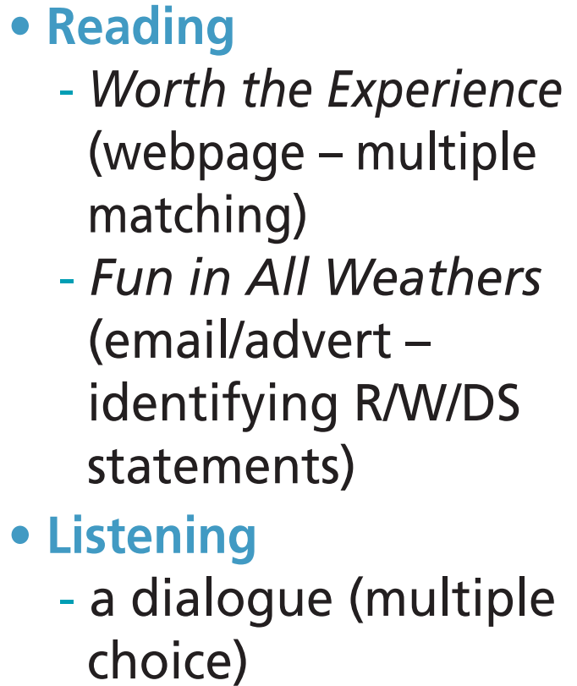
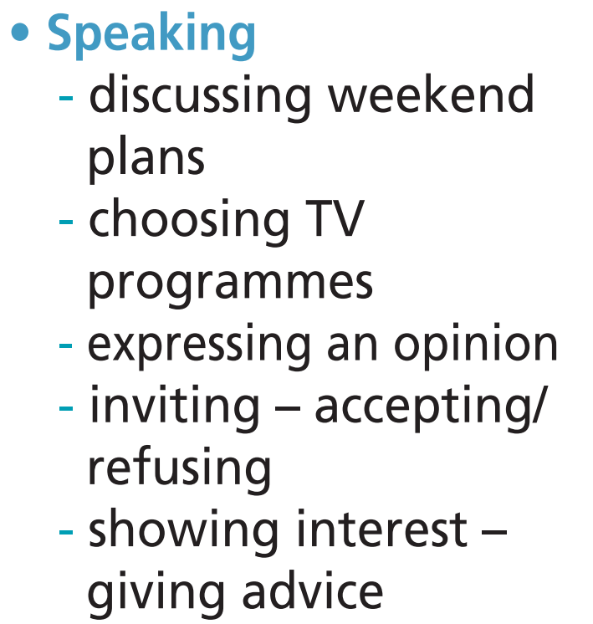
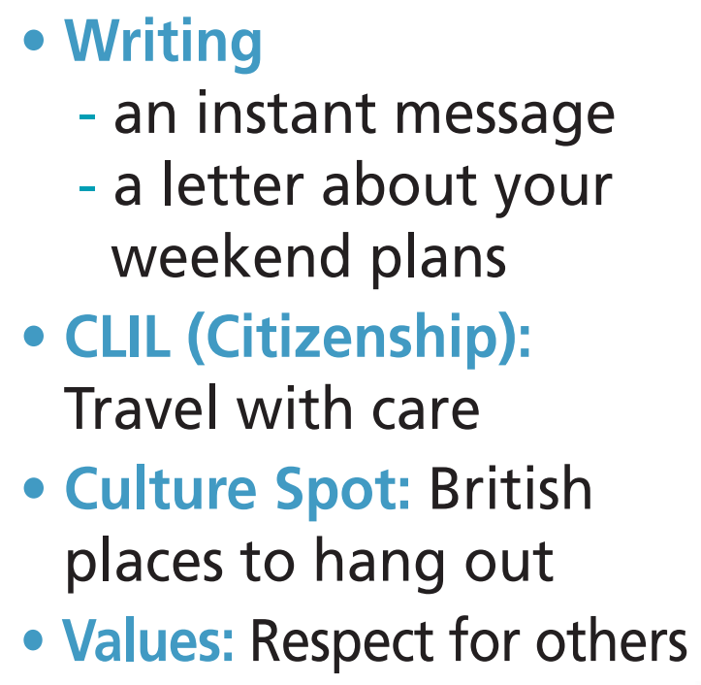

Slide 7

It’s time to learn …

Slide 8

Presentation

Slide 9
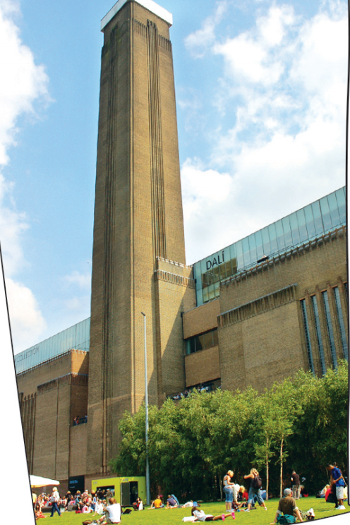
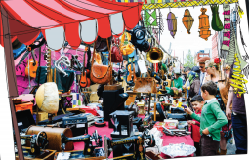
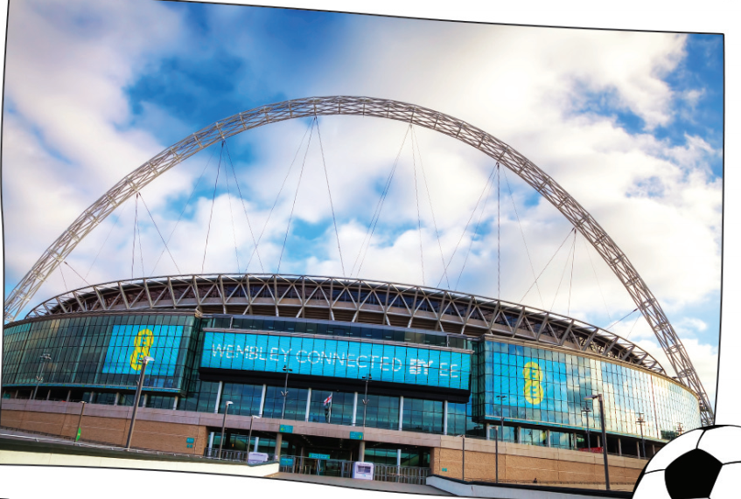
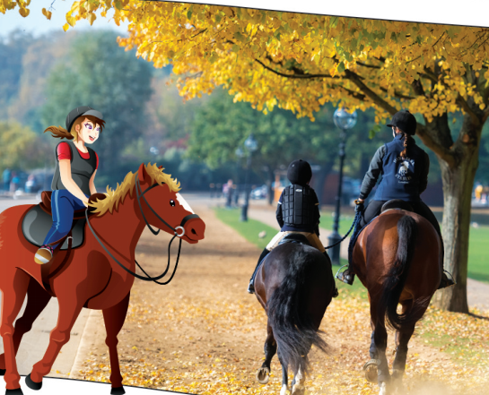
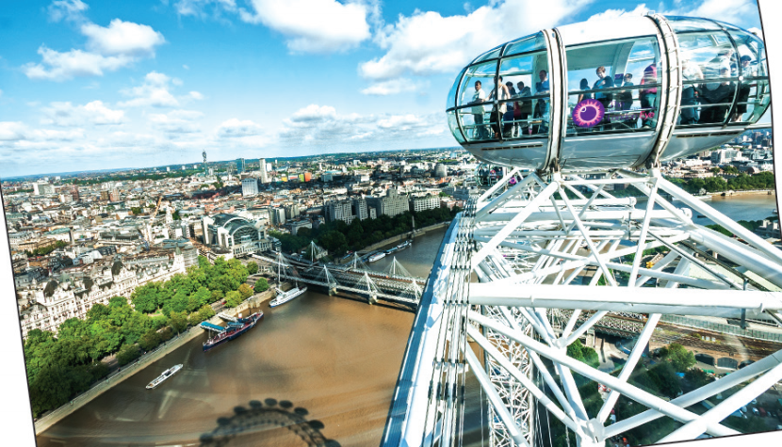
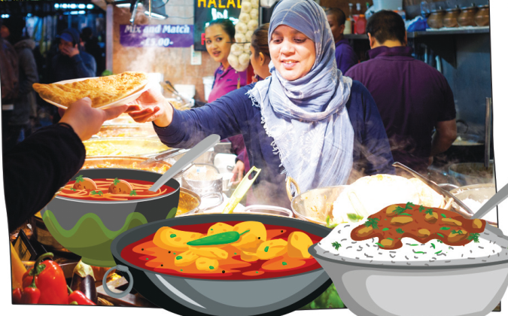
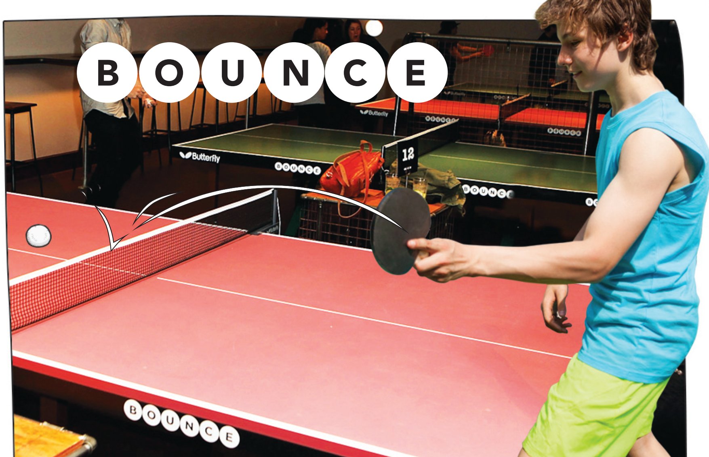
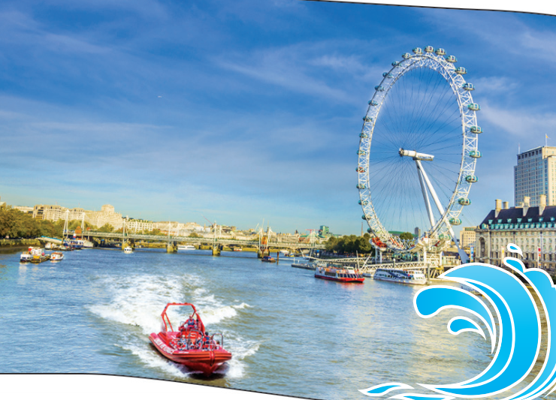
1 a) Look at the pictures and fill in the gaps with the verbs in the list.
take
play
see
watch
sample
go
go
pick
1 ______ works of art at the Tate Modern.
3 _____ up bargains at stalls at Brick Lane Market.
5 ______ a football match at Wembley Stadium.
7 ______ horse riding at Hyde Park Stables.
2 ______ ping pong at Bounce.
4 _____ down the River Thames in a speedboat
6 _____ a ride in a capsule on the London Eye
8 ______ delicious street food in Camden Market.

Slide 10

b) Listen and check your answers.
take
play
see
watch
sample
go
go
pick
1 ______ works of art at the Tate Modern.
3 _____ up bargains at stalls at Brick Lane Market.
5 ______ a football match at Wembley Stadium.
7 ______ horse riding at Hyde Park Stables.
2 ______ ping pong at Bounce.
4 _____ down the River Thames in a speedboat
6 _____ a ride in a capsule on the London Eye
8 ______ delicious street food in Camden Market.

Slide 11
Pre-reading:
Vocabulary:
• capsule /ˈkæpsjuːl/ (n): buồng (cáp treo, vòng đu quay)
• bargain /ˈbɑːɡɪn/ (n): món hời
• works of art /ˌwɜːkz əv ˈɑːt/ (n phr): tác phẩm nghệ thuật

Slide 12
Pre-reading:
Practise saying them and make sentences using them.
•
• capsule /ˈkæpsjuːl/ (n): buồng (cáp treo, vòng đu quay)
•
• bargain /ˈbɑːɡɪn/ (n): món hời
•
• works of art /ˌwɜːkz əv ˈɑːt/ (n phr): tác phẩm nghệ thuật

Slide 13
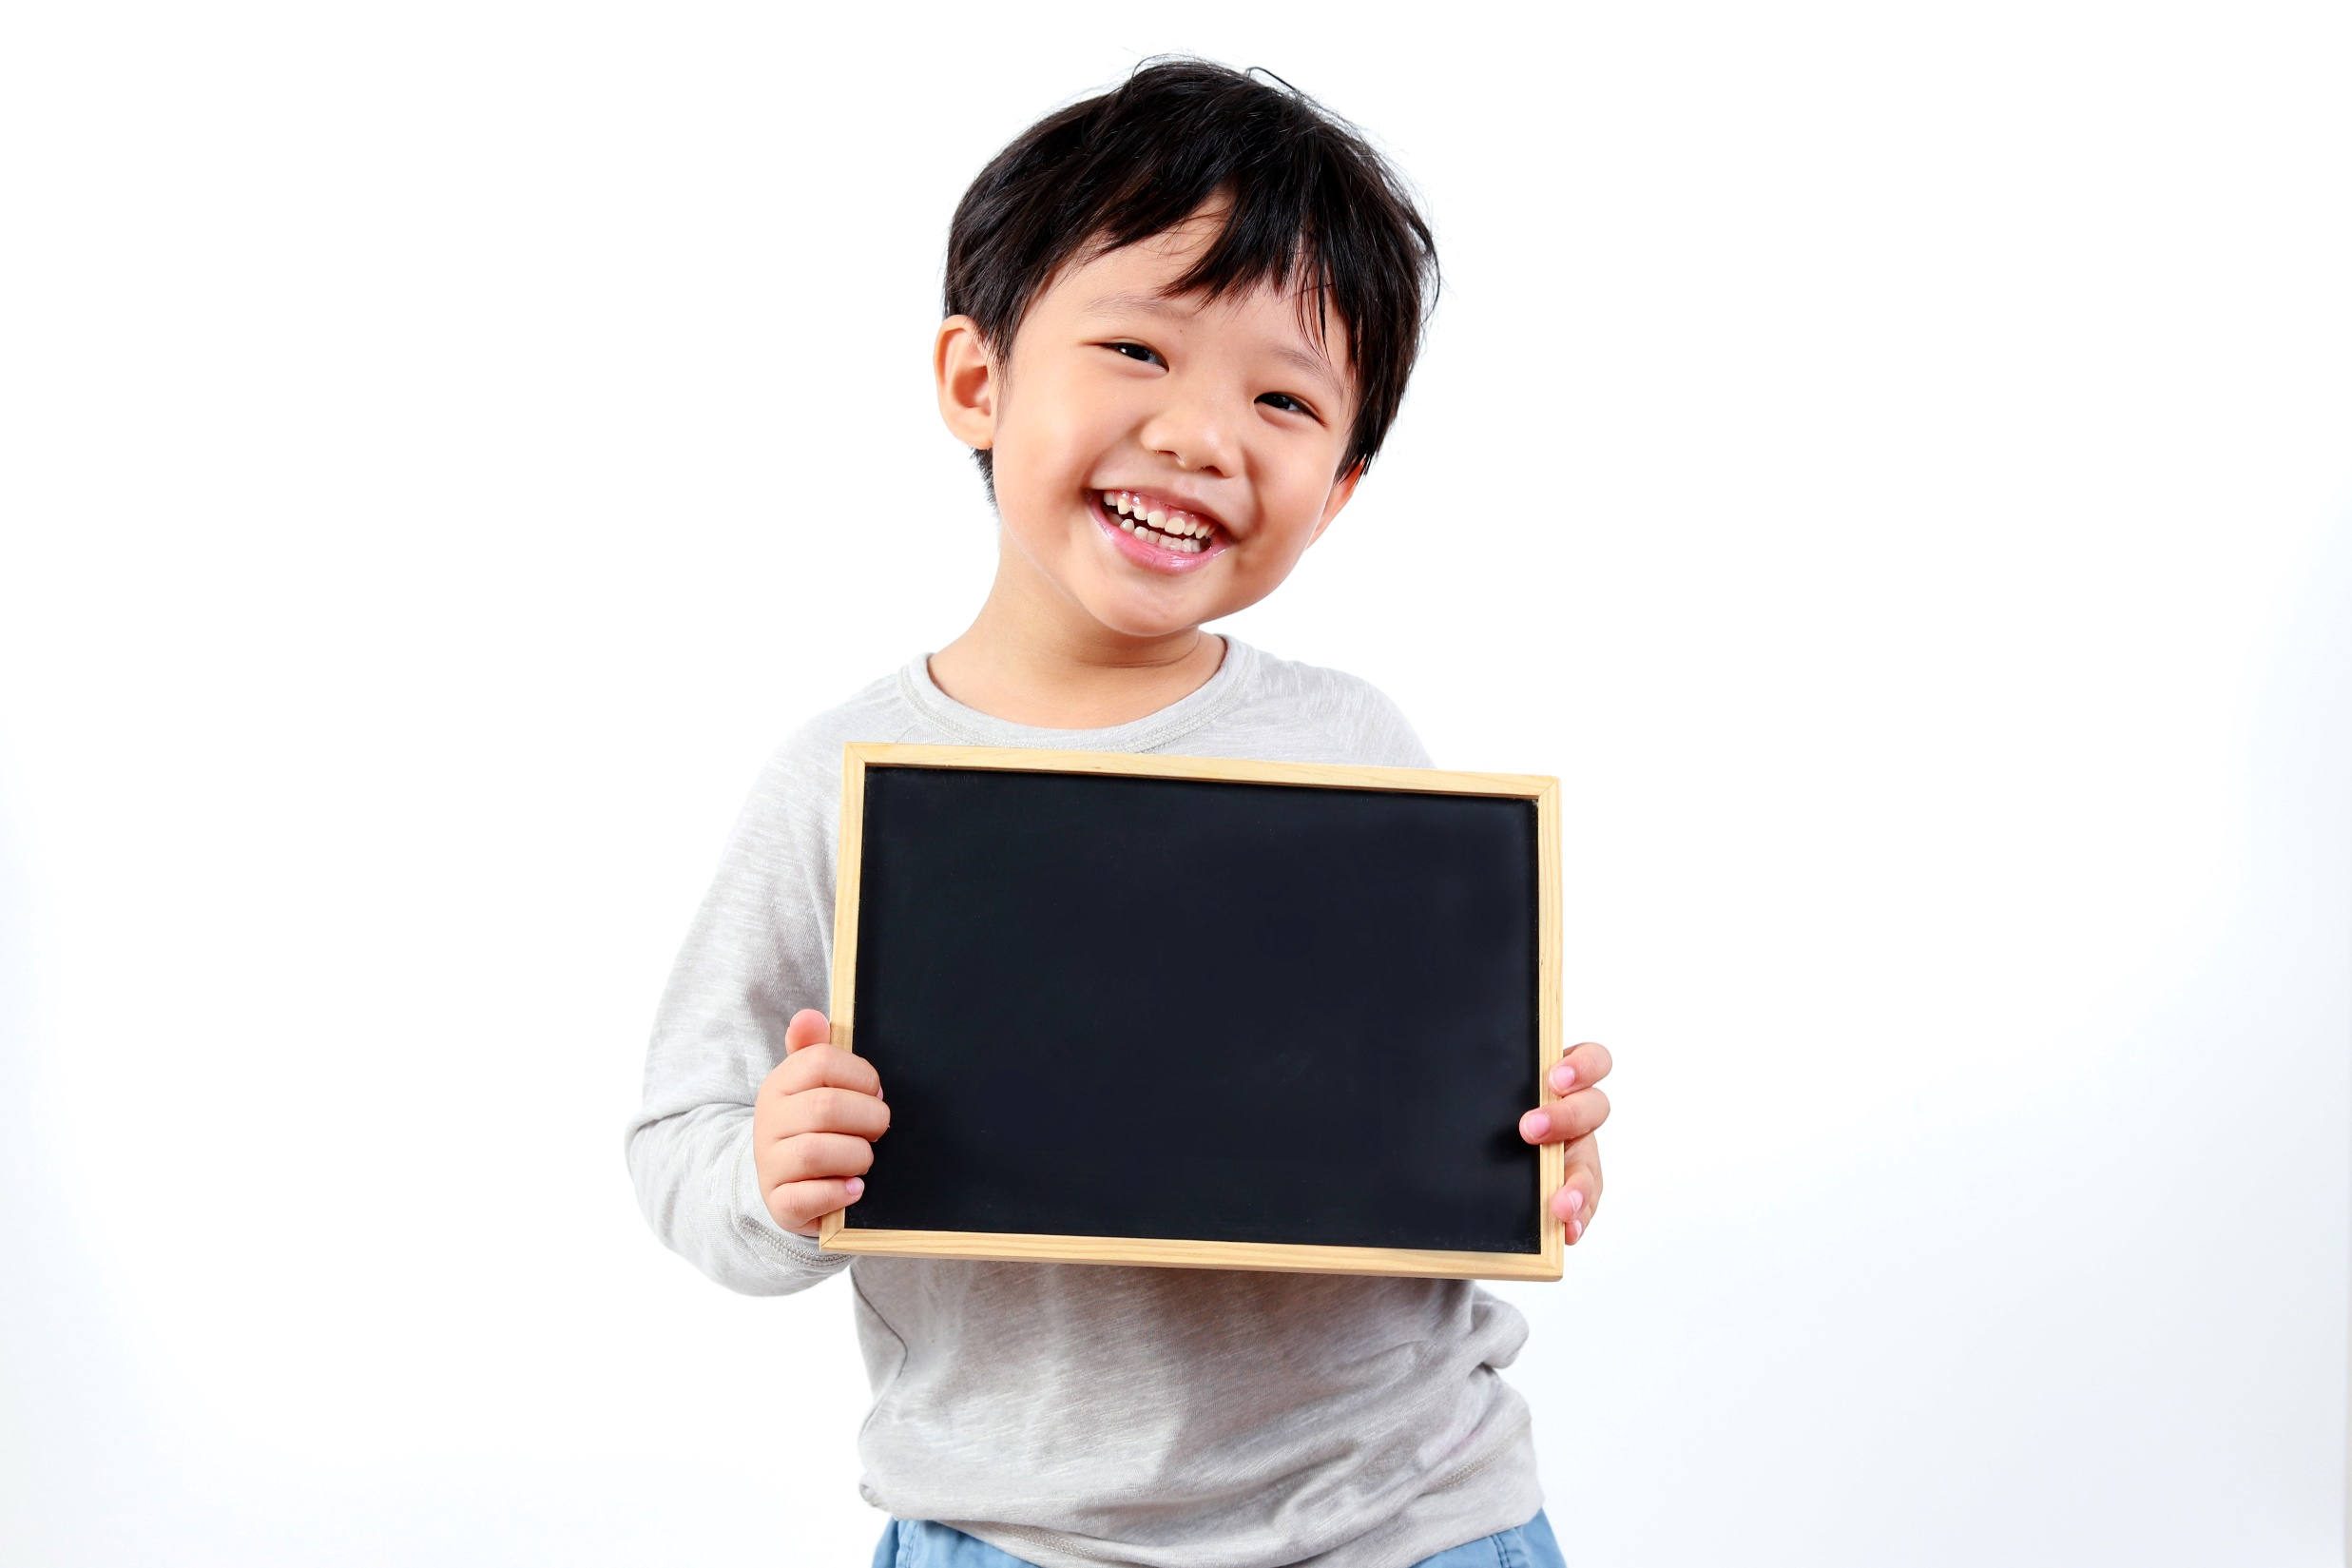
Practice

Slide 14

2 Imagine you are in London. Say what you are going to do this weekend.
Example
A: We’re going to play ping pong at Bounce this Saturday. What about you?
B: We’re going to go horse riding at Hyde Park Stables. I can’t wait.
A: Sounds good!

Slide 15
Martin and his friends are visiting London. Complete the gaps with the verbs in -ing form
Further practice
see
see
go
play
listen
attend
sample
pick
playing
seeing
1 Martin: “I love ____________ ping pong or ____________ robotics exhibitions.”
2 Sophie: “I love ___________ to rock music or __________ live performances.”
3 Jane: “I really enjoy _______ up bargains in markets or ____________ street food.”
4 Adam: “I like ____________ horse-riding at the park or __________ a sports event.”
listening
attending
picking
sampling
going
seeing

Slide 16

Production

Slide 17
Work in pairs. Ask and answer the question.
What are you going to do this weekend?
Suggested answer
This weekend, I’m going to play football with my friends.

Slide 18

CONSOLIDATION

Slide 19
Write a paragraph (60-80 words) to talk about what you usually do for entertainment.

Slide 20

WRAP-UP

Slide 21
Today’s lesson
Vocabularies
Fun activities

Slide 22
Homework
Practise the vocabularies and make sentences using them.
Do the exercises in TA 6 Right on Notebook (pp. 52 & 53).
Prepare the next lesson (p. 104 SB).

Slide 23
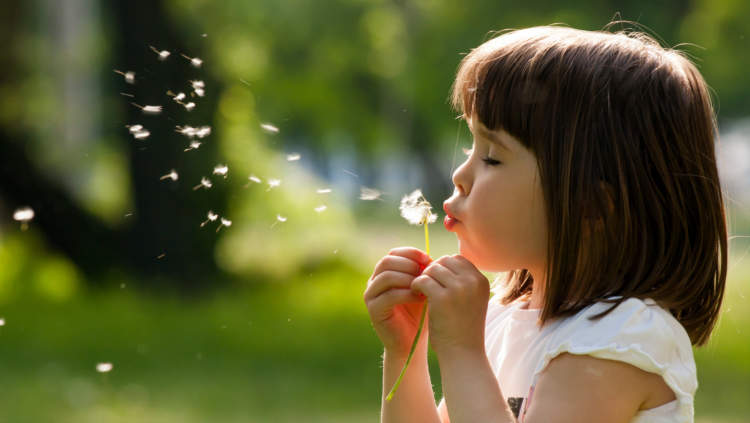
Enjoy your day!

