Slide 1


Slide 2

Unit
4
Asean and Viet Nam
Unit
FAMILY LIFE
LESSON 8
LOOKING BACK AND PROJECT

Slide 3
LESSON 8
LOOKING BACK AND PROJECT
WARM-UP
Game: Odd one out! – The ASEAN
Pronunciation: Elision of vowels
Vocabulary: ASEAN
Grammar: Gerunds as subjects and objects
LOOKING BACK
PROJECT
THE COLOURS OF ASEAN
CONSOLIDATION
- Wrap up
- Homework

Slide 4

THE ASEAN
ODD ONE OUT
WARM-UP

Slide 5
EXAMPLE
Which one doesn’t belong here?
A: Banana
B: Apple
C: Carrot
D: Watermelon
C: Carrot
Why? A carrot is a vegetable, the others are fruits.

Slide 6




B: It is the Dutch flag.
The Netherlands is not a member of ASEAN
A
B
C
D

Slide 7




C: Washington is not in the Southeast Asia
A. Bangkok B. Manila
C. Washington D. Naypyidaw

Slide 8
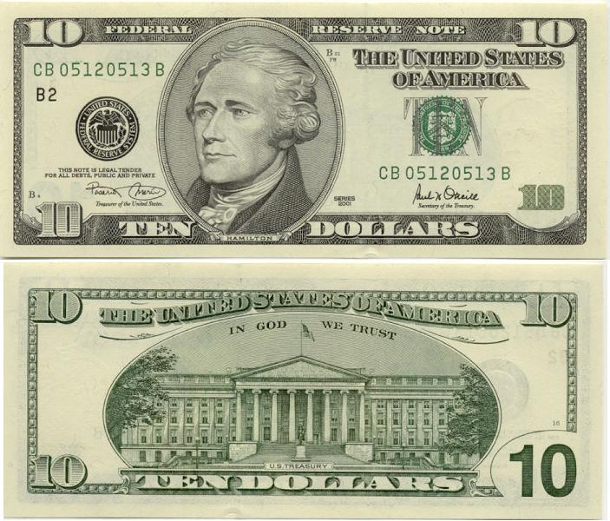
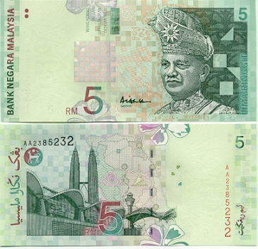
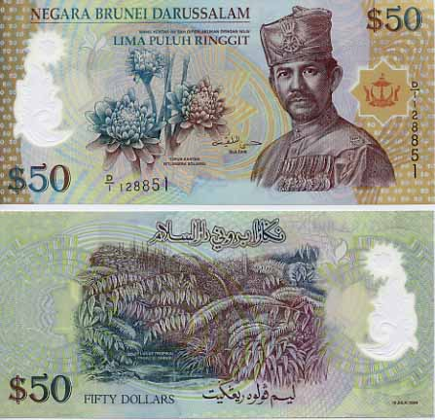
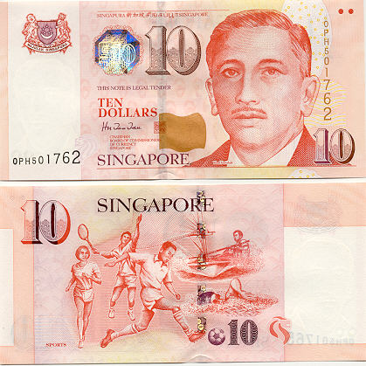
A: It is the 10 US dollar bill
A
B
C
D

Slide 9
B: Thailand is a country,
NOT a language
A. Indonesian B. Thailand
C. English D. Malay

Slide 10
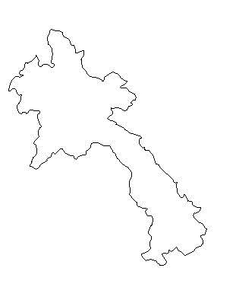
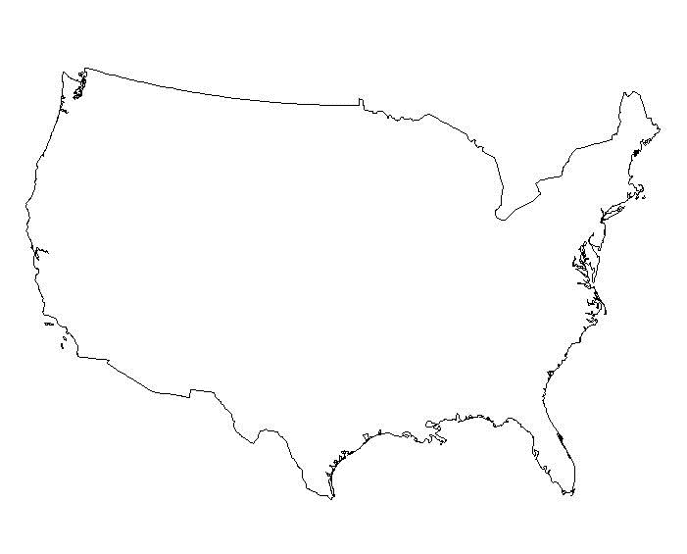
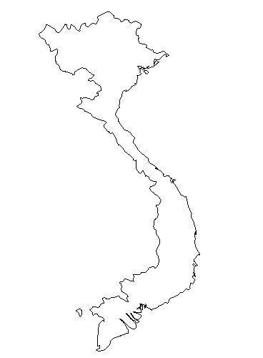
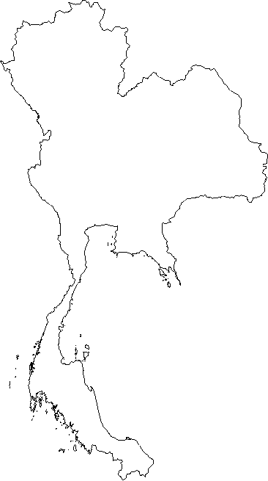
B: USA is not a country in the Southeast Asia
A
B
C
D

Slide 11




C: It is the flag of Indonesia, the other flags are not ASEAN flags.
A
B
C
D

Slide 12


Slide 13

LOOKING BACK
1
Listen and underline words with elision.
1. There are no correct answers on her test paper.
2. He’s going to fly to Bangkok tonight.
3. The participants were probably excited about the palace history.
4. I believe that members expressed different opinions about the issue.

Slide 14
LOOKING BACK
2
Choose the correct words to complete the sentences.
1. Talking to the young volunteers was an eye-opening / a live-streamed experience.
2. Mark was awarded for his contribute / contribution to promoting traditional music.
3. You need to have strong leader / leadership skills to manage the project.
4. This programme tries to encourage culture / cultural exchanges among ASEAN countries.

Slide 15
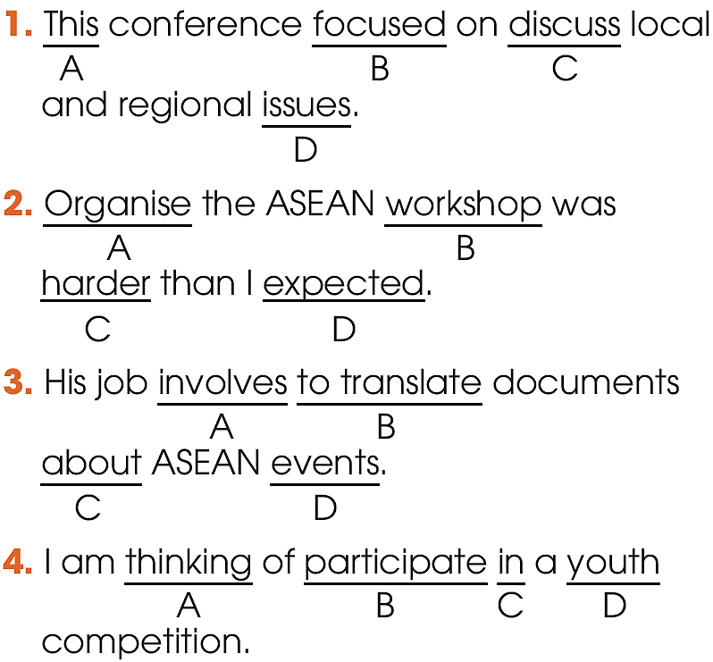
LOOKING BACK
3
Circle the underline part that is incorrect in each of the following sentence. Then correct it.
discussing
Organising
translating
participating

Slide 16
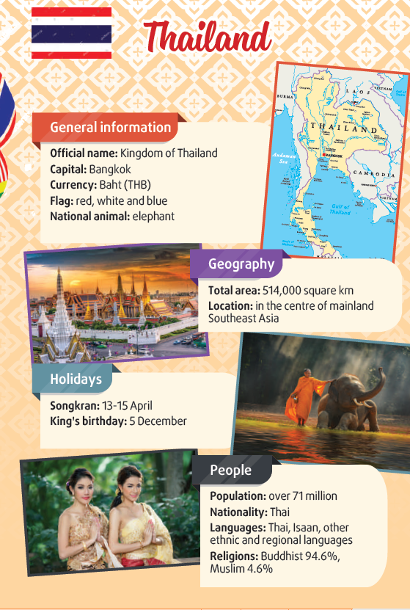
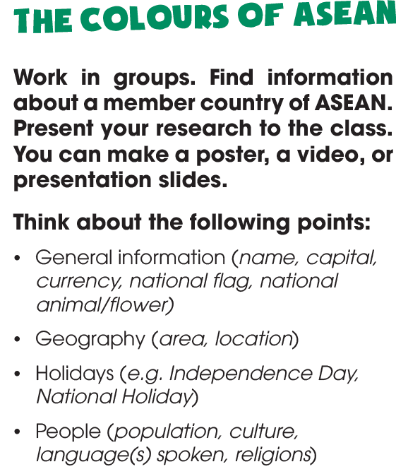
PROJECT

Slide 17
CONSOLIDATION
1
Wrap-up
What have you learnt today?
Review the vocabulary and grammar of Unit 4
Apply what you have learnt (vocabulary and grammar) into practice through a project.

Slide 18

CONSOLIDATION
2
Homework
Do exercises in the workbook.
Prepare for Unit 5.

Slide 19

Website: hoclieu.vn
Fanpage: facebook.com/www.tienganhglobalsuccess.vn

