Slide 1

Unit 6: Entertainment
Lesson 6f: Skills
Page 112

Slide 2
Lesson Outline
Warm-up
Vocabulary
Reading
Consolidation
Wrap-up

Slide 3
Objectives
By the end of this lesson, students will be able to…
learn some vocabulary: outdoor, life-sized, pick sb up, track, session, rate.
talk about the place they want to visit.

Slide 4

WARM-UP

Slide 5
Choose the word whose main stress is placed differently from that of the others.
1. A. fiction B. thriller C. cartoon D. action
/ˈfɪkʃən/ /ˈθrɪlə/ /kɑːˈtuːn/ /ˈækʃən/
2. A. fantasy B. adventure C. opera D. stadium
/ˈfæntəsi/ /ədˈventʃə/ /ˈɒpərə/ /ˈsteɪdiəm/
3. A. animation B. documentary C. opinion D. exhibition
/ˌænɪˈmeɪʃən/ /ˌdɒkjəˈmentəri/ /əˈpɪnjən/ /ˌeksɪˈbɪʃən/

Slide 6

Where are you going this weekend?
What are you going to do there?

Slide 7

It’s time to learn …

Slide 8

Reading

Slide 9

Pre-reading:
Vocabulary:
• outdoor /ˈaʊtdɔː/ (adj): ngoài trời
• life-sized /ˈlaɪf saɪzd/ (adj): có kích thước như vật thật
• pick somebody up /ˌpɪk ˈsʌmbədi ˈʌp/ (v phr): đón (rước) ai đó
• track /træk/ (n): đường đua
• session /ˈseʃən/ (n): buổi, phiên
• rate /reɪt/ (n): giá cả

Slide 10
Pre-reading:
Vocabulary:
•
• outdoor /ˈaʊtdɔː/ (adj): ngoài trời
•
• life-sized /ˈlaɪf saɪzd/ (adj): có kích thước như vật thật
•
• pick somebody up /ˌpɪk ˈsʌmbədi ˈʌp/ (v phr): đón (rước) ai đó
• track /træk/ (n): đường đua
•
• session /ˈseʃən/ (n): buổi, phiên
• rate /reɪt/ (n): giá cả

Slide 11


While-reading:
1. Look at the texts. Which is an advert? a letter? What is each about? Listen and read to find out.
a letter
an advert
Hi Julian,
Hope you’re well! On Saturday, my brother and I are going to Jurassic Falls Adventure Golf, an outdoor mini-golf course in East London. It’s got a dinosaur theme! There are life-sized model dinosaurs everywhere and a dinosaur-themed restaurant, Gogyuzu. Why don’t you join us? We’ll pick you up at 10:00.
Let me know if you can make it.
Alex
Capital Karts in Barking, just 15 minutes from Central London, has the UK’s longest indoor go-karting track. It’s 1,050 metres long and you can drive at speeds of up to 45 miles per hour! For just £10 per person, you can enjoy a 30-minute session. Coming as a large group? Give us a call and we’ll find a special rate for you!

Slide 12
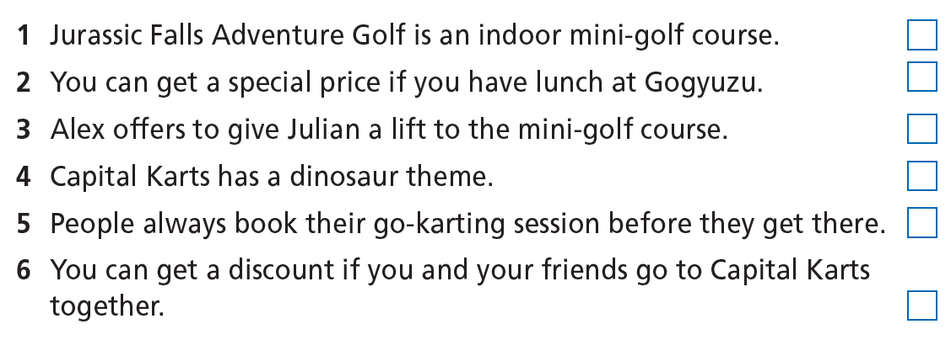
2. Read the texts and decide if the statements are R (right), W (wrong) or DS (doesn’t say).

Slide 13
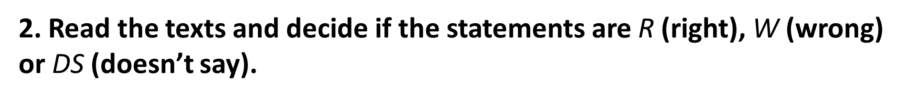
W
1 Jurassic Falls Adventure Golf is an indoor mini-golf course.
2 You can get a special price if you have lunch at Gogyuzu.
3 Alex offers to give Julian a lift to the mini-golf course.
4 Capital Karts has a dinosaur theme.
5 People always book their go-karting session before they get there.
6 You can get a discount if you and your friends go to Capital Karts together.
DS
R
W
Hope you’re well! On Saturday, my brother and I are going to Jurassic Falls Adventure Golf, an outdoor mini-golf course in East London. It’s got a dinosaur theme! There are life-sized model dinosaurs everywhere and a dinosaur-themed restaurant, Gogyuzu. Why don’t you join us? We’ll pick you up at 10:00.
Let me know if you can make it.

Slide 14
W
1 Jurassic Falls Adventure Golf is an indoor mini-golf course.
2 You can get a special price if you have lunch at Gogyuzu.
3 Alex offers to give Julian a lift to the mini-golf course.
4 Capital Karts has a dinosaur theme.
5 People always book their go-karting session before they get there.
6 You can get a discount if you and your friends go to Capital Karts together.
DS
R
W
DS
R
Capital Karts in Barking, just 15 minutes from Central London, has the UK’s longest indoor go-karting track. It’s 1,050 metres long and you can drive at speeds of up to 45 miles per hour! For just £10 per person you can enjoy a 30-minute session. Coming as a large group? Give us a call and we’ll find a special rate for you!

Slide 15
More Practice:
Read the text again and choose the best answer:
1. When are Alex’s brother and he going to Jurassic Falls Adventure Golf?
A. On Sunday B. On Saturday C. On Monday
2. What time will Alex pick Julian up?
A. at 10.00 B. at 9.00 C. at 11.00
3. How long is the go-karting track in Capital Karls?
A. 15 miles B. 45 miles C. 1,050 metres
4. How much does a person pay to enjoy a 30-minute session?
A. £10 B. £40 C. £20

Slide 16

Post-reading:
Which of the places in the texts would you like to visit? Why? Tell the class.

Slide 17

CONSOLIDATION

Slide 18
Write a paragraph (about 40-60 words) about a place you like to visit in your country.

Slide 19

WRAP-UP

Slide 20
Today’s lesson
Vocabularies
outdoor
life-sized
pick sb up
track
session
rate
Skills
- Reading: Jurassic Falls Adventure Golf, Capital Karts in Barking.
- Speaking: places in the texts you would like to visit.

Slide 21
Homework
Practise the vocabularies and make sentences using them.
Do the exercises in TA 6 Right on WB (p. 59).
Do the exercises in TA 6 Right on Notebook (p. 59).
Prepare the next lesson (p. 113 SB).
Do Unit 6 Test 1 in Bài Tập Bổ Trợ TA 6 Right on (pp. 50 & 51).

Slide 22
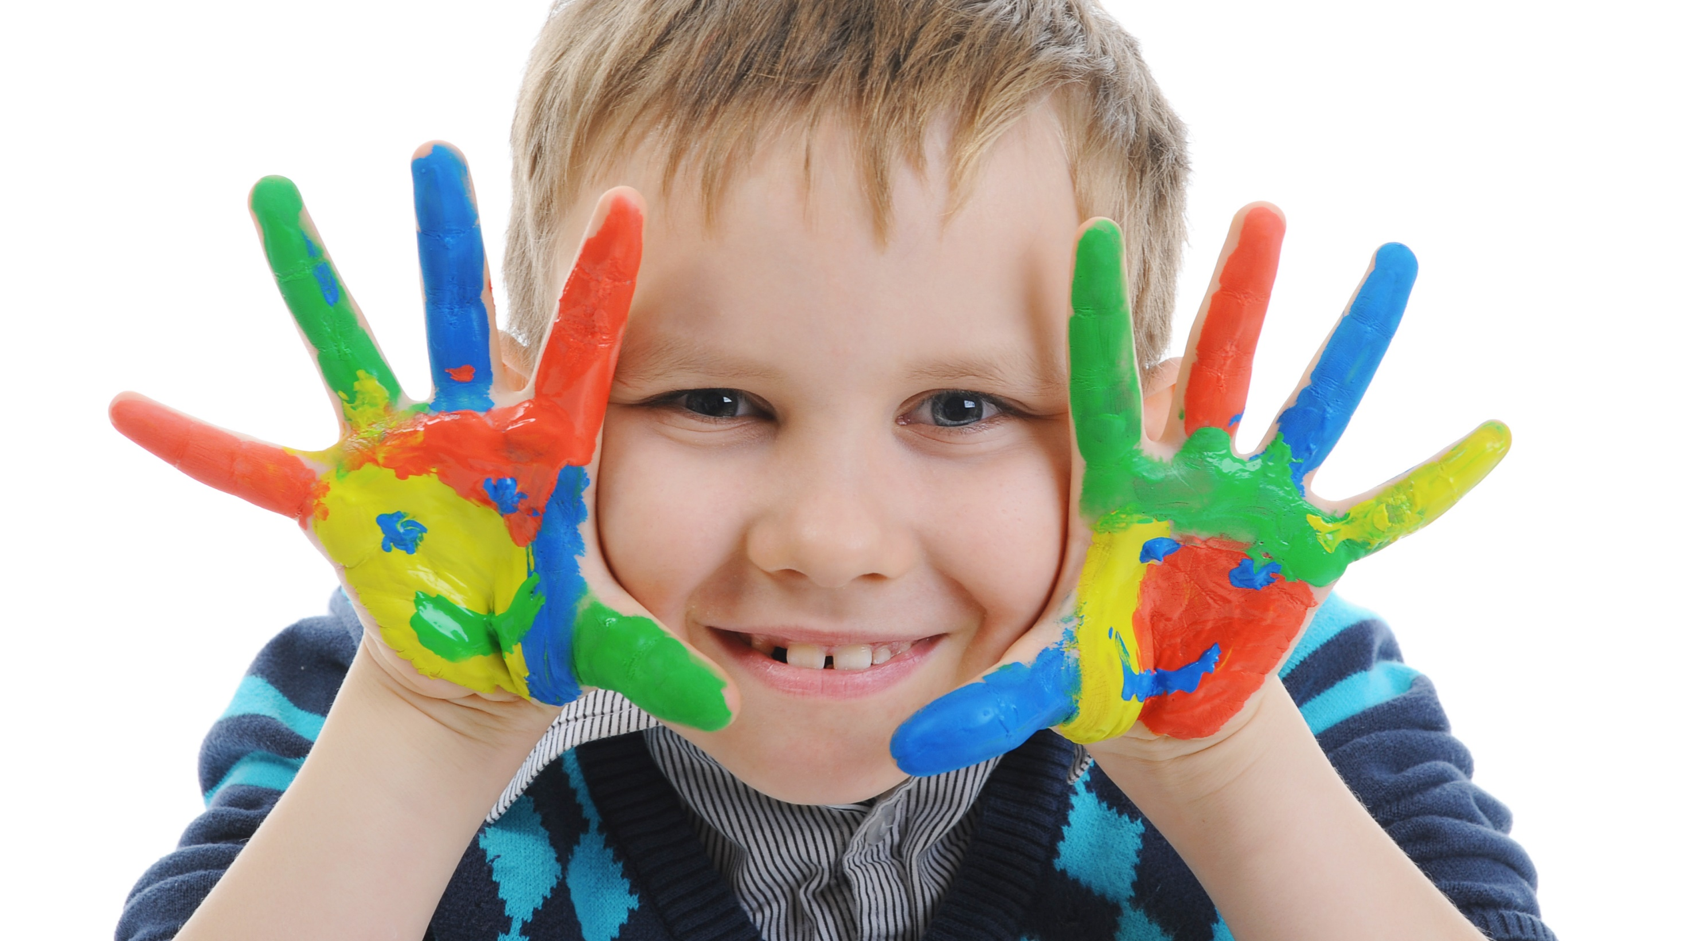
Enjoy your day!

