Slide 1


Slide 2
GIVING AND RESPONDING TO WARNINGS
Unit
5
GLOBAL WARMING
Unit
FAMILY LIFE
LESSON 7
COMMUNICATION AND CULTURE / CLIL
Student Book – page 59

Slide 3
LESSON 7
COMMUNICATION AND CULTURE / CLIL
WARM-UP
- Watch a video, and answer the questions.
- Task 1: Listen and complete the conversation with the expressions in the box.
- Task 2: Use the model to make similar conversations for these situations.
EVERYDAY ENGLISH
CLIL
- Task 1: Read the text and tick (✓) the pictures that show ways to reduce global warming.
- Task 2: Work in groups. Discuss the questions.
CONSOLIDATION
- Wrap-up
- Homework

Slide 4
WARM-UP
WATCH THE VIDEO AND ANSWER THE QUESTIONS
According to the video,
Farm animals contribute less to the emission of CO2 than vehicles. True or False?
How many kg of plant protein are used in order to produce 1kg of animal protein?
What can we do to reduce greenhouse gas?

Slide 5
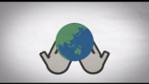
WARM-UP
WATCH A VIDEO
https://www.youtube.com/watch?v=7I0v3LhKhQg

Slide 6
WARM-UP
According to the video,
Farm animals contribute less to the emission of CO2 than vehicles. True or False?
False

Slide 7
WARM-UP
According to the video,
2. How many kg of plant protein are used in order to produce 1kg of animal protein?
6 kg

Slide 8
WARM-UP
According to the video,
3. What can we do to reduce greenhouse gas?
We can consume fewer animal products or even go meat free.

Slide 9

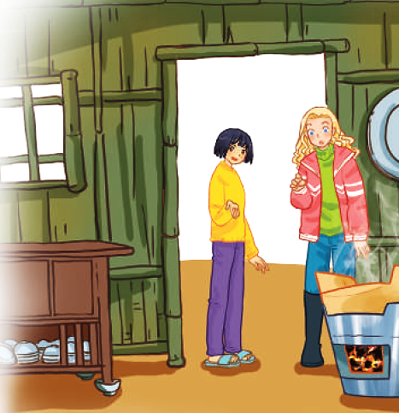
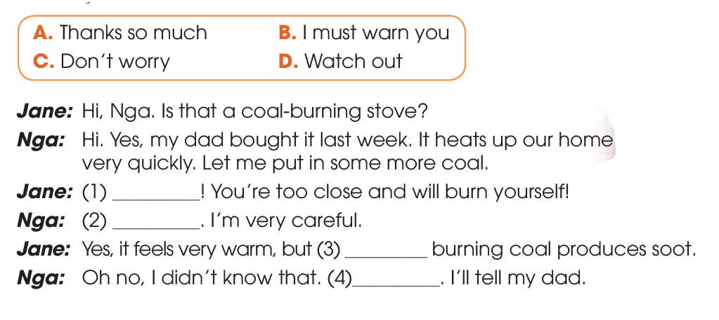
EVERYDAY ENGLISH
1
Listen and complete the conversation with the expressions in the box. Then practise it in pairs.
D
C
B
A

Slide 10
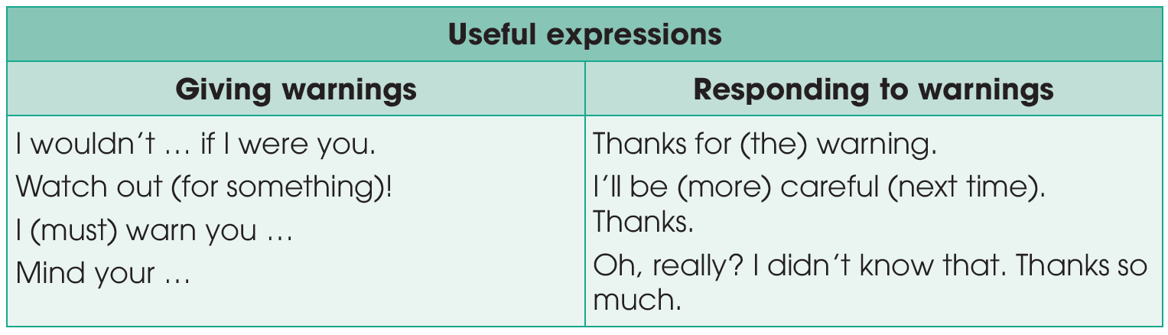
EVERYDAY ENGLISH

Slide 11
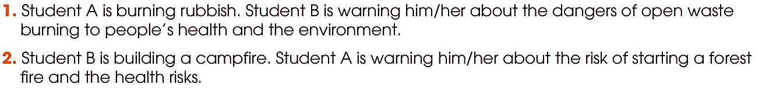
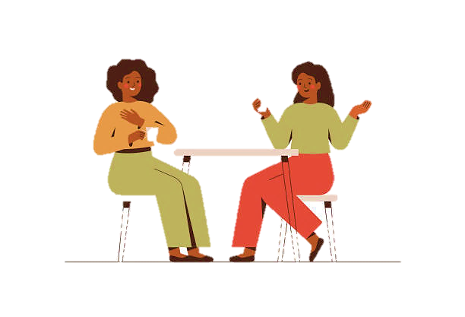
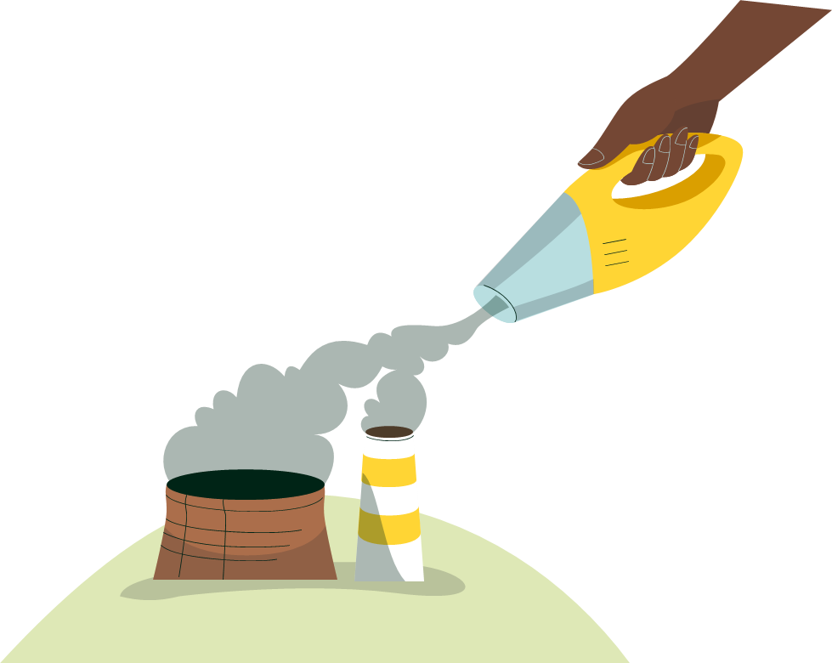
EVERYDAY ENGLISH
2
Work in pairs. Use the model in 1 to make similar conversations for these situations. One of you is Student A, the other is Student B. Use the expressions below to help you.

Slide 12

CLIL
Leaflet (n)
/ˈliː.flət/
a piece of paper that gives you information or advertises something

Slide 13
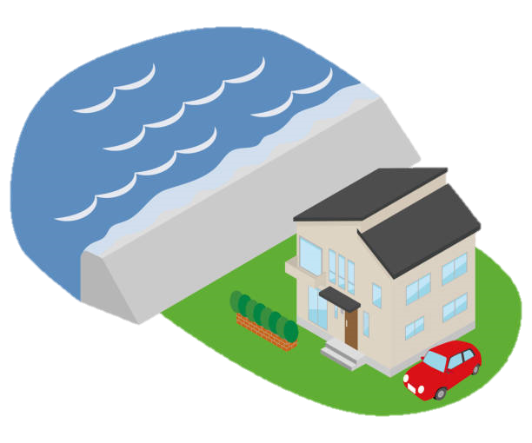
CLIL
sea level (n)
/ˈsiː ˌlev.əl/
the average height of the sea where it meets the land

Slide 14
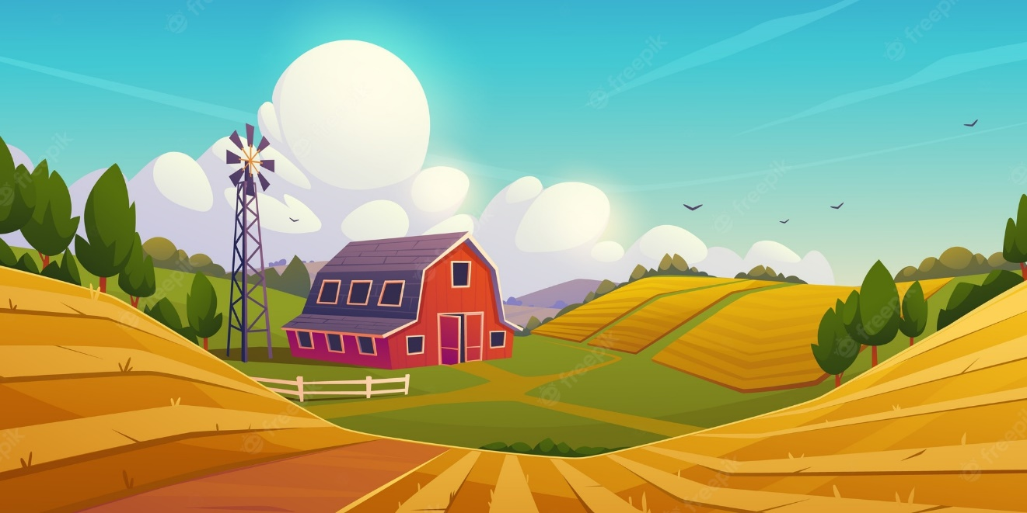
CLIL
Farmland (n)
/ˈfɑːm.lænd/
land that is used for or is suitable for farming

Slide 15
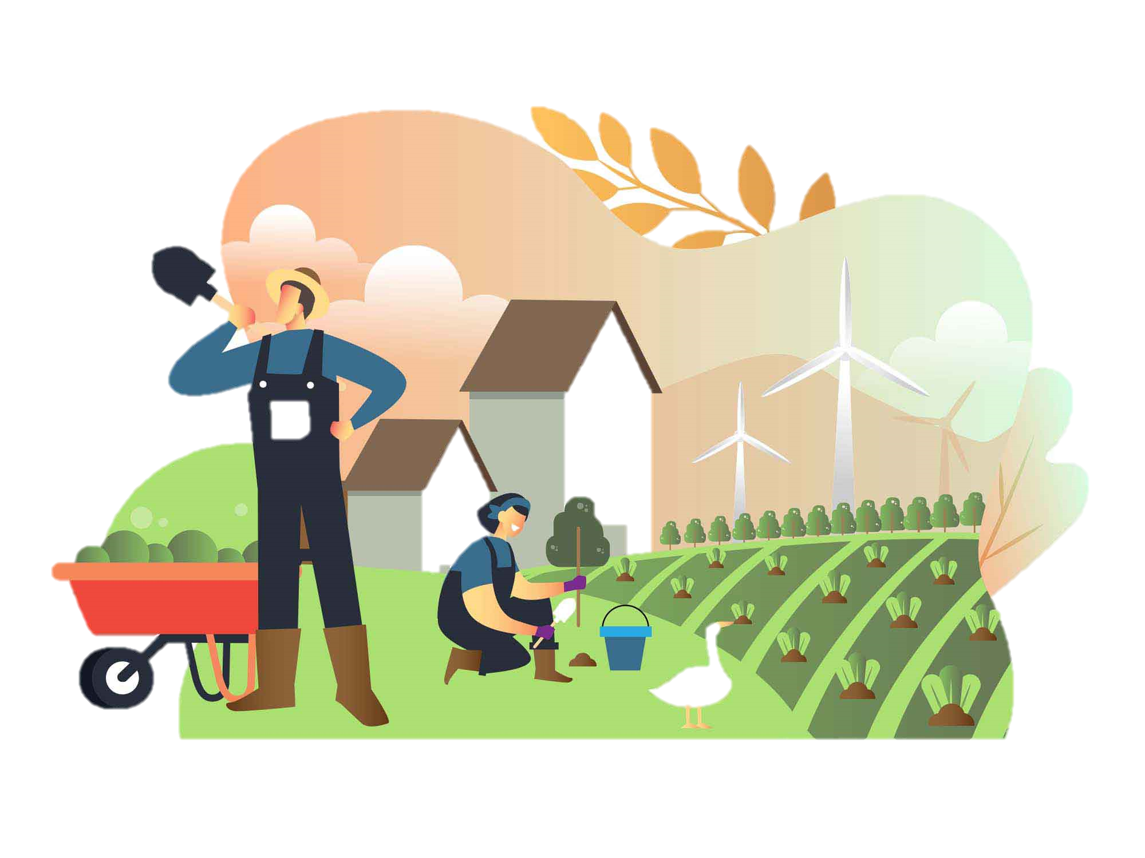
CLIL
Farming (n)
/ˈfɑː.mɪŋ/
the activity of working on a farm or organizing the work there

Slide 16
CLIL
Form | Pronunciation | Meaning
1. Leaflet (n) | /ˈliː.flət/ | a piece of paper that gives you information or advertises something
2. sea level (n) | /ˈsiː ˌlev.əl/ | the average height of the sea where it meets the land
3. Farmland (n) | /ˈfɑːm.lænd/ | land that is used for or is suitable for farming
4. Farming (n) | /ˈfɑː.mɪŋ/ | the activity of working on a farm or organizing the work there

Slide 17
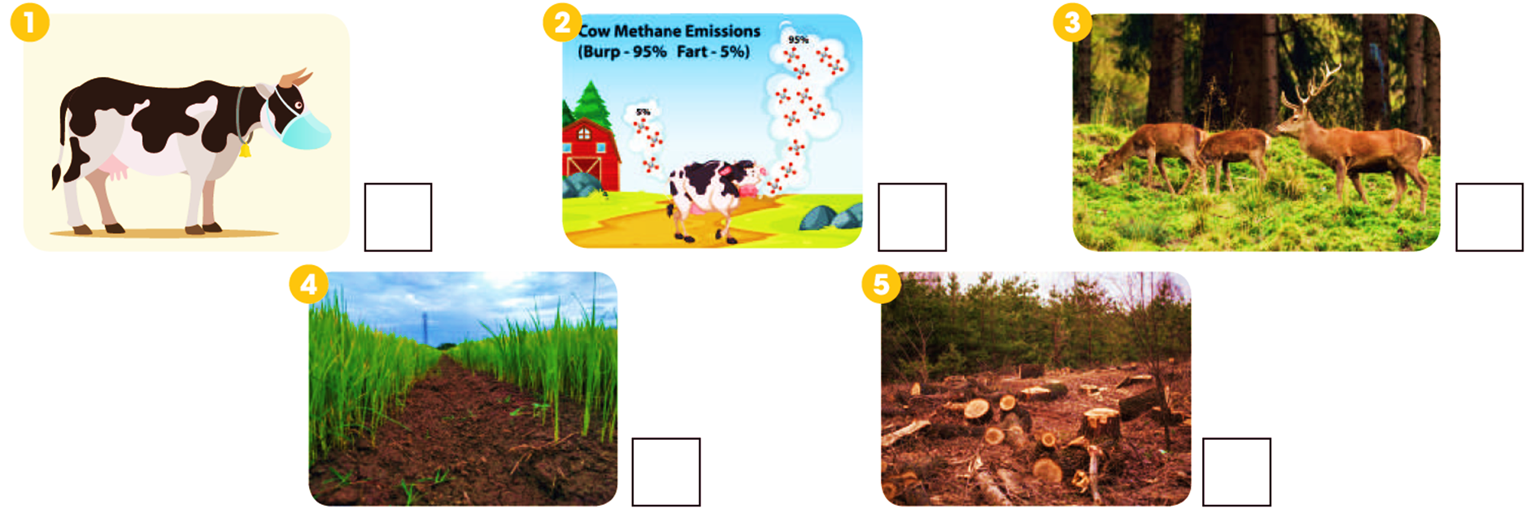
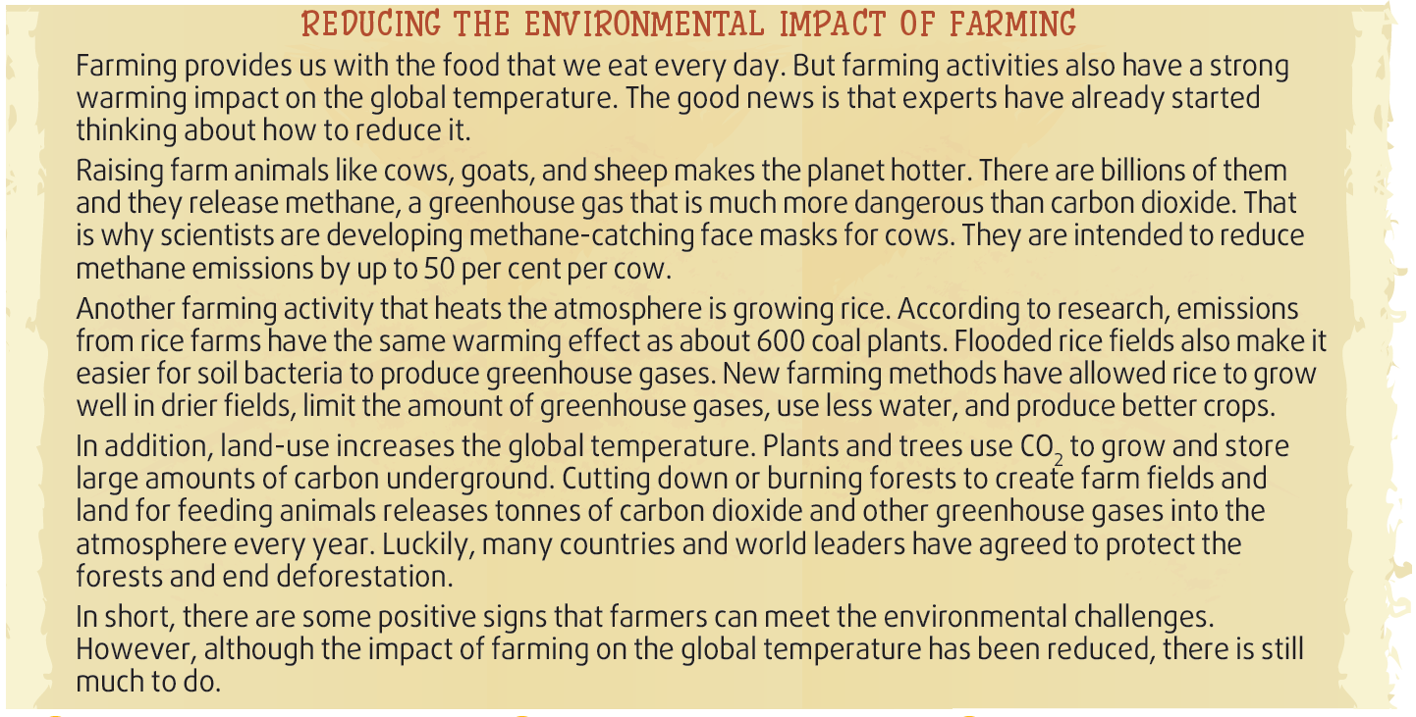
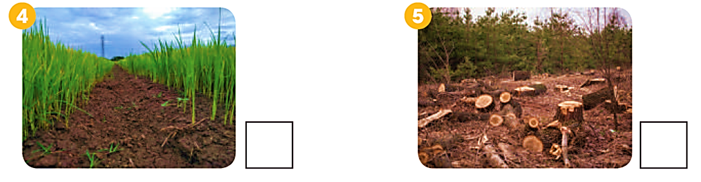
CLIL
1
Read the text and tick (✓) the pictures that show ways to reduce global warming.
✓
✓

Slide 18
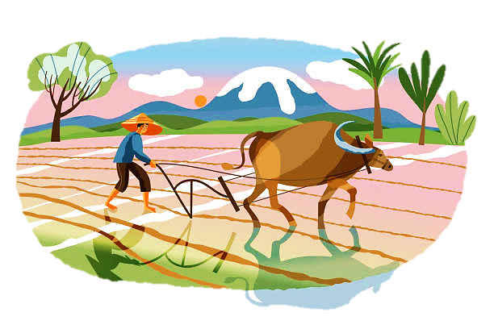
CLIL
2
Work in groups. Discuss the following questions.
What farming activities in Viet Nam do you think have negative impact on the global temperature?
What do you think are the alternatives to those activities?

Slide 19
EXTRA ACTIVITY

Slide 20
What have you learnt today?
CONSOLIDATION
1
Wrap-up
Give and respond to warnings
Understand the environmental impact of farming and how to reduce it

Slide 21
Homework
CONSOLIDATION
2
1. Do exercises in the workbook.
2. Prepare for Lesson 8 - Unit 5.

Slide 22

Website: hoclieu.vn
Fanpage: facebook.com/tienhglobalsuccess.vn/

