Slide 2



Unit
7
TELEVISION
LESSON 4: COMMUNICATION
1

Slide 3
LESSON 4: COMMUNICATION
LESSON 1: GETTING STARTED
WARM-UP
Question forming
*Asking for and giving information about TV programmes
Task 1: Listen and read the conversation. Pay attention to the highlighted words.
Task 2: Work in pairs. Make a similar conversation about your favourite TV programmes.
EVERYDAY ENGLISH
Task 3: Work in groups. Discuss and complete the facts with the countries in the box.
Task 4: Read about two TV programmes and tick the correct programme in the table.
Task 5: Work in groups. Tell your group which programme in Task 4 you prefer and why.
TV PROGRAMMES
CONSOLIDATION
Wrap-up
Homework

Slide 4
WARM-UP
QUESTION FORMING
WHAT…
WHY…
TV PROGRAMME
…
HOW
OFTEN…
WHAT TIME…

Slide 5

EVERYDAY ENGLISH
1
Listen and read the conversation. Pay attention to the highlighted words.
﻿A: What’s your favourite TV programme?
B: The animal programme.
A: Why do you like it?
B: Because I can see the animals in their real life.

Slide 6
EVERYDAY ENGLISH
2
Work in pairs. Make a similar conversation about your favourite TV programme.
For example:
A: What’s your favourite TV programme?
B: The sports programme.
A: Why do you like it?
B: Because I am a big fan of sports.
A: What time is it on?
B: It’s on at 7:30 p.m. on VTV3.
A: How often do you watch it?
B: I watch it every weekend.

Slide 7
TV PROGRAMMES
3
Work in groups. Discuss and complete the facts with the countries in the box.
The USA Viet Nam Japan Iceland
Facts
1. Pokémon cartoons are from ________.
2. Bibi in ________ shows international and Vietnamese cartoons.
3. In ________, there was no TV on Thursdays before 1986.
4. Discovery Channel makes education fun for children in ________.

Slide 8
TV PROGRAMMES
3
Work in groups. Discuss and complete the facts with the countries in the box.
The USA Viet Nam Iceland
Facts
1. Pokémon cartoons are from Japan.
2. Bibi in ________ shows international and Vietnamese cartoons.
3. In ________, there was no TV on Thursdays before 1986.
4. Discovery Channel makes education fun for children in ________.

Slide 9
TV PROGRAMMES
3
Work in groups. Discuss and complete the facts with the countries in the box.
The USA Iceland
Facts
1. Pokémon cartoons are from Japan.
2. Bibi in Viet Nam shows international and Vietnamese cartoons.
3. In ________, there was no TV on Thursdays before 1986.
4. Discovery Channel makes education fun for children in ________.

Slide 10
TV PROGRAMMES
3
Work in groups. Discuss and complete the facts with the countries in the box.
The USA
Facts
1. Pokémon cartoons are from Japan.
2. Bibi in Viet Nam shows international and Vietnamese cartoons.
3. In Iceland, there was no TV on Thursdays before 1986.
4. Discovery Channel makes education fun for children in ________.

Slide 11
TV PROGRAMMES
3
Work in groups. Discuss and complete the facts with the countries in the box.
Facts
1. Pokémon cartoons are from Japan.
2. Bibi in Viet Nam shows international and Vietnamese cartoons.
3. In Iceland, there was no TV on Thursdays before 1986.
4. Discovery Channel makes education fun for children in the USA.

Slide 12
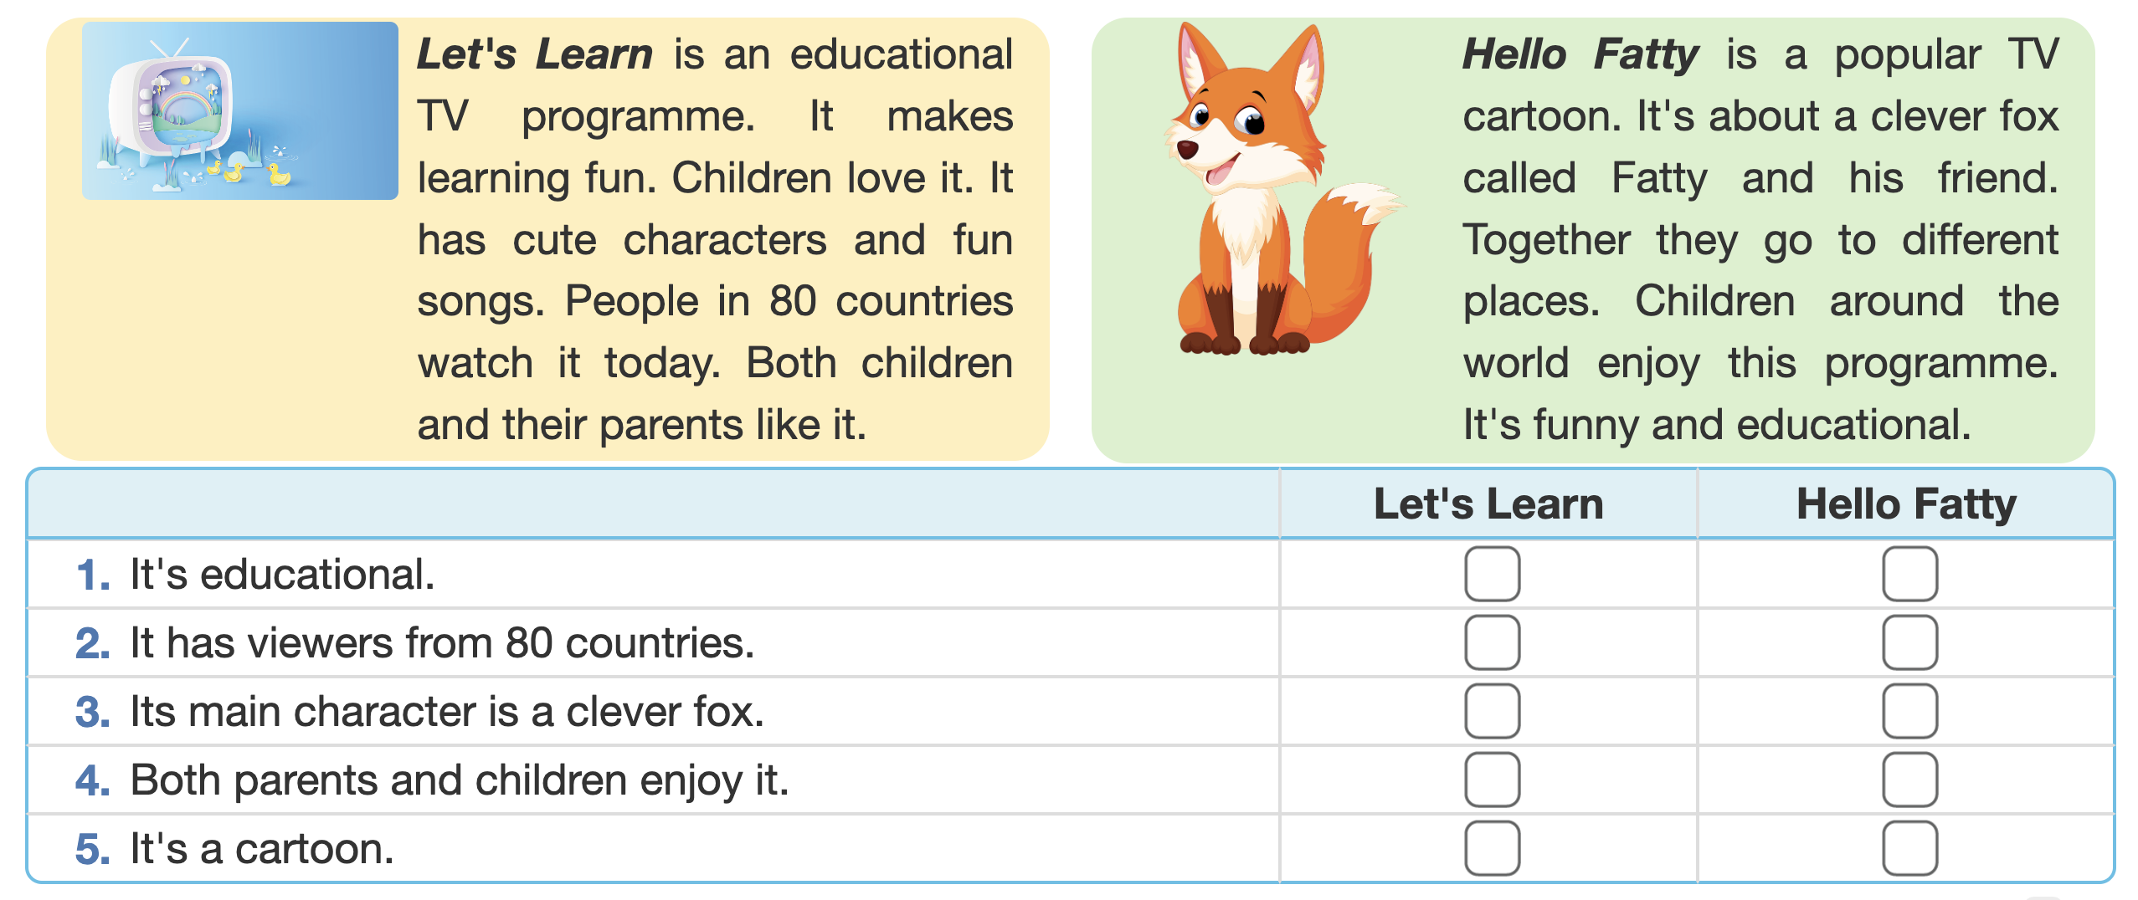
TV PROGRAMMES
4
Read about two TV programmes and tick the correct programme in the table.

Slide 13

TV PROGRAMMES
4
Read about two TV programmes and tick the correct programme in the table.

Slide 14

TV PROGRAMMES
5
Work in groups. Tell your group which programme in Task 4 you prefer and why.
Example:
I like Let’s learn because it has cute characters and fun songs.

Slide 15

CONSOLIDATION
1
Wrap-up
What have we learnt in this lesson?
Everyday English
TV programme

Slide 16

CONSOLIDATION
2
Homework
- Write a paragraph to describe a programme you prefer in your notebook.
- Do exercises in the workbook.
- Prepare for the next lesson: Skills 1

Slide 17






Website: hoclieu.vn
Fanpage: facebook.com/www.tienganhglobalsuccess.vn/

