Slide 1

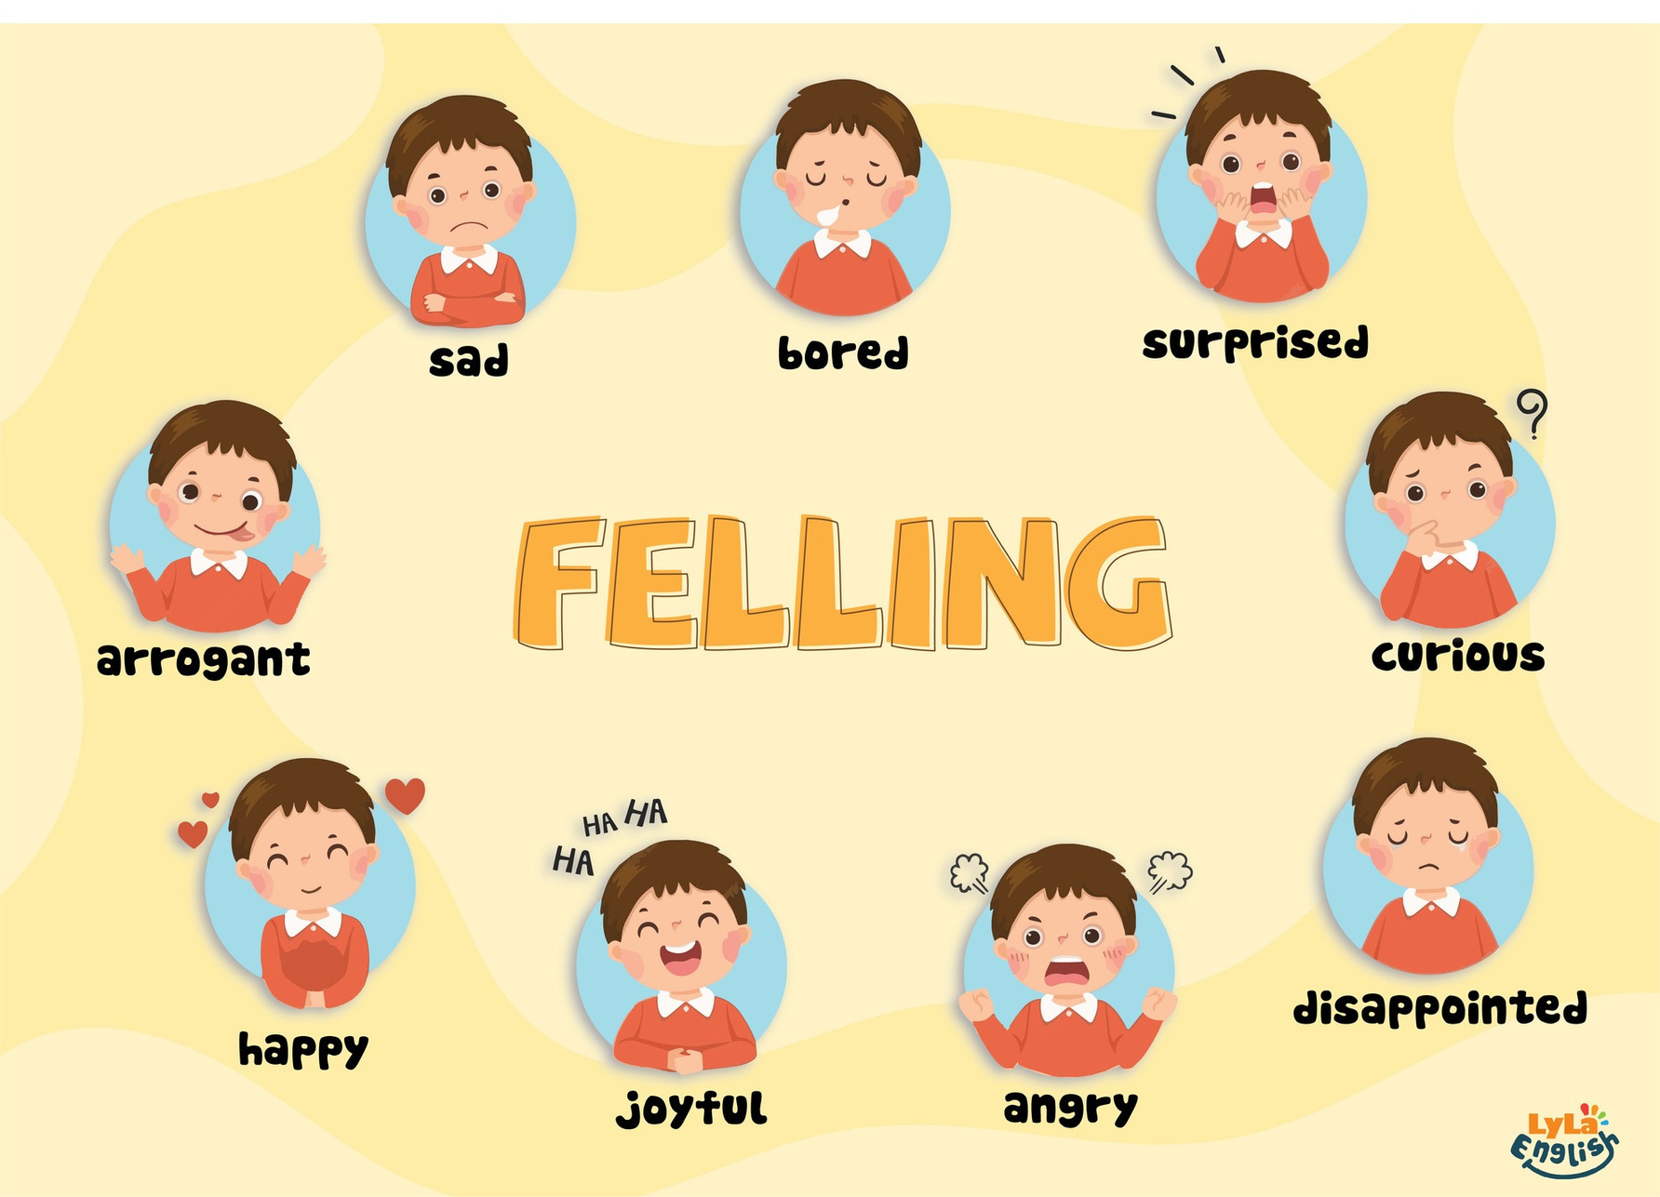

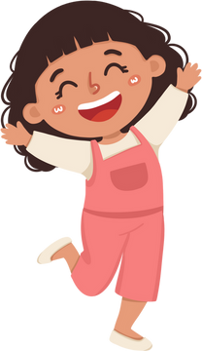

Slide 2

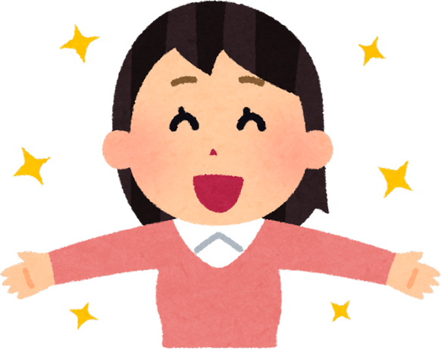
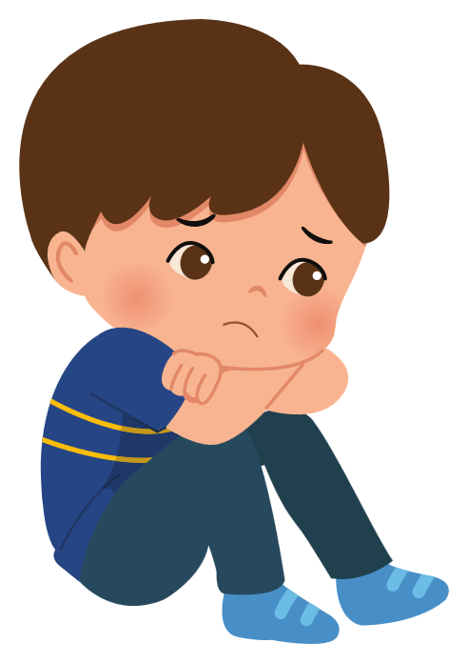
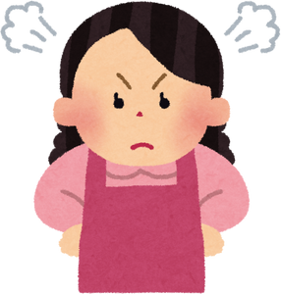
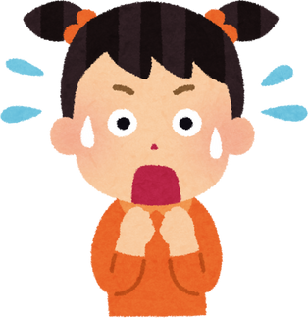
I. QUESTION
1.How do you feel today?
- I’m ...
2. Can you show me your happy face?
3. Can you pretend to be sad/ angry/ surprised?

Slide 3
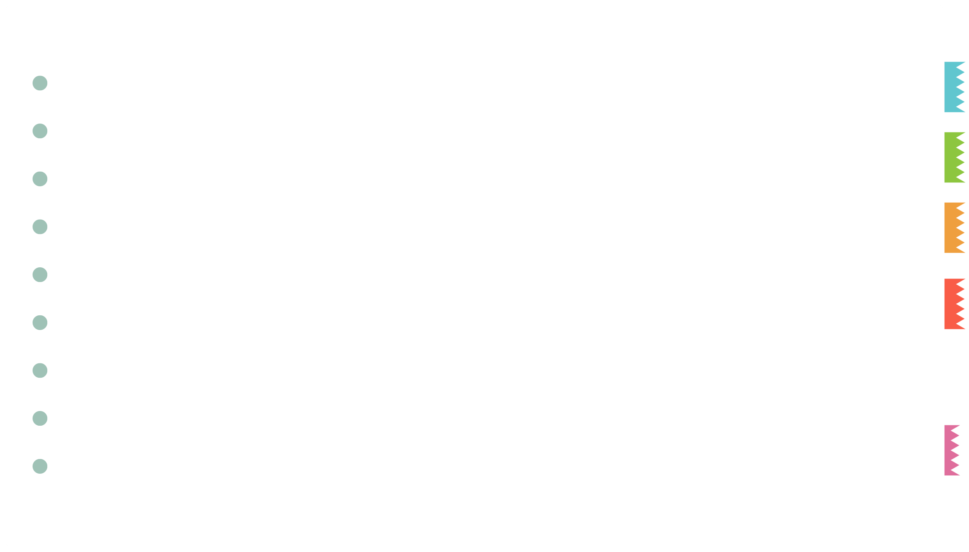
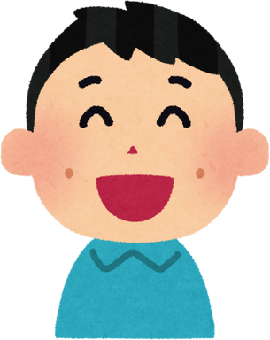
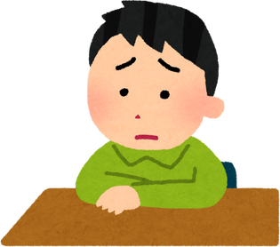
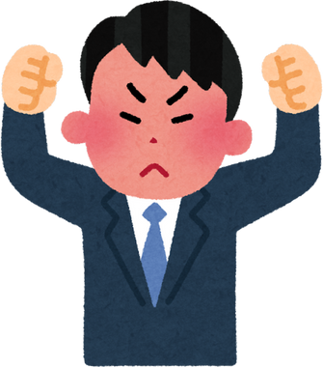
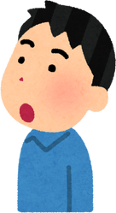
II. VOCABULARY
happy:...........................................................
sad:.............................................................
angry:............................................................
surprised:........................................................

Slide 4
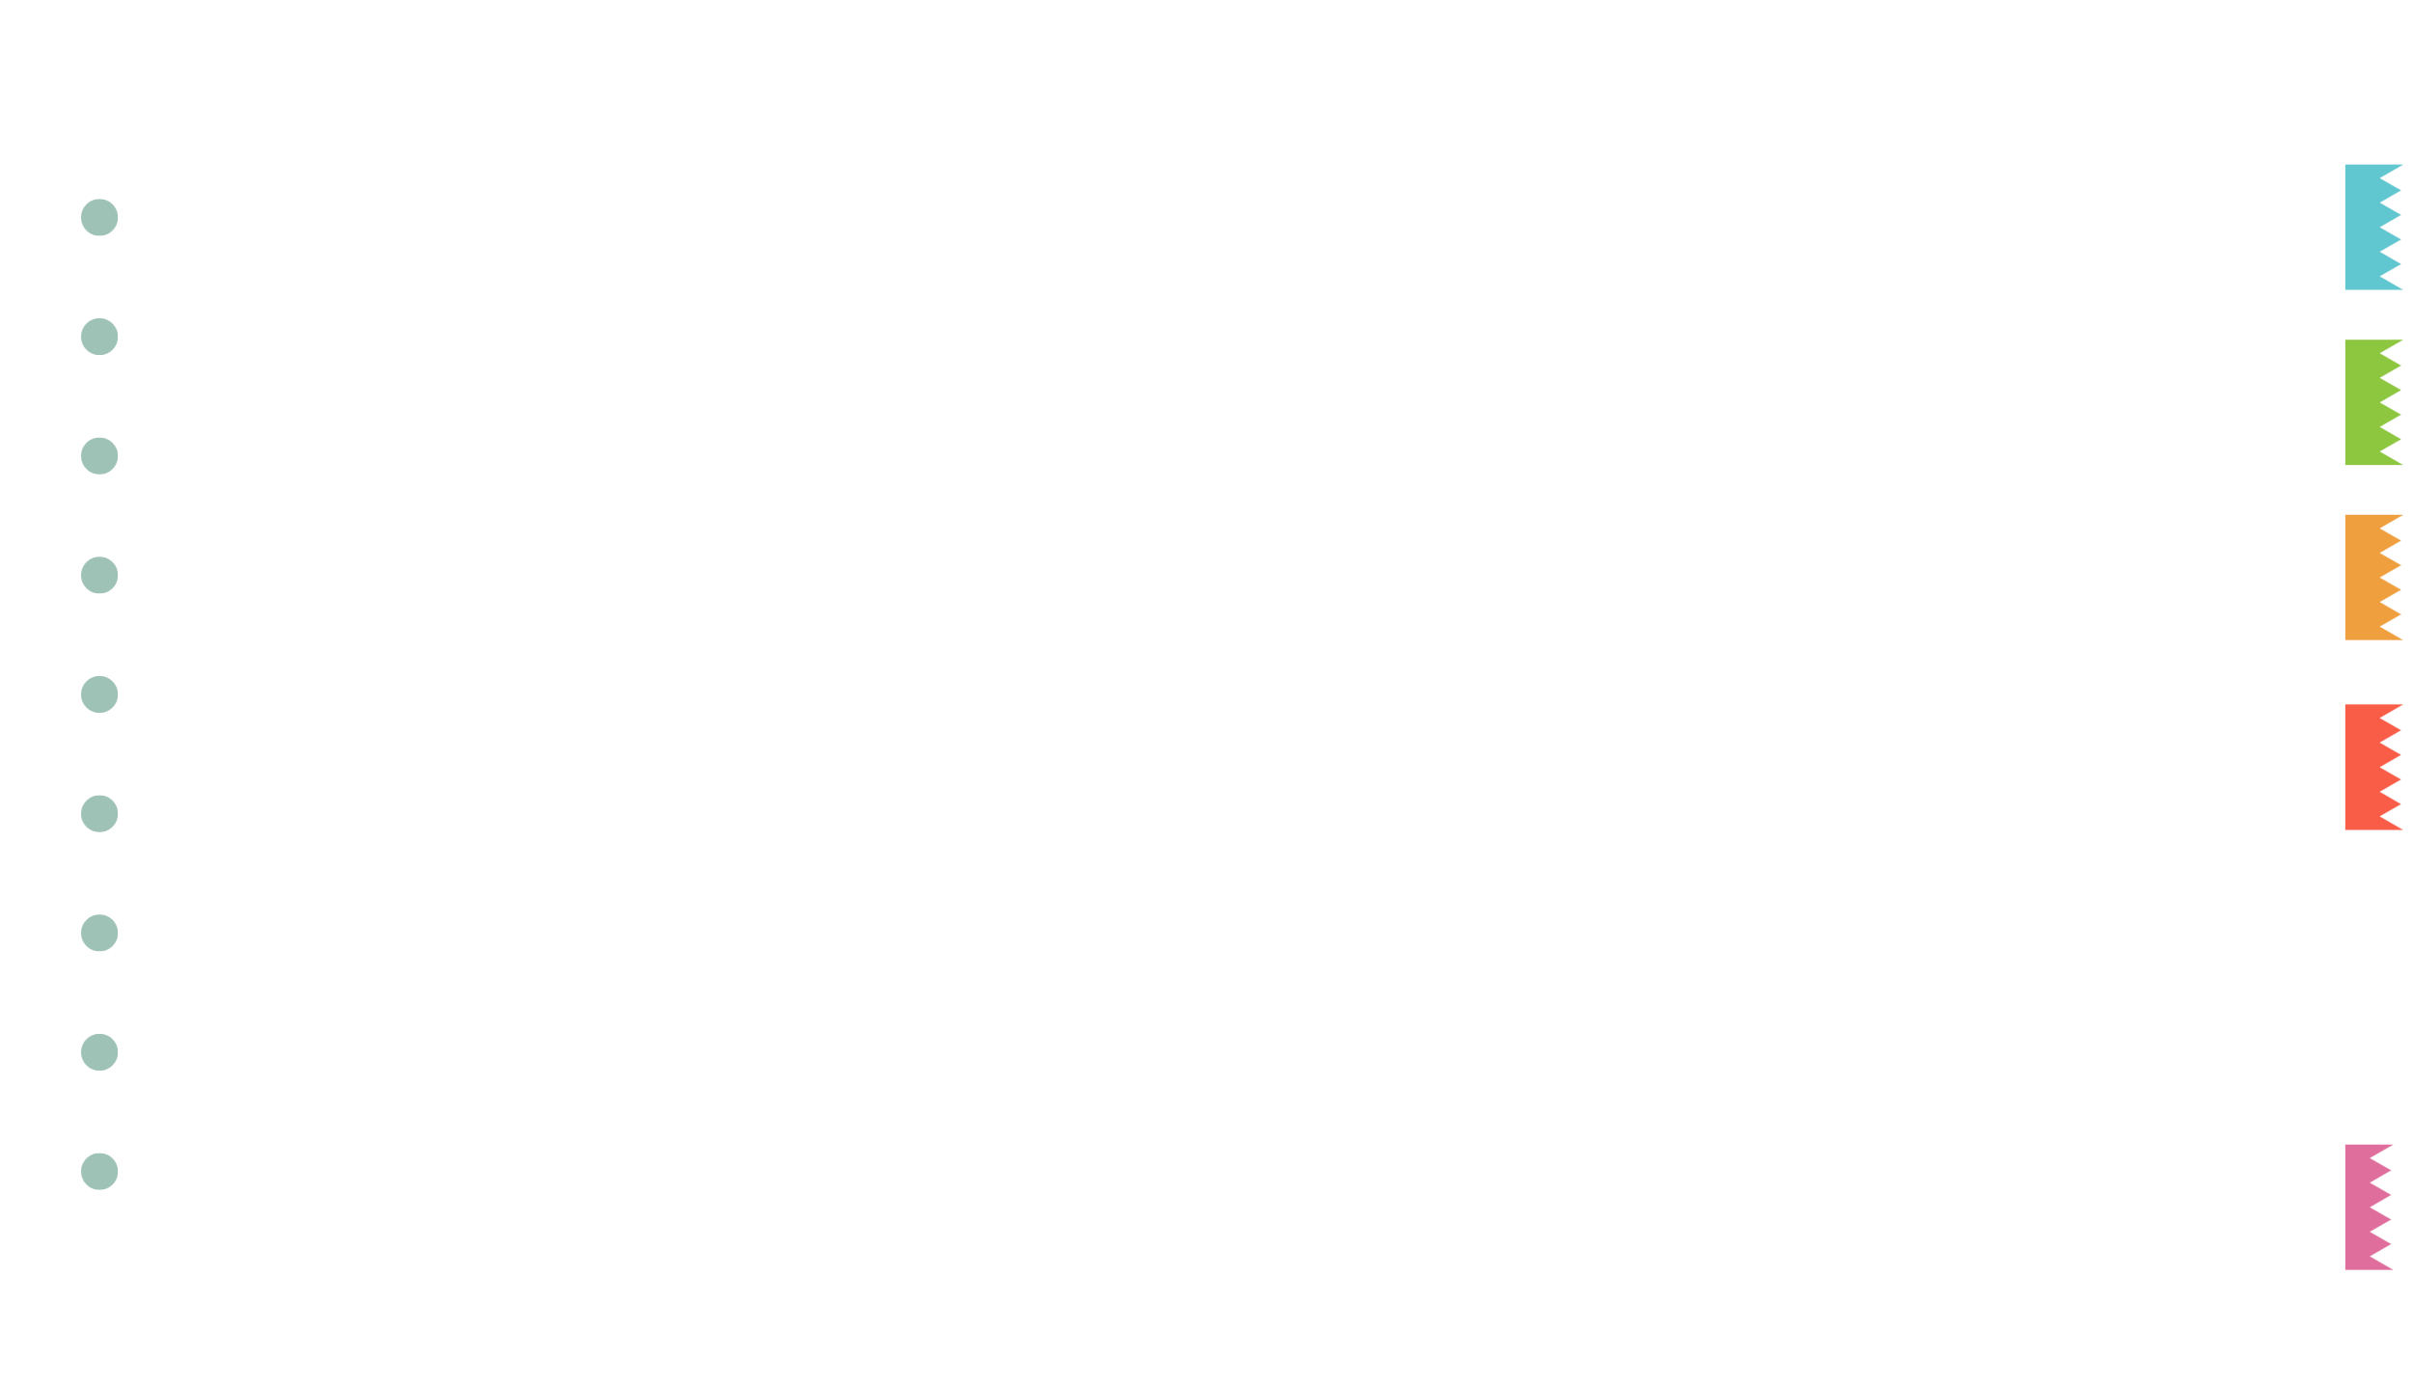
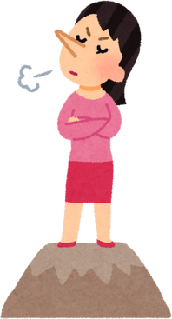
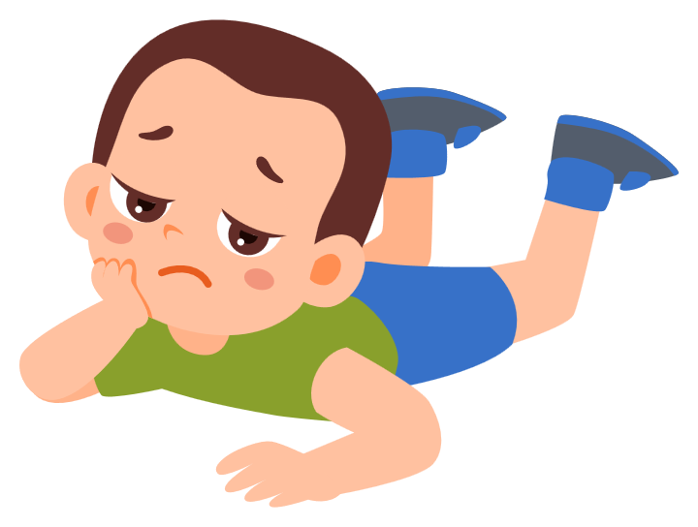
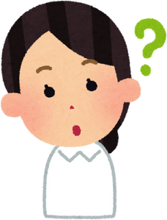
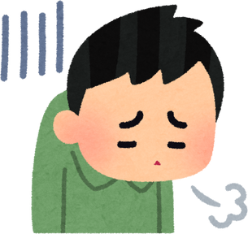
II. VOCABULARY
arrogant:.........................................................
bored:............................................................
curious:............................................................
disappointed:....................................................

Slide 5
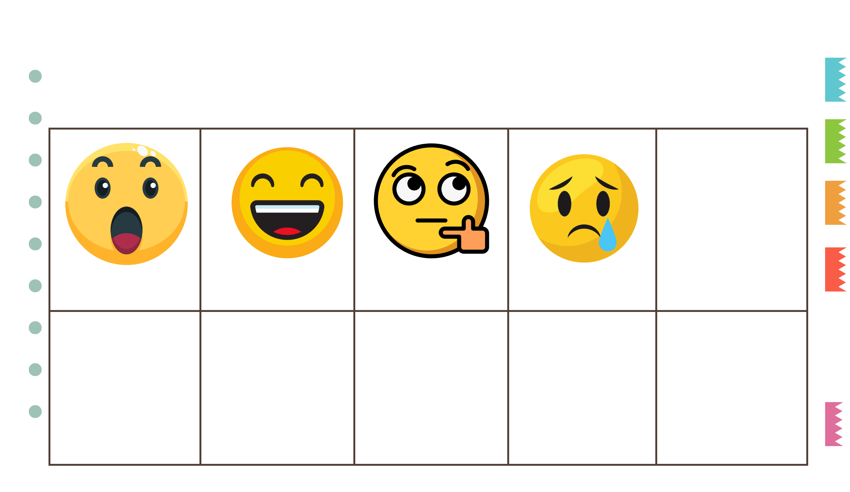

III. EXERCISES
1. Fill the missing words:
Surpr_sed
_appy
Cu_ious
Sa_
Ang_y

Slide 6
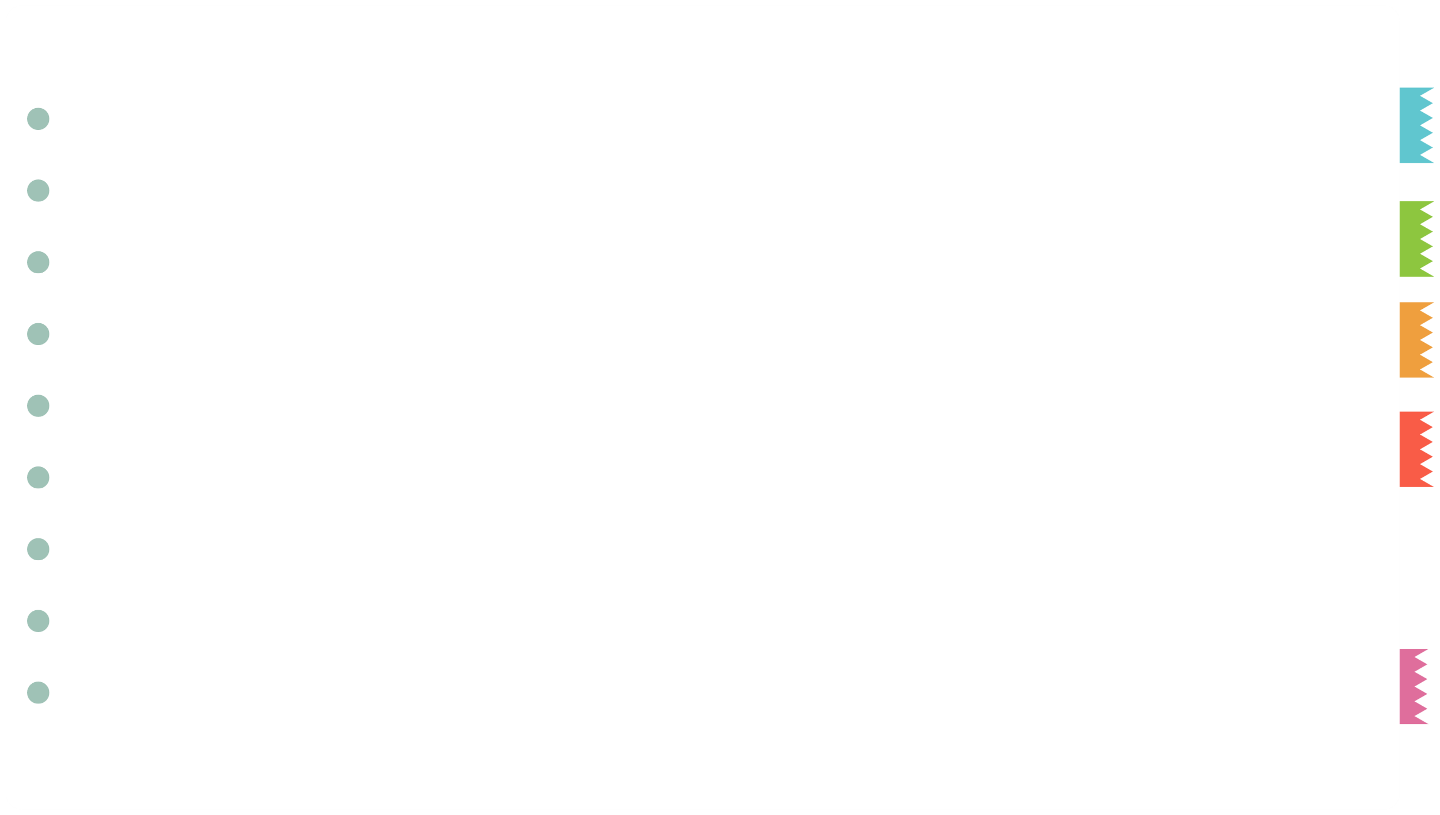
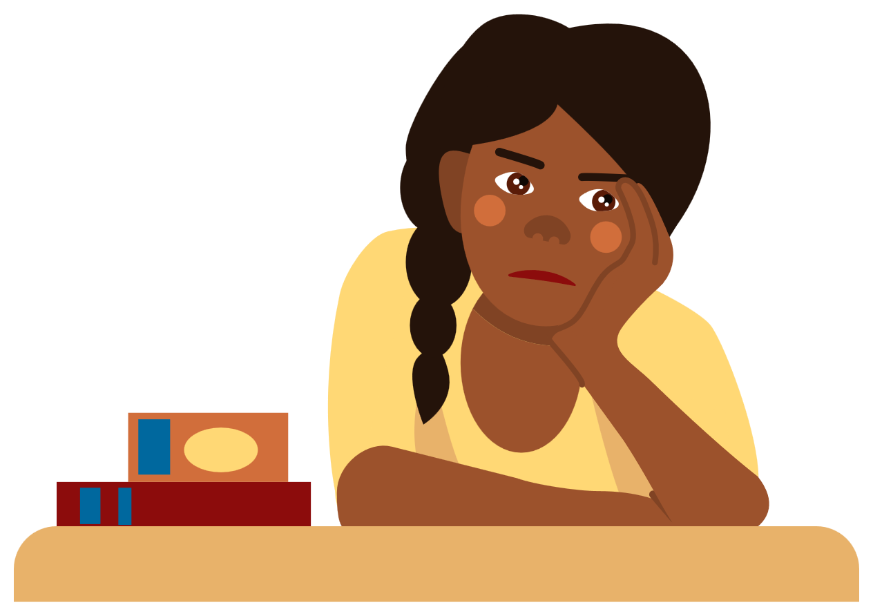
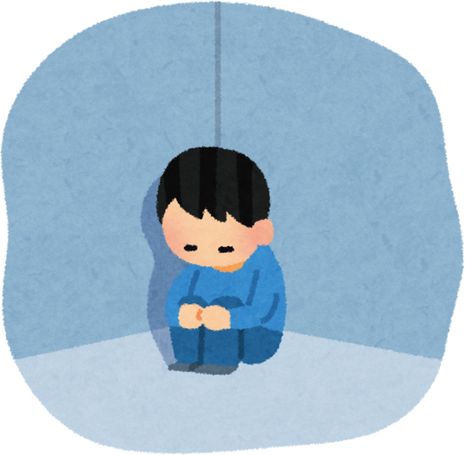
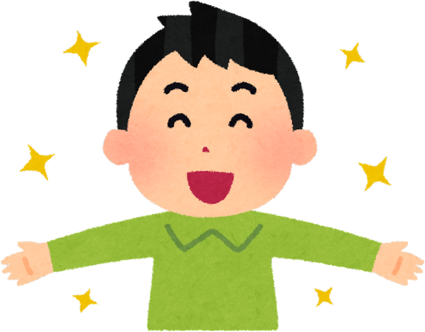
III. EXERCISES
2. Reorder the words:
b/r/o/e/d .....
a/g/n/y/r ...
d/s/a ...
h/p/p/a/y ...

Slide 7
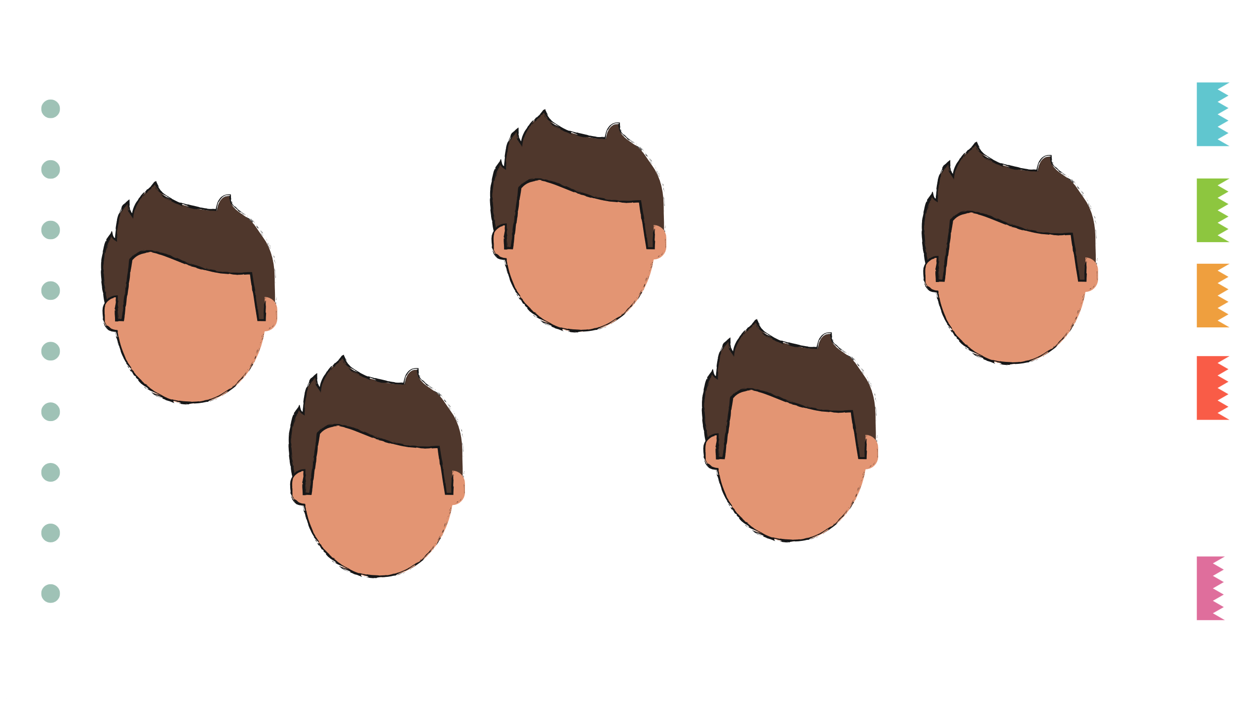
III. EXERCISES
3. Draw the faces:
I’m curious
I’m sad
I’m happy
I’m angry
I’m surprised

Slide 8
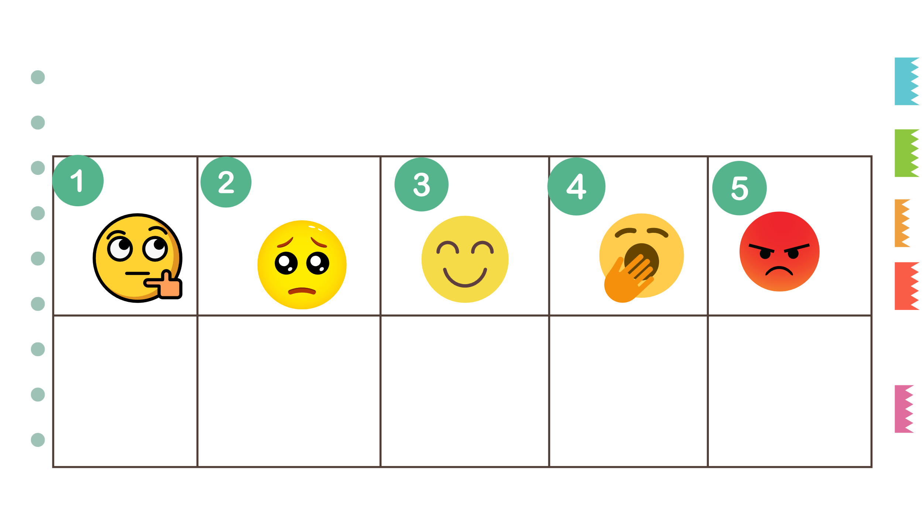
III. EXERCISES
4. Reorder these feelings in correct order:
1.Curious

Slide 9
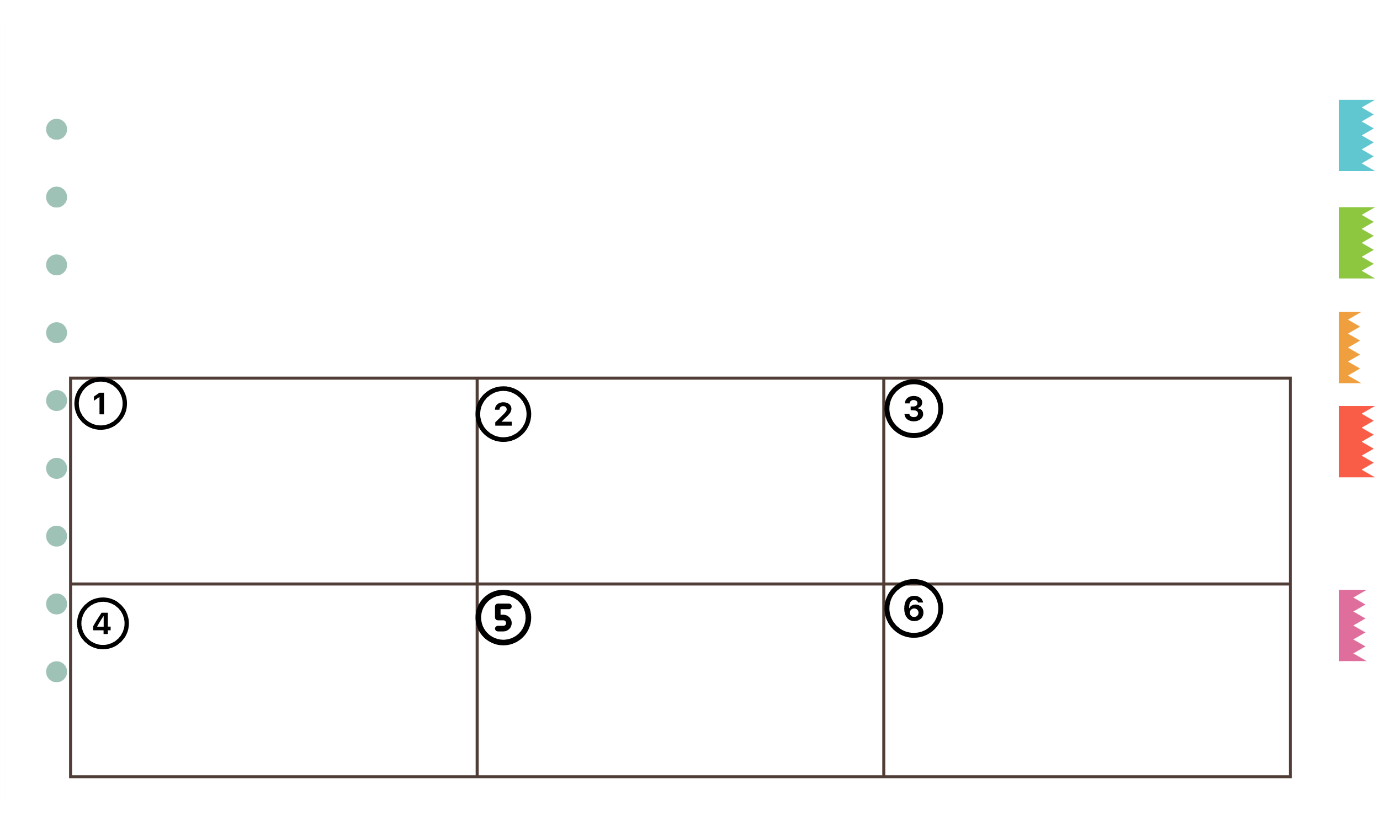
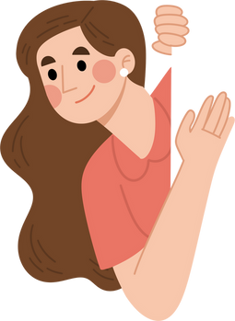
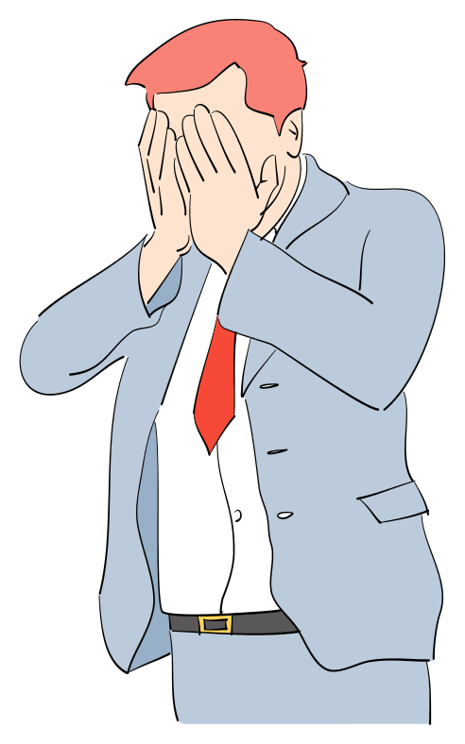

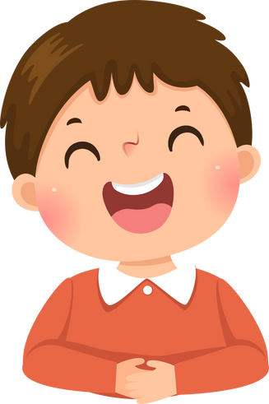
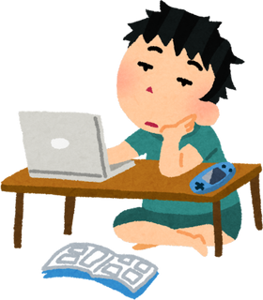
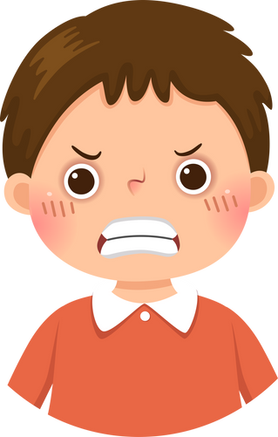
III. EXERCISES
5. Look at the pictures and write the words:
disappointed
happy
angry
sad
curious
bored
.....
.....
.....
.....
.....
.....

Slide 10
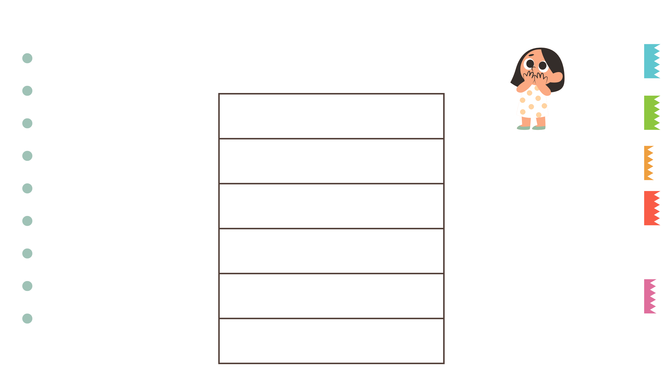
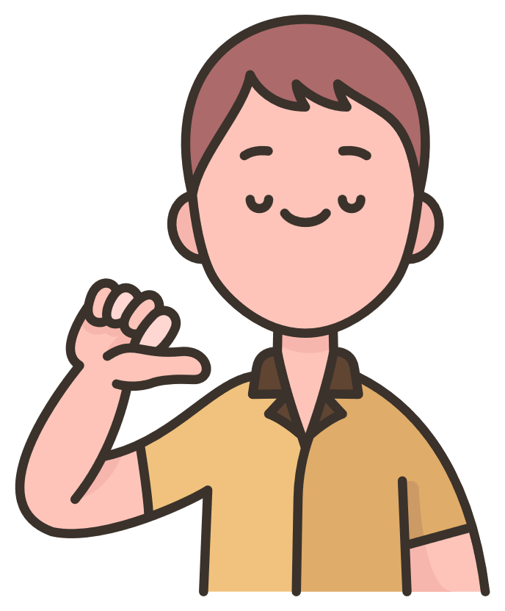
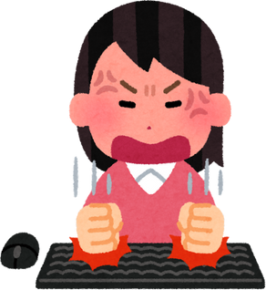
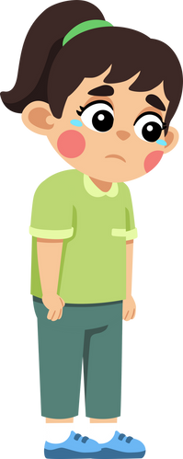

III. EXERCISES
6. Look and match:
curious happy surprised
sad arrogant angry

Slide 11
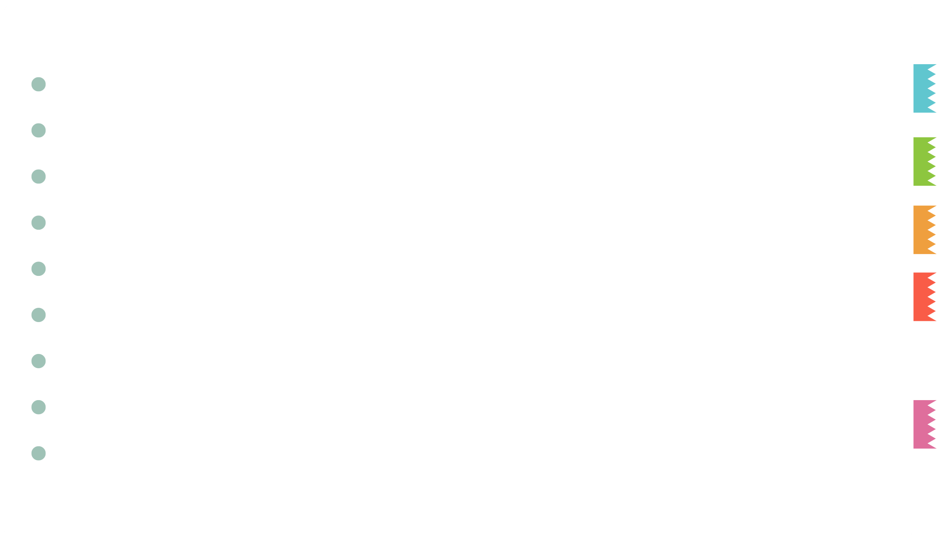
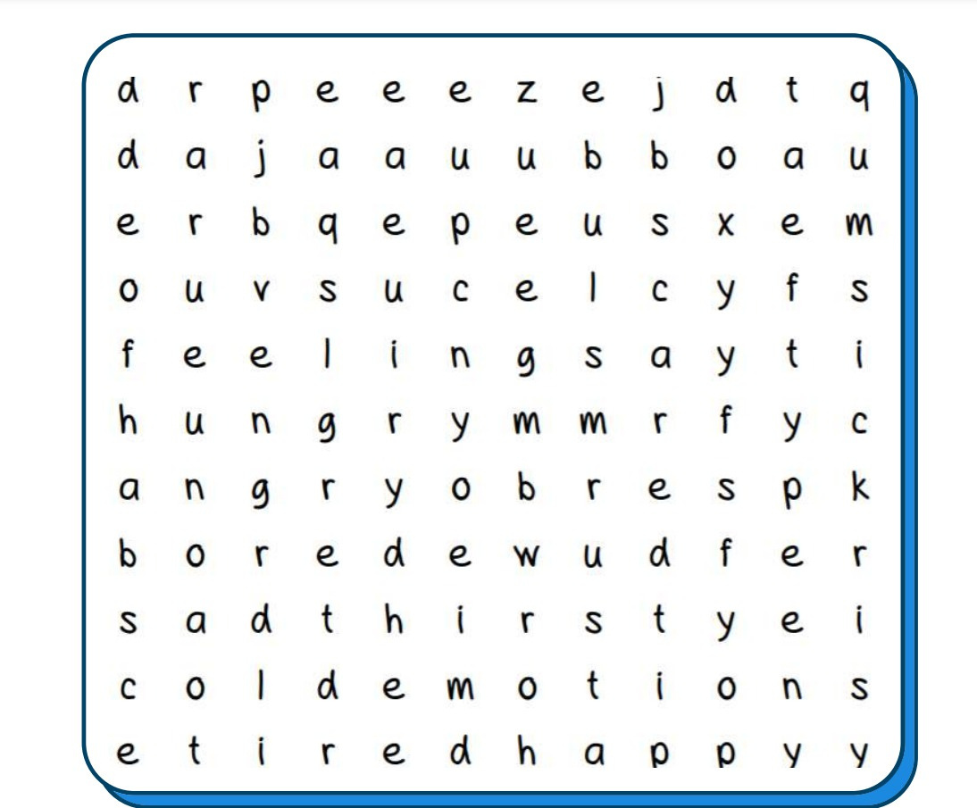
III. EXERCISES
7. Find the word:
happy
sad
angry
bored

Slide 12
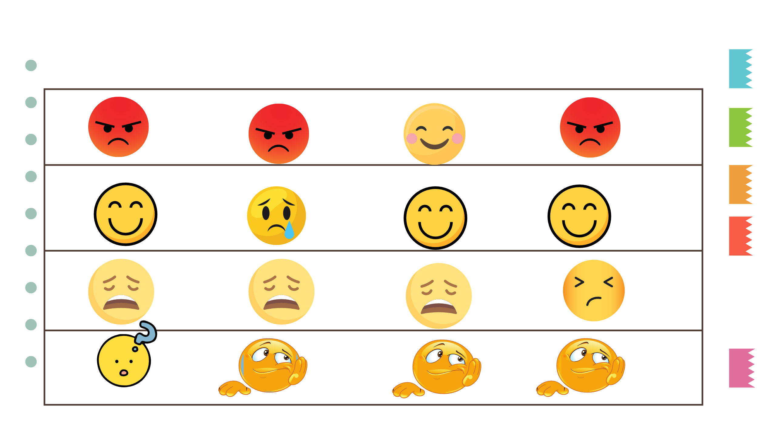
III. EXERCISES
8. Which is different?

