Slide 1


Slide 2




Unit
11
TRAVELLING IN THE FUTURE
LESSON 3: A CLOSER LOOK 2
Grammar: The future simple: Will + Possessive pronouns
Unit
HOBBIES

Slide 3

OBJECTIVES
By the end of the lesson, students will be able to:
know how to recognize “The future simple: Will”
use possessive pronouns to demonstrate ownership.

Slide 4
LESSON 3: A CLOSER LOOK 2
WARM-UP
CHATTING
PRESENTATION
Grammar 1: The future simple
Grammar 2: Possessive pronouns.
Task 1: Complete the sentences with will or won’t.
Task 2: Rearrange the words and phrases to make sentences.
Task 3: Use the correct form of the verbs in brackets to complete the conversation.
Task 4: Replace the underlined phrases with possessive pronouns.
PRACTICE
PRODUCTION
Task 5: Look at the pictures and tell your partner if you will / won’t travel by these means of transport. Give reason(s).
CONSOLIDATION
Wrap-up
Home work

Slide 5

LESSON 3: A CLOSER LOOK 2
CHATTING
WARM-UP
Aims of the stage:
To activate students’ prior knowledge and vocabulary related to the targeted grammar

Slide 6
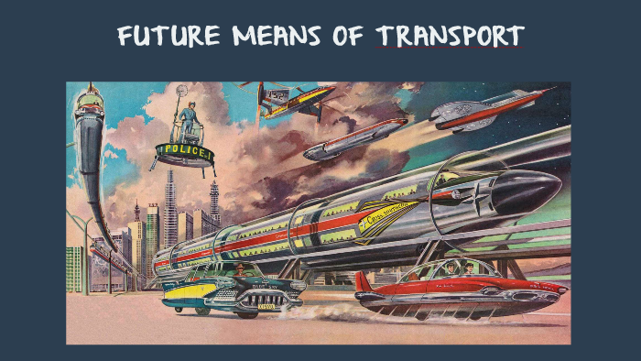
WARM-UP
CHATTING

Slide 7
LESSON 3: A CLOSER LOOK 2
WARM-UP
CHATTING
PRESENTATION
Grammar 1: The future simple

Slide 8
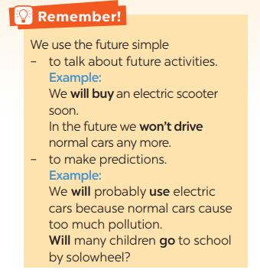
PRESENTATION
GRAMMAR 1: THE FUTURE SIMPLE
+ Usage: to talk about future activities and to make predictions.
+ Form: (+) S + will + V
(-) S + will + not (won’t)
(?) Will + S + V?

Slide 9
LESSON 3: A CLOSER LOOK 2
WARM-UP
CHATTING
PRESENTATION
Grammar 1: The future simple
Task 1: Complete the sentences with will or won’t.
Task 2: Rearrange the words and phrases to make sentences.
Task 3: Use the correct form of the verbs in brackets to complete the conversation.
PRACTICE

Slide 10
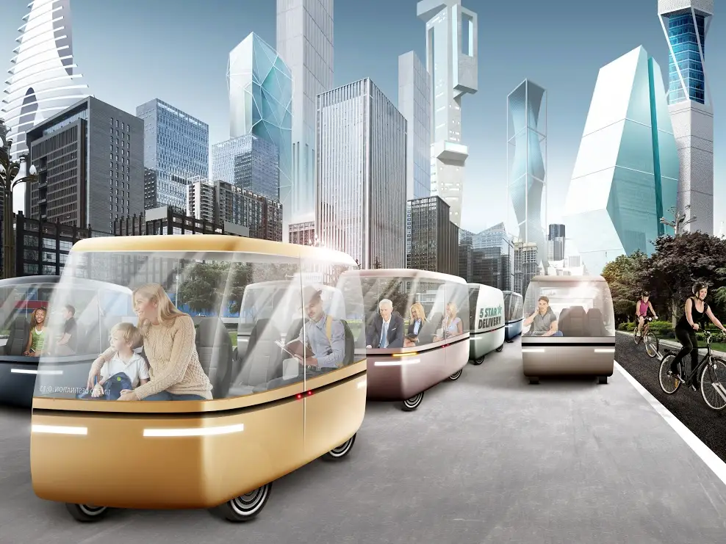
PRACTICE
1
Complete the sentences with will or won’t.
Aim of the task:
To help Ss use the right verb form to talk about future activities.

Slide 11
PRACTICE
1
Complete the sentences with will or won’t.
1. Petrol-powered cars are not eco-friendly, so they ______ be popular.
2. We ______ travel by teleporter soon because it is faster.
3. Rich people ______ choose to travel to other planets for their holidays.
4. People ______ take holidays in crowded places as in the past.
5. Bullet trains ______ soon become a popular means of transport in Viet Nam because they are green and safe.
won’t
will
will
won’t
will

Slide 12
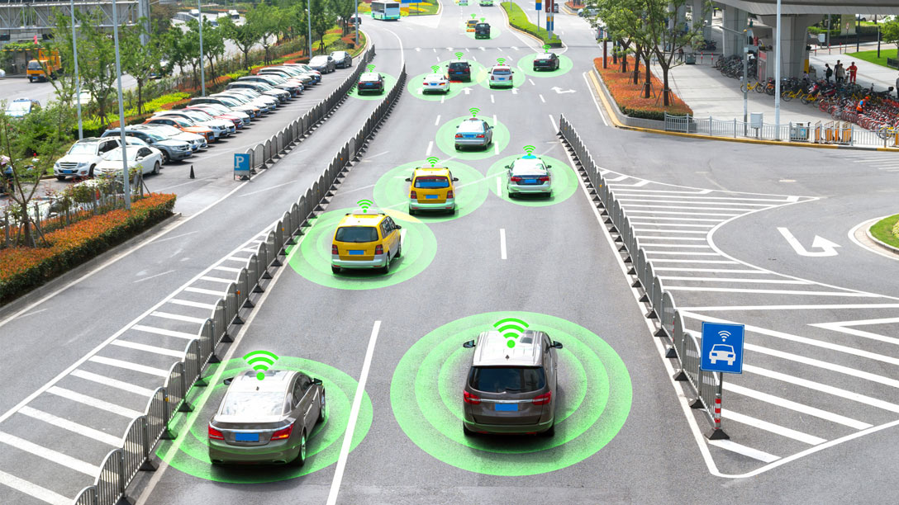
PRACTICE
2
Rearrange the words and phrases to make sentences.
Aim of the task:
To help Ss practise making full sentences about future activities using prompts.

Slide 13

PRACTICE
2
Rearrange the words and phrases to make sentences.
driverless cars / we / will have / in 2030 /.
2. cars / cities / won’t allow / in 2050 /.
3. electric cars / will / popular / be /?
4. we / use / will / buses / soon / solar-powered/.
5. have / enough parking places / we / will / in ten years /?
→ We will have driverless cars in 2030.
→ Cities won’t allow cars in 2050.
→ Will electric cars be popular?
→ We will use solar-powered buses soon.
→ Will we have enough parking places in ten years?

Slide 14
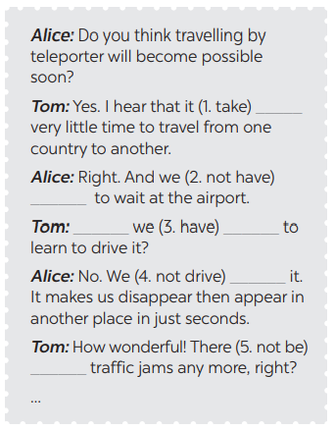
PRACTICE
3
Use the correct form of the verbs in brackets to complete the conversation.
will take
won’t have
will
have
won’t drive
won’t be

Slide 15
LESSON 3: A CLOSER LOOK 2
WARM-UP
CHATTING
PRESENTATION
Grammar 1: The future simple
Grammar 2: Possessive pronouns.
Task 1: Complete the sentences with will or won’t.
Task 2: Rearrange the words and phrases to make sentences.
Task 3: Use the correct form of the verbs in brackets to complete the conversation.
Task 4: Replace the underlined phrases with possessive pronouns.
PRACTICE

Slide 16
PRESENTATION
GRAMMAR 2: POSSESSIVE PRONOUNS (REVIEW)
Personal pronouns | Possessive adjectives | Possessive pronouns
I | my | mine
You | your | yours
We | our | ours
They | their | theirs
He | his | his
She | her | hers
It | its | its
Examples:
This is your bicycle.
That bicycle is her bicycle. → hers

Slide 17
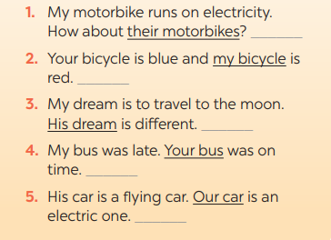
PRACTICE
4
Replace the underlined phrases with possessive pronouns.
theirs
mine
His
yours
ours

Slide 18
LESSON 3: A CLOSER LOOK 2
WARM-UP
CHATTING
PRESENTATION
Grammar 1: The future simple
Grammar 2: Possessive pronouns.
Task 1: Complete the sentences with will or won’t.
Task 2: Rearrange the words and phrases to make sentences.
Task 3: Use the correct form of the verbs in brackets to complete the conversation.
Task 4: Replace the underlined phrases with possessive pronouns.
PRACTICE
PRODUCTION
Task 5: Look at the pictures and tell your partner if you will / won’t travel by these means of transport. Give reason(s).
CONSOLIDATION
Wrap-up
Home work

Slide 19
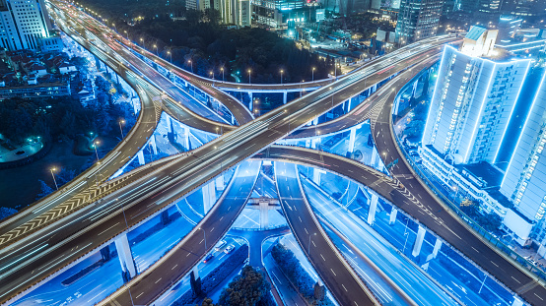
PRODUCTION
5
Look at the pictures and tell your partner if you will / won’t travel by these means of transport. Give reason(s).
Aim of the task:
To help Ss practise talking about some future means of transport
To help Ss learn reasoning skills by giving reasons for their choice.

Slide 20
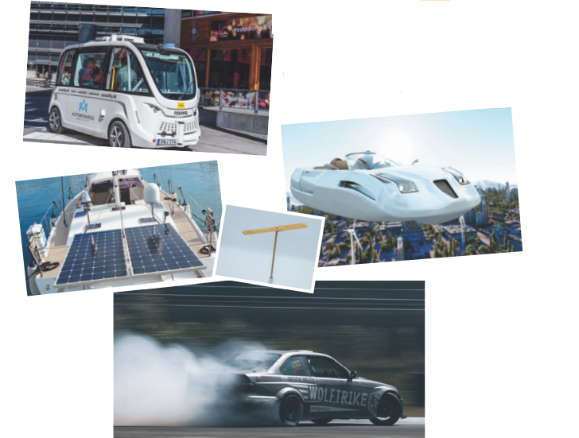
PRODUCTION
5
Look at the pictures and tell your partner if you will / won’t travel by these means of transport. Give reason(s).

Slide 21
LESSON 3: A CLOSER LOOK 2
WARM-UP
CHATTING
PRESENTATION
Grammar 1: The future simple
Grammar 2: Possessive pronouns.
Task 1: Complete the sentences with will or won’t.
Task 2: Rearrange the words and phrases to make sentences.
Task 3: Use the correct form of the verbs in brackets to complete the conversation.
Task 4: Replace the underlined phrases with possessive pronouns.
PRACTICE
PRODUCTION
Task 5: Look at the pictures and tell your partner if you will / won’t travel by these means of transport. Give reason(s).
CONSOLIDATION
Wrap-up
Home work

Slide 22
CONSOLIDATION
1
WRAP-UP
Grammar: The future simple: Will + Possessive pronouns

Slide 23
CONSOLIDATION
2
HOMEWORK
Do exercises in the workbook.

Slide 24


