Slide 1
Notes:
https://www.youtube.com/watch?v=7x0V0yr-13A

Slide 2
Unit 5
The world of work
LESSON IV
SPEAKING
Giving opinions about different jobs

Slide 3
LESSON IV
SPEAKING
WARM-UP
Watching a video
Task 1: Read the descriptions of the following jobs. What do you think about each job? Write the adjectives that describe the nature of the job in the table. Use the words in the box to help you.
Task 2: Work in pairs. Talk about the jobs in 1 using the adjectives. Compare your answers and explain your opinions and feelings.
CONTROLLED PRACTICE
LESS CONTROLLED PRACTICE
Task 3: Work in groups. Compare your answers in 1 and 2, and report to the whole class. Use the questions below as cues.
CONSOLIDATION
Wrap-up
Homework

Slide 4
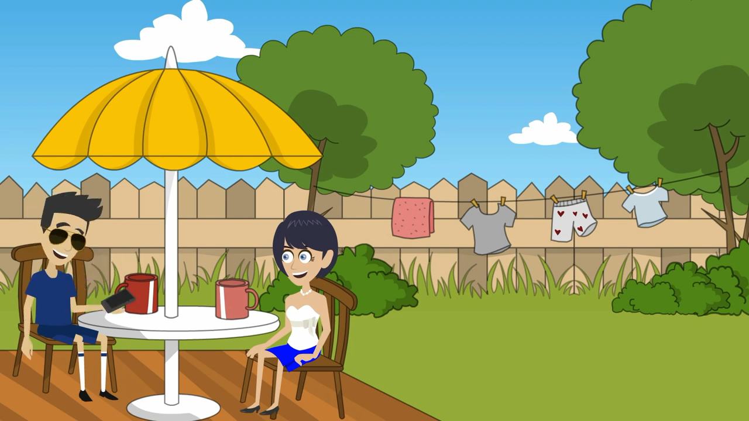
WARM-UP
What are they talking about?
Notes:
https://www.youtube.com/watch?v=7x0V0yr-13A

Slide 5
CONTROLLED PRACTICE
1
Read the descriptions of the following jobs. What do you think about each job? Write the adjectives that describe the nature of the job in the table. Use the words in the box to help you.
boring challenging demanding exciting important
lonely repetitive rewarding stressful tiring
Jobs | Main responsibilities | Adjectives
Teaching assistant | supervising classroom activities, supporting teachers, and checking attendance | rewarding, interesting, fun
Event volunteer | greeting and talking to guests, and sorting donations
Product reviewer | testing product and writing reviews of them
Shop assistant | welcoming customers, arranging window displays, and selling goods.
Babysitter | looking after children while parents are away, playing with them, keeping them safe and feeding them

Slide 6
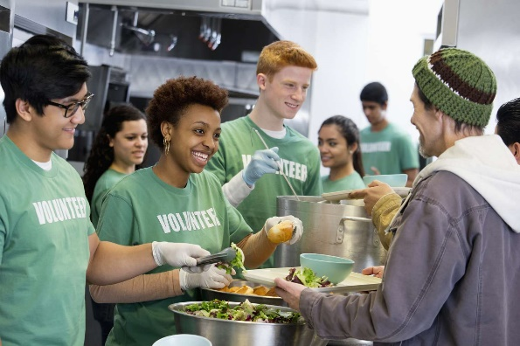
CONTROLLED PRACTICE
1
Read the descriptions of the following jobs. What do you think about each job? Write the adjectives that describe the nature of the job in the table. Use the words in the box to help you.
boring challenging demanding exciting important
lonely repetitive rewarding stressful tiring
rewarding
important
demanding
event volunteer
tiring

Slide 7

CONTROLLED PRACTICE
1
Read the descriptions of the following jobs. What do you think about each job? Write the adjectives that describe the nature of the job in the table. Use the words in the box to help you.
boring challenging demanding exciting important
lonely repetitive rewarding stressful tiring
exciting
challenging
demanding
product reviewer

Slide 8

CONTROLLED PRACTICE
1
Read the descriptions of the following jobs. What do you think about each job? Write the adjectives that describe the nature of the job in the table. Use the words in the box to help you.
boring challenging demanding exciting important
lonely repetitive rewarding stressful tiring
repetitive
boring
tiring
shop assistant

Slide 9

CONTROLLED PRACTICE
1
Read the descriptions of the following jobs. What do you think about each job? Write the adjectives that describe the nature of the job in the table. Use the words in the box to help you.
boring challenging demanding exciting important
lonely repetitive rewarding stressful tiring
stressful
tiring
boring
babysitter

Slide 10

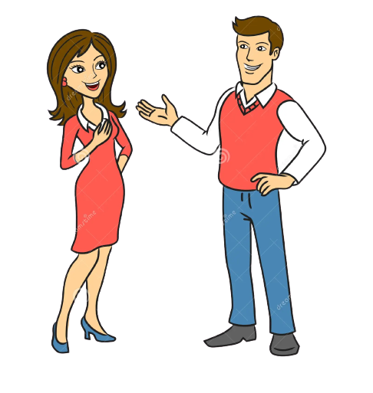
CONTROLLED PRACTICE
2
Work in pairs. Talk about the jobs in 1 using the adjectives. Compare your answers and explain your opinions and feelings.
I think working as a teaching assistant is a very rewarding job. I can help students who have questions or need encouragement during the lesson.
I agree, but it seems like a challenging job. You’ll have to be patient and explain the same thing over and over again. It can get very repetitive. Personally, I’d rather be an event volunteer.
Why? You won’t even get paid for that.
I know, but I’ll meet interesting people and learn important skills like communication and time management. Besides, volunteer experience can help me find a better job later on.
Oh, I get it.

Slide 11

LESS CONTROLLED PRACTICE
3
Work in groups. Compare your answers in 1 and 2, and report to the whole class. Use the questions below as cues.
Which is the most common adjective to describe each job in the table?
Which job do most people in your group like/dislike?
What are the most common reasons?

Slide 12
CONSOLIDATION
1
Wrap-up
What have you learnt today?
Giving opinions about different jobs: teaching assistant, event volunteer, product reviewer, shop assistant, babysitter.

Slide 13
CONSOLIDATION
2
Homework
Do exercises in the workbook.
Practice giving opinion about other jobs
Prepare for the next lesson.

Slide 14
Website: hoclieu.vn
Fanpage: facebook.com/www.tienganhglobalsuccess.vn

