Slide 1
HAVE FUN + Watch Video = 玩得开心 + 看视频 = Wán dé kāixīn + Kàn shìpín=
Be quiet 安靜 Ānjìng Sit down 坐下 Zuò xià Look at me 看着我 Kànzhe wǒ Listen to me 听我说 Tīng wǒ shuō
Answer me 回答我 Huídá wǒ
.

Slide 3
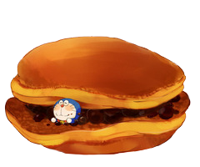
I can’t find my red bean cakes.
Please help me find them.
I’m hungry!

Slide 4
= Mystery
power-up
= points

Slide 5
Scoreboard: – Click the top right corner to add 1, bottom right to subtract 1, top left to add 5, bottom left to subtract 5.

Slide 6
A
B
C
D
E
F
G
H
I
J
K
L
M
N
O
P
Q
R
S
T
U
V
W
X
Y
Z

Slide 7
Do you like …ing?
Yes. I like skating. No. I like …ing.

Slide 9
Do you like …ing?
Yes. I like hopping. No. I like …ing.

Slide 11
Do you like …ing?
Yes. I like running. No. I like …ing.

Slide 13
Do you like …ing?
Yes. I like skipping. No. I like …ing.

Slide 15
Do you like …ing?
Yes. I like dancing. No. I like …ing.

Slide 17
Do you like …ing?
Yes. I like riding a bicycle. No. I like …ing.

Slide 19
Do you like …ing?
Yes. I like singing. No. I like …ing.

Slide 21
Do you like …ing?
Yes. I like writing. No. I like …ing.

Slide 23
Do you like …?
Yes. I like swimming. No. I like …ing.

Slide 25
Do you like …ing?
Yes. I like flying. No. I like …ing.

Slide 27
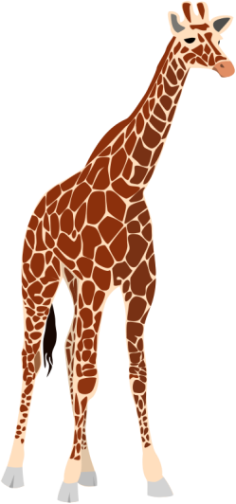
What are they?
They’re giraffes.

Slide 29
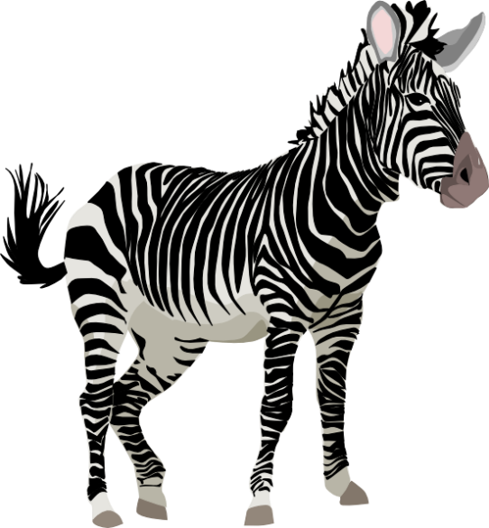
What are they?
They’re zebras.

Slide 31
What are they?
They’re elephants.

Slide 33
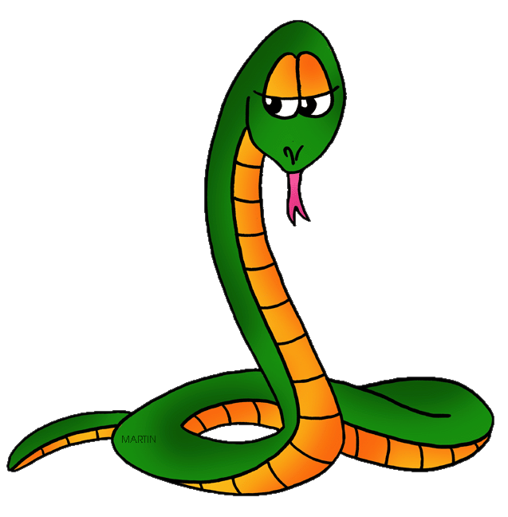
What are they?
They’re snakes.

Slide 35
What are they?
They’re lions.

Slide 37
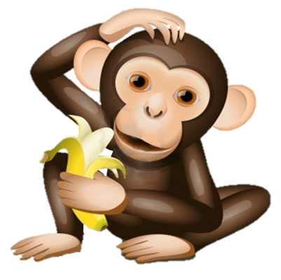
What are they?
They’re monkeys.

Slide 39
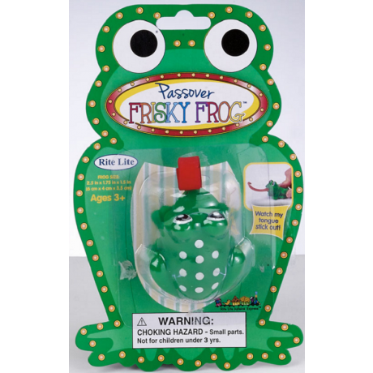
What are they?
They’re toy frogs.

Slide 41
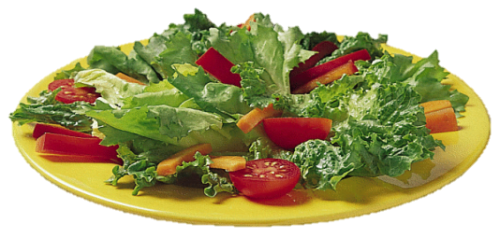
Would you like some …?
Sure. I like salad. No, thanks. I don’t like salad.

Slide 43
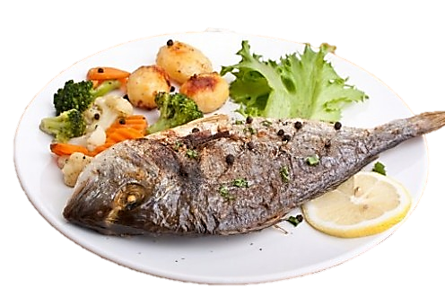
Would you like some …?
Sure. I like fish. No, thanks. I don’t like fish.

Slide 45
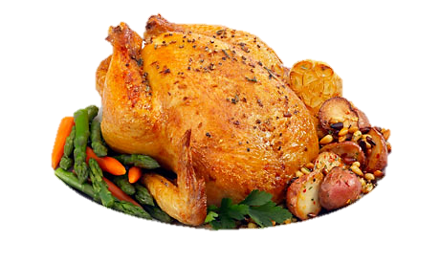
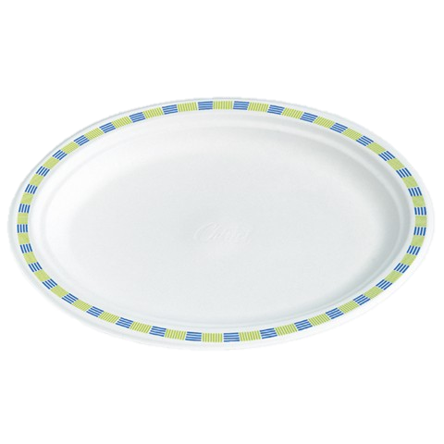
Would you like some …?
Sure. I like chicken. No, thanks. I don’t like ….

Slide 47
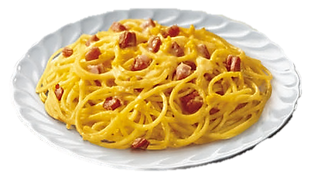
Would you like some noodles?
Sure. I like noodles. No, thanks. I don’t like ….

Slide 48
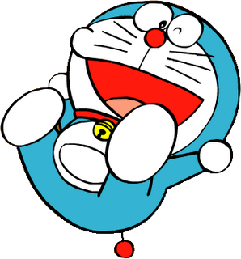
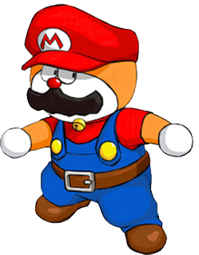

Slide 49
Change points!

Slide 50
Steal 3 points!

Slide 51
7 points!

Slide 52
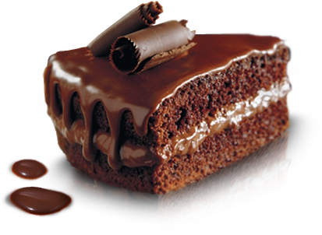
Would you like some cake?
Sure. I like cake. No, thanks. I don’t like ….

Slide 54
Change points!

Slide 55
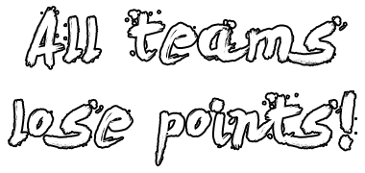

Slide 56
8 points!

Slide 57
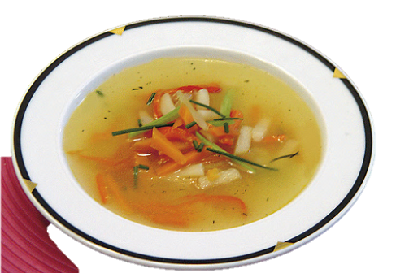
Would you like some soup?
Sure. I like soup. No, thanks. I don’t like ….

Slide 58
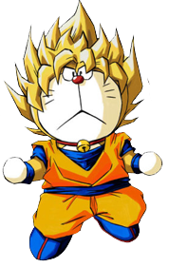
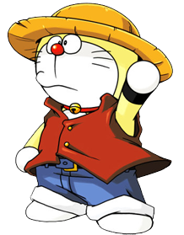
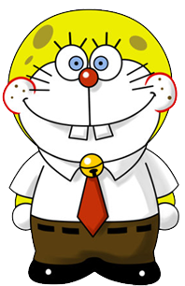

Slide 59
6 points!

Slide 60
Change points!

Slide 61
Steal 3 points!

Slide 62
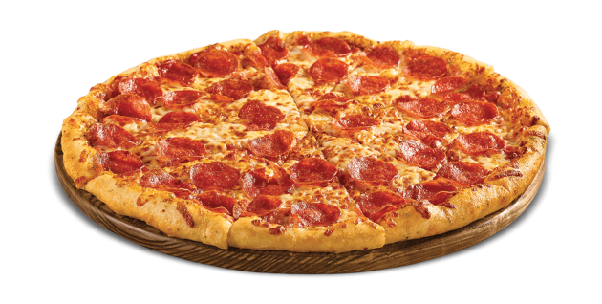
Would you like some pizza?
Sure. I like pizza.. No, thanks. I don’t like ….

Slide 64
Steal 3 points!

Slide 66
9 points!

Slide 67
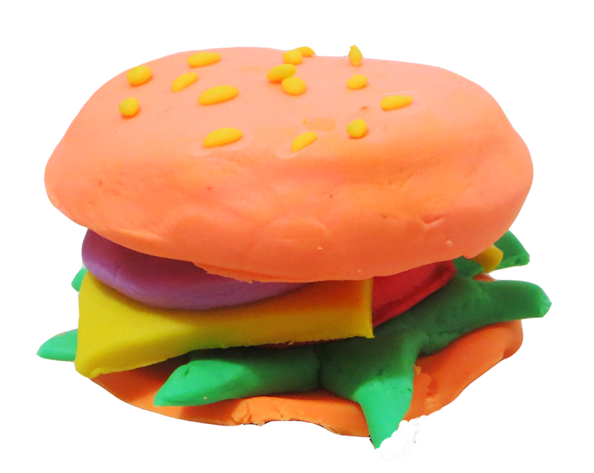
What are they?
They’re toy hamburgers.

Slide 68
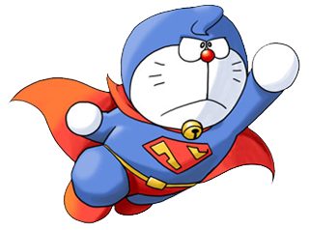

Slide 69
Change points!

Slide 70
Steal 3 points!

Slide 72
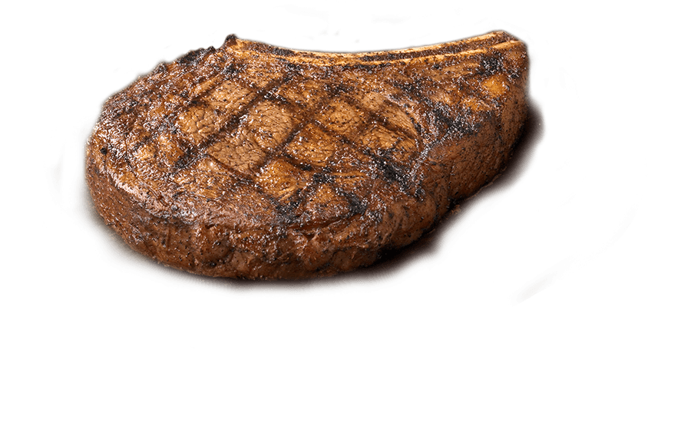
Would you like some meat?
Sure. I like meat.. No, thanks. I don’t like ….

Slide 74
10 points!

Slide 75
Change points!

Slide 77
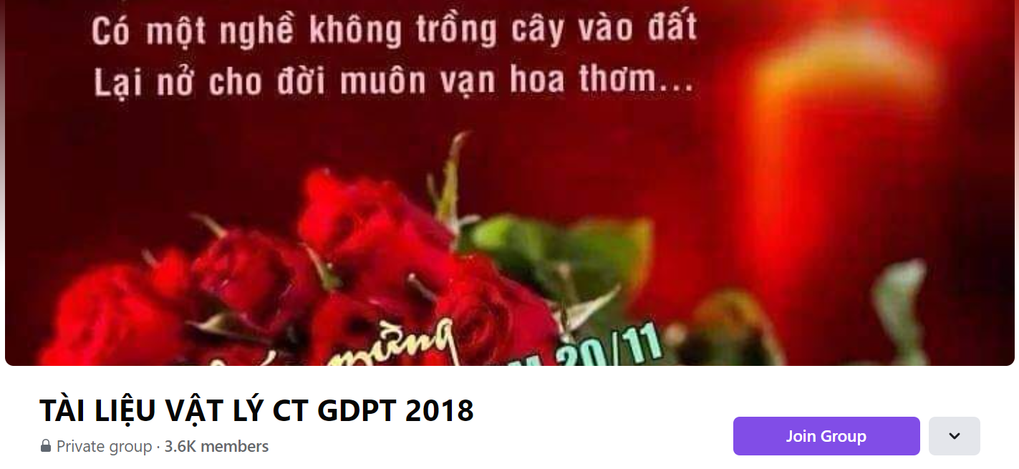
SƯU TẦM: ĐOÀN VĂN DOANH, NAM TRỰC, NAM ĐỊNH
LINK NHÓM DÀNH CHO GV BỘ MÔN VẬT LÝ TRAO ĐỔI TÀI LIỆU VÀ CHUYÊN MÔN CT 2018
https://www.facebook.com/groups/299257004355186

