Slide 2
Unit 6
Artificial Intelligence
LESSON 3
READING
AI applications in education

Slide 3
LESSON 3
READING
WARM-UP
Reveal the secret word
PRE-READING
Task 1: Discuss the pictures in the article.
- Task 2: Choose the correct meanings of the highlighted words.
- Task 3: Choose the correct answer A, B, C, or D
- Task 4: Complete each of the following sentences with one word from the article.
WHILE-READING
POST-READING
Task 5: Discussion.
CONSOLIDATION
- Wrap-up
- Homework

Slide 4
WARM-UP
Reveal the secret word
- Work in groups.
- Teacher delivers a handout to each group, in which students have to fill in the blanks with suitable words.
- Teacher asks students to guess the secret key word after they have completed the task.
- The first group to do the task successfully ang get the correct key word is the winner of the game.

Slide 5
WARM-UP
Reading passage:
In the rapidly evolving world of education, technology has become a (1) _________________ behind innovation and transformation. Among the many (2) ________________ technologies making waves in the educational landscape is KEY WORD HERE. It has emerged as a powerful tool for transforming learning experiences through AI conversations. an advanced natural language processing model, is designed to understand and generate (3) ________________ text based on the input it receives. It operates on the principles of deep learning, leveraging large-scale datasets to pre-train its language comprehension abilities. By employing this (4) ____________________ AI conversational tool in education, the learning process is elevated to new heights, offering students and educators unique (5) _________________ for growth and collaboration.
driving force
cutting-edge
human-like
sophisticated
opportunities

Slide 6
WARM-UP
Reading passage:
In the rapidly evolving world of education, technology has become a (1) _________________ behind innovation and transformation. Among the many (2) ________________ technologies making waves in the educational landscape is KEY WORD HERE. It has emerged as a powerful tool for transforming learning experiences through AI conversations. an advanced natural language processing model, is designed to understand and generate (3) ________________ text based on the input it receives. It operates on the principles of deep learning, leveraging large-scale datasets to pre-train its language comprehension abilities. By employing this (4) ____________________ AI conversational tool in education, the learning process is elevated to new heights, offering students and educators unique (5) _________________ for growth and collaboration.
driving force
cutting-edge
Chat GPT
human-like
sophisticated
opportunities

Slide 7
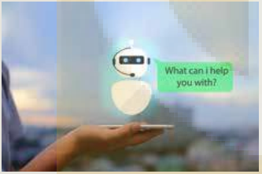
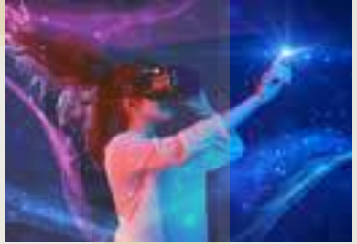
PRE-READING
1
Work in groups. Discuss what the pictures in the article below show and where you might see them.
Questions:
What are there in the pictures?
Where might you see them?
Pic 1. Chatbots
Pic 2. Virtual reality
We may see the first applications on laptops or smartphones. We may see the second one in tech centre, classrooms, museums….

Slide 8
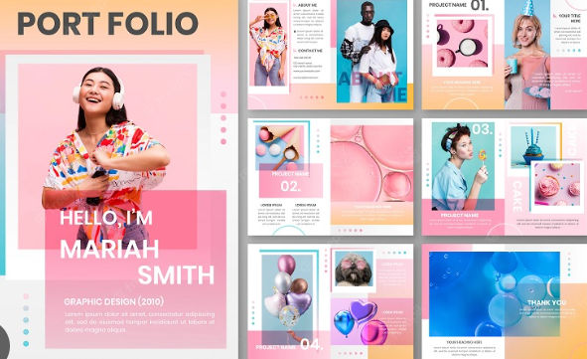

PRE-READING
portfolio (n)
/pɔːtˈfəʊliəʊ/
a collection of photographs, drawings, etc. that you use as an example of your work

Slide 9

PRE-READING
effortlessly (adv)
/ˈefətləsli/
in a way that needs little or no effort, and that seems easy

Slide 10
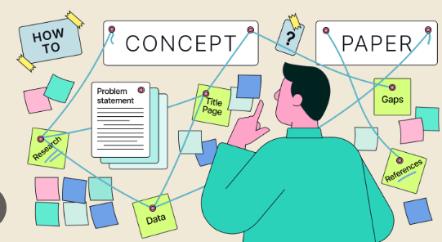
PRE-READING
concept (n)
/ˈkɒnsept/
an idea or a principle that is connected with something abstract

Slide 11

PRE-READING
(to) personalise
/ˈpɜːsənəlaɪz/
personalise something to mark something in some way to show that it belongs to a particular person

Slide 12
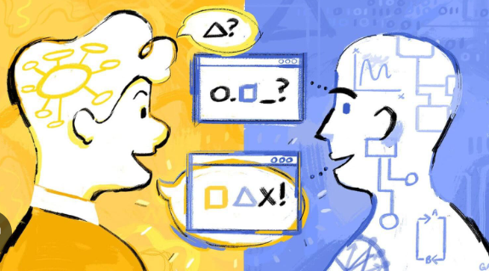
PRE-READING
conversational (adj)
/ˌkɒnvəˈseɪʃənl/
not formal; as used in
conversation

Slide 13
PRE-READING
Form | Pronunciation | Meaning | Vietnamese equivalent
1. portfolio (n) | /pɔːtˈfəʊliəʊ/ | a collection of photographs, drawings, etc. that you use as an example of your work | bộ tài liệu
2. effortlessly (adv) | /ˈefətləsli/ | ​in a way that needs little or no effort, and that seems easy | không tốn sức
3. concept (n) | /ˈkɒnsept/ | an idea or a principle that is connected with something abstract | khái niệm
4. (to) personalise | /ˈpɜːsənəlaɪz/ | personalise something to mark something in some way to show that it belongs to a particular person | cá nhân hóa
5.conversational (adj) | /ˌkɒnvəˈseɪʃənl/ | not formal; as used in conversation | trong giao tiếp thông thường

Slide 14
WHILE-READING
Read the article. Choose the correct meanings of the highlighted words.
2
1. portfolio
A. collection of someone’s prizes
B. collection of someone’s work such as drawings or documents
C. collection of someone’s learning and working experience
2. virtual
A. not made of natural things
B. made, done, or seen on the Internet or a computer rather than the real world
C. very similar to the real world but appearing in a different form

Slide 15
WHILE-READING
Read the article. Choose the correct meanings of the highlighted words.
2
3. hands-on
A. doing something yourself rather than just talking about it
B. asking people to do something
C. doing something by hand
4. platform
A. a floor of a building
B. a kind of computer system or software
C. a working area

Slide 16
WHILE-READING
Read the article again and choose the correct answer A, B, C, or D.
3
1. What can students in Singapore upload on their digital portfolio?
A. Their curriculum vitae.
B. Their test results.
C. Their study and work experience.
D. Descriptions of their skills.
2. Which of the following can AI chatbots NOT do according to Paragraph B?
A. Explain lessons.
B. Provide physical support.
C. Answer questions.
D. Comment on homework

Slide 17
WHILE-READING
Read the article again and choose the correct answer A, B, C, or D.
3
3. Which is one benefit of using VR in Hong Kong schools?
A. Organising field trips that take place online.
B. Replacing real-life travel.
C. Reducing the costs of doing experiments.
D. Creating more ways of communication.
4. Which group of students do NOT benefit from personalised learning app?
A. Physics.
B. Language.
C. Biology.
D. Chemistry.

Slide 18
WHILE-READING
Read the article again and choose the correct answer A, B, C, or D.
3
5. Which AI applications are useful for students who need additional tutoring?
A. Digital portfolio and personalised learning.
B. All the apps mentioned above.
C. Educational chatbots and virtual reality.
D. Personalised learning app and educational chatbots.

Slide 19
WHILE-READING
Complete each of the following sentences with one word from the article
4
1. _____________ at Singaporean secondary schools can benefit from the digital portfolio.
2. Learners create project groups on _____________ so that they can engage with each other.
3. Students in Hong Kong can go on virtual trips to learn about the ______________ of their city.
4. The AI application in Israel has been used as the primary distance-learning ______________ by advanced physics students.
Students
chatbots
history
platform

Slide 20
POST-READING
5
Work in groups. Discuss the following question.
Which of the AI applications do you think your school can adopt?
Suggested answers:
In my opinion, educational chatbots can be of great use at my school as they provide additional support to students before and after class. They can also help tutor weak students to keep up with the class progress and reduce the workload for many teachers.

Slide 21
CONSOLIDATION
1
Wrap-up
What have you learnt today?
Some lexical items about AI applications in education;
Reading skills for general ideas and for specific information about AI applications in education.

Slide 22
CONSOLIDATION
2
Homework
Do exercises in the workbook.
Prepare for Lesson 4.

Slide 23
Website: hoclieu.vn
Fanpage: facebook.com/www.tienganhglobalsuccess.vn

