Slide 1
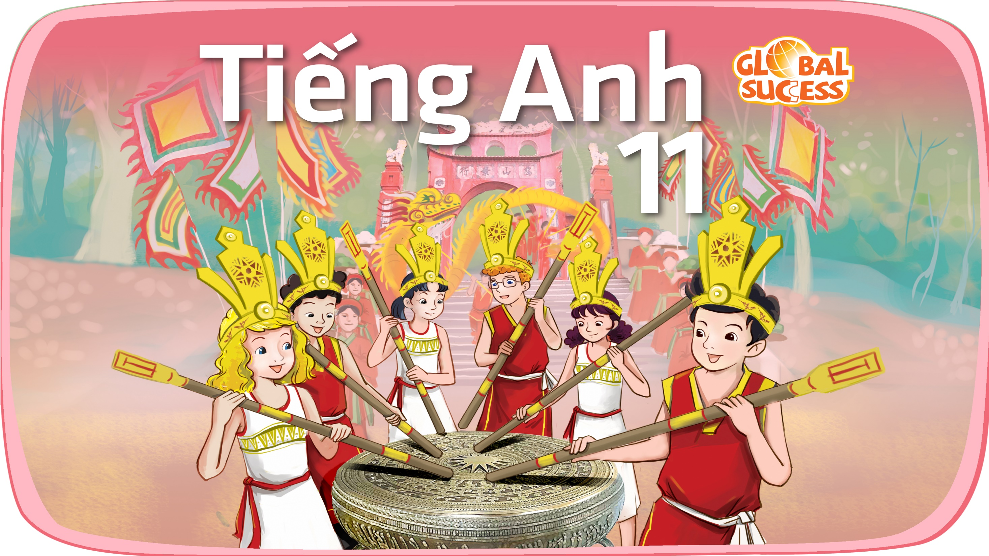

Slide 2
Unit
6
Preserving our heritage
Unit
FAMILY LIFE
LESSON 5
LISTENING
A trip to Trang An Scenic Landscape Complex

Slide 3
LESSON 5
LISTENING
WARM-UP
Jigsaw puzzle
PRE-LISTENING
Vocabulary
- Task 2. Listen to a talk. What is the talk mainly about?
- Task 3. Listen to the talk again and complete each gap in the notes with no more than three words and/or numbers.
WHILE-LISTENING
POST-LISTENING
Make predictions about what the tour guide will say next.
Wrap-up
Homework
CONSOLIDATION

Slide 4
WARM-UP
JIGSAW PUZZLE
- Ss work in groups.
- There are 4 questions related to a key picture.
- Guess the word in each puzzle
- Guess the key picture behind after each puzzle is opened.
- The group which gets the correct answer of the key picture is the winner.

Slide 5
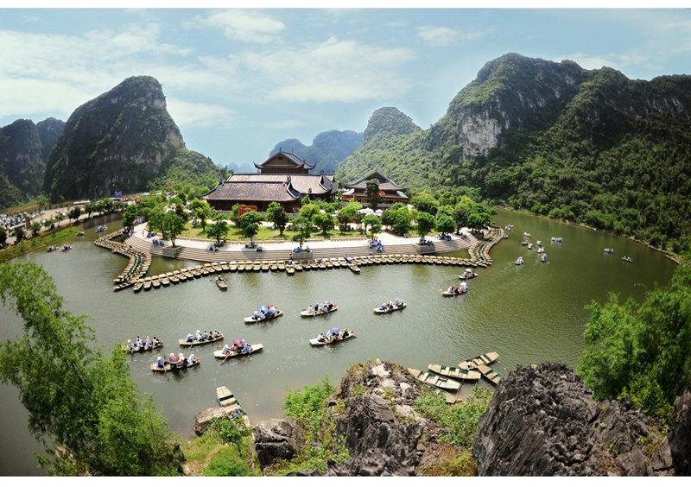
WARM-UP
Answer the question in each puzzle
1
2
3
4

Slide 6
WARM-UP
Question 1
Who was the founding emperor of the Đinh dynasty
of Vietnam?
➔ DINH BO LINH / DINH TIEN HOANG
BACK

Slide 7
WARM-UP
Question 2
What is a complex of Buddhist temples in Gia Viễn District, Ninh Bình Province, Vietnam?
➔ BAI DINH PAGODA
BACK

Slide 8
WARM-UP
Question 3
Which movie took place in the northern part of Vietnam
such as Vân Long and Tam Cốc (Ninh Bình Province),
Hạ Long Bay (Quảng Ninh Province)?
➔ THE MOVIE: KONG – THE SKULL ISLAND
BACK

Slide 9
WARM-UP
Question 4
What are they?
Large holes in the side of a hill, cliff, or mountain, or one that is underground.
➔ CAVES
BACK

Slide 10
WARM-UP
Answer the question in each puzzle

Slide 11
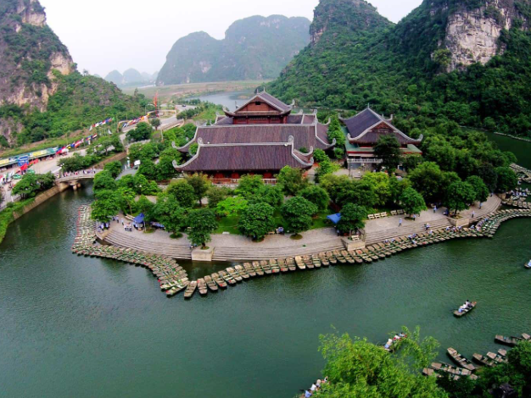
PRE-LISTENING
Discussion
+ Where is Trang An?
+ Is Trang An a World Heritage Site?
+ How big is the area?
+ Have you ever been to Trang An?
+ If yes, what did you see and do there?

Slide 12
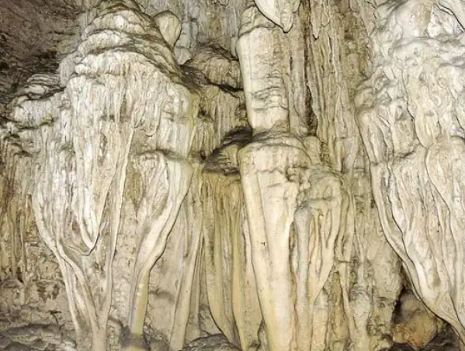

PRE-LISTENING
limestone (n)
/ˈlaɪmstəʊn/
a type of white rock that contains calcium, used in building and in making cement

Slide 13
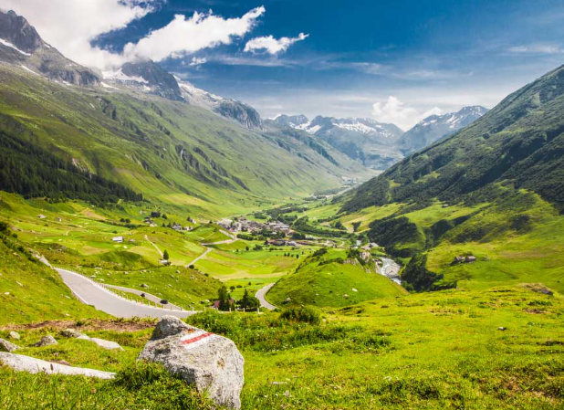
PRE-LISTENING
valley (n)
/ˈvæli/
an area of low land between hills or mountains, often with a river flowing through it

Slide 14
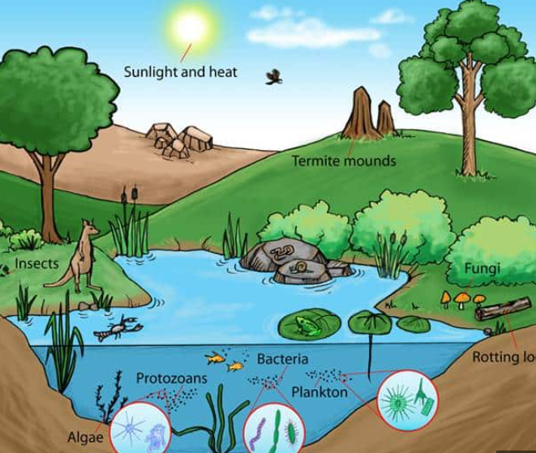
PRE-LISTENING
ecosystem (n)
/ˈiːkəʊsɪstəm/
all the plants and living creatures in a particular area considered in relation to their physical environment

Slide 15

PRE-LISTENING
interact (v)
/ˌɪntərˈækt/
if one thing interacts with another, or if two things interact, the two things have an effect on each other

Slide 16

PRE-LISTENING
original (adj)
/əˈrɪdʒənl/
existing at the beginning of a particular period, process or activity

Slide 17
PRE-LISTENING
Form | Pronunciation | Meaning
1. limestone (n) | /ˈlaɪmstəʊn/ | a type of white rock that contains calcium, used in building and in making cement
2. valley (n) | /ˈvæli/ | an area of low land between hills or mountains, often with a river flowing through it
3. ecosystem (n) | /ˈiːkəʊsɪstəm/ | all the plants and living creatures in a particular area considered in relation to their physical environment
4. interact (v) | /ˌɪntərˈækt/ | if one thing interacts with another, or if two things interact, the two things have an effect on each other
5. original (adj) | /əˈrɪdʒənl/ | ​ existing at the beginning of a particular period, process or activity

Slide 18
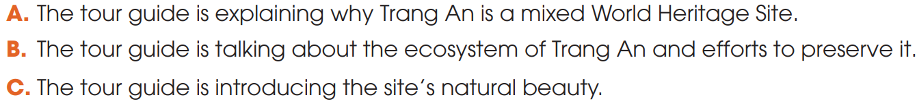
WHILE-LISTENING
2
Listen to a talk. What is the talk mainly about?

Slide 19
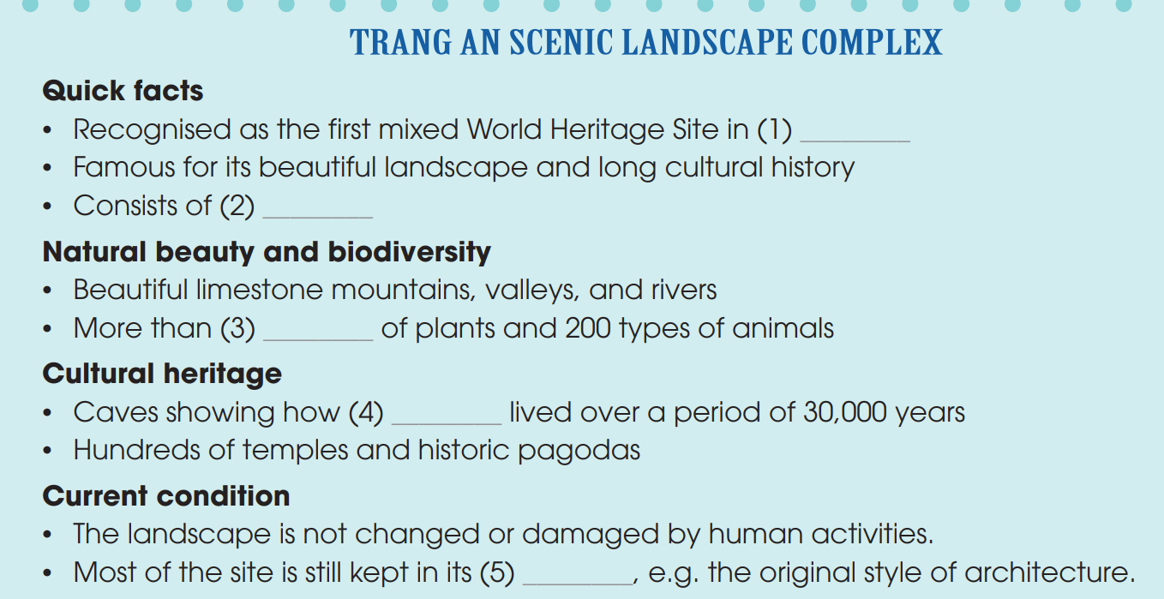
WHILE-LISTENING
3
Listen to the talk again and complete each gap in the notes with no more than three words and/or numbers.
2014
three protected areas
600 types
early humans
natural states

Slide 20
POST-LISTENING
5
Work in pairs. Make some predictions about what the tour guide will say next.

Slide 21
CONSOLIDATION
1
Wrap-up
What have you learnt today?
Trang An Scenic Landscape Complex;
Listening for main ideas and specific information.

Slide 22
CONSOLIDATION
2
Homework
Do exercises in the workbook.
Prepare for Lesson 6 - Unit 6.

Slide 23

Website: hoclieu.vn
Fanpage: facebook.com/sachmem.vn/

