Slide 1


Slide 2

Unit
5
1
Unit
FAMILY LIFE
INVENTIONS
LESSON 4
SPEAKING
Inventions and how they are used

Slide 3

Unit
1
1
FAMILY LIFE
Family Life
Unit
OBJECTIVES
Talk about inventions and how they are used.

Slide 4
LESSON 4
SPEAKING
Unit
GETTING STARTED
WARM-UP
Guessing game
PRE-SPEAKING
Useful expressions
Activity 1: Work in pairs. Talk about the uses of these inventions. Use the expressions below to help you.
Activity 2: Work in groups. Talk more about one of the inventions in activity 1. Use the outline below to help you prepare a group presentation.
WHILE-SPEAKING
POST-SPEAKING
Activity 3: Present your ideas to the whole class. Then vote for the most interesting group presentation.
CONSOLIDATION
Wrap-up
Homework

Slide 5

LESSON 4
SPEAKING
Unit
GETTING STARTED
WARM-UP
Guessing game
Pick a card containing the name of the invention.
Explain it to the class without showing the word.
The rest of the class guess its name.

Slide 6
LESSON 4
SPEAKING
Unit
GETTING STARTED
WARM-UP
Guessing game
PRE-SPEAKING
Useful expressions

Slide 7
PRE-SPEAKING
1
Useful expressions
Functions | Useful expressions
Uses of inventions | - … help(s)/ allow(s) us to do st. Example: The internet helps us to communicate over long distances. - We/ People (can) use the internet to communicate over long distances. - … is/ are used for st/ doing st. Example: The internet is used for communication/ communicating over long distances.

Slide 8
LESSON 4
SPEAKING
Unit
GETTING STARTED
WARM-UP
Guessing game
PRE-SPEAKING
Useful expressions
Activity 1: Work in pairs. Talk about the uses of these inventions. Use the expressions below to help you.
Activity 2: Work in groups. Talk more about one of the inventions in activity 1. Use the outline below to help you prepare a group presentation.
WHILE-SPEAKING

Slide 9
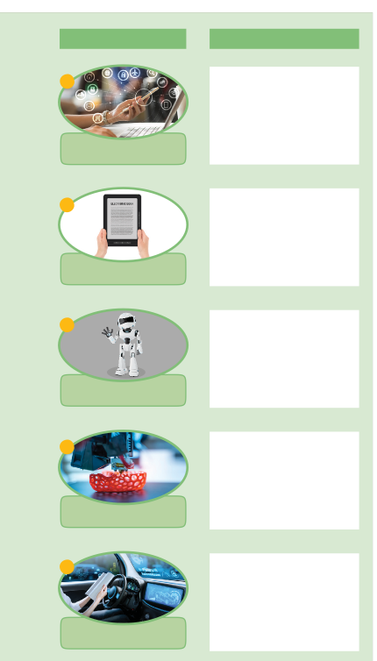
WHILE-SPEAKING
1
Work in pairs. Talk about the uses of these inventions. Use the expressions below to help you.
Skim through the list of inventions and their uses.
Work in pairs, talk about the uses of these inventions, using the expressions in the pre-speaking part.

Slide 10
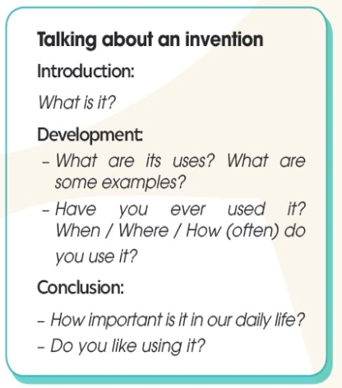
WHILE-SPEAKING
2
Work in groups. Talk more about one of the inventions in activity 1. Use the outline below to help you prepare a group presentation.
Work in groups, choose one of the inventions in activity 1 to talk more about it.
Discuss the inventions in groups and take notes of your ideas.

Slide 11
LESSON 4
SPEAKING
Unit
GETTING STARTED
WARM-UP
Guessing game
PRE-SPEAKING
Useful expressions
Activity 1: Work in pairs. Talk about the uses of these inventions. Use the expressions below to help you.
Activity 2: Work in groups. Talk more about one of the inventions in activity 1. Use the outline below to help you prepare a group presentation.
WHILE-SPEAKING
POST-SPEAKING
Activity 3: Present your ideas to the whole class. Then vote for the most interesting group presentation.

Slide 12

POST-SPEAKING
3
Present your ideas to the whole class. Then vote for the most interesting group presentation.
Present group’s ideas.
Give comments for friends’ groups and vote for the most interesting group presentation.

Slide 13
LESSON 4
SPEAKING
Unit
GETTING STARTED
WARM-UP
Guessing game
PRE-SPEAKING
Useful expressions
Activity 1: Work in pairs. Talk about the uses of these inventions. Use the expressions below to help you.
Activity 2: Work in groups. Talk more about one of the inventions in activity 1. Use the outline below to help you prepare a group presentation.
WHILE-SPEAKING
POST-SPEAKING
Activity 3: Present your ideas to the whole class. Then vote for the most interesting group presentation.
CONSOLIDATION
Wrap-up
Homework

Slide 14
CONSOLIDATION
1
Wrap-up
Speaking about inventions and how they are used.

Slide 15
CONSOLIDATION
2
Homework
Prepare for the next lesson: Unit 5: Listening
2. Do exercises in the workbook

Slide 16


