Slide 1

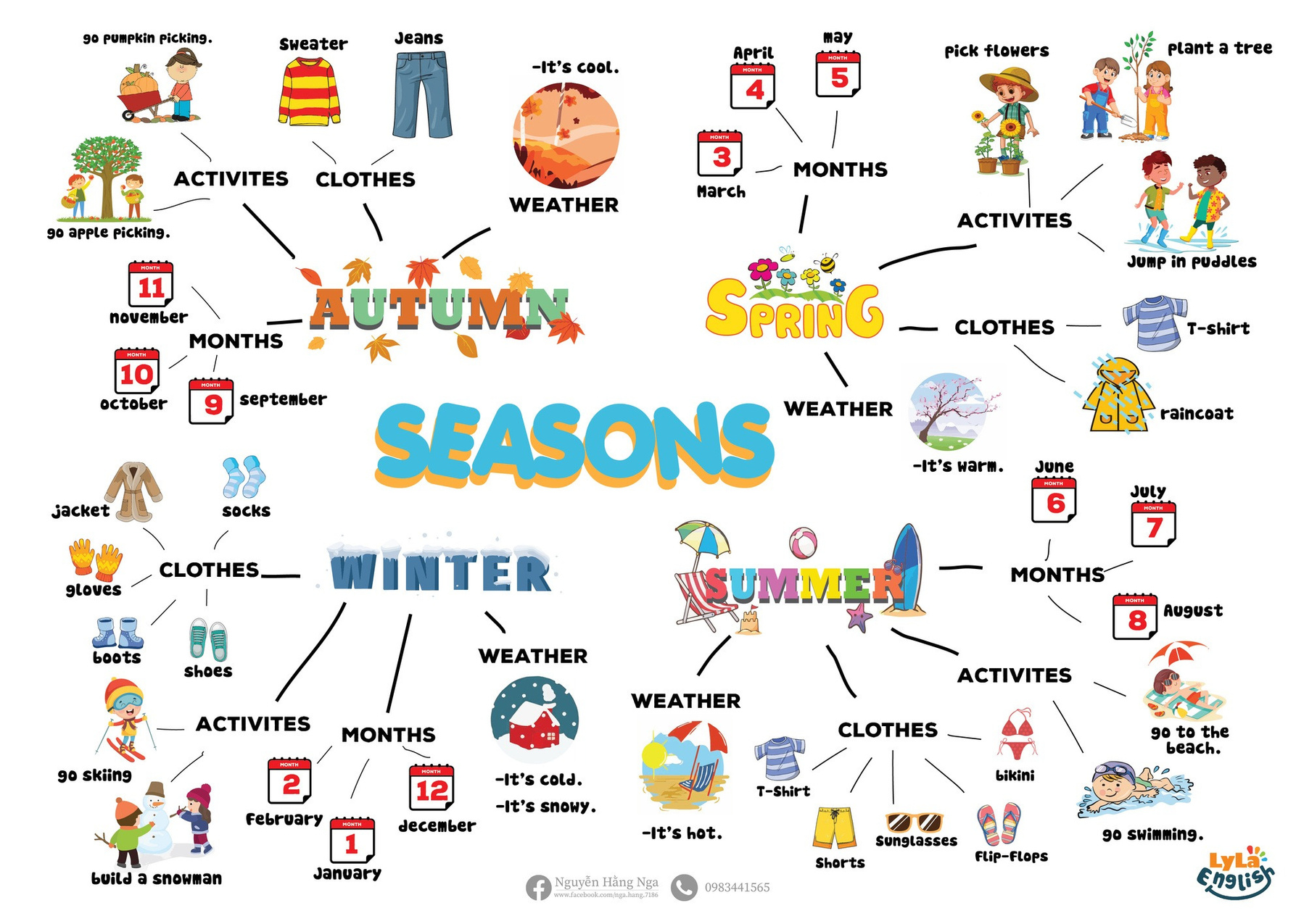


Slide 2
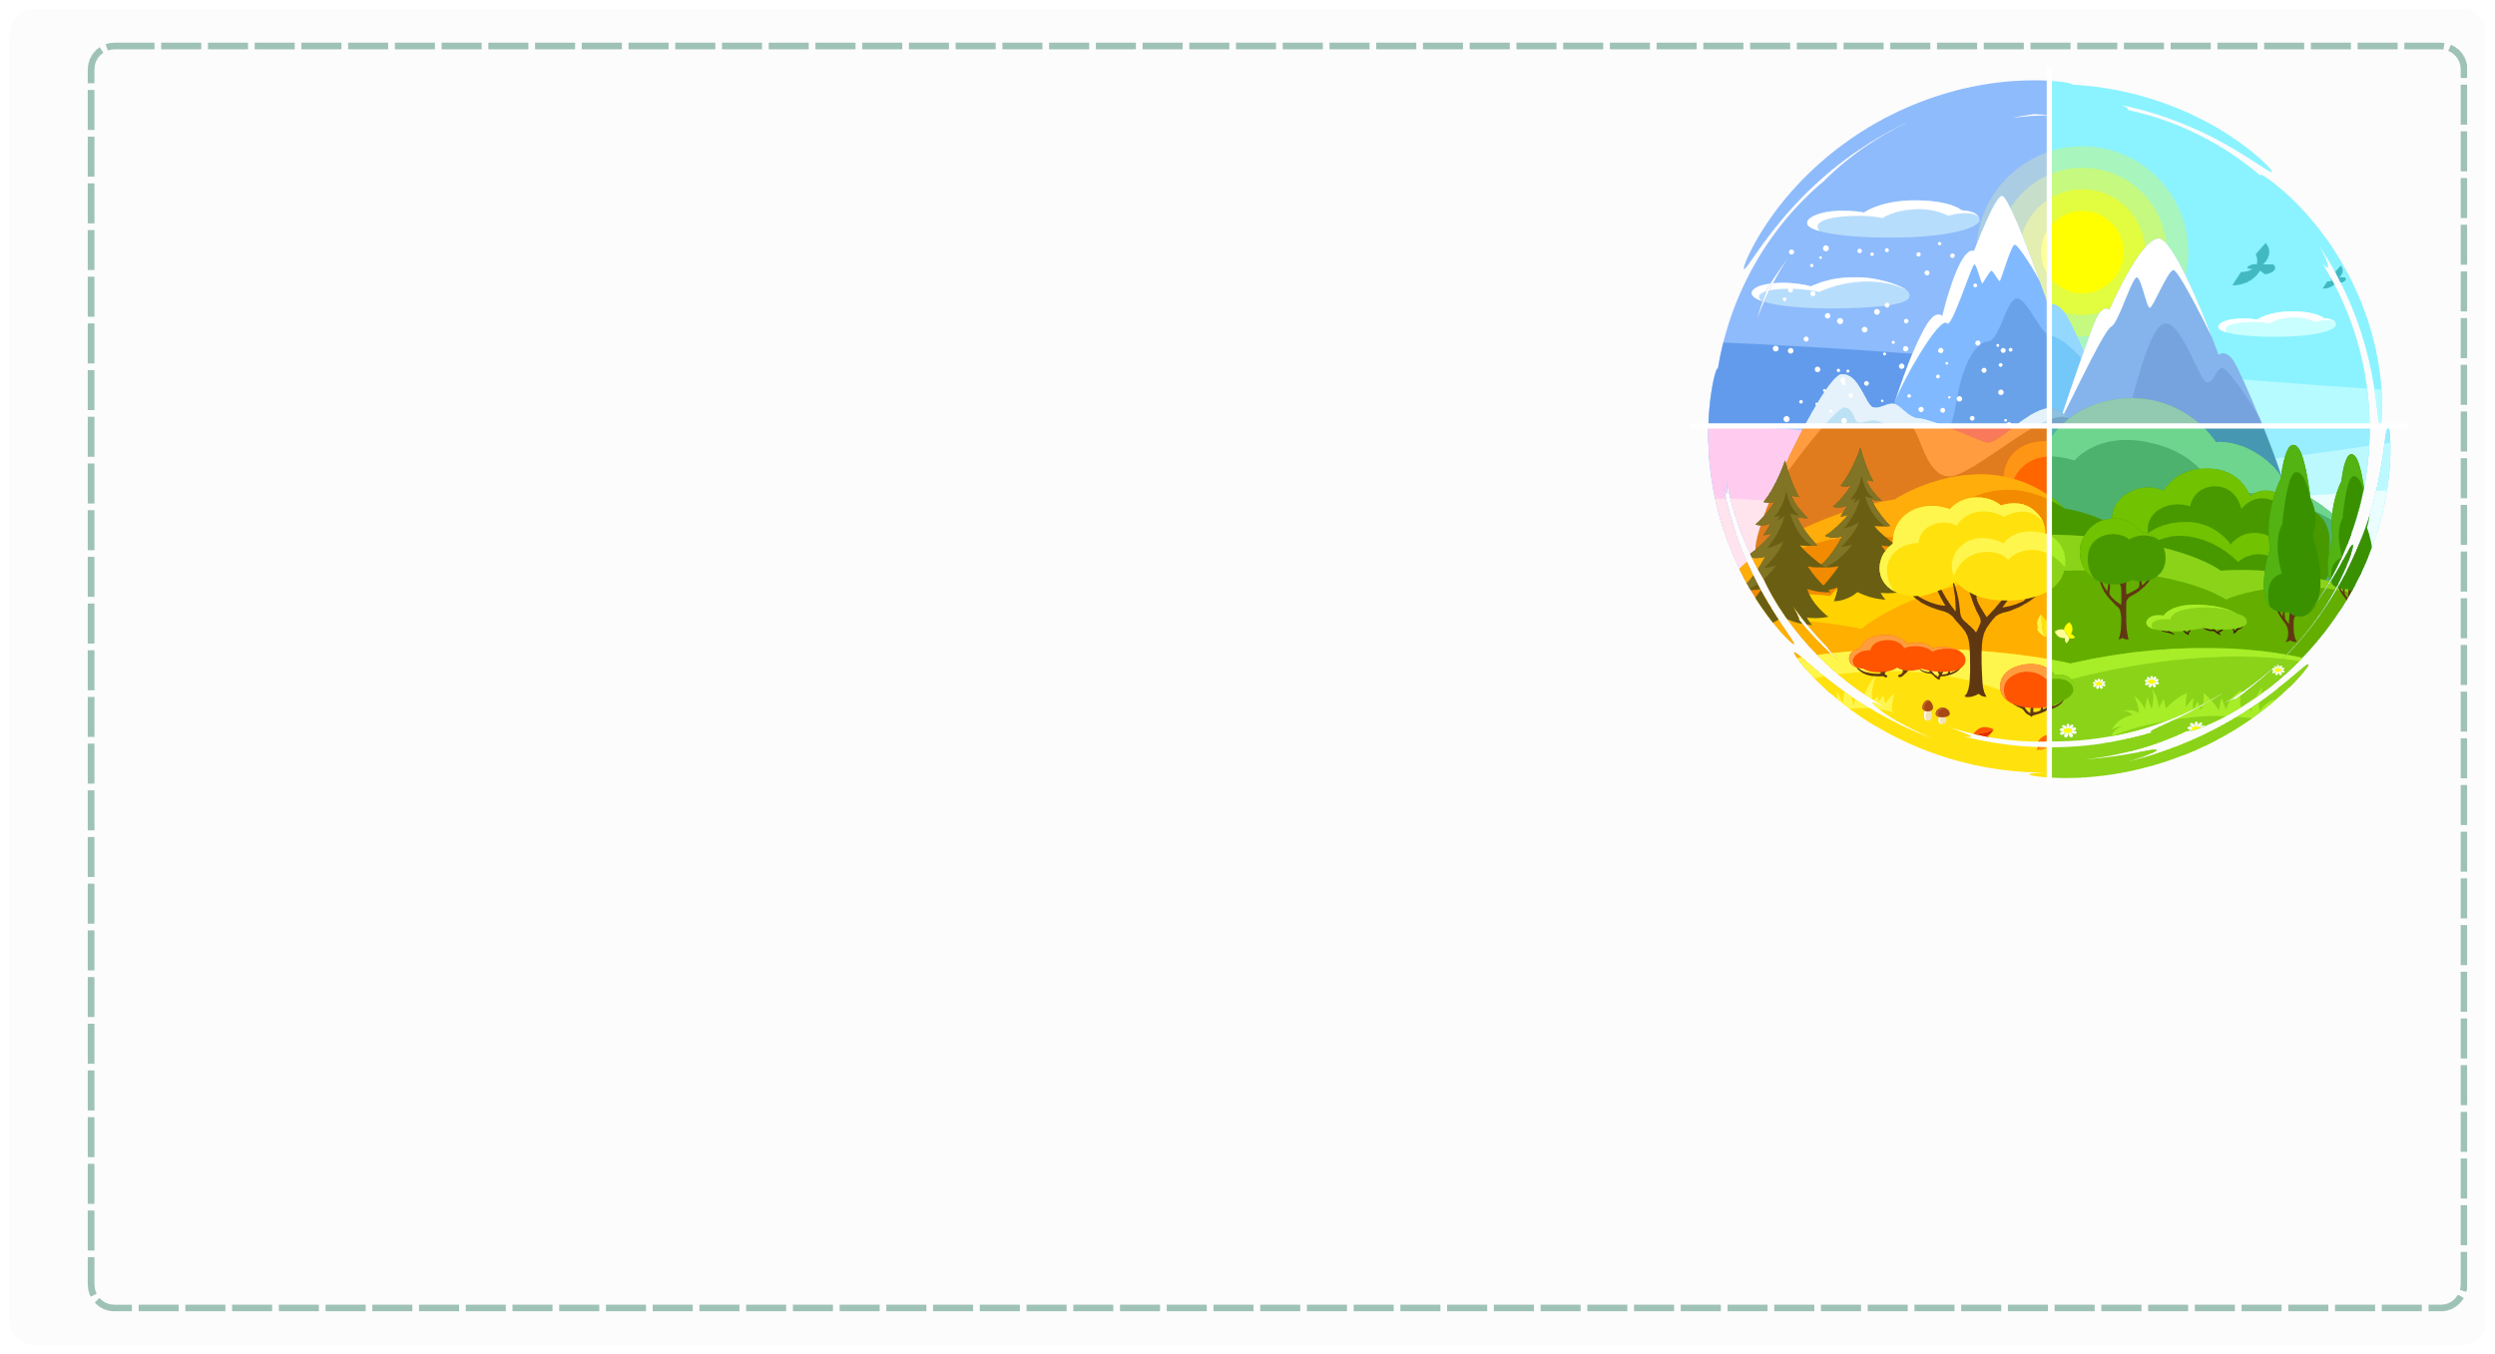
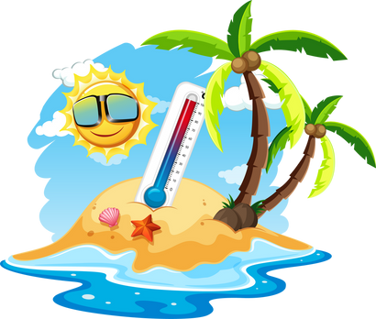
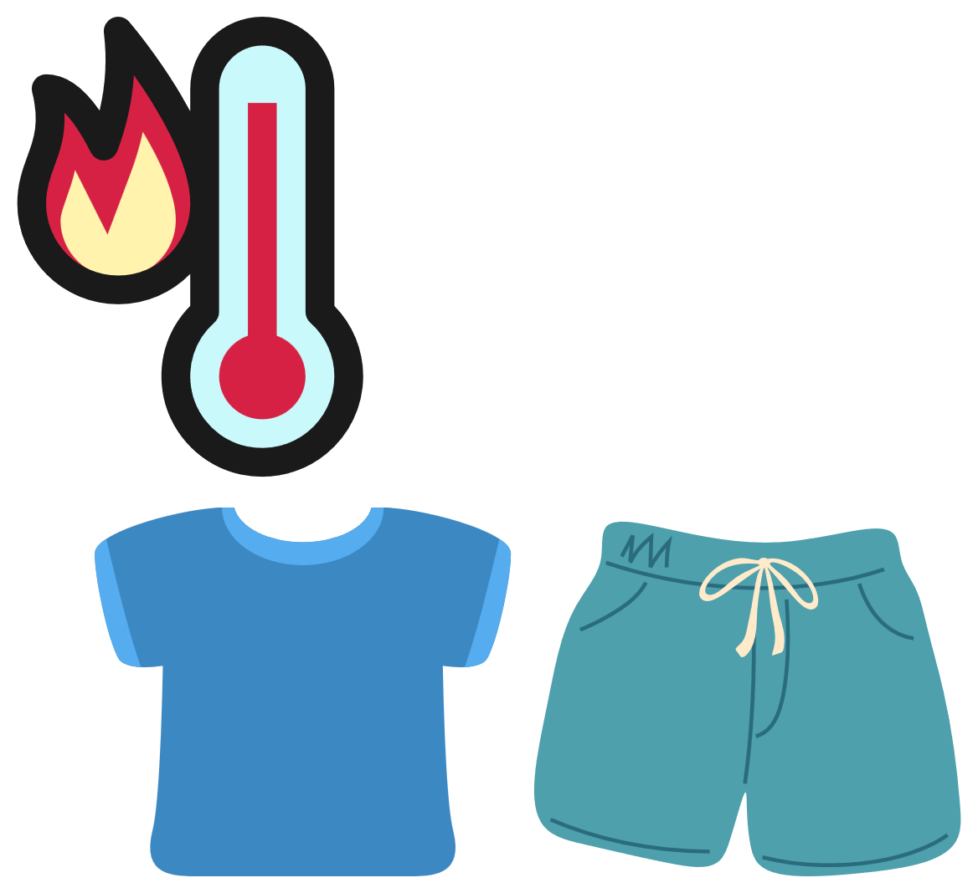
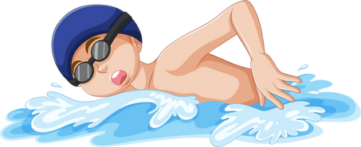
I. QUESTION
1. How many seasons are there in the year?
There are ... seasons:
2. What season is warm/ hot/ cool/ cold?
It’s ...
3. What is your favorite season?
It’s ...
4. How’s the weather in summer?
It’s ...
5. What do you wear when it’s hot?
I wear...
6. What do you do when it’s hot?
I ...

Slide 3



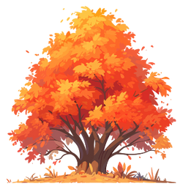

II. VOCABULARY
Spring:.............................................................
Summer:...........................................................
Autumn:.............................................................
Winter:..............................................................

Slide 4
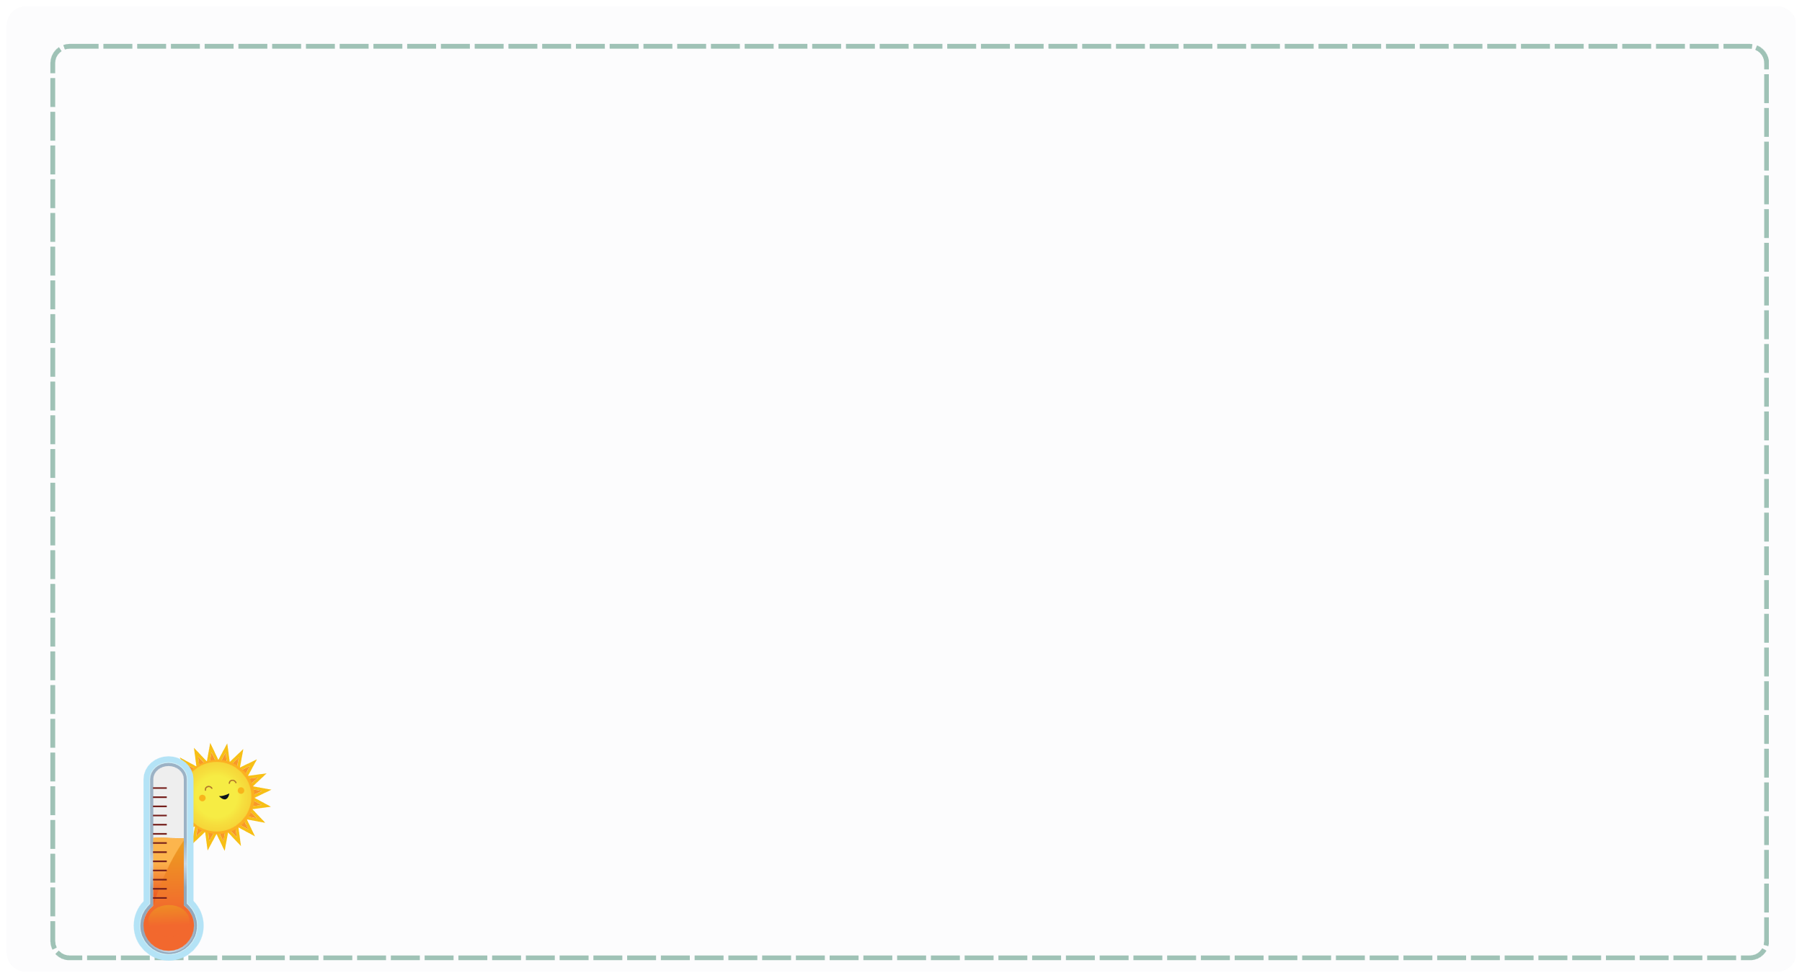
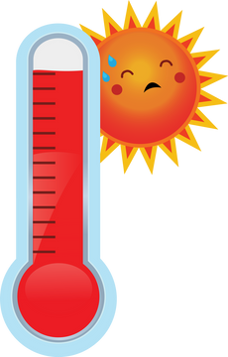
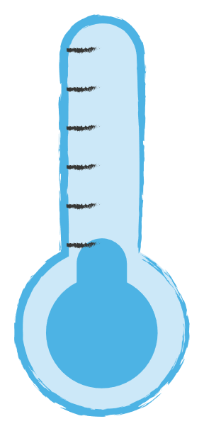
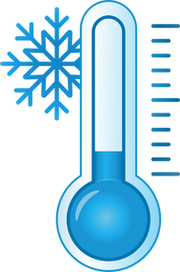
II. VOCABULARY
Hot:.............................................................
Cool:............................................................
Cold:.............................................................
Warm:...........................................................

Slide 5
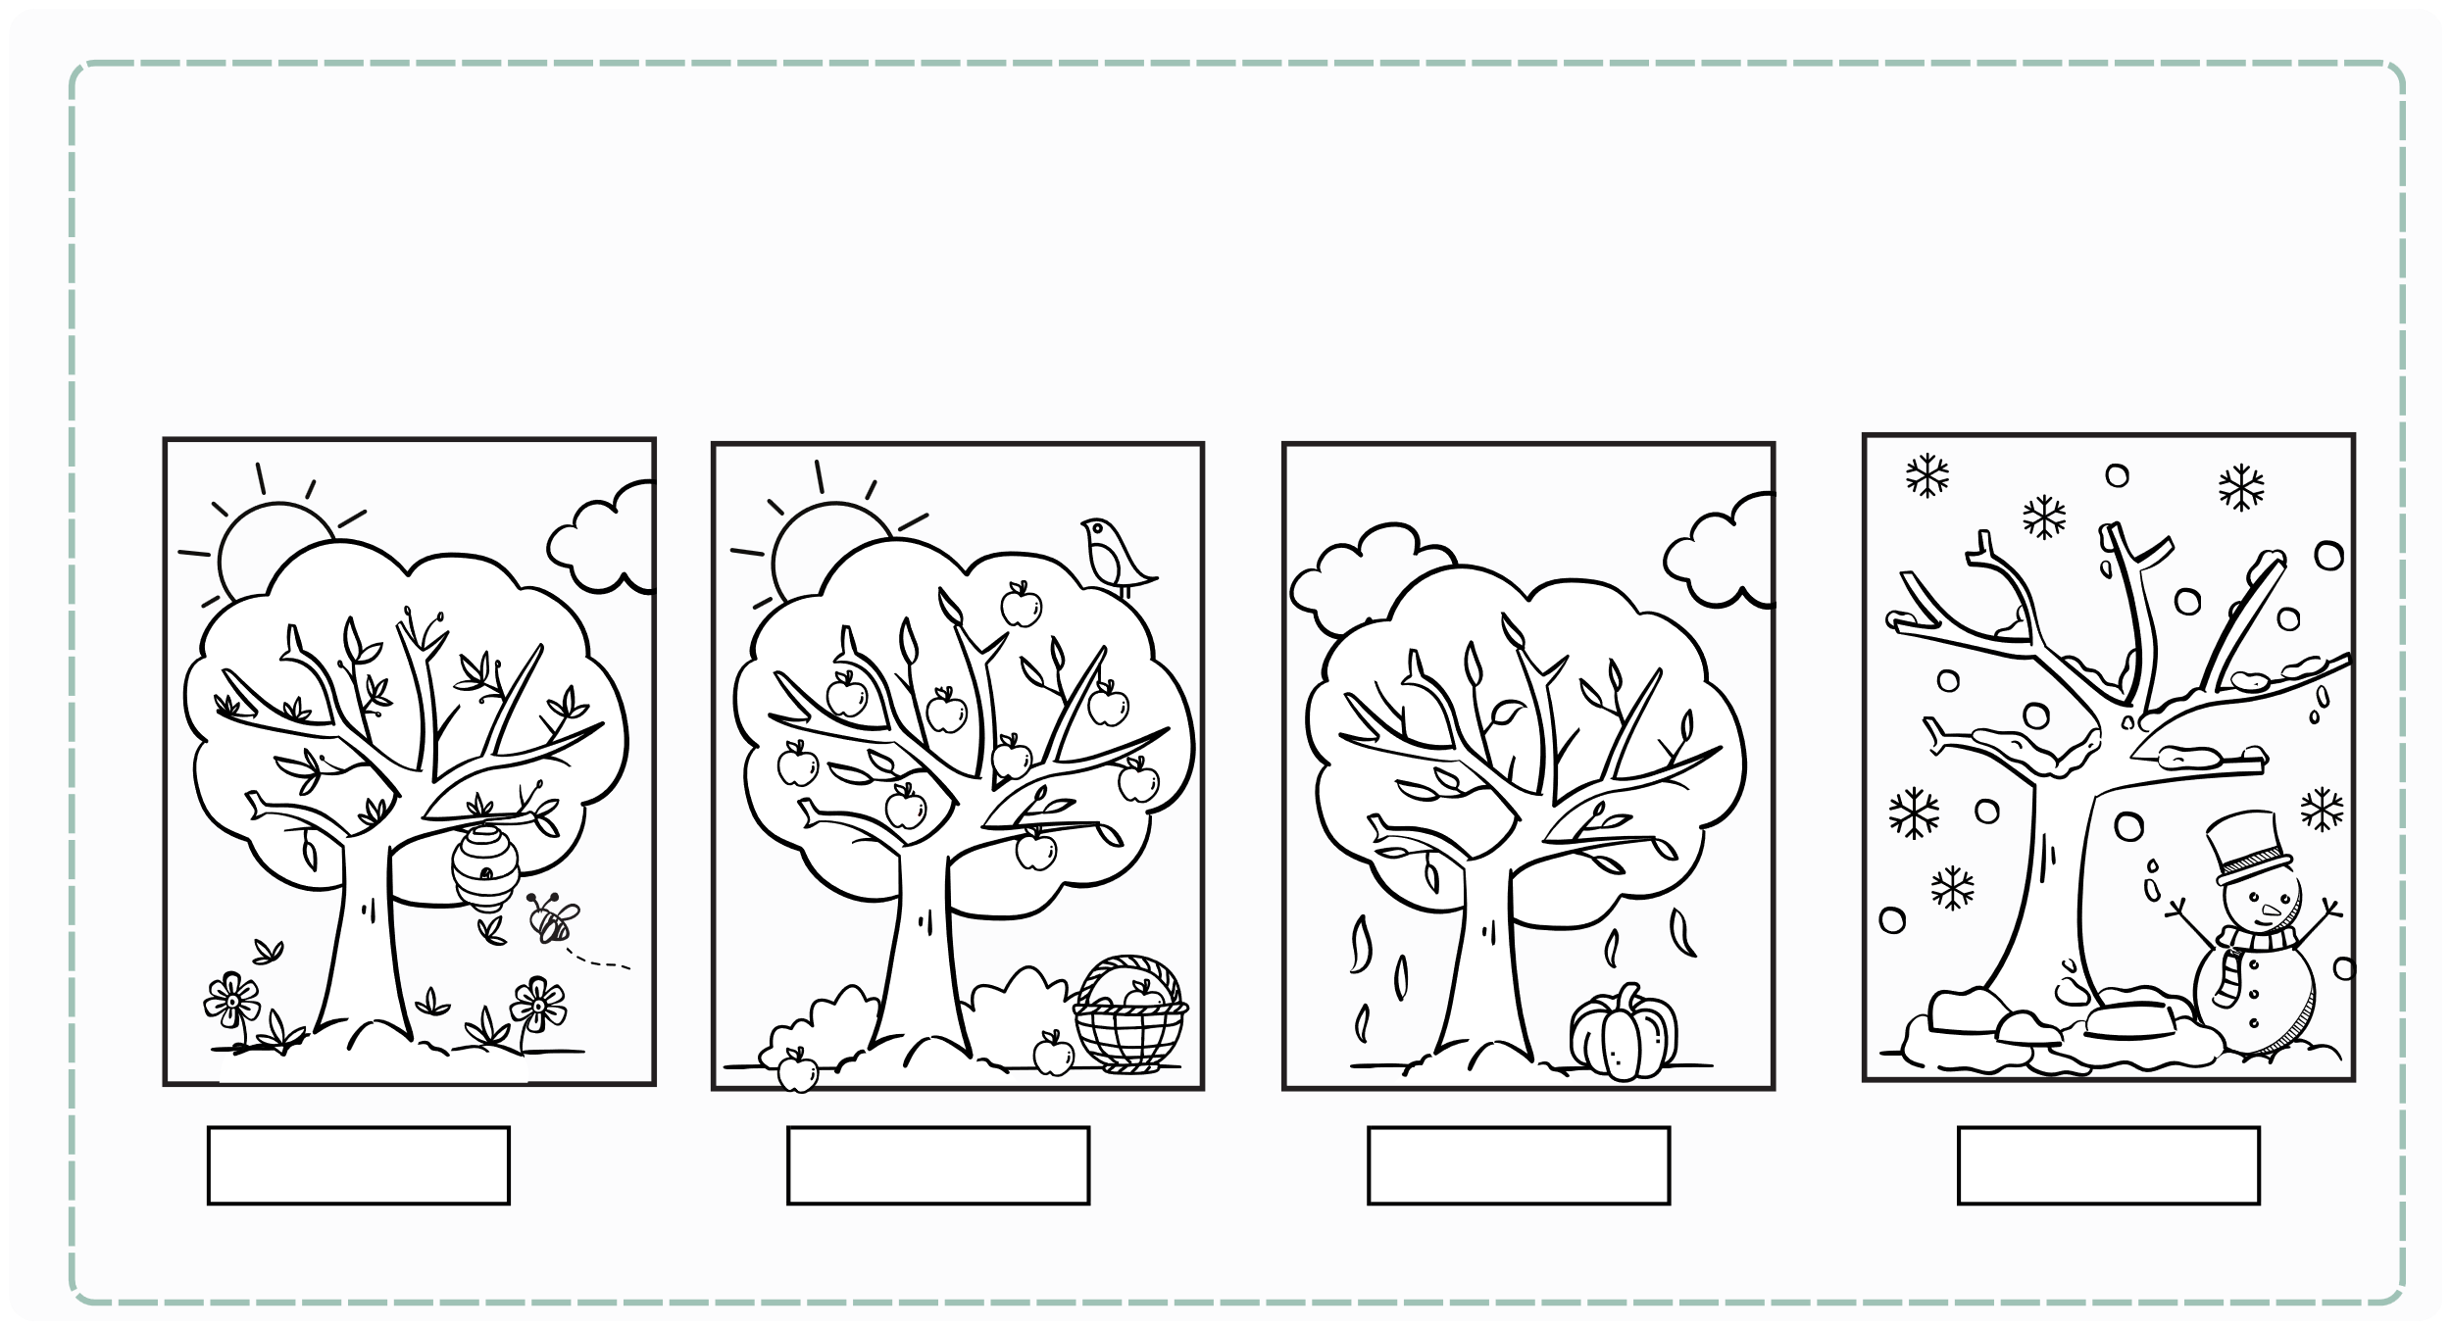
III. EXERCISES:
1. Read and color the seasons:
Spring
Summer
Autumn
Winter

Slide 6
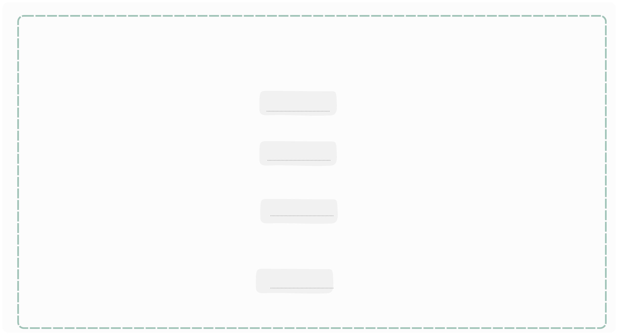
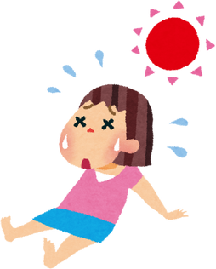
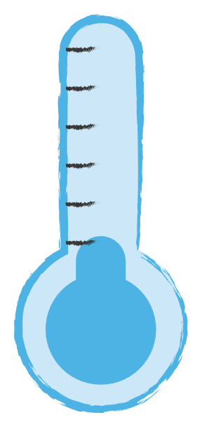
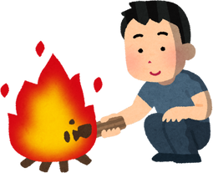
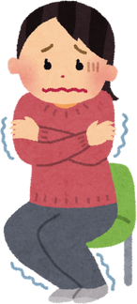
III. EXERCISES:
2. Look at the pictures and fill the words:
It’s
It’s
It’s
It’s

Slide 7
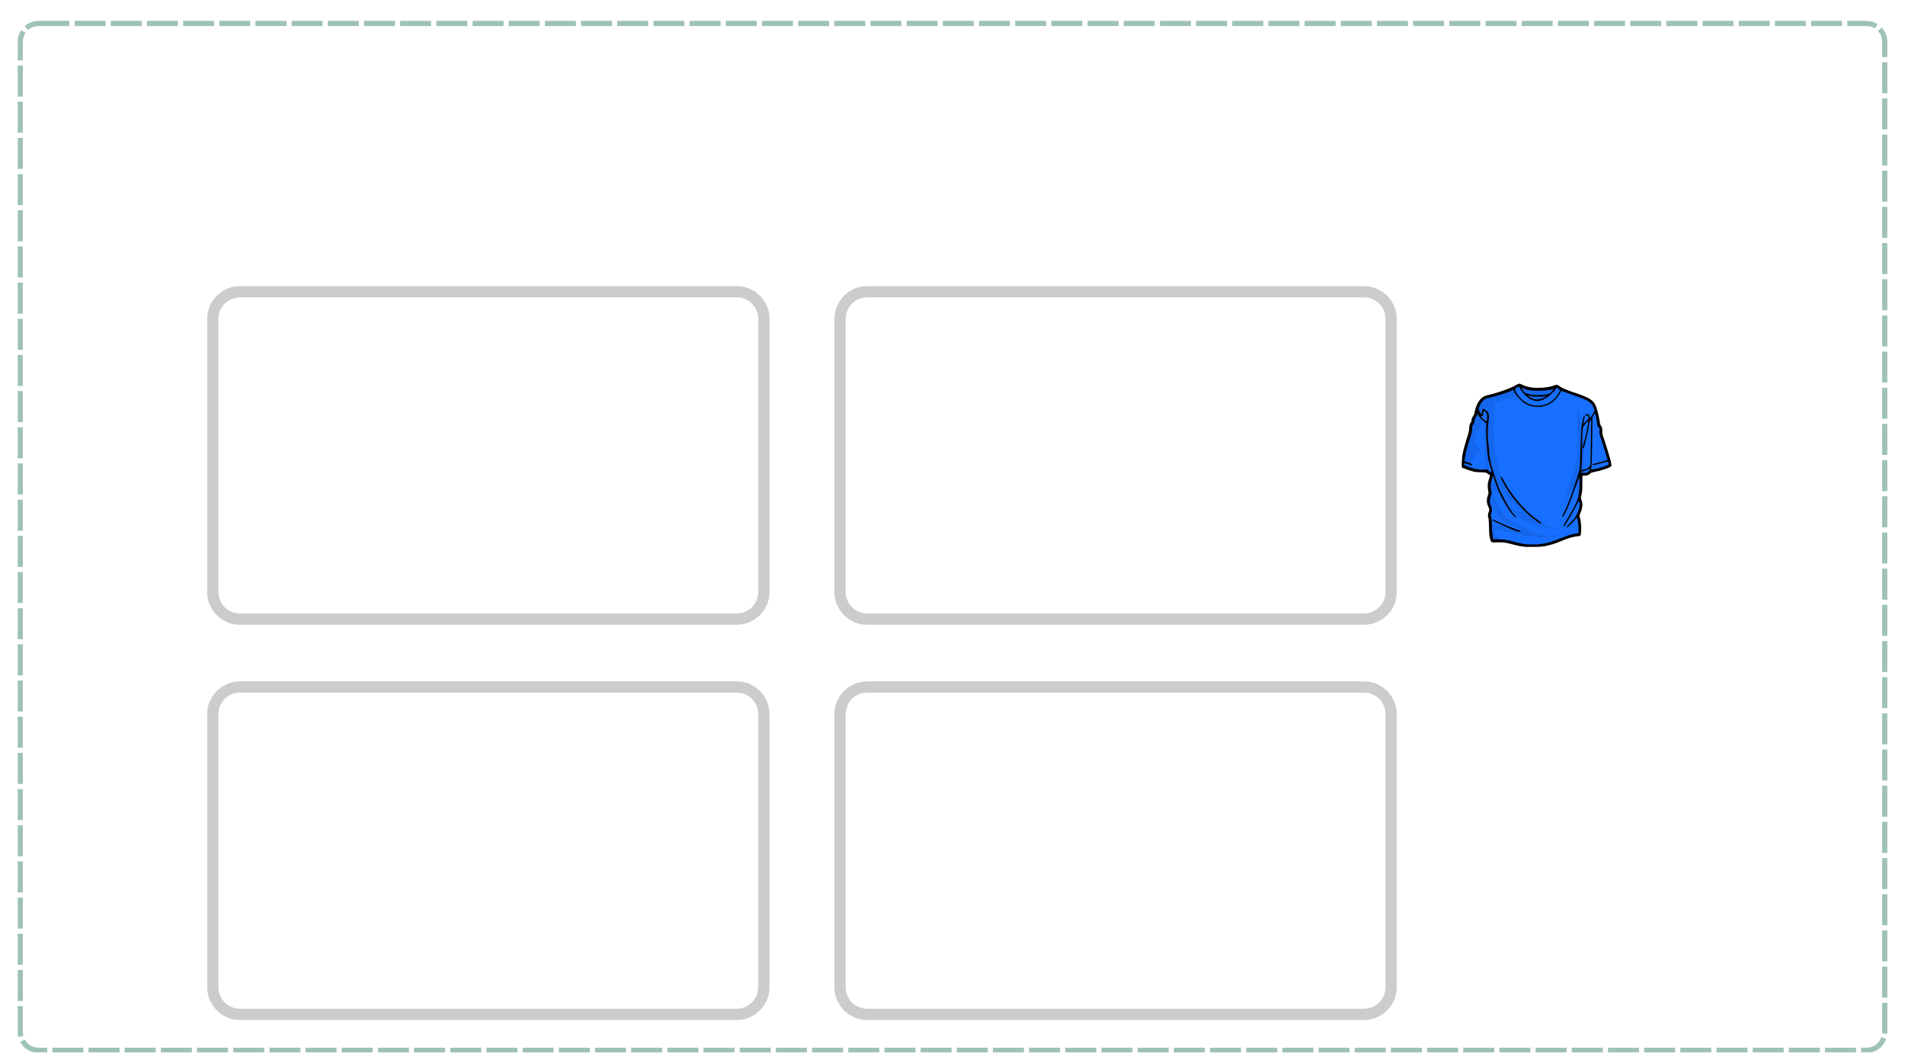
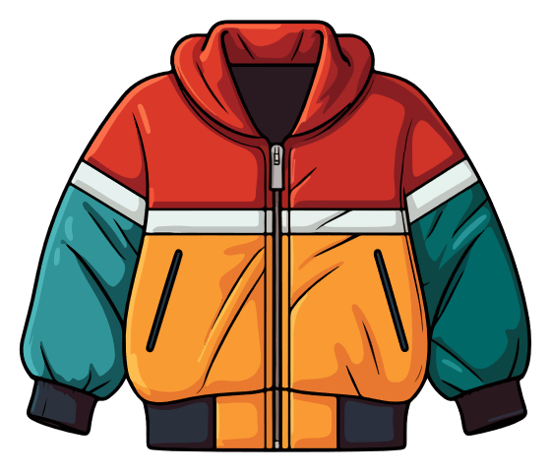
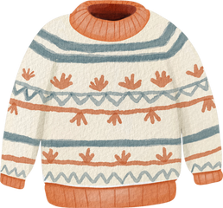
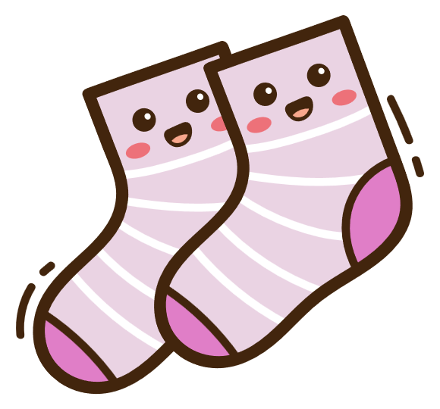

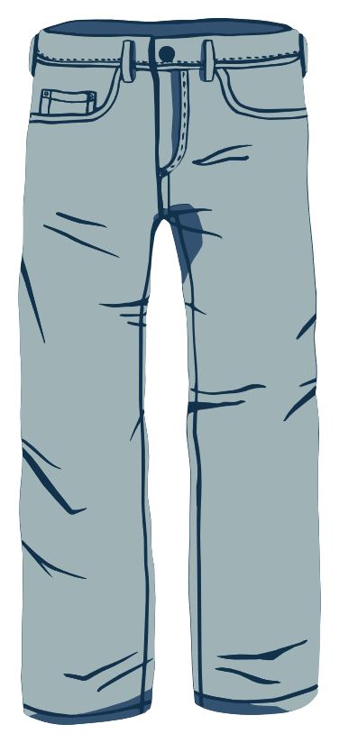
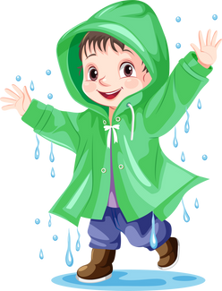
III. EXERCISES
3. Classify the following foods:
spring
autumn
summer
winter

Slide 8
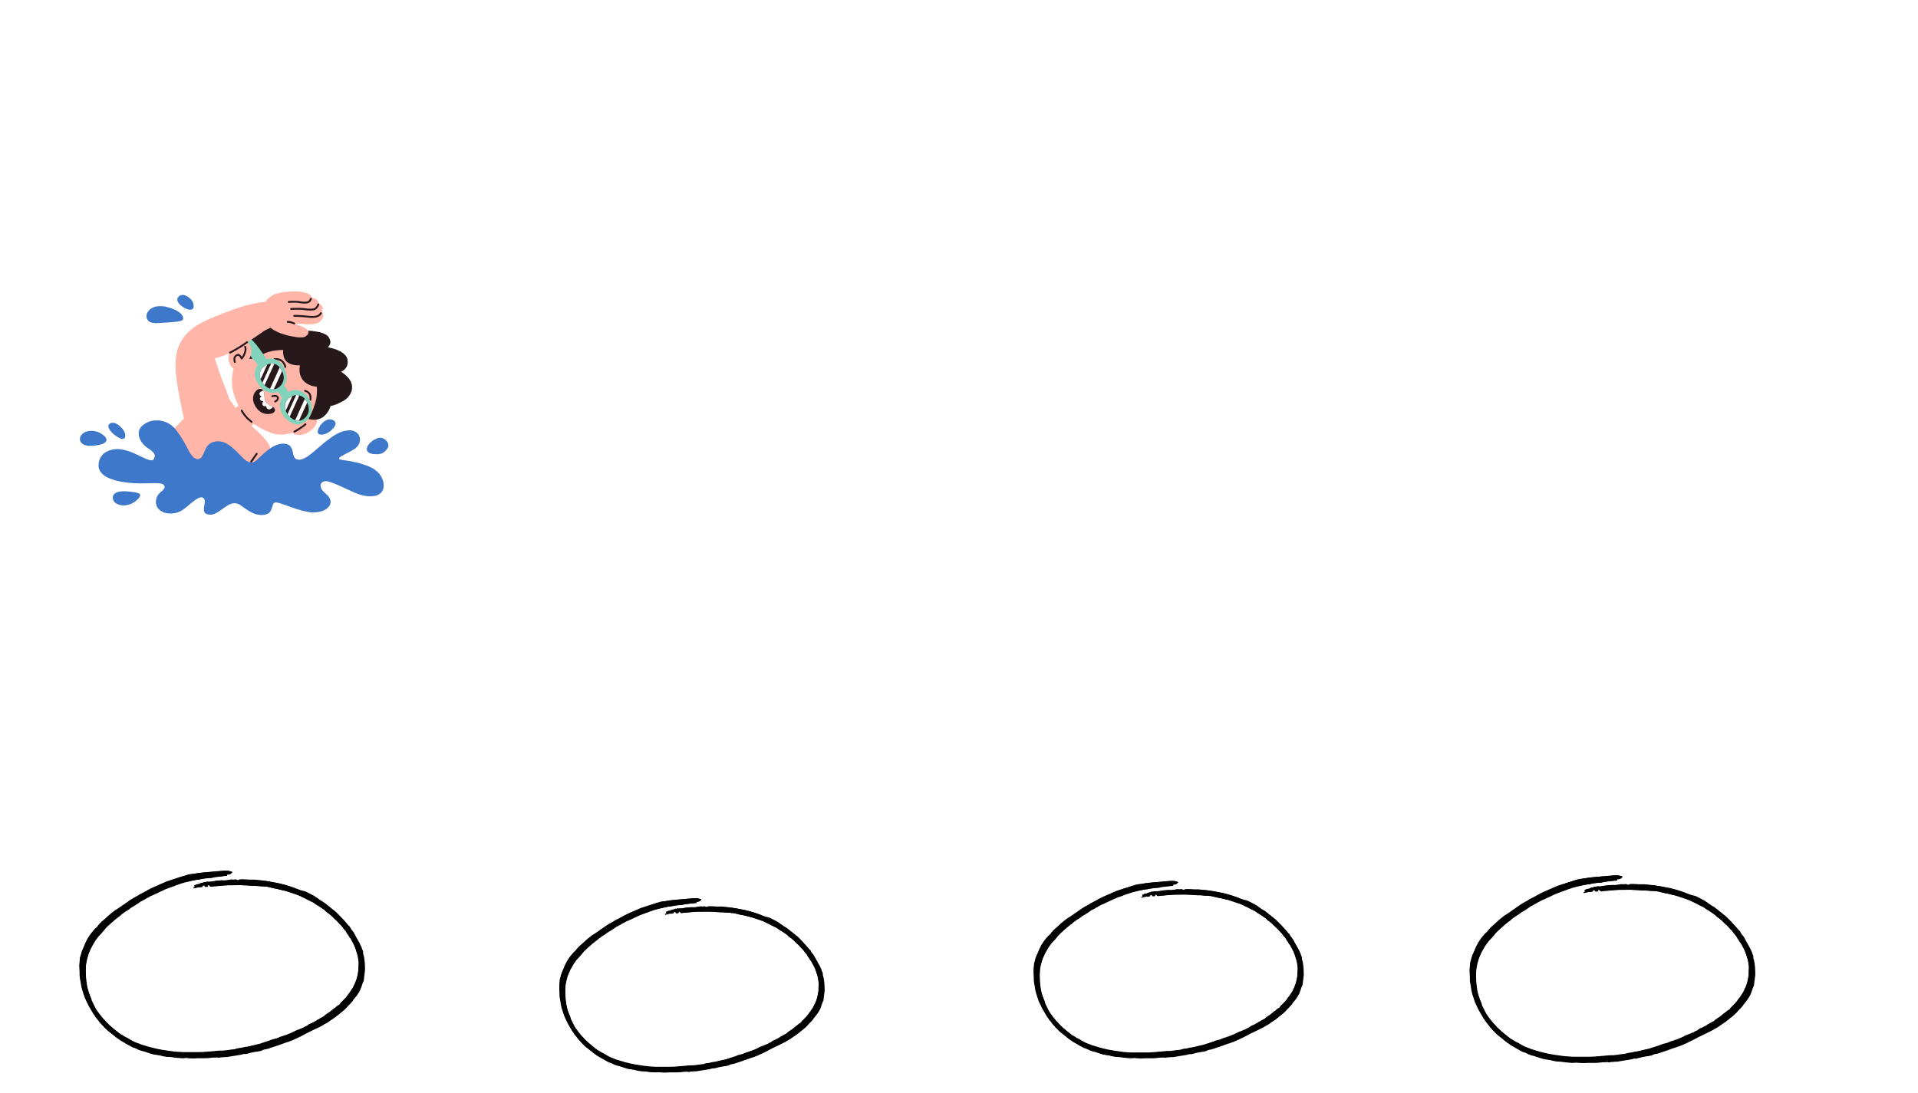
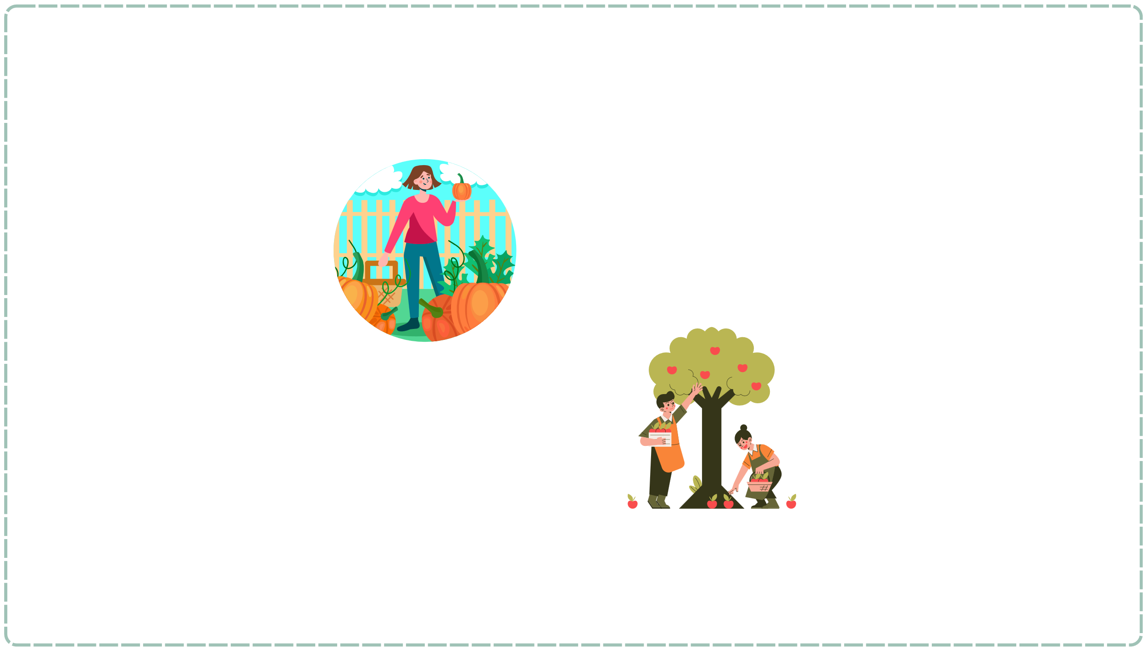
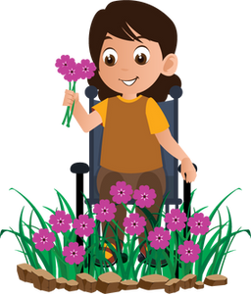
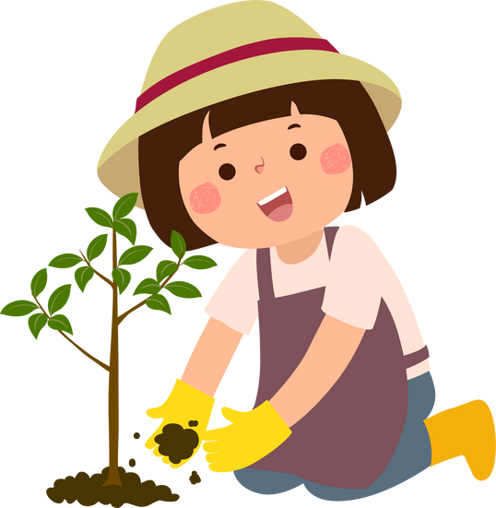
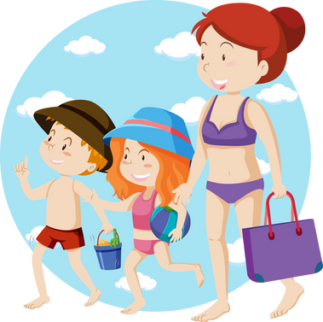
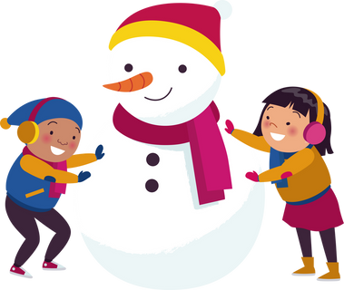
III. EXERCISES
4. Match the season with the suitable activities:
Spring
Autumn
Summer
Winter

Slide 9
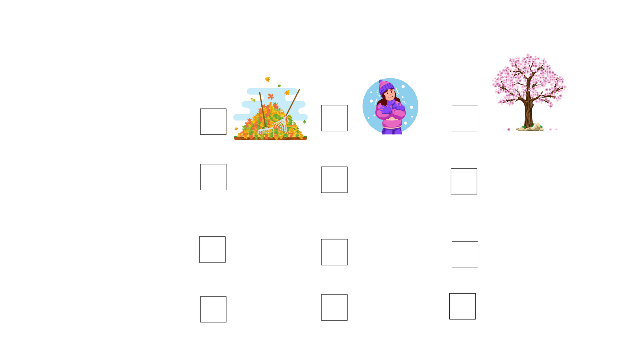

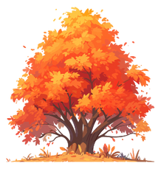
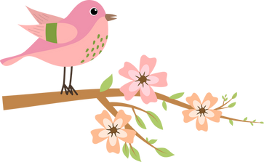
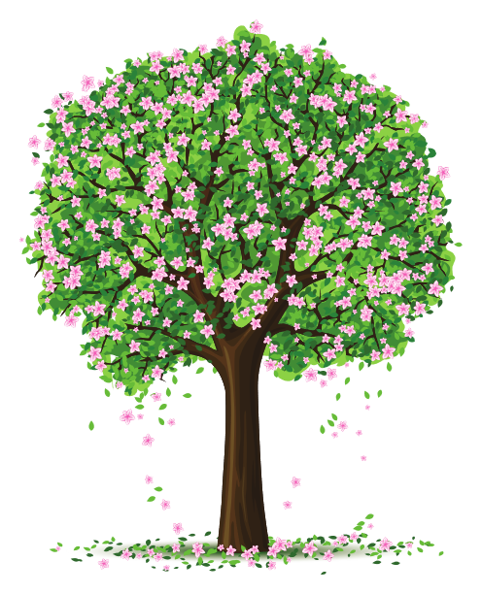
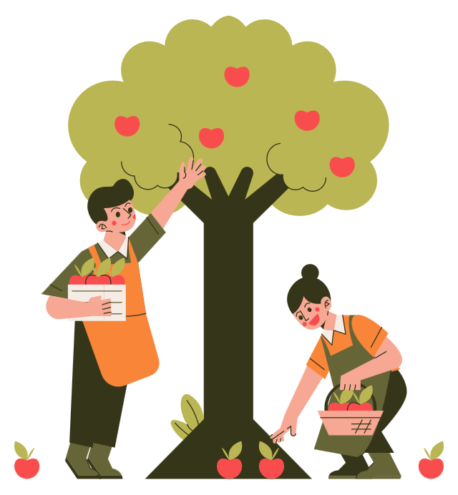

III. EXERCISES
5. Choose the correct answer:
Spring
Summer
Autumn
Winter

Slide 10

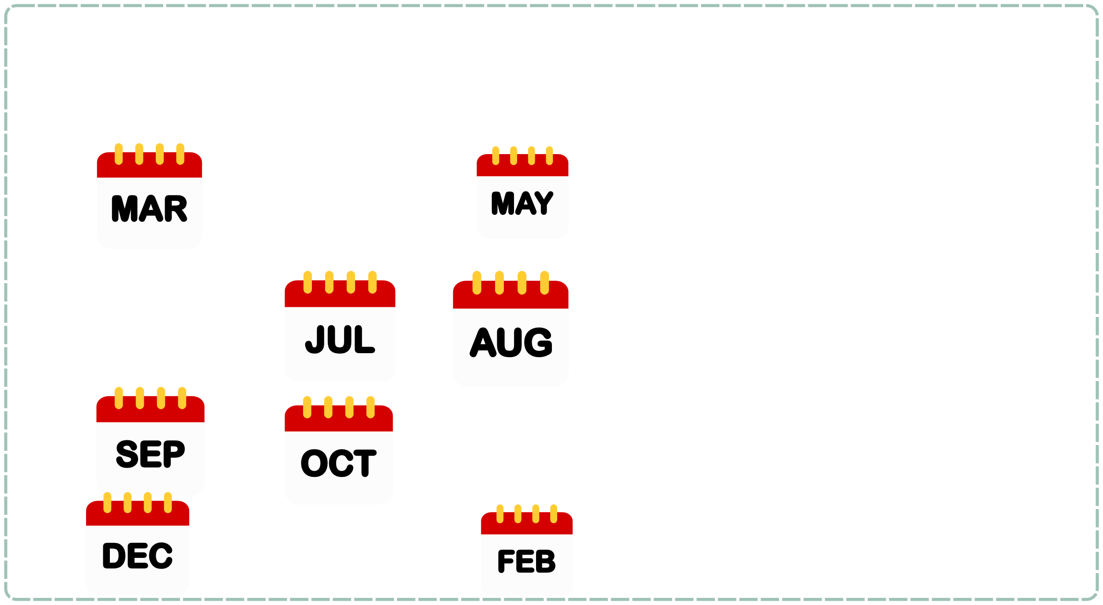




III. EXERCISES:
6. Fill the month:
....
....
...
....

Slide 11
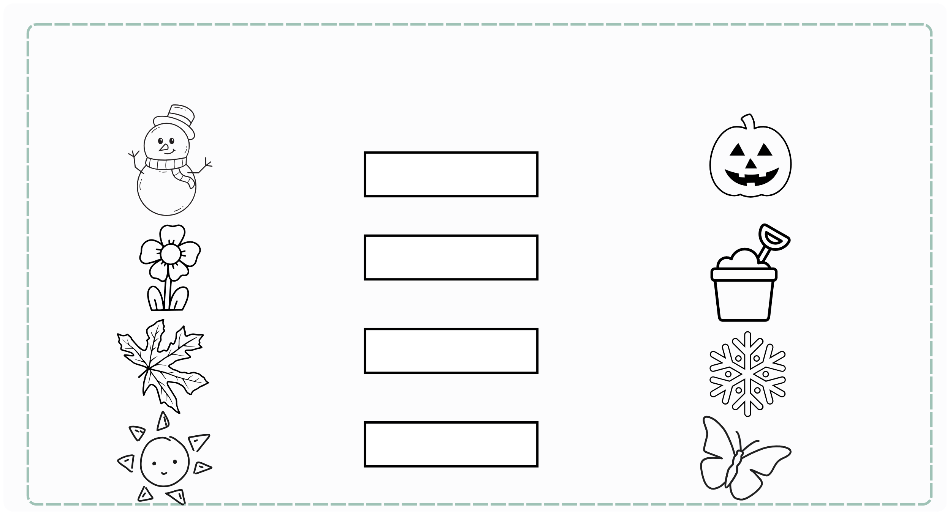
III. EXERCISES:
7. Look at the picture and match:
Spring
Summer
Autumn
Winter

Slide 12
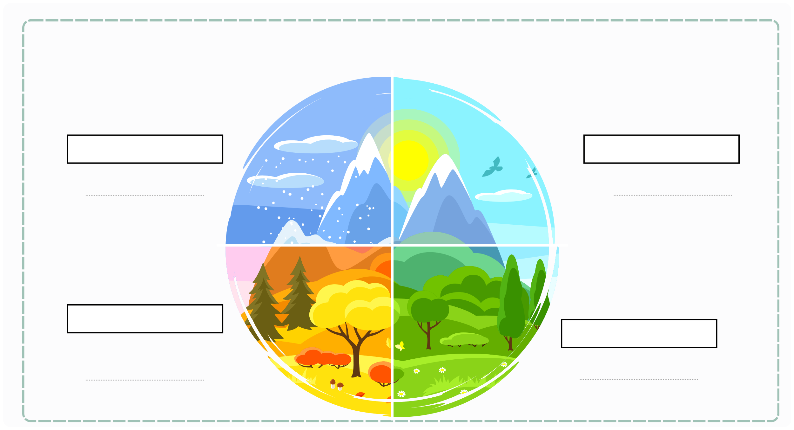
III. EXERCISES:
8. Reorder the words:
W/n/i/e/r/t
S/m/u/e/r/m
A/t/u/u/n/m
S/p/g/n/i/r

