Slide 1


Slide 2
LANGUAGE
Review 4
Unit
FAMILY LIFE
LESSON I

Slide 3
LESSON 1
LANGUAGE
WARM- UP
Mini game: Catch a word
PRONUNCIATION
Mark the intonation.
VOCABULARY
Complete the sentences.
Write one sentence using the linking words and phrases.
Circle the correct answers.
GRAMMAR
CONSOLIDATION
Wrap-up
Homework

Slide 4

Catch a word

Slide 5
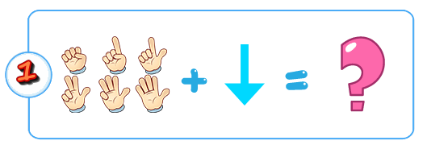


de
+
+
Depression

Slide 6
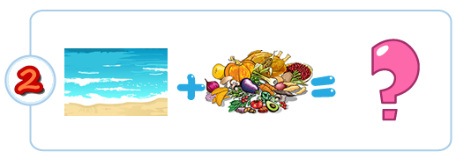

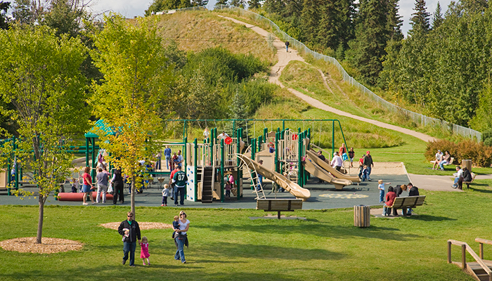
+
National Park

Slide 7
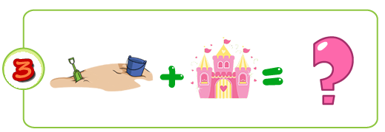

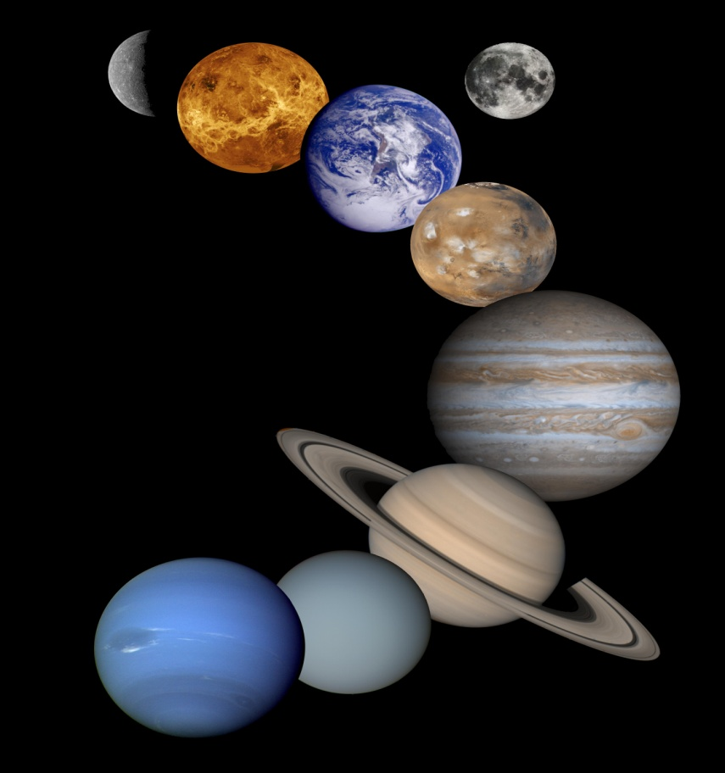
SOLAR
E +
-2
Ecosystem

Slide 8
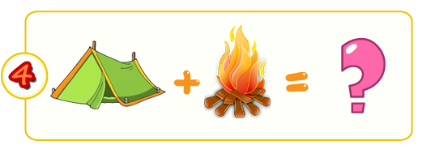

- L
Cr +
Crime

Slide 9
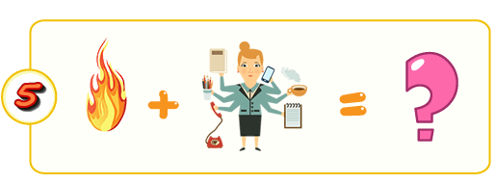


+
Food chain

Slide 10



+
x
Pressure

Slide 11

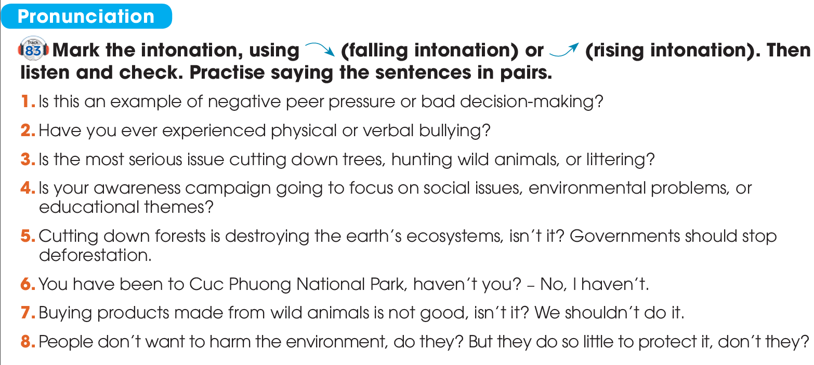


PRONUNCIATION

Slide 12
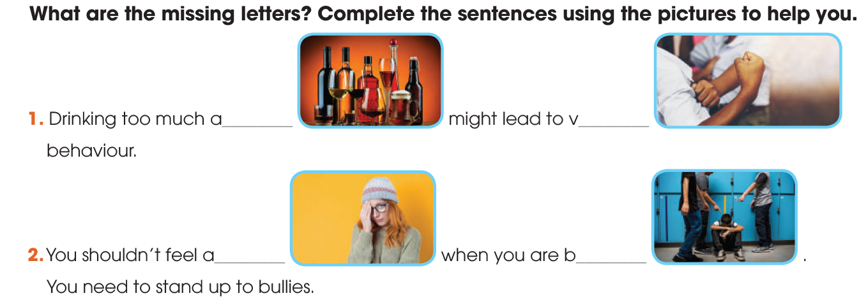
VOCABULARY
alcohol
violent
bullied
ashamed

Slide 13
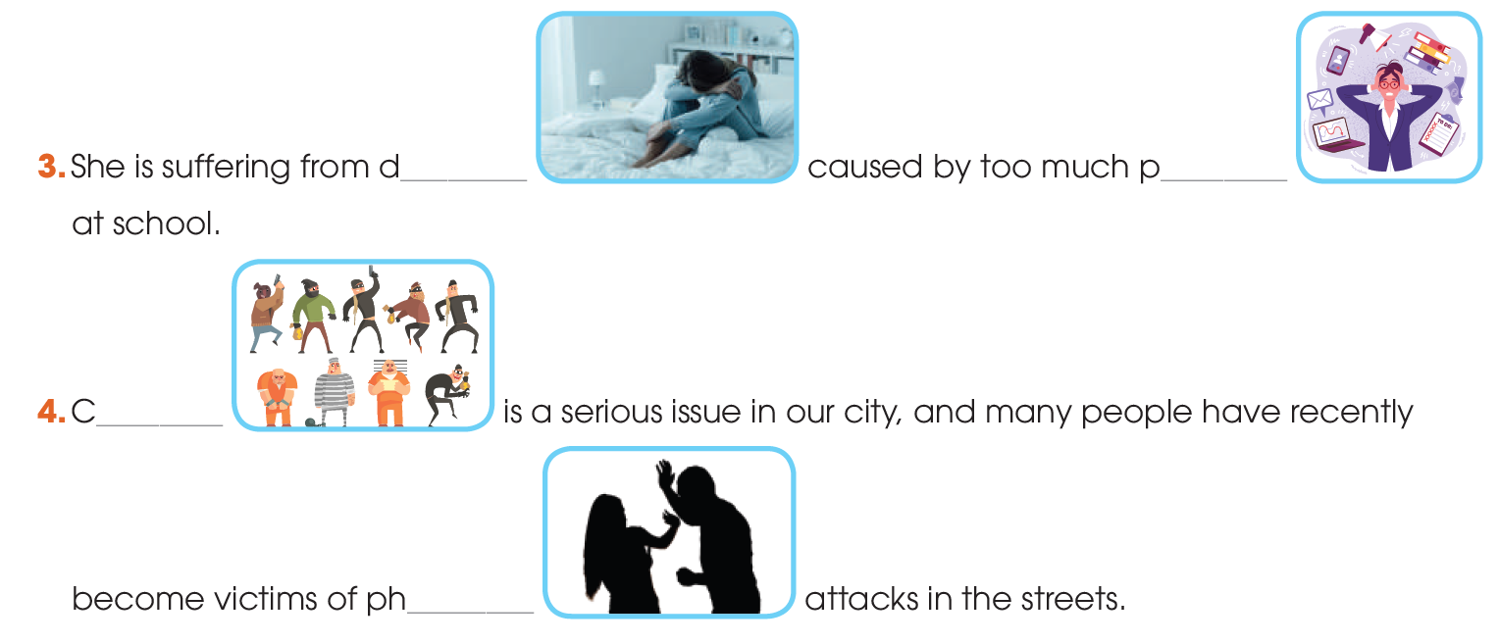
VOCABULARY
depression
pressure
crime
physical

Slide 14
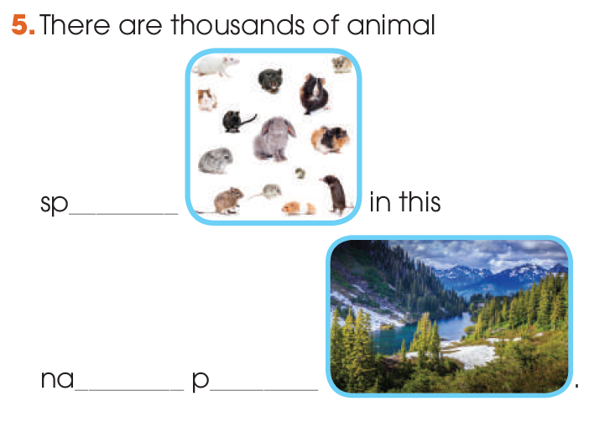
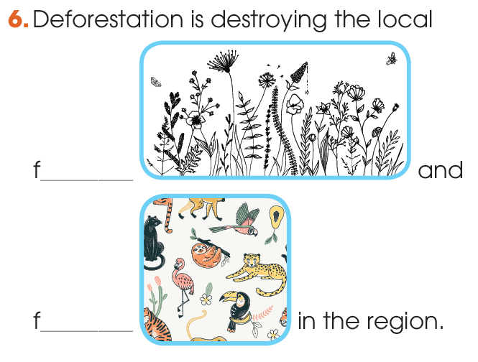
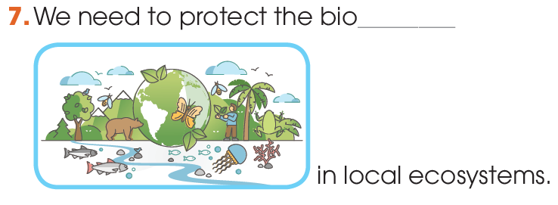
VOCABULARY
species
flora
national
park
fauna
biodiversity

Slide 15
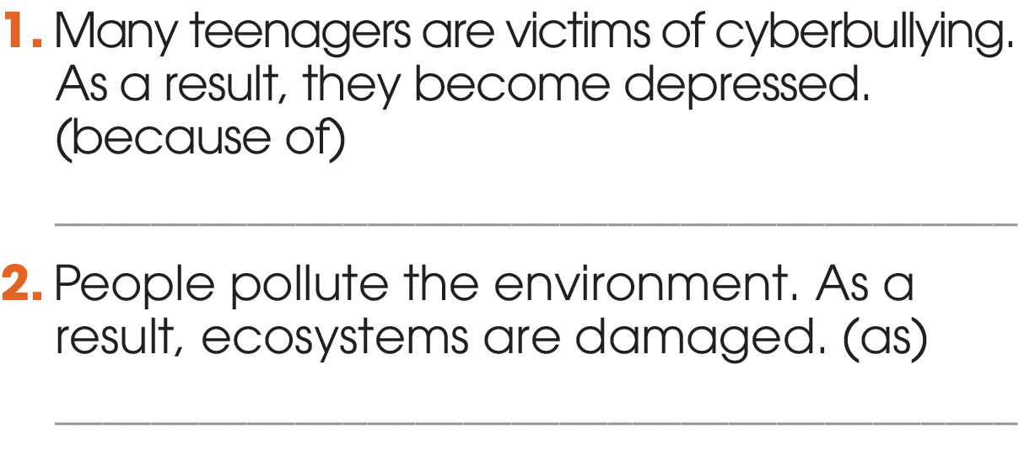
GRAMMAR
1
Write one sentence using the linking words and phrases in brackets. Do not change the meaning of the original sentences.
Because of being victims of cyberbullying, many teenagers become depressed./ Many teenagers become depressed because of being victims of cyberbullying.

Slide 16
GRAMMAR
1
Write one sentence using the linking words and phrases in brackets. Do not change the meaning of the original sentences.
As people pollute the environment, ecosystems are damaged./Ecosystems are damaged as people pollute the environment.

Slide 17
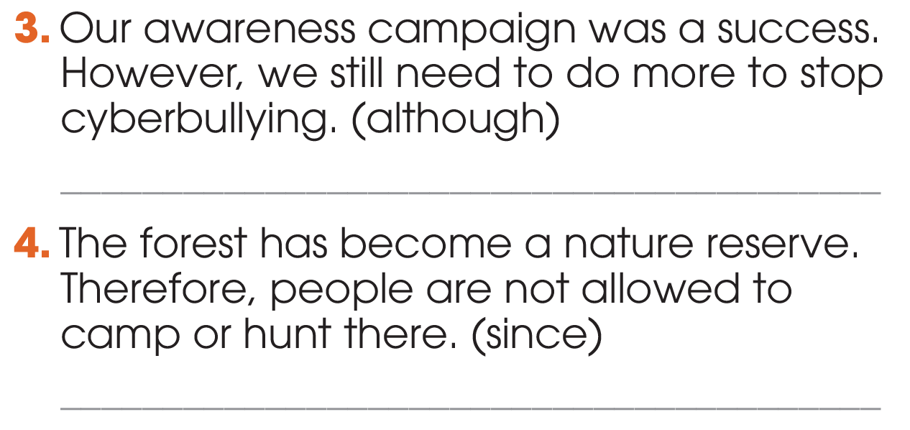
GRAMMAR
1
Write one sentence using the linking words and phrases in brackets. Do not change the meaning of the original sentences.
Although our awareness campaign was a success, we still need to do more to stop cyberbullying./ We still need to do more to stop cyberbullying although our awareness campaign was a success.

Slide 18
GRAMMAR
1
Write one sentence using the linking words and phrases in brackets. Do not change the meaning of the original sentences.
Since the forest has become a nature reserve, people are not allowed to camp or hunt there./
People are not allowed to camp or hunt in the forest since it has become a nature reserve.

Slide 19
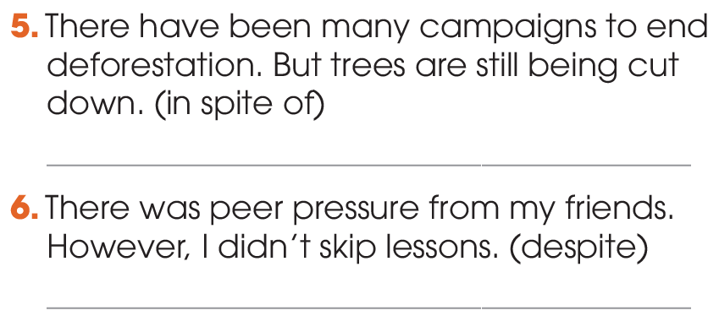
GRAMMAR
1
Write one sentence using the linking words and phrases in brackets. Do not change the meaning of the original sentences.
In spite of many campaigns to end deforestation, trees are still being cut down./Trees are still being cut down in spite of many campaigns to end deforestation.

Slide 20
GRAMMAR
1
Write one sentence using the linking words and phrases in brackets. Do not change the meaning of the original sentences.
Despite peer pressure from my friends, I didn’t skip lessons./I didn’t skip lessons despite peer
pressure from my friends.

Slide 21
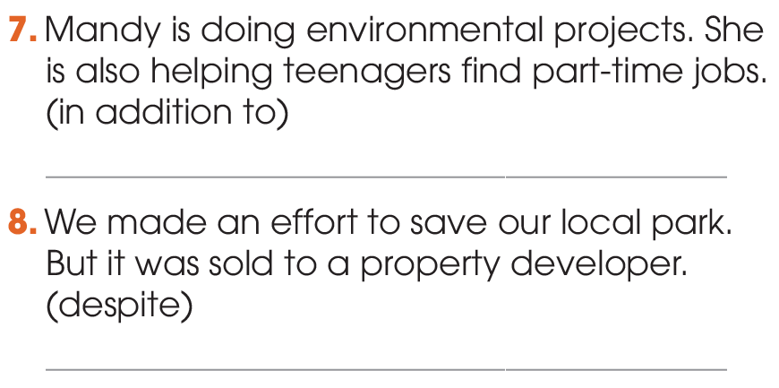
GRAMMAR
1
Write one sentence using the linking words and phrases in brackets. Do not change the meaning of the original sentences.
In addition to doing environmental projects, Mandy is helping teenagers find part-time jobs./ Mandy is helping teenagers find part-time jobs in addition to doing environmental projects.

Slide 22
GRAMMAR
1
Write one sentence using the linking words and phrases in brackets. Do not change the meaning of the original sentences.
Despite the/our effort to save our local park, it was sold to a property developer./Our local park was sold to a property developer despite the/our effort to save it.

Slide 23
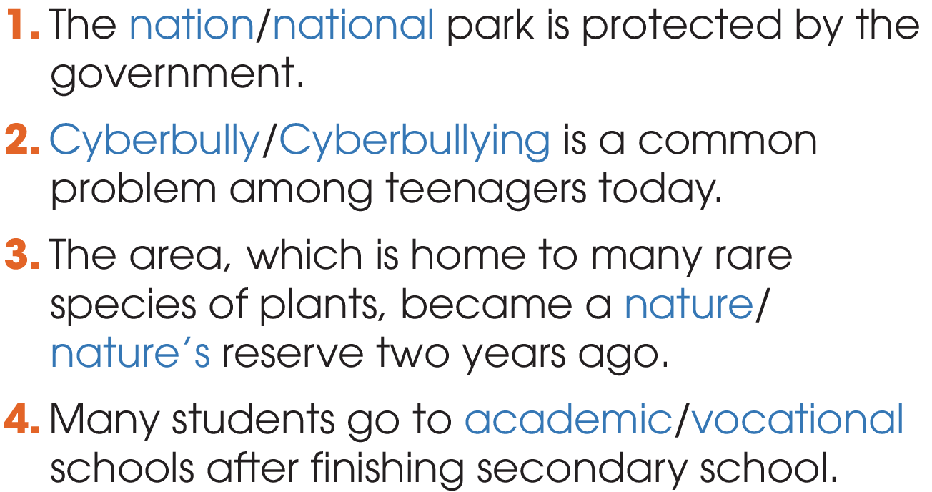
GRAMMAR
2
Circle the correct answers.

Slide 24
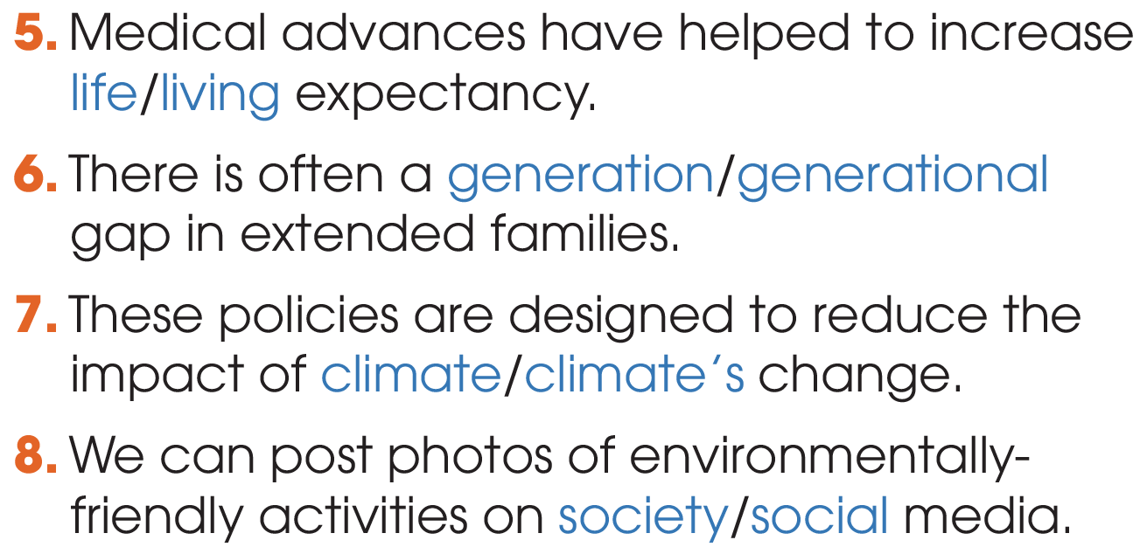
GRAMMAR
2
Circle the correct answers.

Slide 25
CONSOLIDATION
1
Wrap-up
What have you learnt today?
Review the vocabulary and grammar of Unit 9 & 10.
H
0

Slide 26

Website: hoclieu.vn
Fanpage: facebook.com/tienganhglobalsuccess.vn/

