Slide 1
BIRD BRAIN
BASEBALL
CLICK HERE TO CONTINUE
ABOUT
GAME
PLAY BALL!
HOW TO EDIT

Slide 2
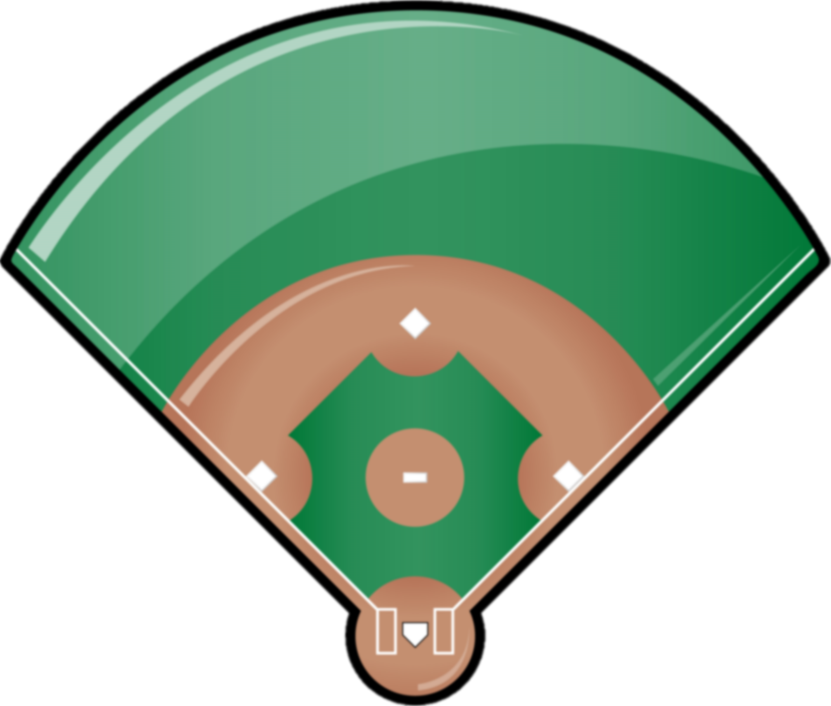
BLUE TEAM
RED TEAM
SAVE PROGRESS?
Would you like to save your game progress?
If you click NO, then all progress will be lost.
* SINGLE *
** DOUBLE **
***TRIPLE***
HOME RUN!
7
HITS
YES
NO
CANCEL
HITS
0
0
RUNS
RUNS
0
0
INNING
OUTS
Top 1
SWITCH SIDES
BATTER UP
BATTER UP
NO MORE QUESTIONS
X

Slide 3
ABOUT/CREDITS
Objective
Teams send one player to answer questions either in order or randomly. Click on Shuffle to turn off randomize.
To Begin
Type in the number of innings (1 – 9) in the blank on the first slide, and then select the first team.
Batter Up!
The player up to bat stands up front and answers a question. If they answer correctly, the team receives a hit point, and advances their team members on baes and themselves based off the difficulty of the question.
Easy questions are worth a Single Hit, Medium difficulty questions are worth Double and Triple, and the Hardest questions are worth a Home Run.
Outs/Switching Sides
An Out is received when a player answers incorrectly.
When a team receives 3 Outs, teams switch sides.
Winning
A Team wins by having the most Runs than the other team after both teams play the set number of Innings.
In the event of a tie, game will go into Overtime (OT) innings until one team wins.
In the event of “No More Questions,” the team in the lead wins.
Saving Game Progress
If you want to end the game early and return to it later, click on the red X button on the lower left corner, and click on Yes. It will automatically save the file.
You can return as you left off next time you open and run the game. Click on the Continue button on Slide 1.
Credits:
Design, Layout & Programing – Mike from rusnakcreative.com
For more game templates like this, visit rusnakcreative.com
ABOUT
EDITING
BACK
This work is licensed under a Creative Commons Attribution-NonCommercial-ShareAlike 4.0 International License.

Slide 4
EDITING
Tips for Editing
Copy/Paste the question slide (Slide 5) As often as you need, paste after Slide 5.
Do NOT remove any other slides, or shapes. Doing so can and will affect gameplay.
Save a copy of the original template before you begin editing, and save often!
Question Difficulty
Replace this letter in CAPS to change the amount of hits a player receives when answered correctly.
Question Text
Replace this text with your own question
Question Answer
Replace this text with your own answer
Action Buttons
Spot for Reveal Answer, Hit (Correct), Out (Incorrect) buttons
ABOUT
EDITING
BACK

Slide 5
Type in a single ALL CAPS letter in the circle below
S = Single, D = Double, T = Triple, H = Home Run
Question Difficulty:
S
BLUE TEAM
QUESTION
RED TEAM
* SINGLE *
** DOUBLE **
***TRIPLE***
HOME RUN!
Insert Question Text here.
7
HITS
HITS
0
0
RUNS
Insert Answer Text here.
RUNS
0
0
INNING
OUTS
REVEAL
ANSWER
HIT
HIT
Top 1
OUT

Slide 6
Type in a single ALL CAPS letter in the circle below
S = Single, D = Double, T = Triple, H = Home Run
Question Difficulty:
S
ANSWER:
D
BLUE TEAM
QUESTION
RED TEAM
* SINGLE *
** DOUBLE **
***TRIPLE***
HOME RUN!
Insert Question Text here.
7
HITS
HITS
0
0
ANSWER A
ANSWER B
RUNS
RUNS
ANSWER C
ANSWER D
0
0
INNING
OUTS
SELECT ANSWER
HIT
HIT
Top 1
OUT

Slide 7
Type in a single ALL CAPS letter in the circle below
S = Single, D = Double, T = Triple, H = Home Run
Question Difficulty:
S
ANSWER:
F
BLUE TEAM
QUESTION
RED TEAM
* SINGLE *
** DOUBLE **
***TRIPLE***
HOME RUN!
Insert Question Text here.
7
HITS
HITS
0
0
RUNS
RUNS
TRUE
FALSE
0
0
INNING
OUTS
SELECT ANSWER
HIT
HIT
Top 1
OUT

Slide 8
SƯU TẦM: ĐOÀN VĂN DOANH, NAM TRỰC, NAM ĐỊNH
LINK NHÓM DÀNH CHO GV BỘ MÔN VẬT LÝ TRAO ĐỔI TÀI LIỆU VÀ CHUYÊN MÔN CT 2018
https://www.facebook.com/groups/299257004355186

