Slide 1

Unit 6: Be green
Lesson: Right on!
Page 107

Slide 2
Lesson Outline
Warm-up
Project
Consolidation
Wrap-up

Slide 3
Objectives
By the end of this lesson, students will be able to…
to prepare a poster advertising Environment Day at school.
to give a presentation on what we can do to protect the environment.
to explain a quotation relating to the value of environment protection.

Slide 4

WARM-UP

Slide 5

Work in groups. Research the information about the World Environment Day.
When is World Environment Day?
What is the aim of the World Environment Day?
What can you do to celebrate this day?

Slide 6

It’s time to learn …

Slide 7
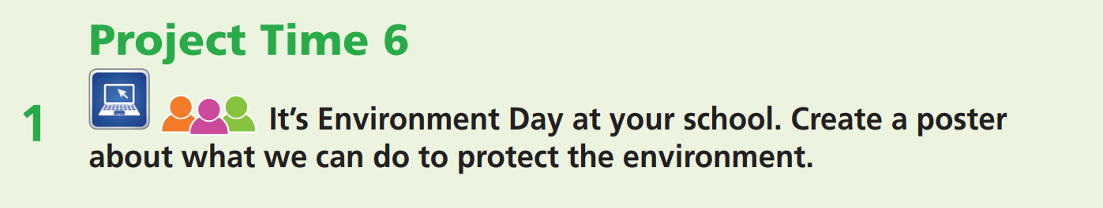
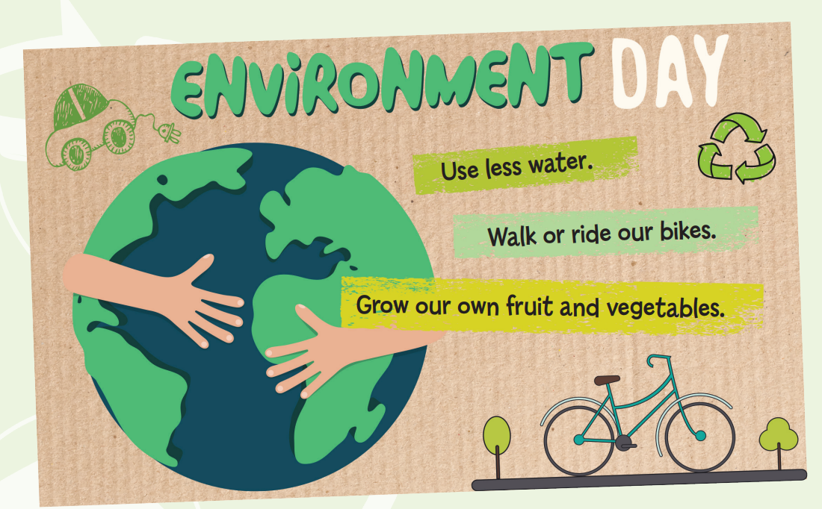

Slide 8
Requirements
At least 25 words
Clear and brief information
Effective use of illustrations
Meaningful messages

Slide 9
Presentation languages & structure
INTRODUCTION
Good morning/afternoon, everyone. I'm here today to ...
BODY
First, we can … For example, …
Second, we can … by + V-ing ...
Third, we should + V …
Finally, we can …
CONCLUSION
There are so many ways for us to protect the environment. Start right here and right now. We should all help. Thanks for listening.

Slide 10
SAMPLE PRESENTATION
Good morning everyone. My name is …. I am here to day to show you what we can do in our daily lives to protect the environment.
First, at home, we can use less water by having showers or turning off the tap when we brush our teeth.
Second, to save electricity, we can turn off the lights when we leave a room and switch off all electrical devices that are on standby.
Third, outside the home, we should walk or ride our bikes instead of driving everywhere. We can also organize special events to plant trees and pick up litter.
Finally, at school, we can use energy-efficient light bulbs and grow our own fruit and vegetables in the school greenhouse.
There are so many ways for us to protect the environment. Start right here and right now. We should all help. Thanks for listening.

Slide 11
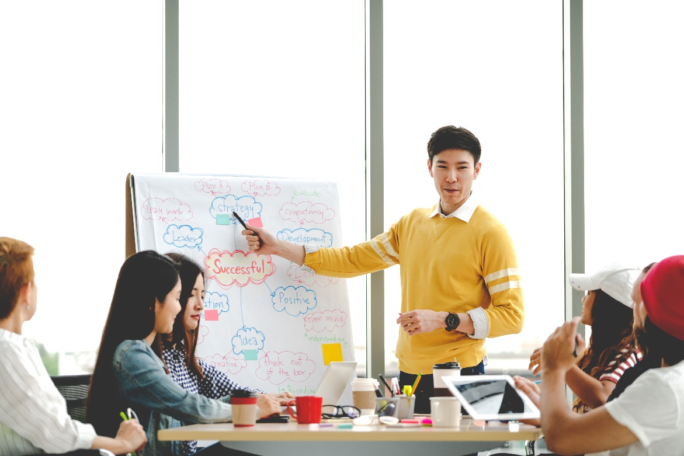
Presentations tips
Maintain eye contact with the audience.
Look around the audience.
Point at the poster (pictures, text…) when needed.
Use appropriate gestures.
Stand up straight.
Be confident!

Slide 12
Evaluation form
While your friends are making a presentation, please leave your comments on the following form.
Criteria | Yes | No | Comments (if any)
Poster Effective use of illustrations Clear and brief information Meaningful messages | ✓ | ✓
Presentation skills Being confident Maintaining eye-contact Standing up straight Appropriate gestures

Slide 13
Evaluation form
Students and teacher share their comments on the presentations.
Criteria | Yes | No | Comments (if any)
Poster Effective use of illustrations Clear and brief information Meaningful messages | ✓ | ✓
Presentation skills Being confident Maintaining eye-contact Standing up straight Appropriate gestures

Slide 14
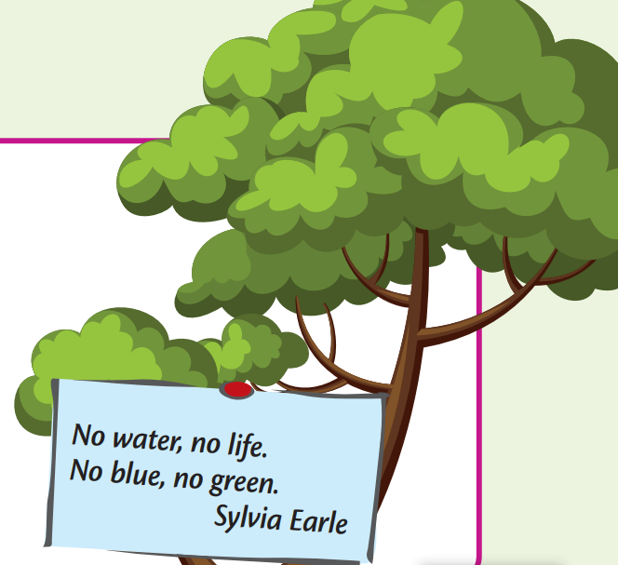
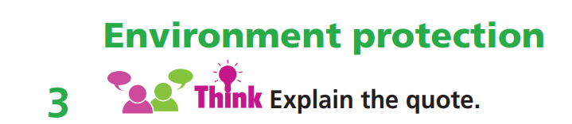
I think the quotation from Sylvia Earle means that …
there would be no blue seas and green trees without water.

Slide 15

CONSOLIDATION

Slide 16

GROUPWORK
It’s Earth Day at your school. Think of activities to celebrate it. The class selects three of the ideas.
e.g. plant trees, watch documentaries, create green art, etc.

Slide 17

WRAP-UP

Slide 18
Today’s lesson
To prepare a poster advertising Environment Day at school.
To give a presentation on what we can do to protect the environment.
To explain a quotation relating to the value of environment protection.

Slide 19
Homework
Prepare the next lesson (page 108 SB).
Do the exercise in TA 7 Right on Notebook (pages 56 & 57).

Slide 20

Enjoy your day!

