Slide 1


Slide 2
REVIEW
1
(UNITS 1-3)
Unit
FAMILY LIFE
LESSON 2
SKILLS (1)
Listening and Speaking

Slide 3
LESSON 2
SKILLS (1)
WARM-UP
Watch a video
Task 1. Listen to a talk and put the information in the correct order you hear it.
Task 2. Listen and choose the correct answer.
LISTENING
SPEAKING
Task 1: Fill in the diagram.
Task 2. Discussion.
CONSOLIDATION
Wrap-up
Homework

Slide 4
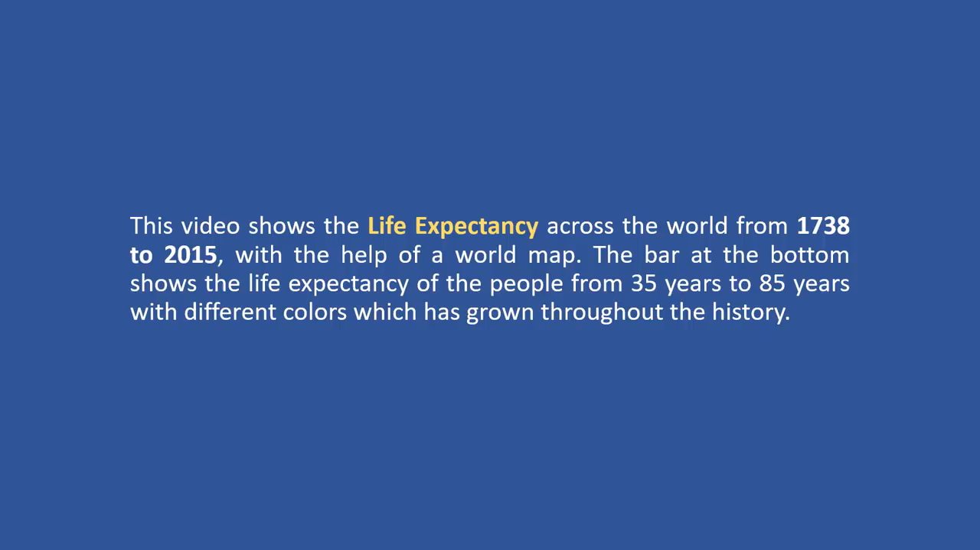
WATCH A VIDEO
Notes:
https://www.youtube.com/watch?v=FttJjqfURB8

Slide 5
WARM-UP
Questions:
What is the trend of life expectancy all over the world?
Which regions in the world have high life expectancy?
3. Which regions in the world have low life expectancy?
➔ There was an increasing trend from 1738 to 2015.
➔ North America, Western Europe, Australia, Japan
➔ Some parts of Africa

Slide 6

LISTENING
1
Listen to a talk about life expectancy. Put the information in the correct order you hear it.
_____ A. Getting access to better medical care
_____ B. Understanding age-related diseases better
_____ C. Giving facts about life expectancy in some countries
_____ D. Understanding the importance of good health
2
4
1
3

Slide 7
LISTENING
2
Listen a choose the correct answer A, B or C.
1. What is the life expectancy in many of the richest countries?
A. More than 80. B. Less than 80. C. More than 85.
2. What was the life expectancy in Japan in 2022?
A. Over 94. B. About 84. C. Over 85.
3. According to the speaker, what is the first reason for the increased life expectancy?
A. People get access to better food.
B. Better medical care is available.
C. People live in a better environment.

Slide 8
LISTENING
2
Listen a choose the correct answer A, B or C.
4. What do people do when they realise the importance of good health?
A. They continue unhealthy habits such as smoking and drinking.
B. They stop doing things that are bad for their health.
C. They ignore what they eat or drink every day.
5. What is the benefit of understanding age-related diseases better?
A. People can live as long as they want.
B. People can treat their diseases.
C. People can take better care of themselves.

Slide 9
SPEAKING
1
Fill in the diagram.
What should future cities have?
(1) ________________
(2) ________________
robots to take care of people’s health
modern vehicles that do not pollute the environment
(3) _________________
smart buildings with sensor technology to reduce waste and save resources
AI technologies to improve people’s safety and security
green space with more pedestrian zones and cycle paths

Slide 10

SPEAKING
2
Work in groups. Compare your diagrams. Discuss which is the most important thing that will help people to live a long and healthy life in the cities of the future.

Slide 11
CONSOLIDATION
1
Wrap-up
What have you learnt today?
Practice listening for main ideas and specific information about life expectancy;
Develop ideas for the speaking task and discuss in groups.

Slide 12
CONSOLIDATION
2
Homework
Do exercises in the workbook.
Prepare for Review 1 – Lesson 3.

Slide 13

Website: hoclieu.vn
Fanpage: facebook.com/www.tienganhglobalsuccess.vn
Website: hoclieu.vn
Fanpage: facebook.com/sachmem.vn/

