Slide 1

Unit 7: Transportation
Lesson 2.3: Pronunciation & Speaking
Page 57

Slide 2



Lesson 2.3
LESSON OUTLINE
Consolidation

Slide 3

By the end of this lesson, students will be able to…
• To practice pronouncing /st/ sound
• To discuss which type of transportation to choose to go somewhere

Slide 4
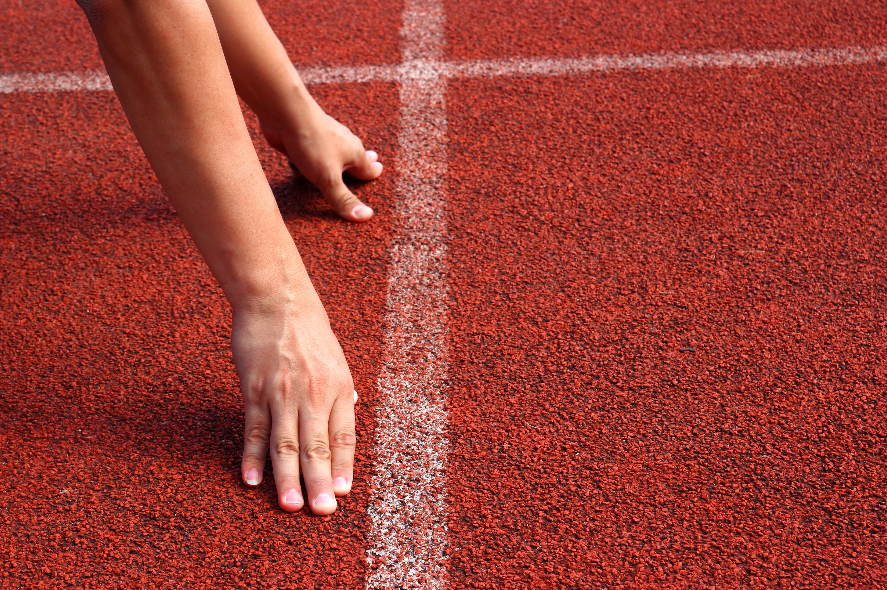
WARM UP

Slide 5

Work in pairs.
Choose the word whose main stress is placed
differently from the others.
A. tradition B. visitor C. paradise D. traveling
2. A. subway B. ticket C. local D. today
3. A. reliable B. convenient C. traditional D. regulated
/trəˈdɪʃən/
/ˈvɪzɪtə/
/ˈperədaɪs/
/ˈtrævəlɪŋ/
/ˈsʌbweɪ/
/ˈtɪkɪt/
/ˈloʊkəl/
/təˈdeɪ/
/rɪˈlaɪəbəl/
/kənˈvi:niənt/
/trəˈdɪʃənəl/
/ˈreɡjəleɪtɪd/

Slide 6
Work in pairs.
Choose the word whose underlined part is
pronounced differently from that of the other words.
A. ring B. think C. swim D. shine
2. A. customs B. luggage C. suitcase D. subway
3. A. bag B. can C. taste D. back
/rɪŋ/
/θɪŋk/
/swɪm/
/ʃaɪn/
/ˈkʌstəmz/
/ˈlʌɡɪdʒ/
/ˈsu:teɪs/
/ˈsʌbweɪ/
/ bæɡ/
/cæn/
/teɪst/
/bæk/

Slide 7
What type of transportation do you choose in each situation?
Work in pairs
You want to go shopping with your friend in a shop in a narrow street.
Your family want to go back to your hometown to visit your relatives. There are 5 members in your family. You want to avoid the hot weather on the street and need private space for your family.
You need to go a long way to work every day. You want to be friendly to the environment and save money.
You want to travel abroad in the fastest way. You have saved enough money to pay for travelling.
=> motorbike
=> car
=> bus
=> plane

Slide 8



Slide 9
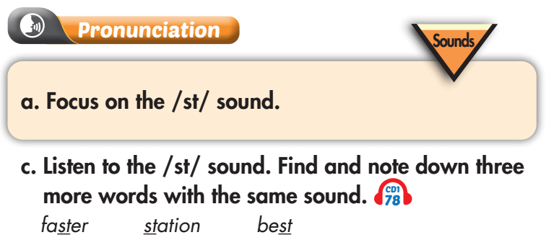

Listen again and repeat

Slide 10
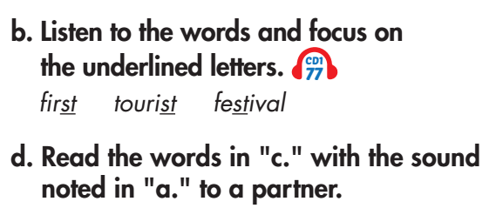
Listen again and repeat

Slide 11
Practice pronouncing /st/ sound in the following text:
Last time I went to the store, the storekeeper told me a story about the stamp which was sticked to the picture on the wall. After hearing the story, I stood still and stared at the picture for a while before I stepped out and discovered that my car had been stolen.

Slide 12
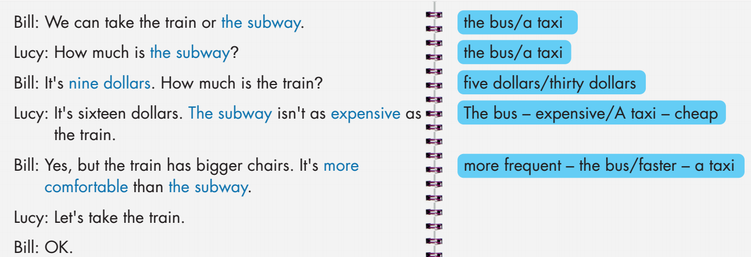

Slide 13
the bus
Bill: We can take the train or ________.
Lucy: How much is _________?
Bill: It’s ___________. How much is the train?
Lucy: It's sixteen dollars. ________ isn't as ___________ as
the train.
Bill: Yes, but the train has bigger chairs. It's _______________ than ________.
Lucy: Let's take the train.
Bill: OK.
the bus
five dollars
The bus
expensive
more frequent
the bus

Slide 14
a taxi
Bill: We can take the train or ________.
Lucy: How much is _________?
Bill: It’s _____________. How much is the train?
Lucy: It's sixteen dollars. ________ isn't as ___________ as
the train.
Bill: Yes, but the train has bigger chairs. It's _______________ than ________.
Lucy: Let's take the train.
Bill: OK.
a taxi
thirty dollars
A taxi
cheap
faster
a taxi

Slide 15
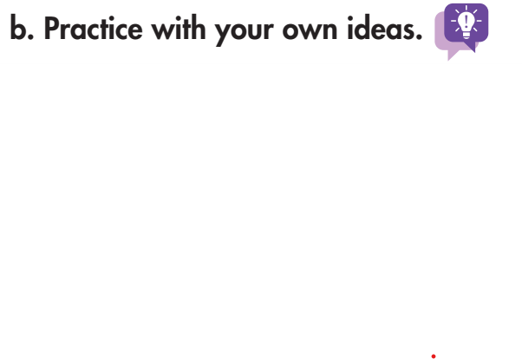
A: We can take the train or ________.
B: How much is _________?
A: It’s _____________. How much is the train?
B: It's sixteen dollars. ________ isn't as ___________ as
the train.
A: Yes, but the train has bigger chairs. It's _______________ than ________.
B: Let's take the train.
A: OK.

Slide 16



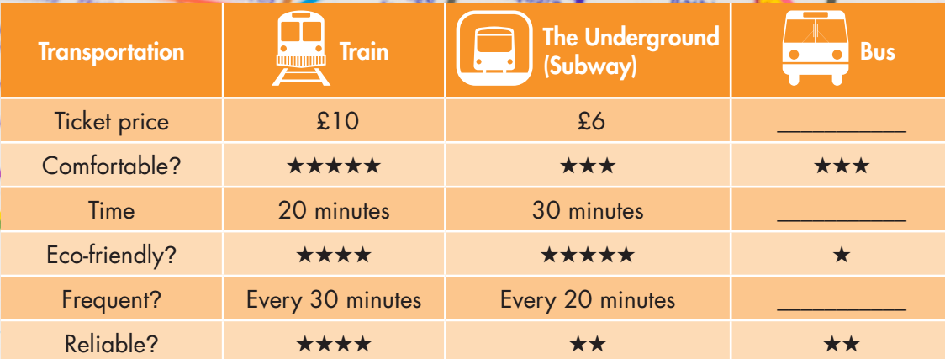

Slide 17
We’ll go to Richmond Park by bus. How do your group get there?
We decide to go by train because it’s faster and more comfortable than the bus.

Slide 18

Unit 7
CONSOLIDATION

Slide 19
Unit 7
Write about what type of transportation do you want to go to school and compare it with other types of transportation. You can use the words and information in speaking task a. (about 50-70 words)

Slide 20

WRAP-UP

Slide 21
Unit 7
Today’s lesson
Pronunciation:
- Practice pronouncing /st/ sound
Speaking & Writing:
- Talk and write about which type of transportation to choose to go somewhere

Slide 22
Unit 7
Homework
Practice pronouncing /st/ sound.
Practice talking about which type of transportation you choose to go somewhere.
Prepare the next lesson (page 58 SB).
Play consolidation games in Tiếng Anh 10 i-Learn Smart World DHA App on www.eduhome.com.vn

Slide 23
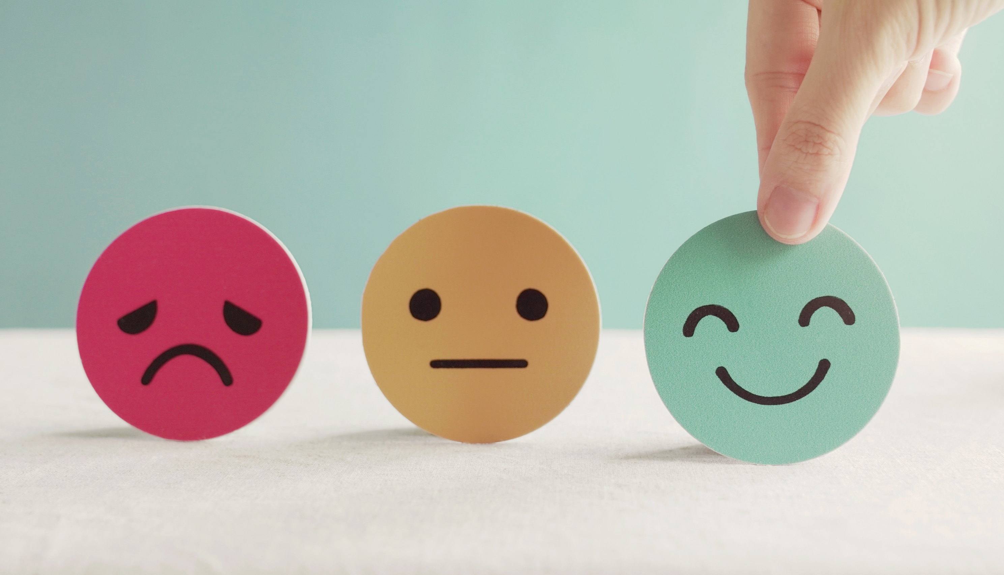
Lesson 3
Stay positive and have a nice day!

