Slide 1

Unit 4: Festivals and Free Time
Lesson 1.1: Vocabulary & Listening
Page 30

Slide 2
Lesson Outline
Warm-up
Vocabulary
Listening
Consolidation
Wrap-up

Slide 3
Objectives
By the end of this lesson, students will be able to…
- Talk about how often they do activities in their free time.
- Use adverbs of frequency.

Slide 4

New words
Never
Rarely
Sometimes
Often
Usually
Always

Slide 5

WARM-UP

Slide 6

Work in pairs
1. Do you like playing video games?
2. How often do you play video games?

Slide 7
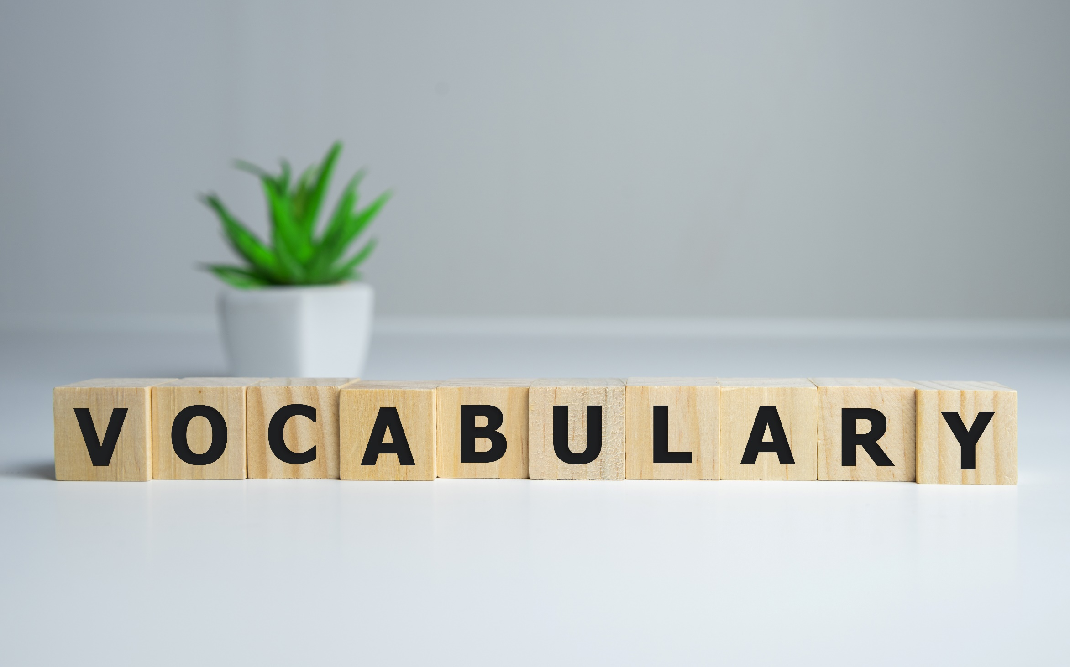


Slide 8
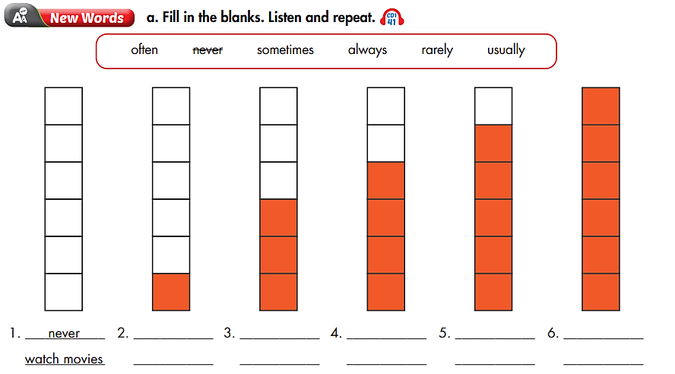

rarely
sometimes
often
usually
always

Slide 9

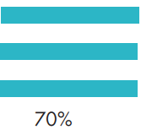


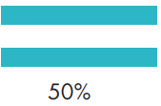

rarely
never
often
sometimes
always
usually
never (adv) /ˈnevər/ không bao giờ
rarely (adv) /ˈrerli/ hiếm khi
sometimes (adv) /ˈsʌmtaɪmz/ thỉnh thoảng
often (adv) /ˈɑːfən/, /ˈɑːftən/ thường
usually (adv) /ˈjuːʒuəli/ thường xuyên
always (adv) /ˈɑːlweɪz/ luôn luôn

Slide 10
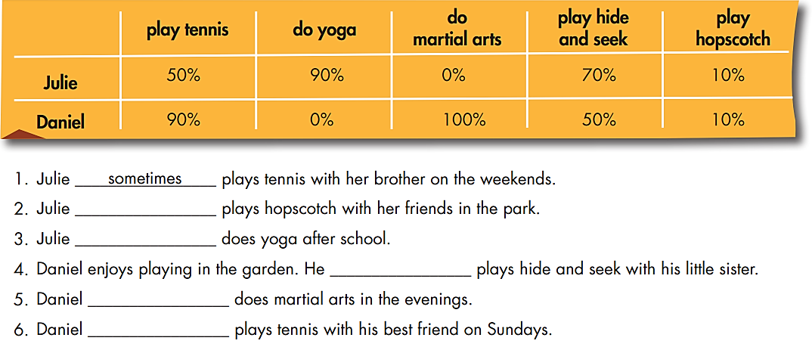
Extra Practice
WB page 20
rarely
Practice
usually
sometimes
always
usually

Slide 11
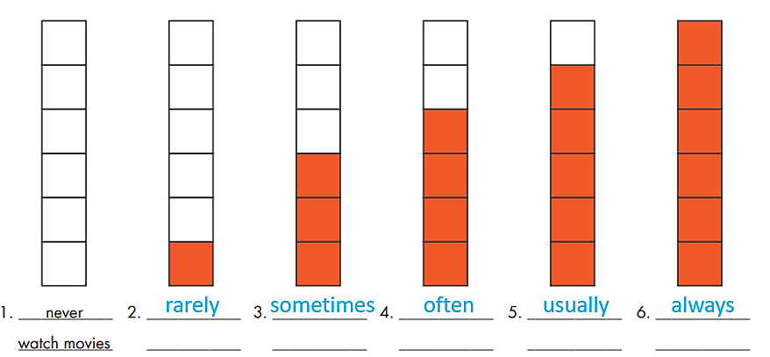

Slide 12

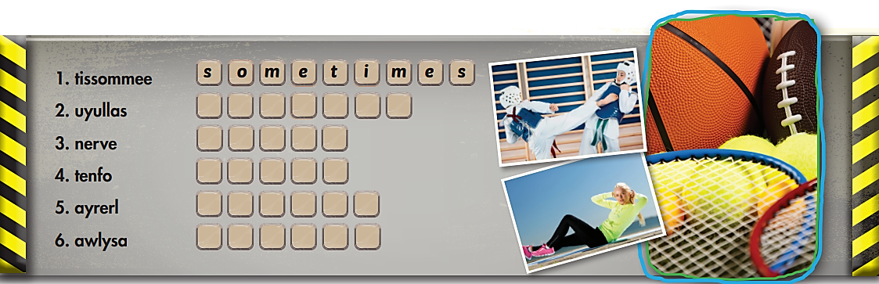
Extra Practice
WB page 20
Game
u
s
u
a
l
l
y
n
e
v
e
r
o
f
t
e
n
r
a
r
e
l
y
a
l
w
a
y
s

Slide 13

Listening

Slide 14
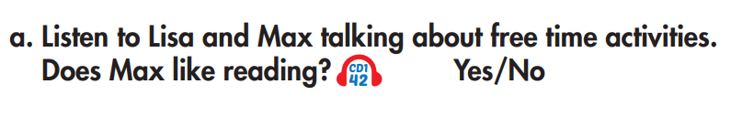
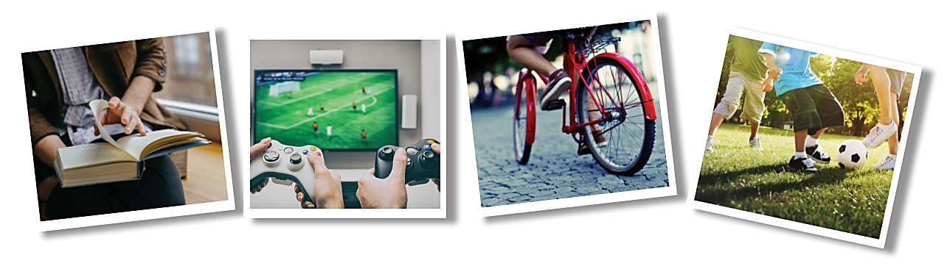
Pre-Listening
Read the instruction quickly. Underline the key words.

Slide 15
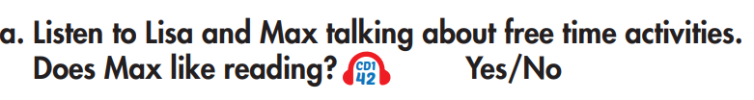

While-Listening
Listen and Circle “Yes or No”. Why?
Why?
Why?

Slide 16

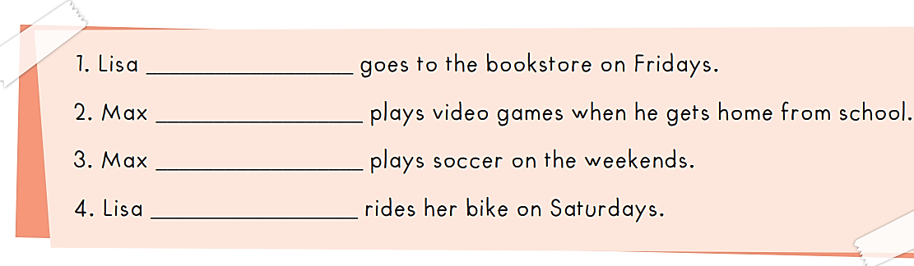
Pre-Listening
Read the statements quickly. Underline the key words.

Slide 17
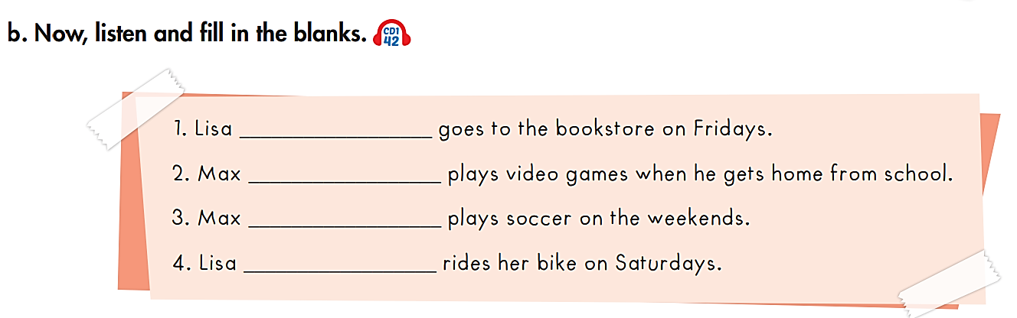
While-Listening
always
usually
often
sometimes

Slide 18
Post-Listening
Practice the conversation with a partner.
Max: Hi, Lisa. Where are you going?
Lisa: I'm going to the bookstore. Do you want to come?
Max: Oh, no, thanks. I can't today.
Lisa: How about next week? I always go there on Fridays.
Max: Mmm, maybe. I never go to the bookstore.
Lisa: Really? I love reading! Don't you?
Max: Not really.
Lisa: So, what do you like doing?
Max: I love playing video games.
Lisa: How often do you play them?
Max: I usually play them after school.
Lisa: What about on the weekends? What do you do then?
Max: I often go to the park to play soccer.
Lisa: Nice, I sometimes ride my bike at the park on Saturdays. Maybe I'll see you there!
Max: Great!

Slide 19

CONSOLIDATION

Slide 20
- Use adverbs of frequency to talk about your activities in your free time.
Adverbs of frequency: never, rarely, sometimes, often, usually, always.
Structure: I usually ….…….

Slide 21
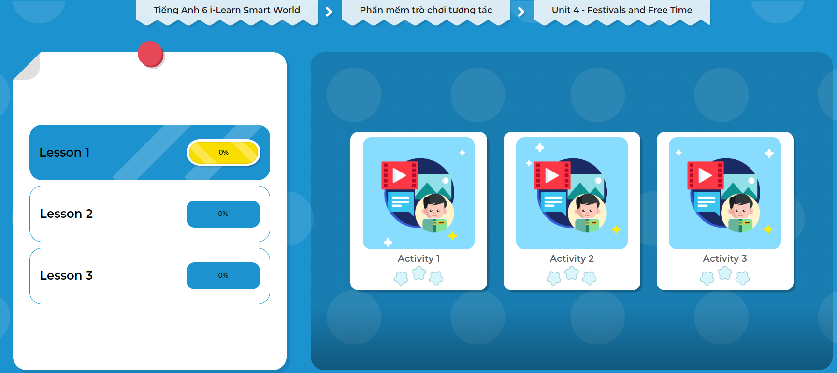
Click on the picture to play the games.

Slide 22

WRAP-UP

Slide 23
Today’s lesson
Vocabularies
Never
Rarely
Sometimes
Often
Usually
Always
Structures/ Sentence patterns
  - I usually ………………….in my free time/ on Sundays….

Slide 24
Homework
Review the vocabulary and practice using them.
Do the exercise(s) in Tiếng Anh 6 i-Learn Smart World Workbook (page 20).
Do the vocabulary exercise in Tiếng Anh 6 i-Learn Smart World Notebook (page 20).
Play the consolation games in Tiếng Anh 6 i-Learn Smart World DHA App on www.eduhome.com.vn.
Prepare the next lesson (page 31 - SB).

Slide 25
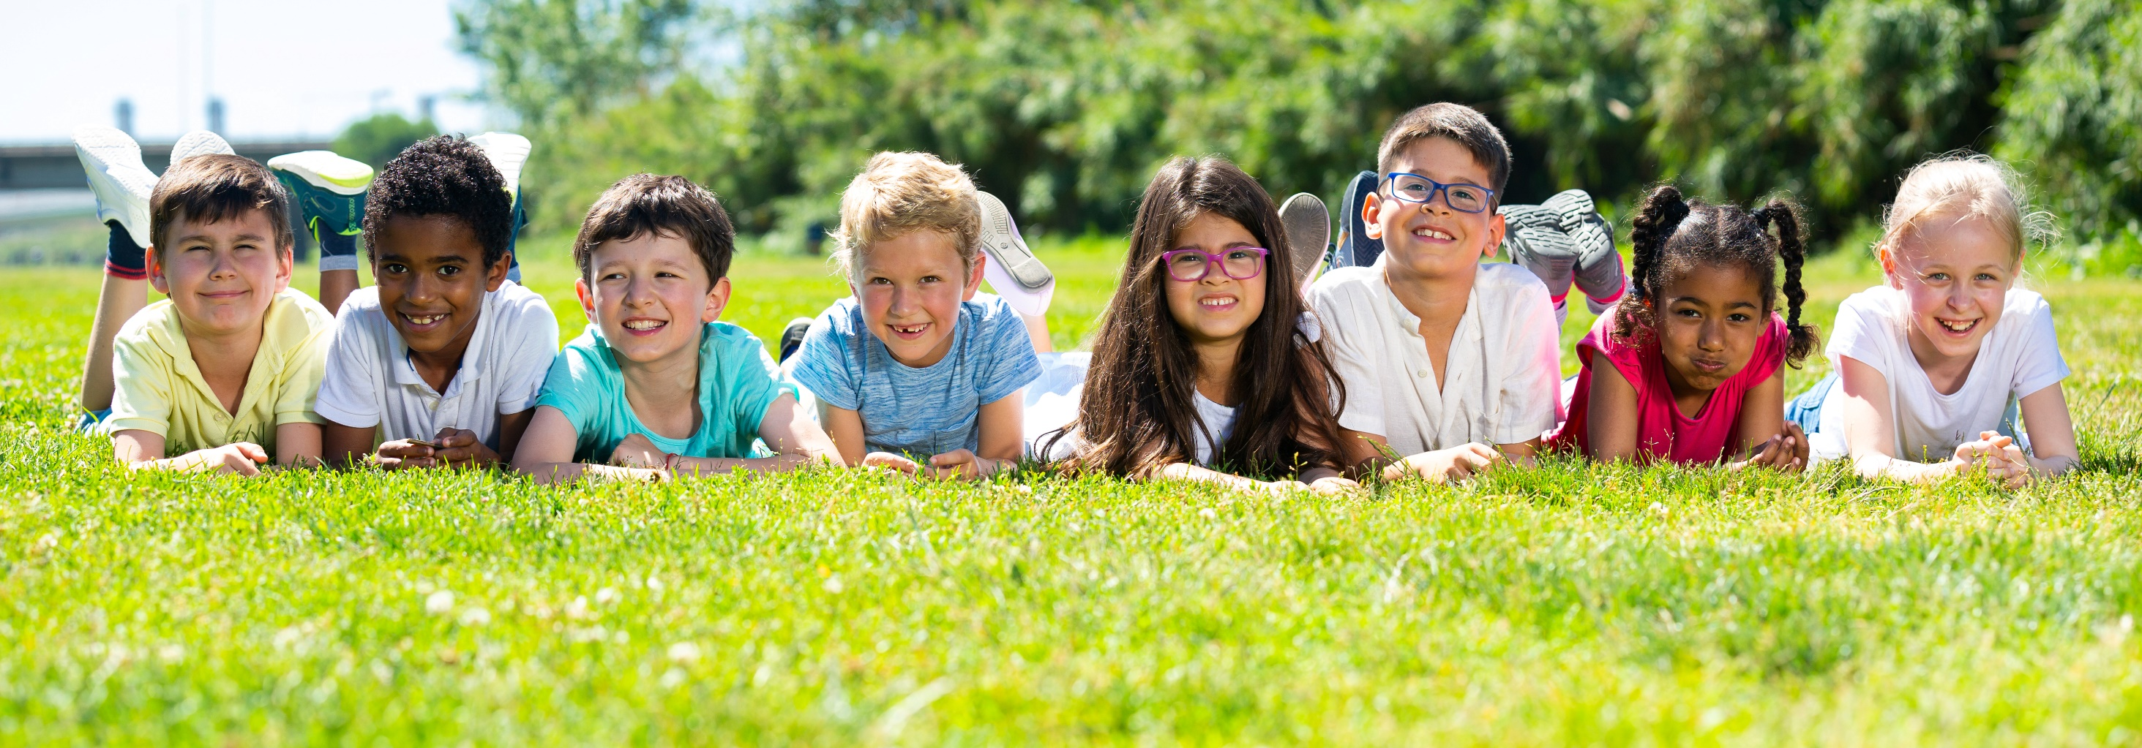
Have a nice day!

