Slide 1


Slide 2



Unit
3
COMMUNITY SERVICE
LESSON 7: LOOKING BACK & PROJECT
  Words related to community activities
Grammar
  Discuss some environmental problems and the solutions to them.
  The past simple
Vocabulary
Project
Unit

Slide 3

OBJECTIVES
By the end of the lesson, students will be able to:
review the vocabulary and grammar of Unit 3
apply what they have learnt (vocabulary and grammar) into practice through a project

Slide 4
LESSON 7: LOOKING BACK & PROJECT
WARM-UP
Game: Who’s faster?
Task 1: Complete the table with the words and phrases from the box.
Task 2: Complete each sentence with one phrase from Task 1. Remember to use the correct forms of the verbs.
VOCABULARY REVIEW
Task 3: Use the correct form of the verbs from the box to complete the passage.
Task 4: Write full sentences about the activities the students did to help their community last year.
GRAMMAR REVIEW
PROJECT
Project: Our green neighbourhood
CONSOLIDATION
Wrap-up
Homework

Slide 5


LESSON 7: LOOKING BACK & PROJECT
WARM-UP
Game: Who’s faster?

Slide 6
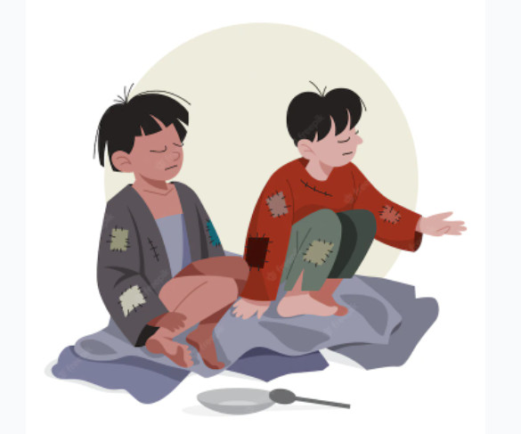
WARM-UP
Give descriptions to the pictures.
homeless children

Slide 7
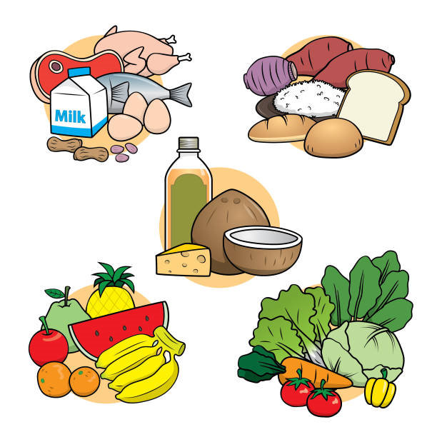

WARM-UP
Give descriptions to the pictures.
food
the elderly

Slide 8
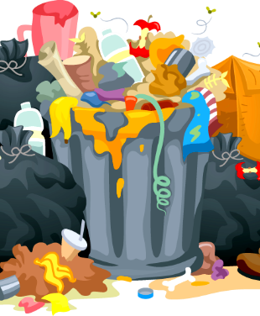
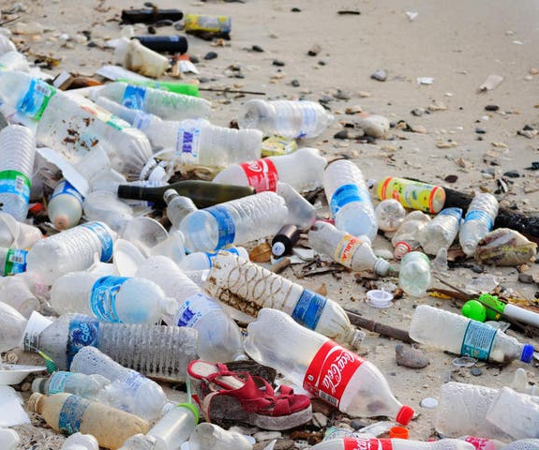

WARM-UP
Give descriptions to the pictures.
bottles
books
litter

Slide 9
LESSON 7: LOOKING BACK & PROJECT
WARM-UP
Game: Who’s faster?
Task 1: Complete the table with the words and phrases from the box.
Task 2: Complete each sentence with one phrase from Task 1. Remember to use the correct forms of the verbs.
VOCABULARY REVIEW

Slide 10
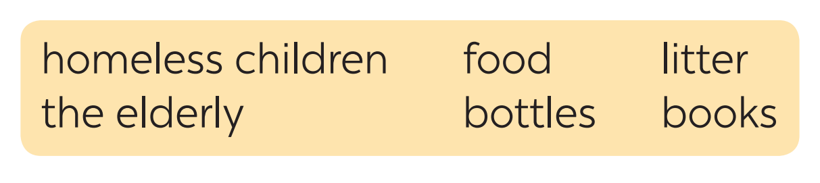
VOCABULARY REVIEW
1
Complete the table with the words and phrases from the box.
help | pick up | donate
homeless children
litter
food
the elderly
bottles
books

Slide 11
VOCABULARY REVIEW
2
Complete each sentence with one phrase from Task 1. Remember to use the correct forms of the verbs.
1. The club __________________ to some poor farmers last week.
2. Yesterday, we __________________ around our area and recycled them.
3. We __________________ do the cleaning last summer.
4. Last month, our club __________________ to the community library.
5. In our recent project, we _________________________ learn to read and write.
donated food
picked up bottles
helped the elderly
donated books
helped homeless children

Slide 12
LESSON 7: LOOKING BACK & PROJECT
WARM-UP
Game: Who’s faster?
Task 1: Complete the table with the words and phrases from the box.
Task 2: Complete each sentence with one phrase from Task 1. Remember to use the correct forms of the verbs.
VOCABULARY REVIEW
Task 3: Use the correct form of the verbs from the box to complete the passage.
Task 4: Write full sentences about the activities the students did to help their community last year.
GRAMMAR REVIEW

Slide 13

GRAMMAR REVIEW
3
Use the correct form of the verbs from the box to complete the passage.
Warm Clothes is a famous volunteer group in Viet Nam. Its members are both parents and their children. Last year, they (1) ___________ many activities to help their community. The group (2) ___________ clothes and sent them to poor people in rural areas. The parents taught their children to make things from bamboo and bottles. They then (3) ___________ these to buy books, and (4) ___________ them to village children. They also (5) ___________ to the villages and tutored small kids there. They really brought love to those small villages.
had
collected
sold
donated
went

Slide 14
GRAMMAR REVIEW
4
Write full sentences about the activities the students did to help their community last year.
1. Mi: singing and dancing for the elderly at a nursing home
2. Mark and his friends: collecting books and setting up a community library
3. Lan and Mai: growing and donating vegetables to a primary school
4. Minh and his friends: giving food to young patients in a hospital
5. Tom: making and sending postcards to the elderly at Christmas
Mi sang and danced for the elderly at a nursing home.
Mark and his friends collected books and set up a community library.
Lan and Mai grew and donated vegetables to a primary school.
Minh and his friends gave food to young patients in a hospital.
Tom made and sent postcards to the elderly at Christmas.

Slide 15
LESSON 7: LOOKING BACK & PROJECT
WARM-UP
Game: Who’s faster?
Task 1: Complete the table with the words and phrases from the box.
Task 2: Complete each sentence with one phrase from Task 1. Remember to use the correct forms of the verbs.
VOCABULARY REVIEW
Task 3: Use the correct form of the verbs from the box to complete the passage.
Task 4: Write full sentences about the activities the students did to help their community last year.
GRAMMAR REVIEW
PROJECT
Project: Our green neighbourhood

Slide 16
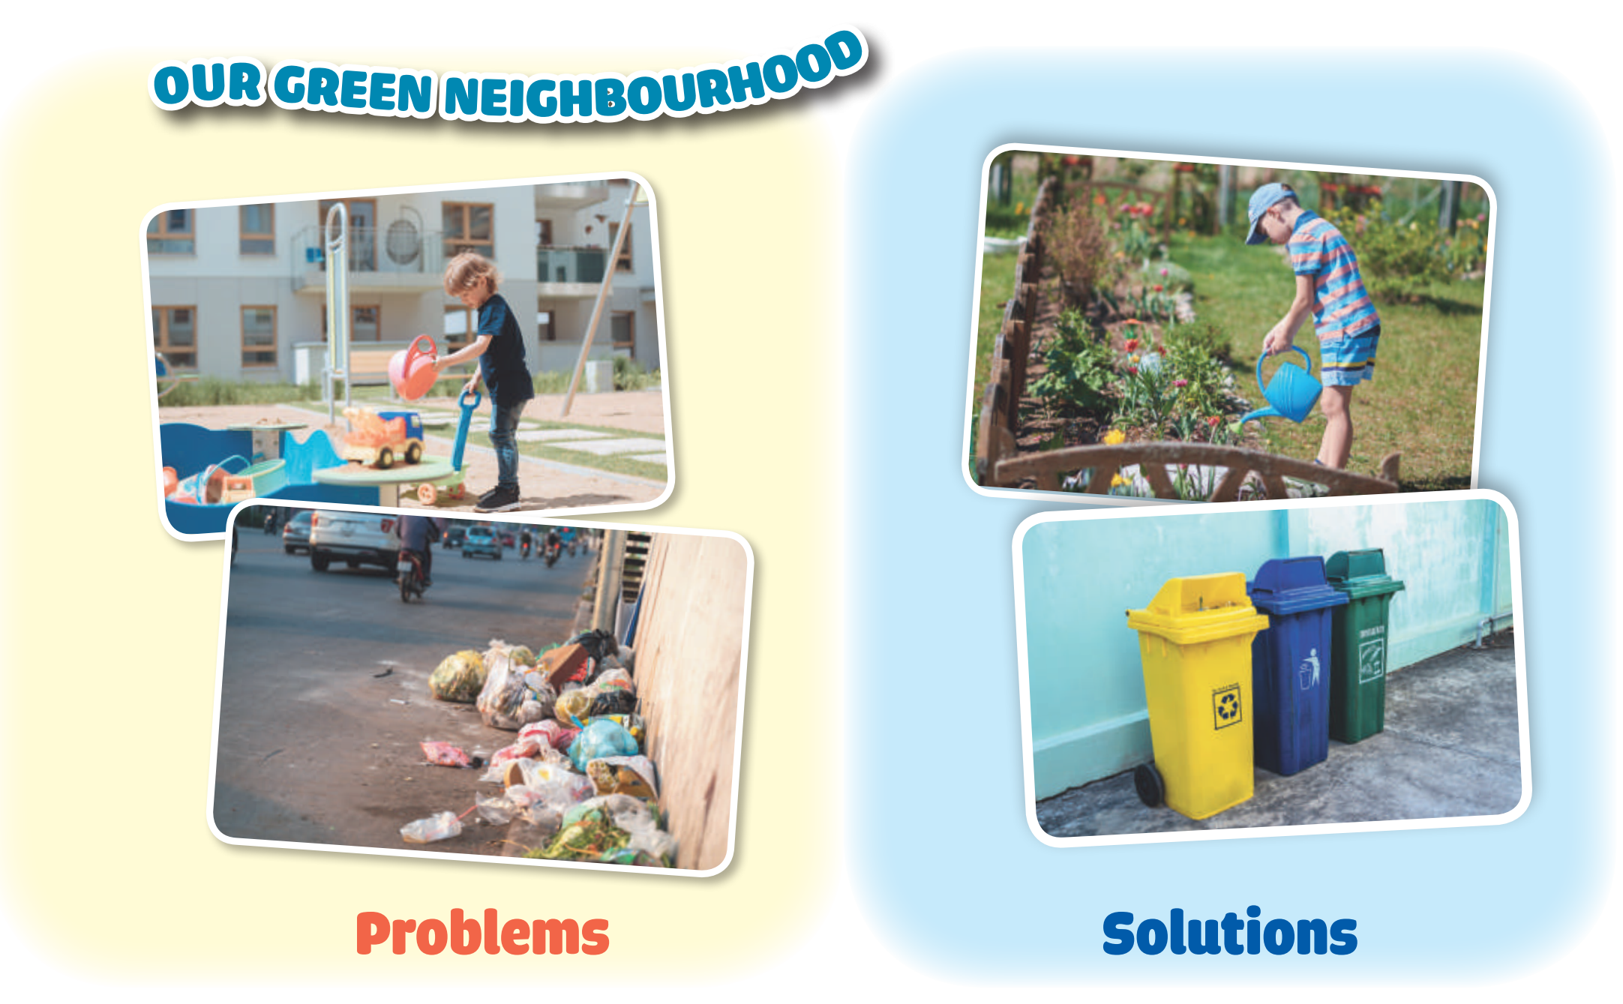
PROJECT
5
1. Think about some environmental problems in your neighbourhood.
2. Discuss and find the answers to the questions.
• What problems can you find?
• What do you want to do to solve the problems?
• How are you going to do them?
3. Present them to your class.
Work in groups.
1

Slide 17
LESSON 7: LOOKING BACK & PROJECT
WARM-UP
Game: Who’s faster?
Task 1: Complete the table with the words and phrases from the box.
Task 2: Complete each sentence with one phrase from Task 1. Remember to use the correct forms of the verbs.
VOCABULARY REVIEW
Task 3: Use the correct form of the verbs from the box to complete the passage.
Task 4: Write full sentences about the activities the students did to help their community last year.
GRAMMAR REVIEW
PROJECT
Project: Our green neighbourhood
CONSOLIDATION
Wrap-up
Homework

Slide 18
CONSOLIDATION
1
WRAP-UP
  Words related to community activities
Grammar
  Discuss some environmental problems and the solutions to them.
  The past simple
Vocabulary
Project

Slide 19

CONSOLIDATION
2
HOMEWORK
Prepare for the next lesson:
Unit 4: Music and Arts - Lesson 1: Getting started

Slide 20

Website: sachmem.vn
Fanpage: facebook.com/sachmem.vn/

