Slide 1



Unit 2: Adventure
Lesson 2G: Speaking

Slide 2
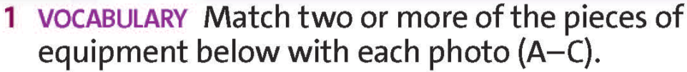
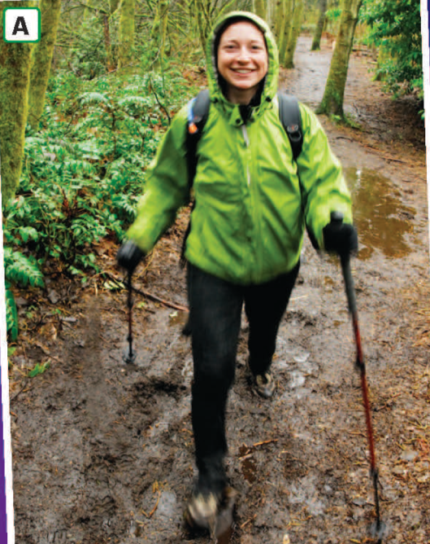

rucksack
helmet
dinghy
/ˈrʌksæk/
Life jacket
paddles
poles
/pəʊlz/
boots
safety harness
rope
/buːts/
Check all
www.phuongnam.edu.vn

Slide 3

boots
helmet
rope
/ˈhelmɪt/
/ˈlaɪf dʒækɪt/
Life jacket
paddles
poles
/ˈpædlz/
safety harness
dinghy
rucksack
/ˈdɪŋi / or/ˈdɪŋɡi/
Check all
www.phuongnam.edu.vn

Slide 4

safety harness
helmet
dinghy
/ˈseɪfti ˈhɑːnɪs/
Life jacket
paddles
poles
rope
rucksack
boots
/rəʊp /
Check all
www.phuongnam.edu.vn

Slide 5



UNIT 1:
FEELINGS
www.phuongnam.edu.vn

Slide 6

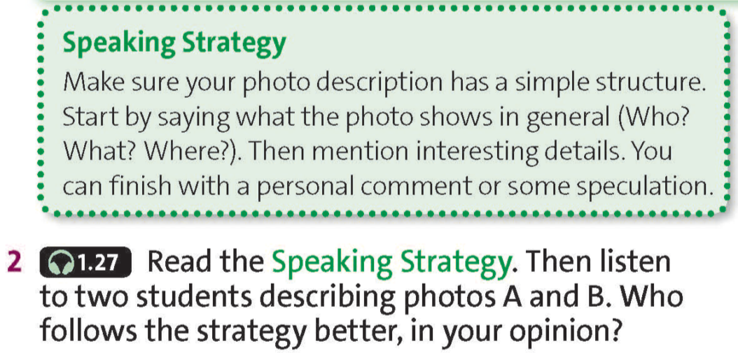
www.phuongnam.edu.vn

Slide 7

Student A
1. Detail: + Far: on the left, there are some trees
2. General: + Who: a woman + What: hiking + Where: a forest
3. Detail: + Near: she’s holding a pole in each hand and she’s wearing a rucksack + Far: at the bottom, it’s a really muddy path + Near: the woman doesn’t look worried and seems to be having a good time
4. Personal comment: none
Student B
1. General: + Who: five people in a dinghy + What: white-water rafting + Where: on a river
2. Detail: + Far: top left corner, a man leaning out of the boat; in the foreground, there’s a lot of water. + Near: the man at the back is trying to guide the dinghy with his paddle; the other four aren’t helping much; they are wearing the same life jackets and helmets
3. Personal comment: I imagine they’re doing this as a holiday activity.
has the incorrect structure
has the correct structure
Student B follows the strategy better!
www.phuongnam.edu.vn

Slide 8

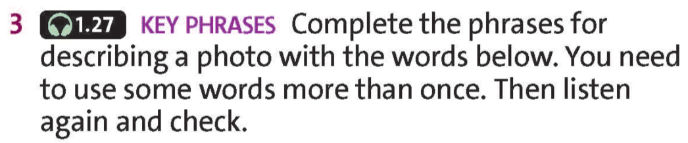



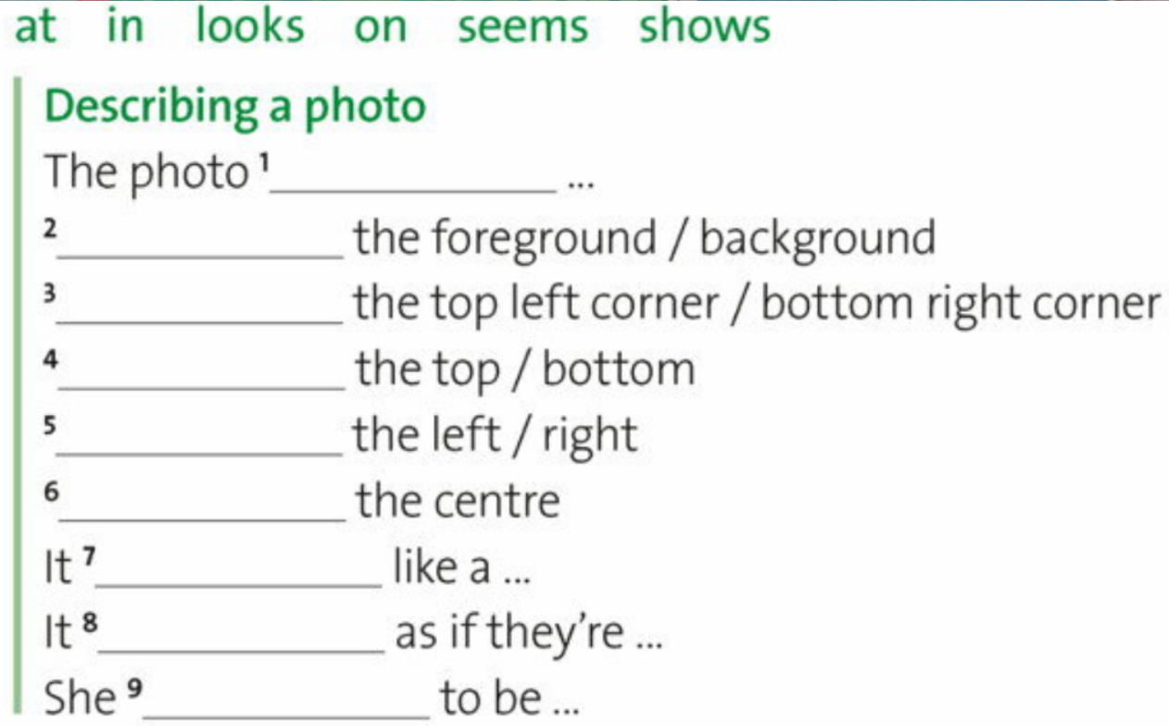

shows
In
In
At
On
In
looks
looks/seems
seems
www.phuongnam.edu.vn

Slide 9
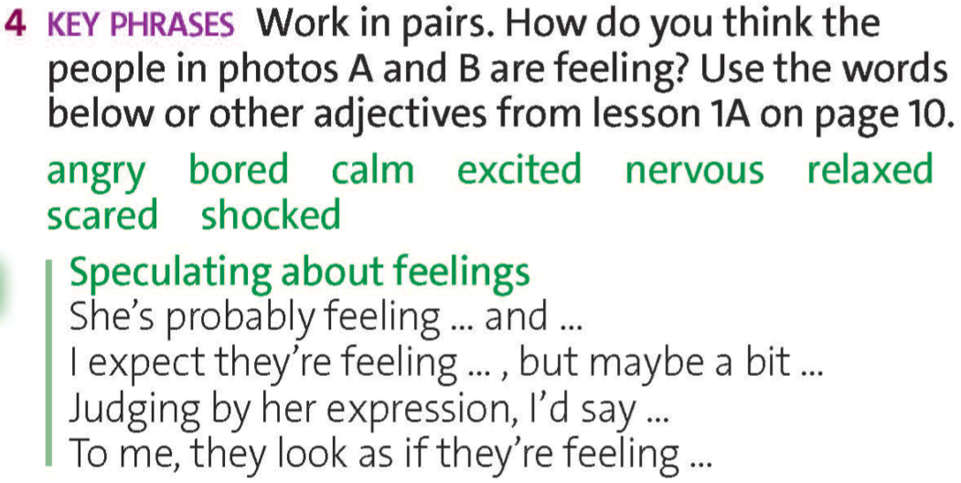
www.phuongnam.edu.vn

Slide 10
Judging by her expression, I’d say she’s relaxed and excited.
www.phuongnam.edu.vn

Slide 11
To me, they look as if they’re feeling excited, nervous, and scared.
www.phuongnam.edu.vn

Slide 12


scared
excited
bored
www.phuongnam.edu.vn

Slide 13
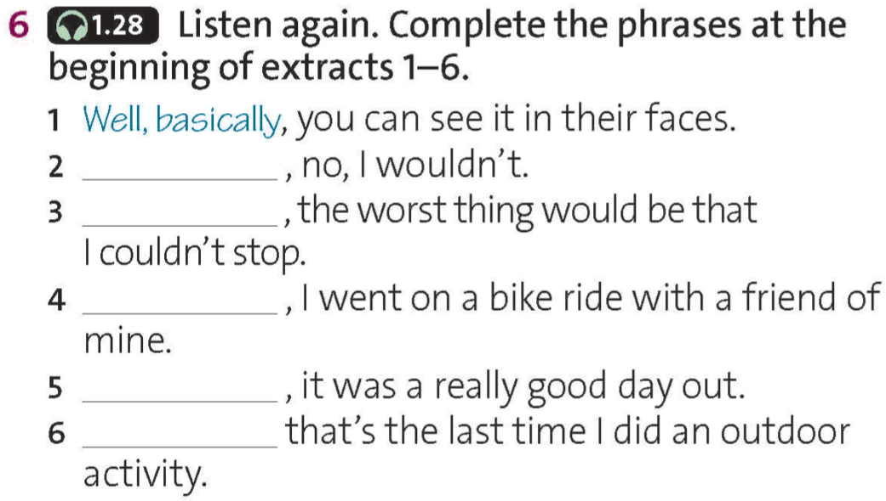
To be honest
For me
A while ago
In fact
I suppose
www.phuongnam.edu.vn

Slide 14

Discussion
Ex7. Work in groups. Describe photo C using words and phrases from this lesson.
www.phuongnam.edu.vn

Slide 15
Well, basically,
A while ago,
To be honest,
For me,
In fact,
I suppose,
www.phuongnam.edu.vn

Slide 16



- Practice describing photos around you.
- Prepare for next lesson – Writing
www.phuongnam.edu.vn

Slide 17

www.phuongnam.edu.vn

Slide 18



Thank you!
CTCP ĐẦU TƯ VÀ PHÁT TRIỂN GIÁO DỤC PHƯƠNG NAM

