Slide 1
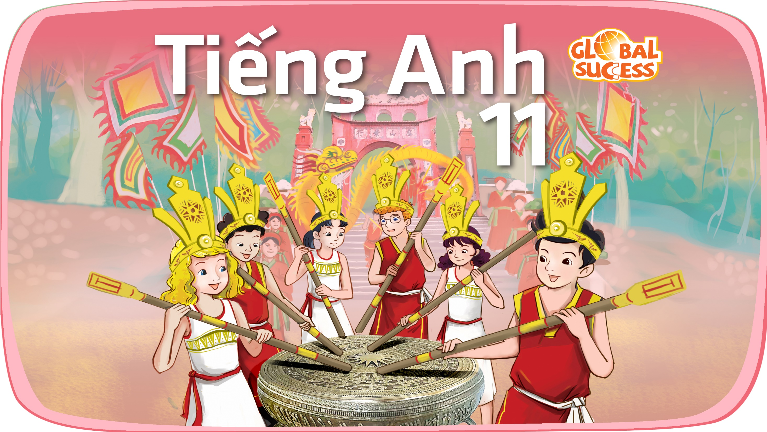

Slide 2
Unit
10
The ecosystem
Unit
FAMILY LIFE
COMMUNICATION AND CULTURE / CLIL
LESSON 7

Slide 3
LESSON 7
COMMUNICATION AND CULTURE / CLIL
WARM-UP
Watch a video
Task 1: Complete the conversation.
Task 2: Make similar conversations.
EVERYDAY ENGLISH
CLIL
Task 1: Tick the correct project in the table.
Task 2: Discussion.
CONSOLIDATION
Wrap-up
Homework

Slide 4

WARM-UP
WATCH A VIDEO
Which expressions are used to talk about likes and dislikes?
Notes:
https://www.youtube.com/watch?v=sAPK6-pEoPk

Slide 5
WARM-UP
Answer key
Likes | Dislikes
I’d love to. I love them. Sounds good. Sounds great. Perfect. Great. Wonderful. | … sounds better to me Not my style. I don’t like. No, thanks. No way. It’s just awful. It’s terrible. I’m not a fan.

Slide 6

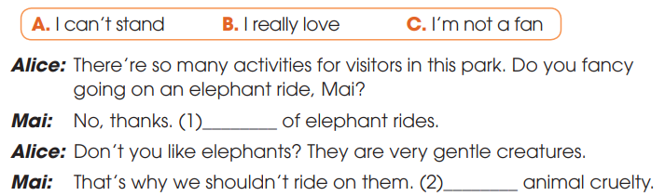
EVERYDAY ENGLISH
1
Listen and complete the conversation with the expressions in the box. Then practice it in pairs
C
A
B

Slide 7
EVERYDAY ENGLISH
Useful expressions
Expressing likes | Expressing dislikes
+ I love/adore … + I’m really into … + I’m a (big) fan of … + I’m keen on … + I’m into … | + I hate/don’t like … + I can’t bear/stand … + I’m not really into … + … is not my favourite

Slide 8
EVERYDAY ENGLISH
2
Make similar conversations for these situations.
2. Student A and Student B are planning an
eco-friendly class party. They talked about the things and activities they like or dislike at the party.
1. Student A is talking about activities he/she does on field trips to national parks. Student B expresses likes/dislikes about these activities.

Slide 9
EVERYDAY ENGLISH
2
Work in pairs. Make similar conversations for these situations.
Situation 1. Sample conversation
A: On our fіeld trip to the national park next week, we should collect some insects for our biology lessons. We should bring some jars to put them in.
B: I’m a big fan of insects. Putting them in jars will kill them. And I don’t think we should do that. Insects play an important role in the ecosystem. Why don’t we just observe them and take photos of them?
A: Great idea. I love it!
1. Student A is talking about activities he/she does on field trips to national parks. Student B expresses likes/dislikes about these activities.

Slide 10
EVERYDAY ENGLISH
2
Work in pairs. Make similar conversations for these situations.
Situation 2. Sample conversation
A: Shall we use paper plates and cups for our class party this Saturday?
B: Yes, I like your idea. They’re better for the environment than plastic ones. I’m keen on using eco-friendly products.
A: Then let’s ask our classmates to bring their chopsticks or forks.
B: I love your suggestion.
2. Student A and Student B are planning an eco-friendly class party. They talked about the things and activities they like or dislike at the party.

Slide 11

CLIL
fancy (v)
/ˈfænsi/
to want something or want to do something

Slide 12
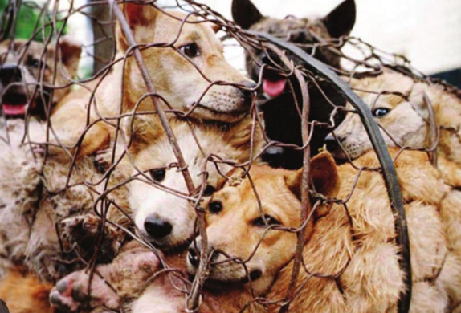
CLIL
cruelty (n)
/ˈkruːəlti/
(to somebody/something)
behaviour that causes physical or mental pain to others and makes them suffer, especially deliberately

Slide 13

CLIL
barrier (n)
/ˈbæriə(r)/
something that exists between one thing or person and another and keeps them separate

Slide 14
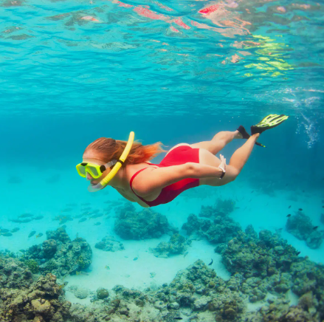
CLIL
snorkelling (n)
/ˈsnɔːkəlɪŋ/
the sport or activity of swimming underwater with a snorkel

Slide 15
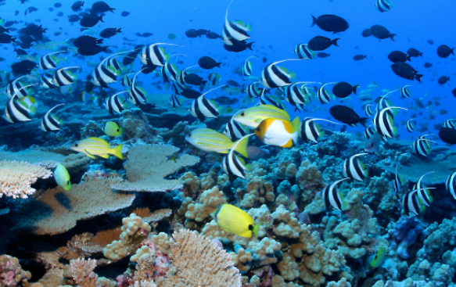
CLIL
marine (adj)
/məˈriːn/
connected with the sea and the creatures and plants that live there

Slide 16
Form | Pronunciation | Meaning
1. fancy (v) | /ˈfænsi/ | to want something or want to do something
2. cruelty (n) | /ˈkruːəlti/ | (to somebody/something) behaviour that causes physical or mental pain to others and makes them suffer, especially deliberately
3. barrier (n) | /ˈbæriə(r)/ | something that exists between one thing or person and another and keeps them separate
4. snorkelling (n) | /ˈsnɔːkəlɪŋ/ | the sport or activity of swimming underwater with a snorkel
5. marine (adj) | /məˈriːn/ | connected with the sea and the creatures and plants that live there

Slide 17
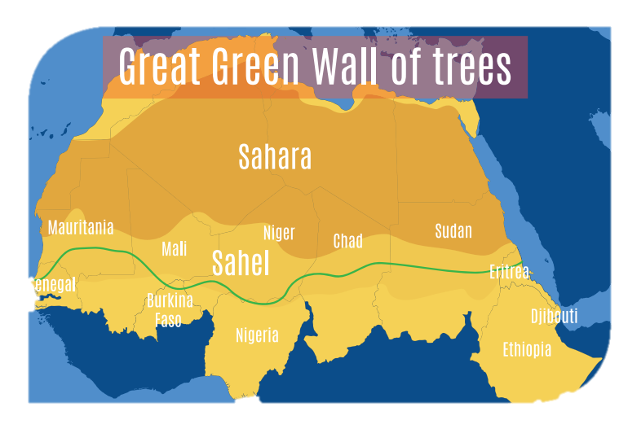
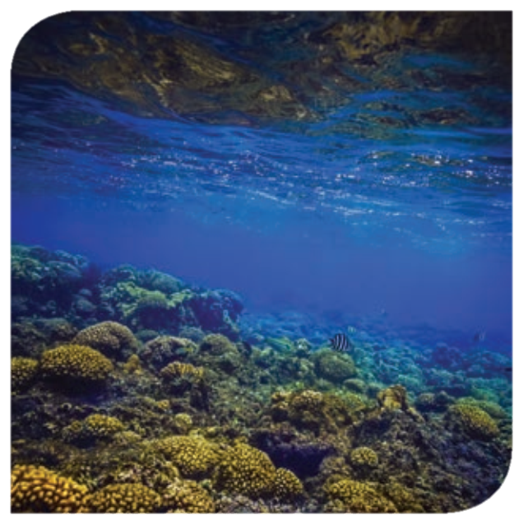
CLIL
1
Read the text and tick the correct project in the table.

Slide 18


CLIL
1
Read the text and tick the correct project in the table
 | The Great Green Wall | Belize Barrier Reef
1. It is a marine ecosystem of rich biodiversity.
2. Its aim is to build the world’s biggest living structure
3. Millions of trees have been planted in several African countries.
4. The government has taken measures to restore and protect the ecosystem.

Slide 19
CLIL
2
Work in groups. Discuss the following questions
Are there similar projects in Viet Nam?
Do you think the projects in Task 1 can be applied in Viet Nam?

Slide 20
CONSOLIDATION
1
Wrap-up
What have you learnt today?
Some methods for protecting local ecosystems in the world;
Review expressions for likes and dislikes.

Slide 21
CONSOLIDATION
2
Homework
Do the exercises in the workbook.
Prepare for Lesson 8 - Unit 10.

Slide 22

Website: hoclieu.vn
Fanpage: facebook.com/www.tienganhglobalsuccess.vn
Website: hoclieu.vn
Fanpage: facebook.com/sachmem.vn/

