Slide 1



Unit Introduction
Lesson A: Vocabulary

Slide 2


Slide 3

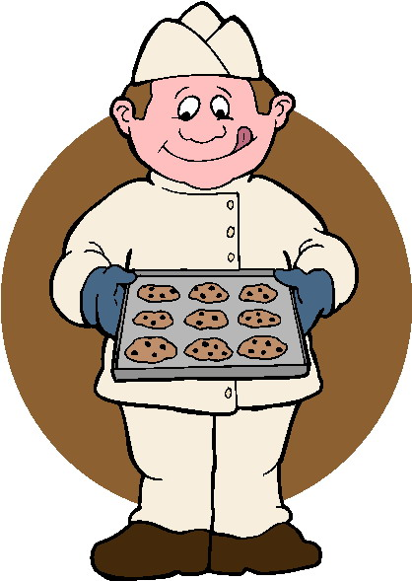



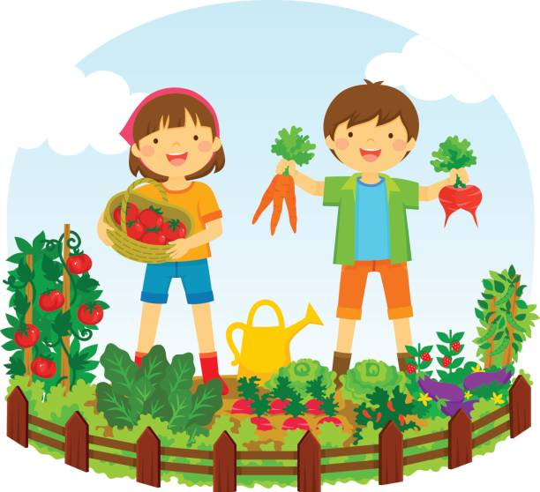

1
H | I | K | I | N | G
2
J | O | G | G | I | N | G
3
C | L | I | M | B | I | N | G
4
B | A | K | I | N | G
5
S | E | W | I | N | G
6
G | A | R | D | E | N | I | N | G
7
F | I | S | H | I | N | G
Question 1: The activity of going for long walks in the countryside (6 letters)
Question 2: The activity of running at a slow, regular speed, especially as a form of exercise (7 letters)
Question 3: The sport of climbing on rocks or in mountains (8 letters)
Question 4: The activity of making cakes, and bread by cooking them inside an oven(7 letters)
Question 5: The activity of making or repairing clothes or other things made from cloth (6 letters)
Question 6: The activity of working in a garden, growing, and taking care of the plants (9 letters)
Question 7: The sport of catching fish ( 7 letters)

Slide 4




www.phuongnam.edu.vn

Slide 5
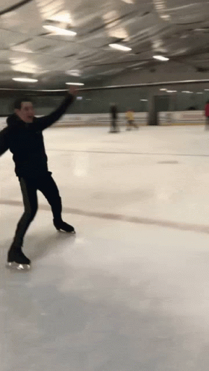
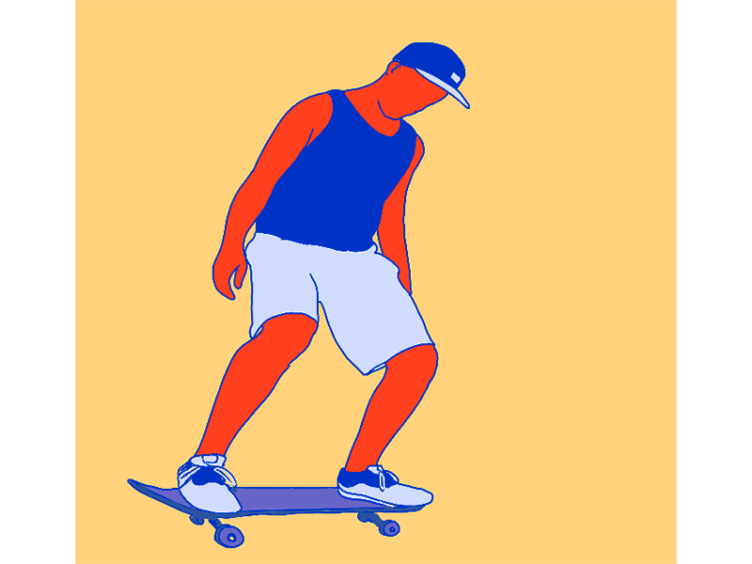
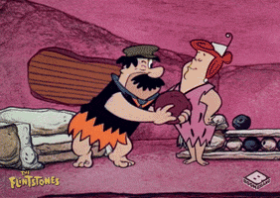
NEW VOCABULARY
1. Skateboarding (n) /ˈskeɪtˌbɔː.dɪŋ/ the activity or sport of riding a skateboard
2. Ice skating (n) /ˈaɪs ˌskeɪ.tɪŋ/ the sport or activity of moving on ice, wearing ice skates
3. Bowling (n) /ˈbəʊ.lɪŋ/ a game played inside, in which you roll a heavy ball down a track to try to knock down a group of pins
www.phuongnam.edu.vn

Slide 6


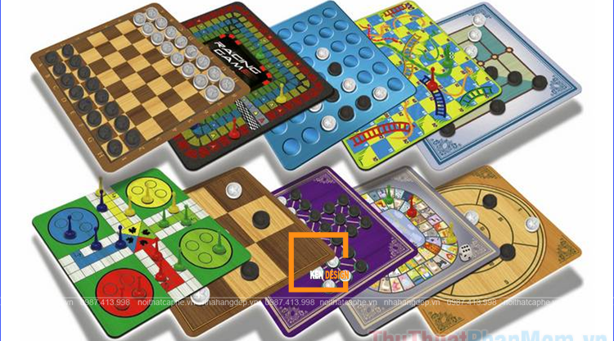
NEW VOCABULARY
4. PE = Physical education (n) /ˌfɪz.ɪ.kəl ed.jʊˈkeɪ.ʃən/ school classes in which children exercise and learn to play sports
5. Board game (n) /ˈbɔːd ˌɡeɪm/ any of many games in which small pieces are moved around on a board with a pattern on it
6. Drawing (n) /ˈdrɔː.ɪŋ/ the act of making a picture with a pencil or pen, or a picture made in this way
www.phuongnam.edu.vn

Slide 7
NEW VOCABULARY
1. Skateboarding (n) /ˈskeɪtˌbɔː.dɪŋ/ the activity or sport of riding a skateboard
2. Ice skating (n) /ˈaɪs ˌskeɪ.tɪŋ/ the sport or activity of moving on ice, and wearing ice skates
3. Bowling (n) /ˈbəʊ.lɪŋ/ a game played inside, in which you roll a heavy ball down a track to try to knock down a group of pins
4. PE = Physical education (n) /ˌfɪz.ɪ.kəl ed.jʊˈkeɪ.ʃən/ school classes in which children exercise and learn to play sports
5. Board game (n) /ˈbɔːd ˌɡeɪm/ any of many games in which small pieces are moved around on a board with a pattern on it
6. Drawing (n) /ˈdrɔː.ɪŋ/ the act of making a picture with a pencil or pen, or a picture made in this way
www.phuongnam.edu.vn

Slide 8
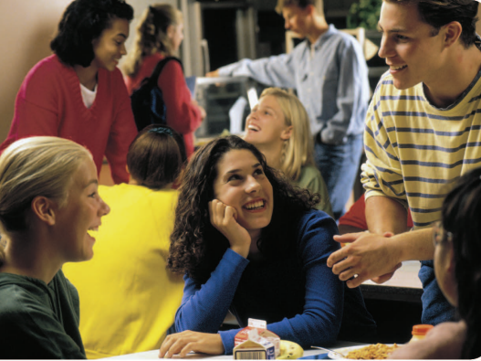
1. Where are the people?
2. What are they doing?
www.phuongnam.edu.vn

Slide 9


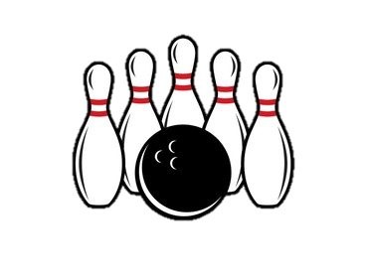
Ryan Hi, Izzy. Can I sit here?
Izzy Yes, of course. This is Becky. She’s new.
Ryan Hi, Becky. I’m Ryan, Izzy’s brother.
Becky Hi. Nice to meet you!
Ryan Where are you from, Becky?
Becky I’m from London. I moved here two weeks ago.
Ryan I love London. I’ve got friends there. I sometimes visit them and we go skateboarding.
Izzy Do you like skateboarding, Becky?
Becky Not really. But I like ice skating.
Izzy Me too! Let’s go ice skating after school.
Becky Great idea!
Ryan I’m not very keen on ice skating. What do you think of bowling?
Becky Bowling? I hate it.
Ryan Oh. Actually, I don’t mind ice skating …
Izzy There’s the bell. I’ve got maths, then history.
Becky I’ve got PE now. I love PE! See you after school, Izzy!
Izzy Bye, Becky.
Ryan Yeah … Bye …
2. Read and listen to the dialogue. Find people’s names
www.phuongnam.edu.vn

Slide 10



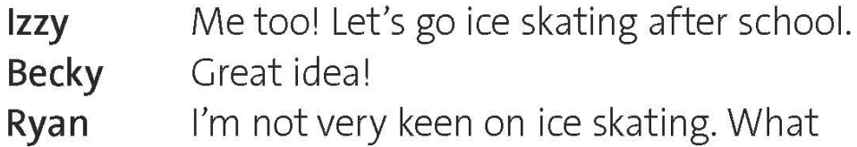


3. Are the sentences true or false? Write T or F.
not
This is the first time Izzy and Ryan have met.
F
>
This is the first time Becky and Ryan have met.
T
Ryan sometimes goes skateboarding in London.
T
Becky does not like skateboarding or bowling.
T
Izzy
Ryan and Becky agree to go ice skating after school.
F
Izzy and Becky have got PE next.
F
www.phuongnam.edu.vn

Slide 11
4. VOCABULARY Add three words from the dialogue in exercise 2 to each list.
SPORTS AND HOBBIES
- Board games
- Drawing
SCHOOL SUBJECTS
- Drama
- IT (information technology)
- Skateboarding
- Ice skating
- Bowling
- Maths
- History
- PE
www.phuongnam.edu.vn

Slide 12
5 Work in pairs. How many more words can you add to the lists in exercise 4 in three minutes?
HOBBIES
Gymnastics
Chess
Dance / dancing
Swimming
Cycling
SCHOOL SUBJECTS
Chemistry
Geography
Physics
English
Literature
www.phuongnam.edu.vn

Slide 13
6. KEY PHRASES Label the phrases below A (like), B (OK) or C (don’t like)
A (Like) | B (Ok) | C (Don’t like)
I can’t stand …
I don’t mind …
I hate …
I love …
I (quite) like …
I’m really keen on …
… isn’t bad.
… is great.
… is terrible.
Check all
www.phuongnam.edu.vn

Slide 14
Ryan Hi, Izzy. Can I sit here?
Izzy Yes, of course. This is Becky. She’s new.
Ryan Hi, Becky. I’m Ryan, Izzy’s brother.
Becky Hi. Nice to meet you!
Ryan Where are you from, Becky?
Becky I’m from London. I moved here two weeks ago.
Ryan I love London. I’ve got friends there. I sometimes visit them and we go skateboarding.
Izzy Do you like skateboarding, Becky?
Becky Not really. But I like ice skating.
Izzy Me too! Let’s go ice skating after school.
Becky Great idea!
Ryan I’m not very keen on ice skating. What do you think of bowling?
Becky Bowling? I hate it.
Ryan Oh. Actually, I don’t mind ice skating …
Izzy There’s the bell. I’ve got maths, then history.
Becky I’ve got PE now. I love PE! See you after school, Izzy!
Izzy Bye, Becky.
Ryan Yeah … Bye …
6. Which phrases are in the dialogue in exercise 2?
www.phuongnam.edu.vn

Slide 15

Pair - Work
www.phuongnam.edu.vn

Slide 16



7 SPEAKING Work in pairs. Give opinion of school subjects. Use the phrases in exercise 6.
www.phuongnam.edu.vn

Slide 17
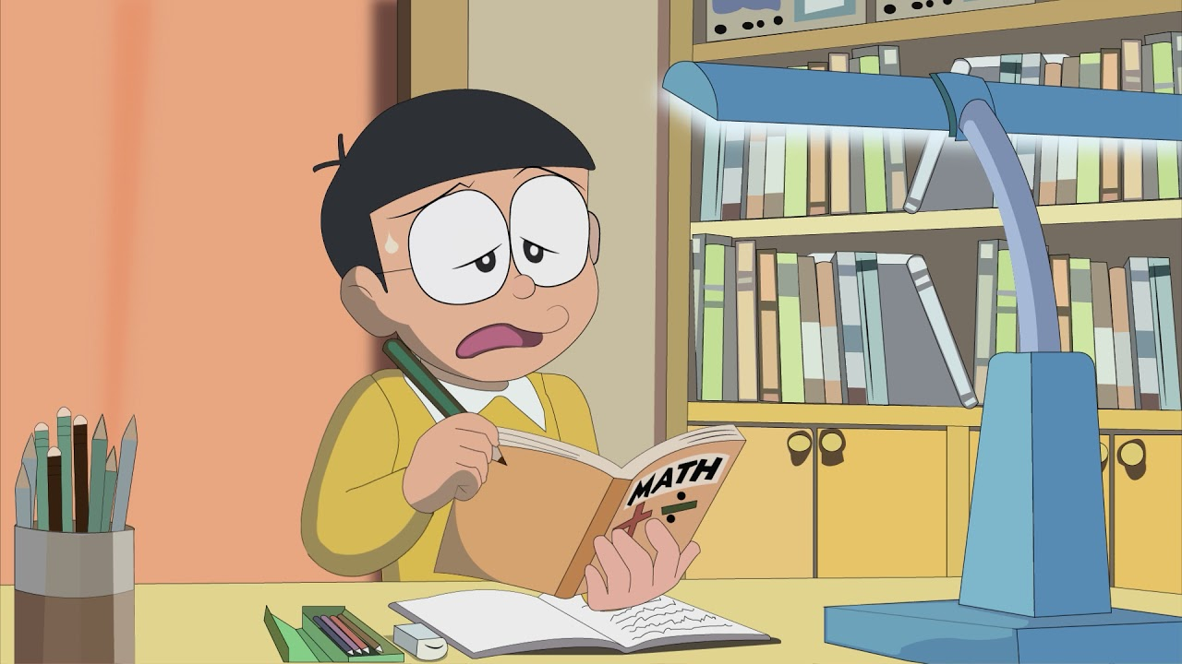
LEARN WITH NOBITA
Guess the name of the school subject.
Give your opinion on that subject.
www.phuongnam.edu.vn

Slide 18
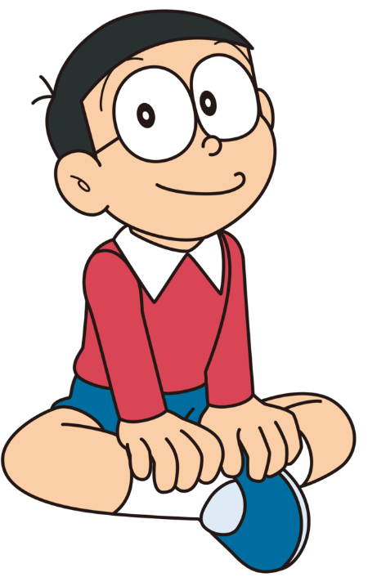
Using following phrases:
I can’t stand… I don’t mind… I hate…
I love… I (quite) like… I’m really keen on…
… isn’t bad. … is great. … is terrible.
1. What subject is about numbers, shapes and space using reason and usually system of symbols and rules for organizing them?
1. MATHS
www.phuongnam.edu.vn

Slide 19
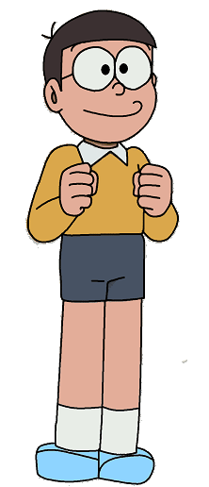
Using following phrases:
I can’t stand… I don’t mind… I hate…
I love… I (quite) like… I’m really keen on…
… isn’t bad. … is great. … is terrible.
2. GEOGRAPHY
2. What subject is about countries, landscapes and environments?
www.phuongnam.edu.vn

Slide 20
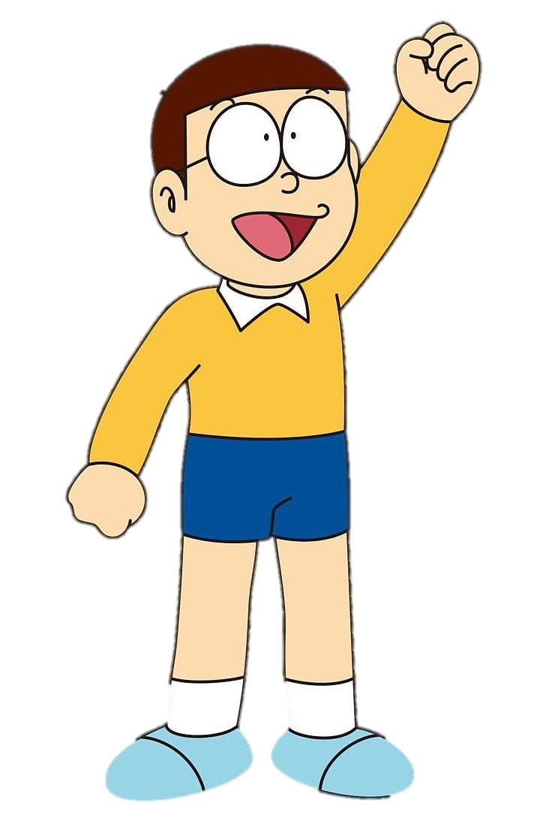
Using following phrases:
I can’t stand… I don’t mind… I hate…
I love… I (quite) like… I’m really keen on…
… isn’t bad. … is great. … is terrible.
3. What subject is about classes at school in which children do exercise and learn to play sport?
3. PE = PHYSICAL EDUCATION
www.phuongnam.edu.vn
www.phuongnam.edu.vn

Slide 21

Using following phrases:
I can’t stand… I don’t mind… I hate…
I love… I (quite) like… I’m really keen on…
… isn’t bad. … is great. … is terrible.
4. What subject is about matter and the chemical reactions between substances?
4. CHEMISTRY
www.phuongnam.edu.vn

Slide 22
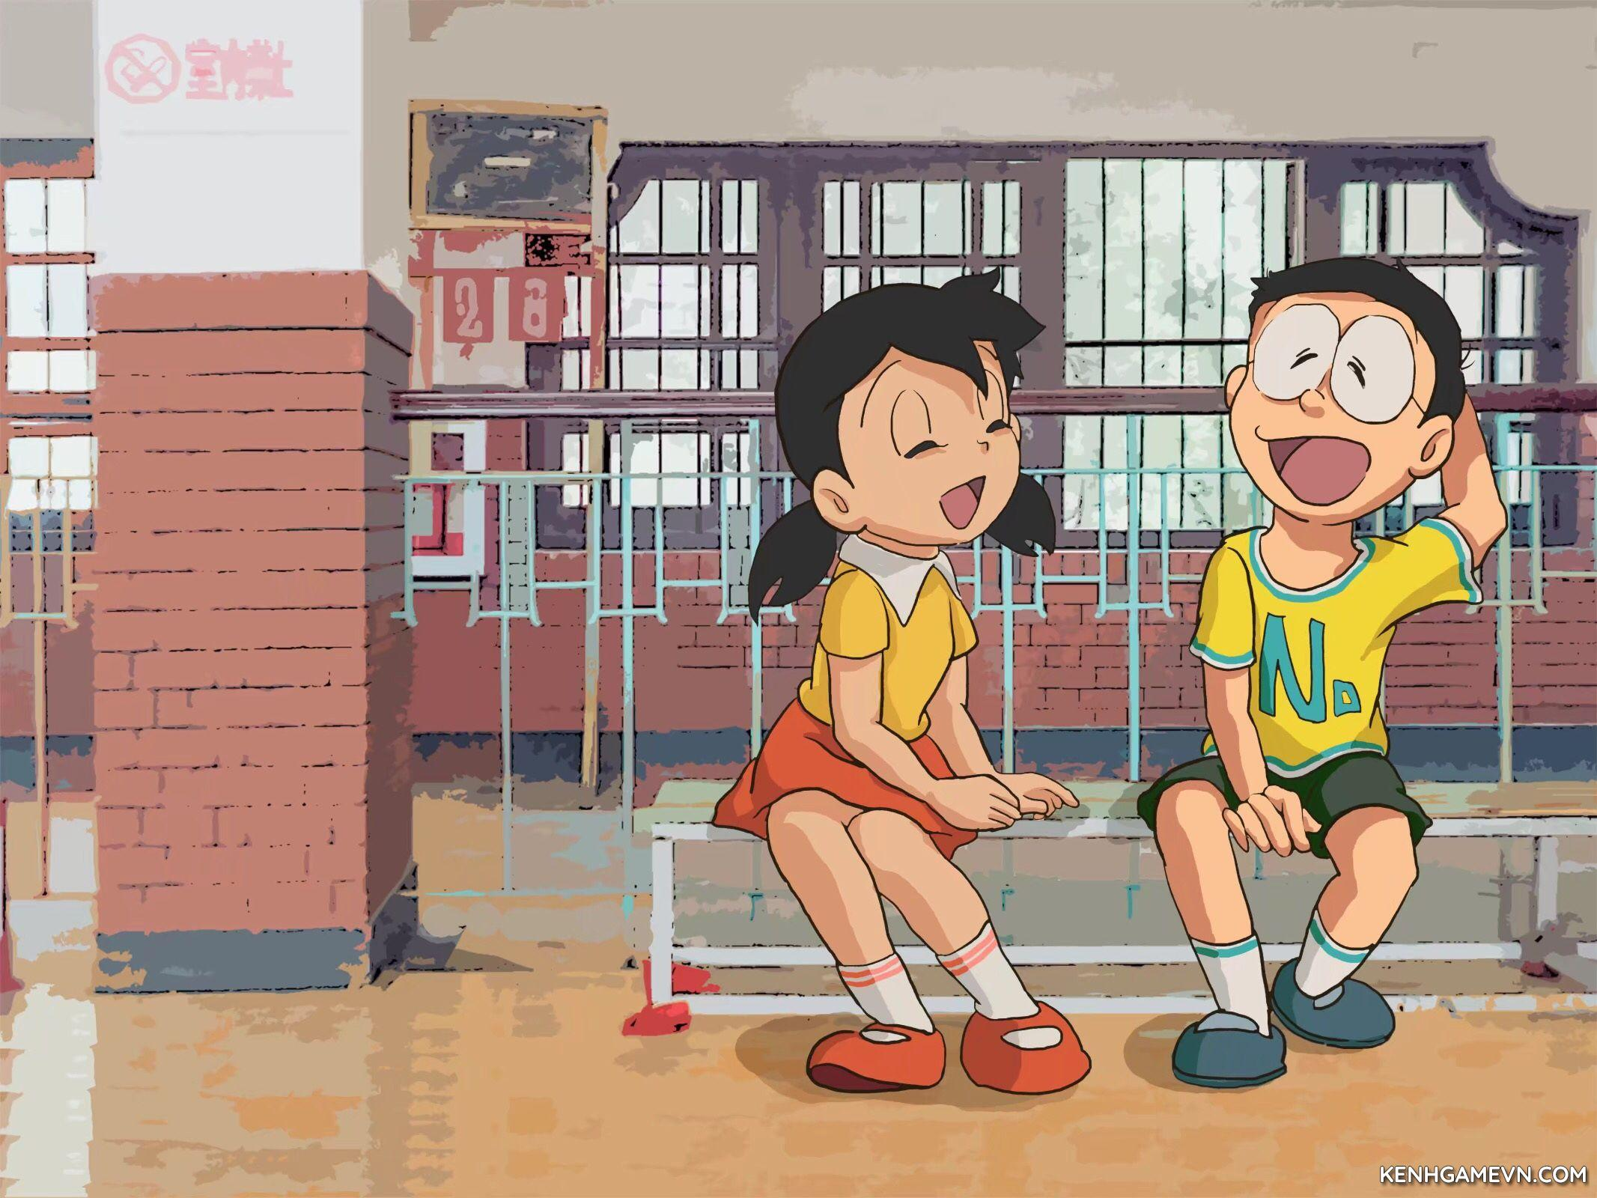
Thanks! I tried my best
Well-done!
You completed your homework!
www.phuongnam.edu.vn

Slide 23
Homework
 Learn by heart all the new words.
 Prepare for next lesson – grammar: Contrast: present simple and present continuous.
www.phuongnam.edu.vn

Slide 24

www.phuongnam.edu.vn

Slide 25



Thank you!
CTCP ĐẦU TƯ VÀ PHÁT TRIỂN GIÁO DỤC PHƯƠNG NAM

