Slide 2
Unit 1
Life stories we admire
LESSON 2
LANGUAGE

Slide 3
LESSON 2
LANGUAGE
WARM-UP
Game: Say a name
PRONUNCIATION
Task 1. Listen and repeat.
Task 2. Underline the words.
Task 1. Match the words/phrases with the words/preposition.
Task 2. Complete the sentences.
VOCABULARY
Task 1. Circle the correct answer.
Task 2. Tell the life stories of people you know and admire.
GRAMMAR
CONSOLIDATION
Wrap-up
Homework

Slide 4
WARM-UP
Game: Say a name

Slide 5
WARM-UP
Rules
- Work in two teams. There are 5 turns for each team.
- There are two separate boxes. Box A contains the names of some nationalities, Box B contains names of jobs.
- Pick up one card from box A and one from box B.
- Say the name of one famous person corresponding to your cards.
- If you cannot answer ➔ the chance is transferred to the other team.
E.g: Box A = “South African”, Box B = “politician” ➔ say “Nelson Mandela”.
- One point for a correct answer.
- The group getting the highest points will be the winner.

Slide 6

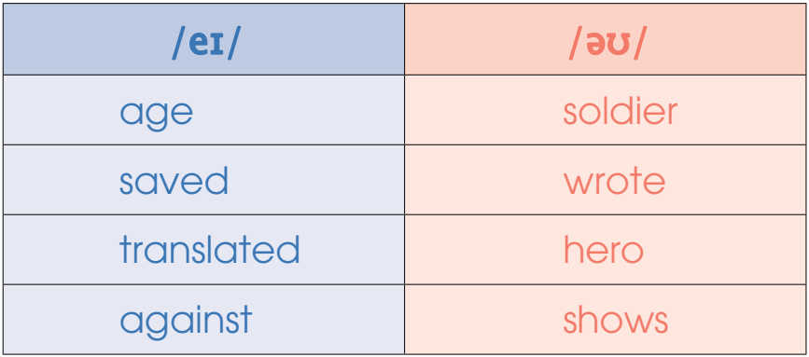
PRONUNCIATION
1
Listen and repeat. Then practise saying the words

Slide 7
PRONUNCIATION
2
Underline the words that contain the /eɪ/ and /əʊ/ sounds.
In the first year when The Diary of Dang Thuy Tram was published, more than 300,000 copies were sold. The book was also translated into more than 16 different languages. A film based on the diary was made in 2009. Its name is Don’t burn.

Slide 8
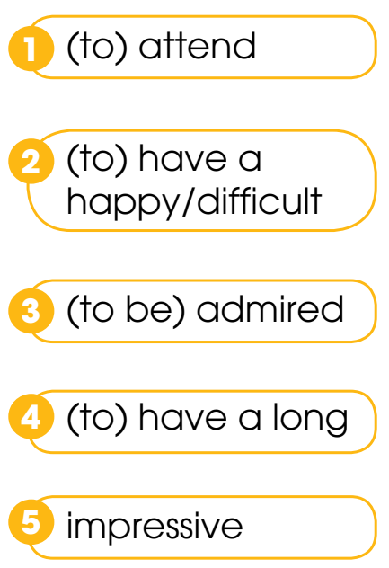
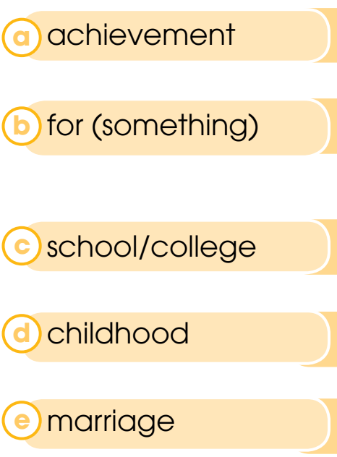
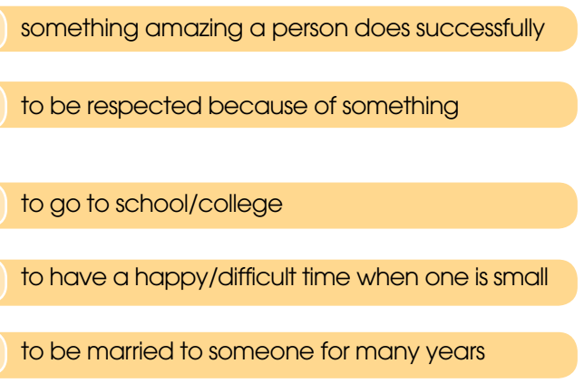
VOCABULARY
1
Match the words/phrases (1–5) with the words/preposition (a–e).
Key: 1. c 2. d 3. b 4. e 5. a

Slide 9
VOCABULARY
2
Complete the sentences.
attended college
1. My father ________________ in Ha Noi between the ages of 19 and 21.
2. Like so many people in their generation, my grandparents _________________. They were together for 60 years.
3. My friend ____________________ because his mother died when he was very small.
had a long marriage
had a difficult childhood

Slide 10
VOCABULARY
2
Complete the sentences.
4. Thomas Edison’s _____________________ in science include the invention of the phonograph and development of the light bulb.
5. Uncle Ho was _________ his simple lifestyle.
impressive achievements
admired for

Slide 11
GRAMMAR
Past simple tense | Past continuous tense
1. Describe something started and finished in the past E.g. You did a great job yesterday. | 1. Describe an action which was happening at a specific point of time in the past. E.g: I was reading a good book at 10 p.m. last night.
2. Describe main events in a story. E.g. Mary read a few pages of her book and went to bed. | 2. Describe the settings of a story. E.g. It was raining heavily outside. Mary read a few pages of her book and went to bed.
• When one action in the past happens in the middle of another, we use the past simple to talk about the shorter action, and the past continuous for the longer action. E.g. I was reading a book when the phone rang. • When two or more actions in the past are happening at the same time, we use the past continuous for both/all. E.g. While I was reading a book, my mother was watching TV.

Slide 12
GRAMMAR
1
Circle the correct answer to complete each of the sentences.
1. My dad watched / was watching a documentary about war heroes at 9 p.m. on 30th April.
2. It snowed / was snowing heavily, and icy winds were blowing / blew across the city. We lit a fire in the fireplace and sat next to it to keep warm.

Slide 13
GRAMMAR
1
Circle the correct answer to complete each of the sentences.
3. She finished / was finishing school and
applied / was applying to college at the age of 18.
4. My father started / was starting his own business in his youth and became / was becoming very successful.

Slide 14
GRAMMAR
2
Tell the life stories of people you know and admire. Use the Past simple and past continuous.
Suggested answer:
When the war started, my grandfather was enjoying a happy life and marriage with my grandmother. Then he left his hometown to join the army. When he was fighting in the war, my grandmother was taking care of the whole family. While he was serving in the army, he was awarded a medal for bravery.

Slide 15
CONSOLIDATION
1
Wrap-up
What have you learnt today?
Use the lexical items related to the topic Life stories we admire;
Recognise and practise diphthongs /eɪ/ and /əʊ/;
Review the use of Past Simple and the Past Continuous tenses.

Slide 16
CONSOLIDATION
2
Homework
Do exercises in the workbook.
Prepare for Lesson 3 - Reading.

Slide 17
Website: hoclieu.vn
Fanpage: facebook.com/www.tienganhglobalsuccess.vn

