Slide 1

Unit 3: All about food
Lesson 3a: Reading
Page 54

Slide 2
Lesson Outline
Warm-up
Pre-reading
While-reading
Post-reading
Consolidation
Wrap-up

Slide 3
Objectives
By the end of this lesson, students will be able to…
learn about some TV chefs’ favourite foods.
practise reading skills (read for specific information).

Slide 4

WARM-UP

Slide 5
Pair work
Ask and answer about TV chefs.
Do you usually watch cooking shows on TV?
Name some famous TV chefs.
What dishes are they famous for?

Slide 6

It’s time to learn …

Slide 7

Pre-reading

Slide 8
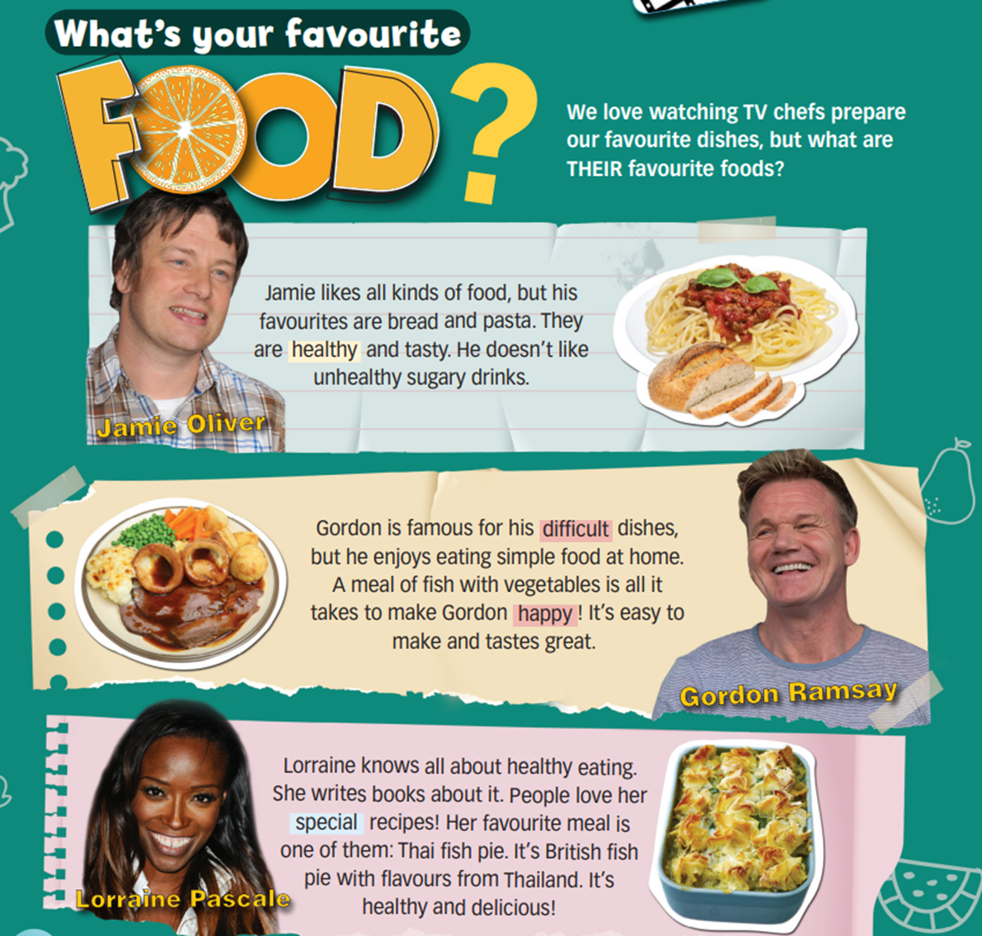
Look at the pictures and answer the questions:
Who are the people in the photos?
Who is famous for his/her difficult recipes?

Slide 9


Listen and read to find out.
1. Who are the people in the photos?
They are TV chefs.
2. Who is famous for his/her difficult recipes?
Gordon Ramsay is famous for his difficult recipes.

Slide 10
Find these words and underline them. Can you guess their meanings?
meal, recipe, pie, flavour, healthy, difficult, happy, special
Jamie likes all kinds of food, but his favourites are bread and pasta. They are healthy and tasty. He doesn’t like unhealthy sugary drinks.
Gordon is famous for his difficult dishes, but he enjoys eating simple food at home. A meal of fish with vegetables is all it takes to make Gordon happy ! It’s easy to make and tastes great.
Lorraine knows all about healthy eating. She writes books about it. People love her special recipes! Her favourite meal is one of them: Thai fish pie. It’s British fish pie with flavours from Thailand. It’s healthy and delicious!

Slide 11
vocabulary
Listen and repeat. Click on each word to hear the sound.
• meal (n) /mɪəl/: bữa ăn
• recipe (n) /ˈresɪpi/: công thức nấu ăn
• pie (n) /paɪ/: bánh nướng (có vỏ phủ)
• flavour (n) /ˈfleɪvə/: hương vị
• healthy (adj) /ˈhelθi/: có lợi cho sức khoẻ
• difficult (adj) /ˈdɪfɪkəlt/: khó khăn
• special (adj) /ˈspeʃəl/: đặc biệt

Slide 12
vocabulary
Practise saying them. Focus on the word stress.
• meal (n) /mɪəl/: bữa ăn
• recipe (n) /ˈresɪpi/: công thức nấu ăn
• pie (n) /paɪ/: bánh nướng (có vỏ phủ)
• flavour (n) /ˈfleɪvə/: hương vị
• healthy (adj) /ˈhelθi/: có lợi cho sức khoẻ
• difficult (adj) /ˈdɪfɪkəlt/: khó khăn
• special (adj) /ˈspeʃəl/: đặc biệt

Slide 13
Make your own sentences, using the words you have learnt.
I have three meals a day: breakfast, lunch and dinner.

Slide 14
While-reading

Slide 15
2. Read the questions and underline key words.
1 Jamie Oliver doesn’t like _____________________________ .
A pasta B bread C sugary drinks
2 At home, Gordon Ramsay likes _______________________ .
A fish with vegetables B difficult dishes C unhealthy food
3 Lorraine writes books about __________________________ .
A healthy eating B Thai food C British pies

Slide 16
2. For questions (1-3), choose the best answer (A, B or C).
1 Jamie Oliver doesn’t like _____________________________ .
A pasta B bread C sugary drinks
Jamie likes all kinds of food, but his favourites are bread and pasta. They are healthy and tasty. He doesn’t like unhealthy sugary drinks.

Slide 17
2 At home, Gordon Ramsay likes _______________________ .
A fish with vegetables B difficult dishes C unhealthy food
Gordon is famous for his difficult dishes, but he enjoys eating simple food at home. A meal of fish with vegetables is all it takes to make Gordon happy! It’s easy to make and tastes great.

Slide 18
3 Lorraine writes books about __________________________ .
A healthy eating B Thai food C British pies
Lorraine knows all about healthy eating. She writes books about it. People love her special recipes! Her favourite meal is one of them: Thai fish pie. It’s British fish pie with flavours from Thailand. It’s healthy and delicious!

Slide 19
Read the sentences and underline the key words.
1 Jamie likes bread and pasta because they are healthy and delicious.
2 It’s not difficult to make a meal of fish with vegetables.
3 Lorrain’s favourite meal is British fish pie.

Slide 20
Read the text and write TRUE or FALSE
1 Jamie likes bread and pasta because they are healthy and delicious.
T
Jamie likes all kinds of food, but his favourites are bread and pasta. They are healthy and tasty.

Slide 21
2 It’s not difficult to make a meal of fish with vegetables.
T
A meal of fish with vegetables is all it takes to make Gordon happy! It’s easy to make and tastes great.

Slide 22
3 Lorrain’s favourite meal is British fish pie.
F
Her favourite meal is one of them: Thai fish pie. It’s British fish pie with flavours from Thailand.

Slide 23

Post-reading

Slide 24
Pair work
Ask and answer about your favorite food and why.
What’s your favourite food? Why?
I like vegetables because they’re healthy.

Slide 25

CONSOLIDATION

Slide 26
Write five sentences (about 60 words) about healthy food, using the vocabulary you have learnt today.

Slide 27

WRAP-UP

Slide 28
Today’s lesson
Vocabularies
meal
recipe
pie
flavour
healthy
difficult
special
Reading
Read a text about famous chefs’ favourite foods.
Practise reading and choose the best answers.

Slide 29
Homework
Practise the vocabularies and make sentences using them.
Do the exercises in TA 6 Right on WB (p. 28)
Prepare the next lesson (p. 55 SB)

Slide 30

Enjoy your day!

