Slide 1
Gender Equality
Unit 6
Lesson 3: Reading
For an equal world

Slide 2
OBJECTIVES
Gain vocabulary related to gender equality
Read for specific information about gender
equality in employment

Slide 3
Table of contents
01
02
03
Warm-up
Pre-reading
While-reading
04
05
Post-reading
Consolidation

Slide 4
01
Warm-up
Small talk: Gender privileges

Slide 5
WARM-UP
Gender Privileges
1. List some activities boys are allowed to do but girls are not.
2. List some activities girls are allowed to do but boys are not.
3. Are such advantages fair/unfair?

Slide 6
02
Pre-reading

Slide 7
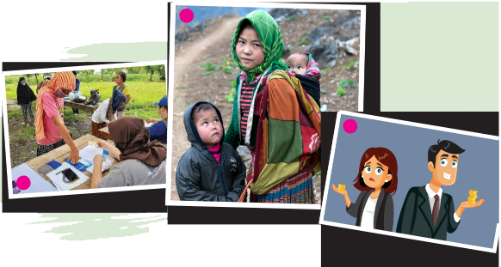
PRE-READING
1
1
Match the sentence with the pictures.
1. Men often earn more than women for doing the same job.
c
2. A child mother takes care of her small kids.
b
3. Some women are unable to read and write.
a
b
c
a

Slide 8
03
While-reading

Slide 10
Reading Quiz
Choose the correct meaning of the words and phrases.
be forced
be made to do something necessary
be made to do something unwanted

Slide 11
Reading Quiz
Choose the correct meaning of the words and phrases.
domestic violence
behaviour intended to hurt someone you live with
action taken to please someone

Slide 12
Reading Quiz
Choose the correct meaning of the words and phrases.
uneducated
having little or no formal education at school
not having many job opportunities

Slide 13
Reading Quiz
Choose the correct meaning of the words and phrases.
low-paying
giving money to a person
providing very little money

Slide 14
WHILE-READING
3
True (T), False (F), Not given (NG).
 | T | F | NG
1. Child marriage involves a girl under the age of 18.
2. Fewer men than women around the world are educated.
3. Men work much less than women, but earn much more.
4. Men’s career choices lead to high-paying jobs.
5. Only individuals must work towards gender equality.
✔
✔
✔
✔
✔

Slide 15
04
Post-reading

Slide 16
POST-READING
PRESIDENTIAL ELECTION
Work in groups of four and role play as “president candidate”. Discuss ideas and make a speech about what you would do to solve ONE of these problems.
Child marriage
A lack of education for girls
Low pay for women

Slide 17
POST-READING
VOTING TIME!
Listen to other groups and vote for the most persuasive speech.
The group with most votes becomes “President”!
Child marriage
A lack of education for girls
Low pay for women

Slide 18
SUGGESTED SOLUTIONS
Child marriage
Educating girls: When girls can go to school and stay long there, they will get the knowledge and skills necessary to support themselves and their families.
Giving girls the right to decide their future: If girls are knowledgeable and independent, they won’t choose to get married early.
Educating parents and other adults: When parents and other adults know about the negative impacts of child marriage, they will change their views and support girls’ rights.

Slide 19
SUGGESTED SOLUTIONS
A lack of education for girls
Keeping girls in school: Poverty can prevent or stop girls from going to school. Education should be free, and governments and charity organizations should help poor families pay for transport, textbooks and uniforms.
Making school safe for girls: It’s not safe for girls to travel long distances to school. Also, at school, girls may become victims of violence and bullying.
Reducing girls’ workload at home: In developing countries, girls may be kept home to do household chores like carrying water, preparing food and washing clothes. Sharing housework between all members of the family helps girls succeed in getting an education.

Slide 20
SUGGESTED SOLUTIONS
Low pay for women
Supporting equal pay: Companies have to commit to and provide equal pay for equal work.
Making salary information clear: Payment should be made clear to both genders so that women know if they make less money than men for doing the same job.
Sharing housework: When couples share household chores, women can focus on their paid jobs.

Slide 21
05
Consolidation

Slide 22
CONSOLIDATION
1
Wrap-up
Vocabulary related to gender equality
Skills: Reading for specific information about gender equality in employment

Slide 23
CONSOLIDATION
2
Homework
Do exercises in the workbook.
Prepare for Speaking lesson: Write down your opinion about gender equality in bullet points.

Slide 24
SEE YOU NEXT TIME !!

