Slide 2
Unit 5
Artificial Intelligence
LESSON 5
LISTENING
Operating a home robot

Slide 3
LESSON 5
LISTENING
WARM-UP
Watch a video
PRE-LISTENING
- Task 1: Work in pairs. Discuss the questions.
- Vocabulary
- Task 2: Listen and decide whether the following statements are true (T) or false (F)
- Task 3: Listen and complete each gap in the diagram with no more than TWO words
WHILE-LISTENING
POST-LISTENING
- Task 4: ﻿Work in pairs and discuss.
CONSOLIDATION
- Wrap-up
- Homework

Slide 4
WARM-UP
Watch a video
- Teacher divides the class into 2 groups.
- Before playing the video, teacher asks Ss to watch carefully and try to remember as many details as possible. Ss can take notes if they want.
- Teacher shows questions one by one, Ss raise their hands to grab the chance to answer.
- If the answer is correct, they get one point for their team.
- The team with higher score will be the winner.

Slide 5

WARM-UP
Video

Slide 6
WARM-UP
Question 1:
What is it?
A robotic vacuum cleaner

Slide 7
WARM-UP
Question 2:
Do you have this at home?

Slide 8
WARM-UP
Question 3:
Do you think it is a useful invention? Why?
- It can do almost all the work of cleaning, which frees your hands and can give you more time to do other, more interesting things.
- Compared to traditional vacuums, robotic vacuums are much quieter.
- The mobile application, as a remote-control device, can be used to control the robot, and no extra manual operation is needed.
- Robotic vacuums are self-charging

Slide 9
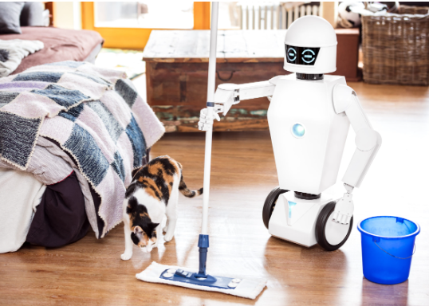
PRE-LISTENING
1
Work in pairs. Discuss the following questions.
Questions: 1. Would you like to have a robot to help you in your daily life? 2. What would you like it to do for you?

Slide 10


PRE-LISTENING
command (n)
/kəˈmɑːnd/
an order given to a person or an animal

Slide 11
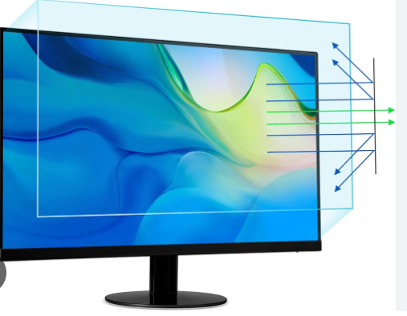
PRE-LISTENING
monitor (n)
/ˈmɒnɪtə(r)/
a screen that shows information from a computer; a television screen used to show particular kinds of information

Slide 12
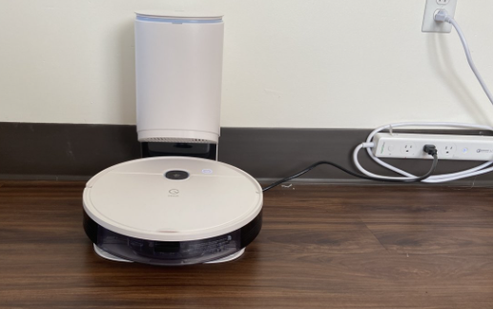
PRE-LISTENING
station (n)
/ˈsteɪʃn/
a place where somebody/something has to wait and watch or be ready to do work if needed

Slide 13

PRE-LISTENING
function (n)
/ˈfʌŋkʃn/
a special activity or purpose of a person or thing

Slide 14
PRE-LISTENING
Form | Pronunciation | Meaning | Vietnamese equivalent
1. command (n) | /kəˈmɑːnd/ | an order given to a person or an animal | mệnh lệnh
2. monitor (n) | /ˈmɒnɪtə(r)/ | a screen that shows information from a computer; a television screen used to show particular kinds of information | màn hình điều khiển
3. station (n) | /ˈsteɪʃn/ | a place where somebody/something has to wait and watch or be ready to do work if needed | nơi chờ
4. function (n) | /ˈfʌŋkʃn/ | a special activity or purpose of a person or thing | chức năng

Slide 15
WHILE-LISTENING
2
Listen to the first part of a conversation between Nam and an AI expert. Decide whether the following statements are true (T) or false (F).
 | True | False
1. They are talking about an educational robot.
2. Ally is the most advanced robot using AI at the New Tech Centre
3. Ally can see, hear, speak, and even teach maths and science
4. This robot runs on batteries.
x
x
x
x

Slide 16
WHILE-LISTENING
3
Listen to the second part of the conversation and complete each gap in the diagram with no more than TWO words.
HOW TO OPERATE ALLY
Download the Ally connect app or use (1) ____________ to control it.
voice commands
Log in the app using the (2) _____________ at the back of Ally's head.
serial numbers
Press the Start button and choose a function.
To ask questions, just say (3) ‛____________’ and ask your questions.
Hey Ally
Open the (4) ______________ and choose the Standby mode.
monitor screen

Slide 17
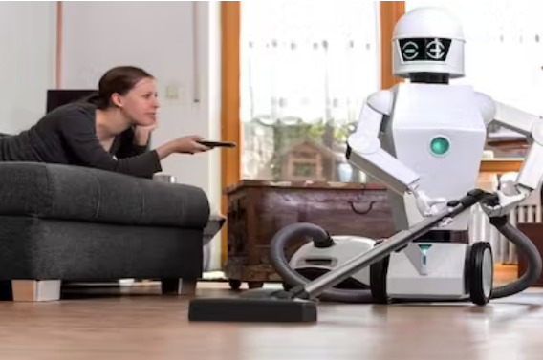
POST-LISTENING
3
Work in pairs. Discuss the question.
Do you want to have the same type of robot? Why/Why not?

Slide 18
CONSOLIDATION
1
Wrap-up
What have you learnt today?
An overview about a home robot;
Listening skills for general ideas and for specific information

Slide 19
CONSOLIDATION
2
Homework
Do exercises in the workbook.
Prepare for Lesson 6 - Writing.

Slide 20
Website: hoclieu.vn
Fanpage: facebook.com/www.tienganhglobalsuccess.vn

