Slide 1
Unit 6: Life on other planets
Lesson 2.3 – Pronun. & Speaking
Pages 60 & 61

Slide 2
Lesson Outline
Warm-up
Pronunciation
Speaking
Consolidation
Wrap-up

Slide 3
By the end of this lesson, students will be able to…
- practice sound changes.
- talk about possible UFO and alien sightings in the past, using Past Continuous and Past Simple.
- practice functional English - Showing interest.

Slide 4
Lesson 1
WARM UP

Slide 5
Odd One Out
Choose the word whose underlined part is pronounced differently form that of the others.
A. space B. aid C. air D. waste
/speɪs/ /eɪd/ /er/ /weist/
2. A. school B. chip C. chat D. inch
/skuːl/ /tʃɪp/ /tʃæt/ /ɪntʃ/
3. A. hover B. open C. hope D. smoke
/ˈhʌvər/ /ˈoʊpən/ /hoʊp/ /smoʊk/

Slide 6
Odd One Out
Choose the words whose main stress is placed differently from the others.
A. terrified B. similar C. circular D. amazing
/ˈterəfaɪd/ /ˈsɪmələr/ /ˈsɜːkjələr/ /əˈmeɪzɪŋ/
2. A. gravity B. oxygen C. battery D. tsunami
/ˈɡrævət̬i/ /ˈɑːksɪdʒən/ /ˈbæt̬ɚi/ /tsuːˈnɑːmi/
3. A. protect B. appear C. reuse D. visit
/prəˈtekt/ /əˈpɪr/ /riːˈjuːz/ /ˈvɪzɪt/

Slide 7
Watch the video and answer the questions.
A Missing Alien on Earth
What can you see in the video?
What happened to the little alien?
What did he look like?
Why did he get lost?
What was he doing when her mother found him?

Slide 8
Presentation

Slide 9
/ in /

running
moving

fishing

standing


Slide 13
Practice

Slide 14
Jim: You won't believe it! I just saw something crazy! Danny: Calm down. What happened? Jim: I (play) soccer earlier when suddenly I (see) a strange light in the sky. I think it (be) a UFO! It (be) big and triangular. Danny: That's strange. What (be) it doing? Jim: It (move) very quickly. Danny: What happened next? Jim: I (run) home. Danny: That sounds scary! How did you feel? Jim: I was terrified! Danny: Do you believe that it (be) from another planet? Jim: Yes, I do!

Slide 15
 | Conversation 1 | Conversation 2
Jim: You won't believe it! I just saw something crazy! Danny: Calm down. What happened? Jim: I (play) soccer earlier when suddenly I (see) a strange light in the sky. I think it (be) a UFO! It (be) big and triangular. Danny: That's strange. What (be) it doing? Jim: It (move) very quickly. Danny: What happened next? Jim: I (run) home. Danny: That sounds scary! How did you feel? Jim: I was terrified! Danny: Do you believe that it (be) from another planet? Jim: Yes, I do! | I (read) a book a large object (appear) – sky it (be) a flying saucer It (be) big and disk-shaped (be) it It (make) a strange noise It (disappear) immediately I was excited it (be) Yes, I think so | We (have) a picnic I (see) two strange people – forest they (be) aliens They (have) huge eyes (be) they They (run) towards us We (call) the police I was very afraid they (be) Maybe

Slide 16
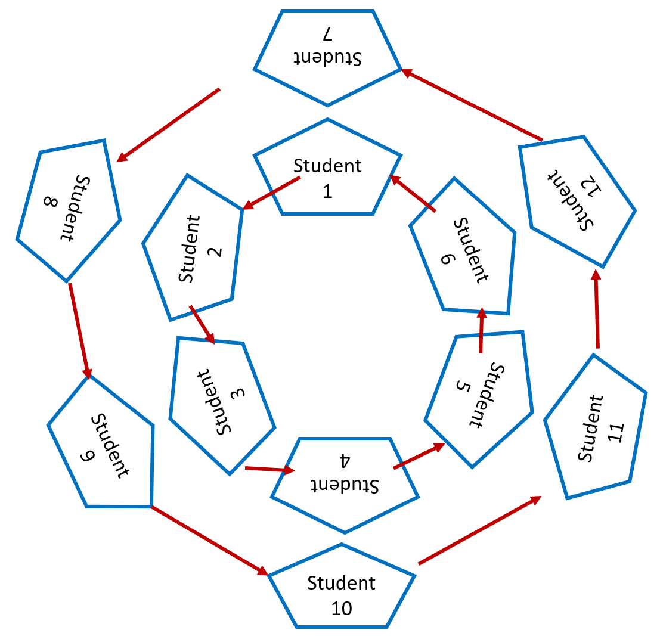
SPEED CONVERSATION
- Bring your books, stand up and make two circles to have face-to-face conversations.
- Talk to another S standing across from you and talk for two to three minutes as much as you can about either conversation 1 or 2.
- One on one side moves one space to the left hand when the time is up. Then, continue your talk with your new partners.
- Repeat as many as necessary or until you find your original partner.

Slide 17
Production

Slide 18
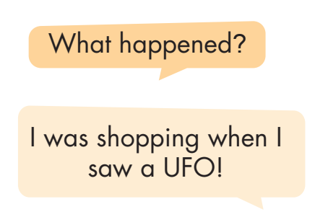
vs.

Slide 19
Work in pairs
Do you think there is life on other planets? Why (not)?

Slide 20
CONSOLIDATION

Slide 21
In pairs: Do you think there is life on other planets? Why (not)?

Slide 22
WRAP-UP

Slide 23
Today’s lesson
Focusing on the sound /-ɪn/.
Talking about sightings of UFOs and alien using the past tenses.

Slide 24
Lesson 3
Homework
- Make two statements and practice reading them, paying attention to the /-ɪn/ sound.
- Prepare: Lesson 3.1 – Reading & Writing (pages 62 & 63).
- Review the vocabulary and grammar notes in Tiếng Anh 8
i-Learn Smart World Notebook.
- Play the consolidation games in Tiếng Anh 8 i-Learn Smart World DHA App on www.eduhome.com.vn

Slide 25
Lesson 3
Stay positive and have a nice day!

