Slide 1
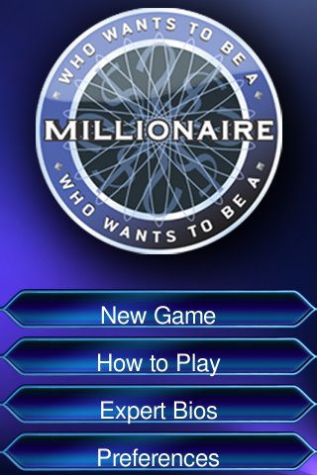

Slide 2
50/50
A
black
C
yellow
blue
red
blue
B
D
1.what is the sky color ?

Slide 3
50/50
Japan
A
Rome
C
Japan
London
India
B
D
2.It’s capital is Tokyo ?

Slide 4
50/50
A
London
Phôm Phêng
London
C
Rome
Viêng Chăn
B
D
3. This is the capital of England ?

Slide 5
50/50
A
Rome
London
Rome
C
Japan
Mexico
B
D
4. What is the capital of Italy?

Slide 6
50/50
A
C
Backetball
Football
Football
Handball
Table-tennis
B
D
5. What sport is Brazil famous for ?

Slide 7
50/50
A
England
C
America
India
Russia
India
B
D
6. This country has the world second largest population after China ?

Slide 8
50/50
A
Japan
C
America
Iran
Vietnamese
Iran
B
D
7. This is the oldest country in the world ?

Slide 9
50/50
China
A
Mexico
C
China
Thailand
India
B
D
8. This is the country where the Great wall is ?

Slide 10
50/50
Australia
A
Mexico
C
Australia
Italia
America
B
D
9. This country is home to the kangaroos and koalas ?

Slide 11
50/50
A
Mexico
C
Nepan
Spain
Sweden
Spain
D
B
10. It is a Spanish speaking country in Westerm Europe ?

Slide 12
50/50
A
Myanmar
C
Austria
Germany
Italia
Germany
B
D
11. This country hosted the 2006 World Cup ?

Slide 13
50/50
A
Green
Red
Green
C
Blue
Yellow
B
D
12. What Is the leaves color ?

Slide 14
50/50
Brazil
A
India
C
Brazil
Thailand
Laos
B
D
13. The capital is Brasilia ?

Slide 15
50/50
A
Black
C
Blue
Yellow
Red
yellow
D
B
14. What is the Sun color ?

Slide 16
50/50
Newzealand
A
Gemany
C
Newzealand
Malaixia
Nepan
B
D
15. Like Austalia , this country is England speaking with a Maori and European population ?

Slide 17
SƯU TẦM: ĐOÀN VĂN DOANH, NAM TRỰC, NAM ĐỊNH
LINK NHÓM DÀNH CHO GV BỘ MÔN VẬT LÝ TRAO ĐỔI TÀI LIỆU VÀ CHUYÊN MÔN CT 2018
https://www.facebook.com/groups/299257004355186

