Slide 1

Unit 5: Food and Drinks
Lesson 2.1: Vocabulary & Reading
Page 39

Slide 2



LESSON OUTLINE
Consolidation

Slide 3
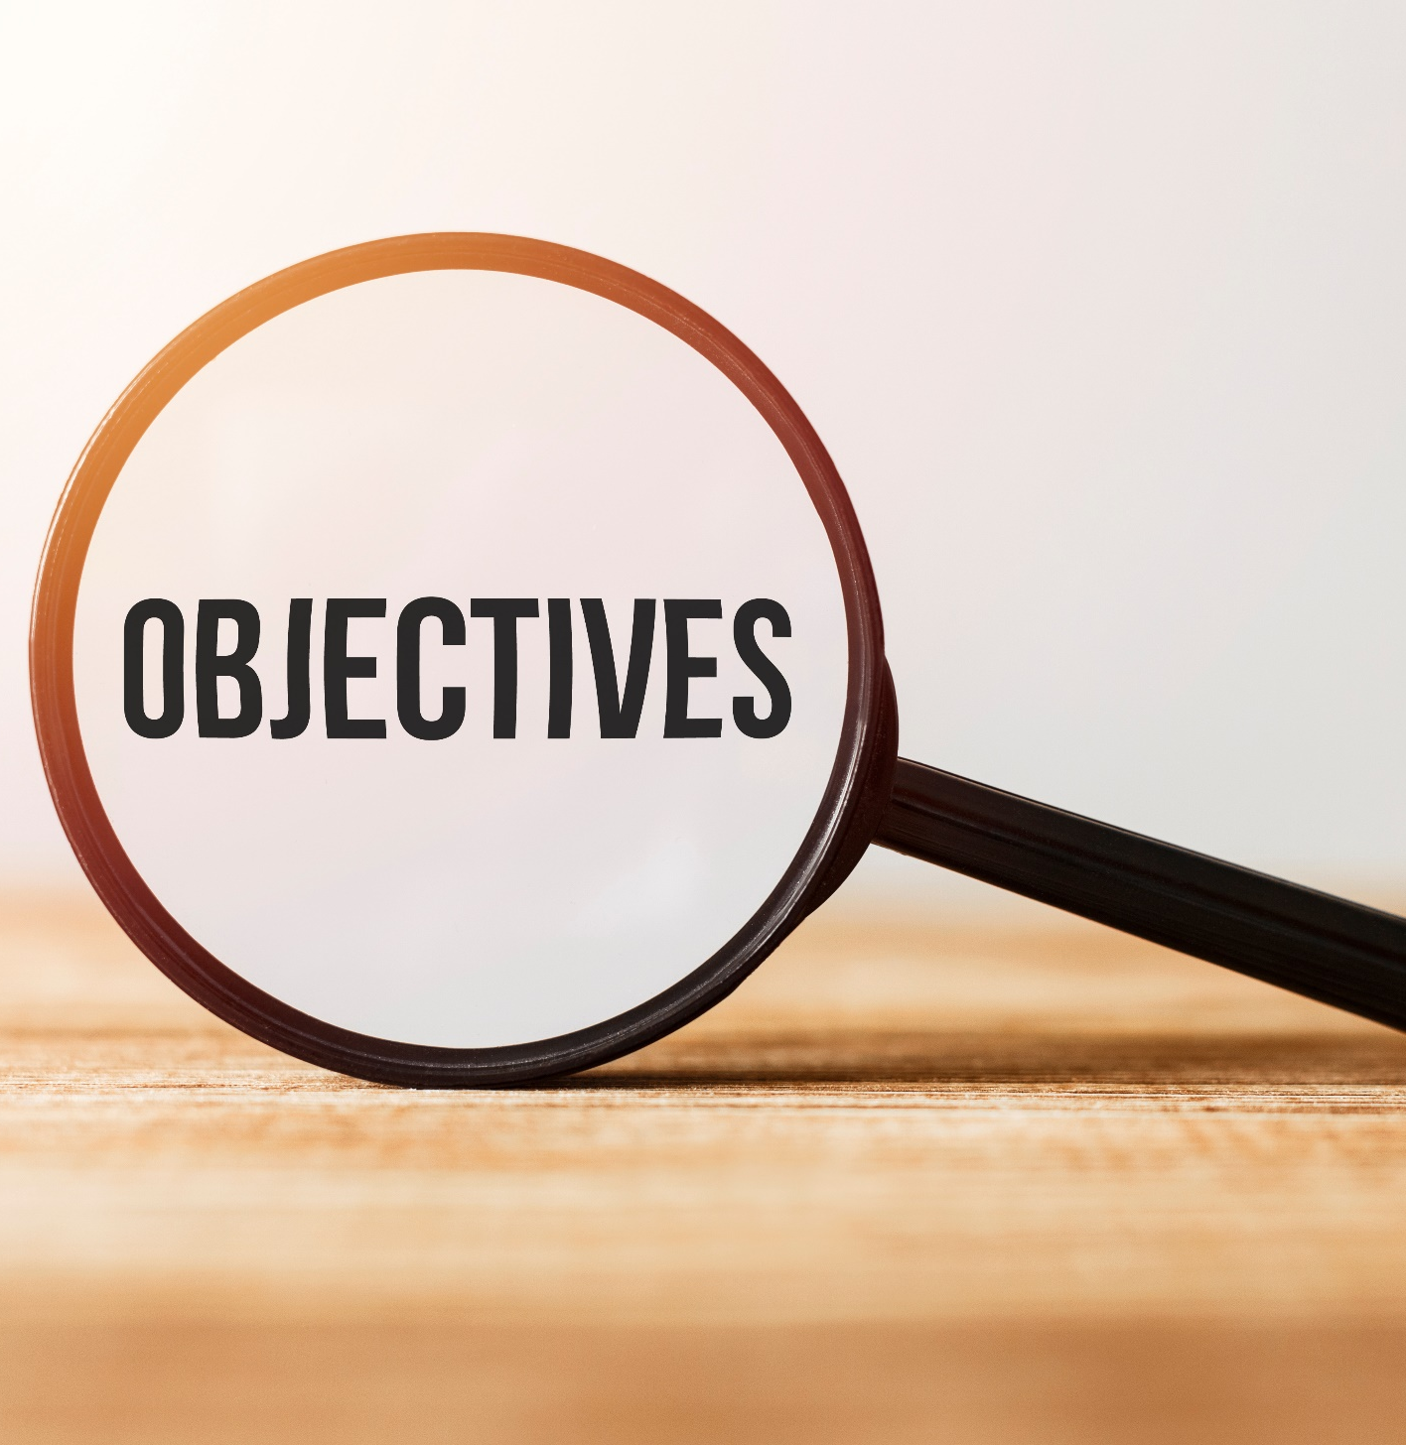
By the end of this lesson, students will be able to…
talk about containers and quantities of food and drinks.
practice reading for main ideas and specific information.

Slide 4
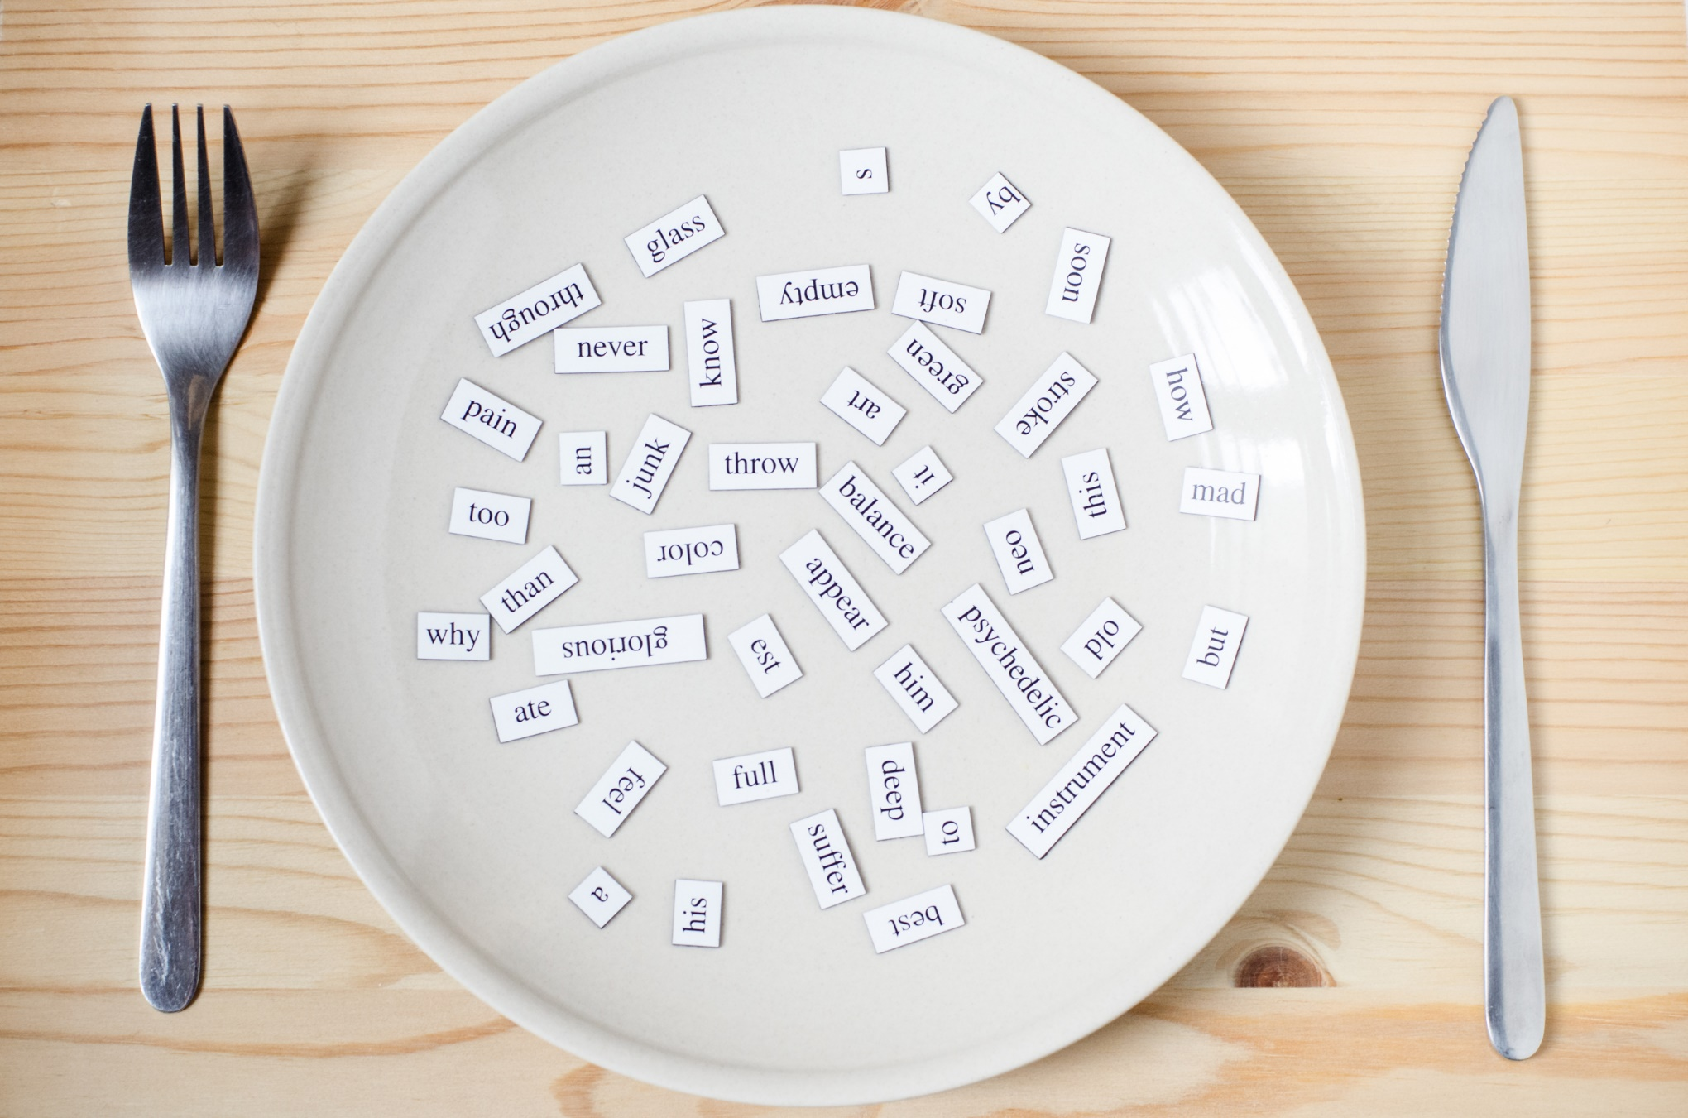
New words
Bag
Bottle
Box
Bunch
Can
Carton
Container
Groceries
Stick

Slide 5
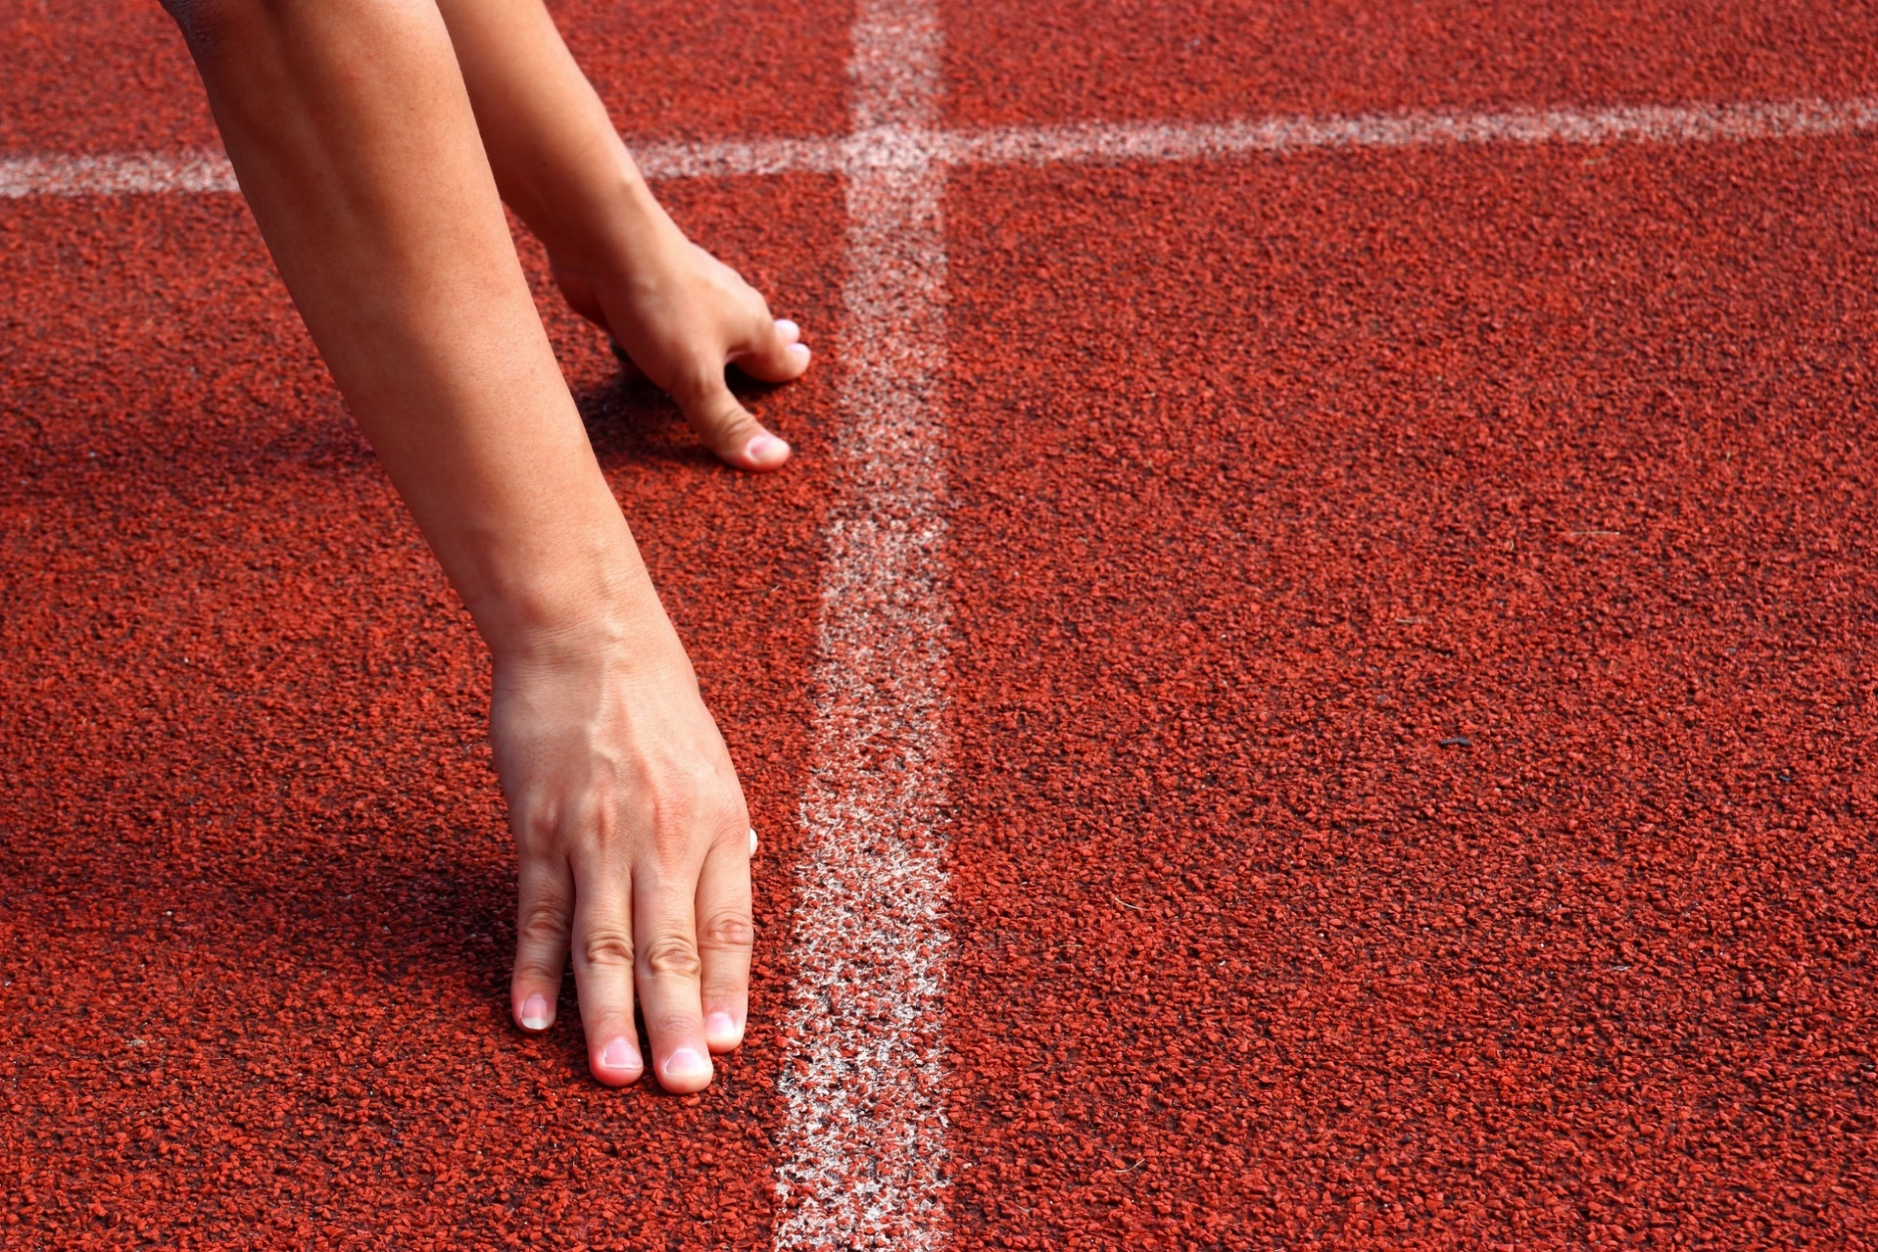
WARM-UP

Slide 6

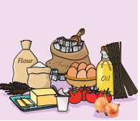
Game Time
We have some ingredients. Try to remember what are shown in the picture. You have 1 minute.

Slide 7
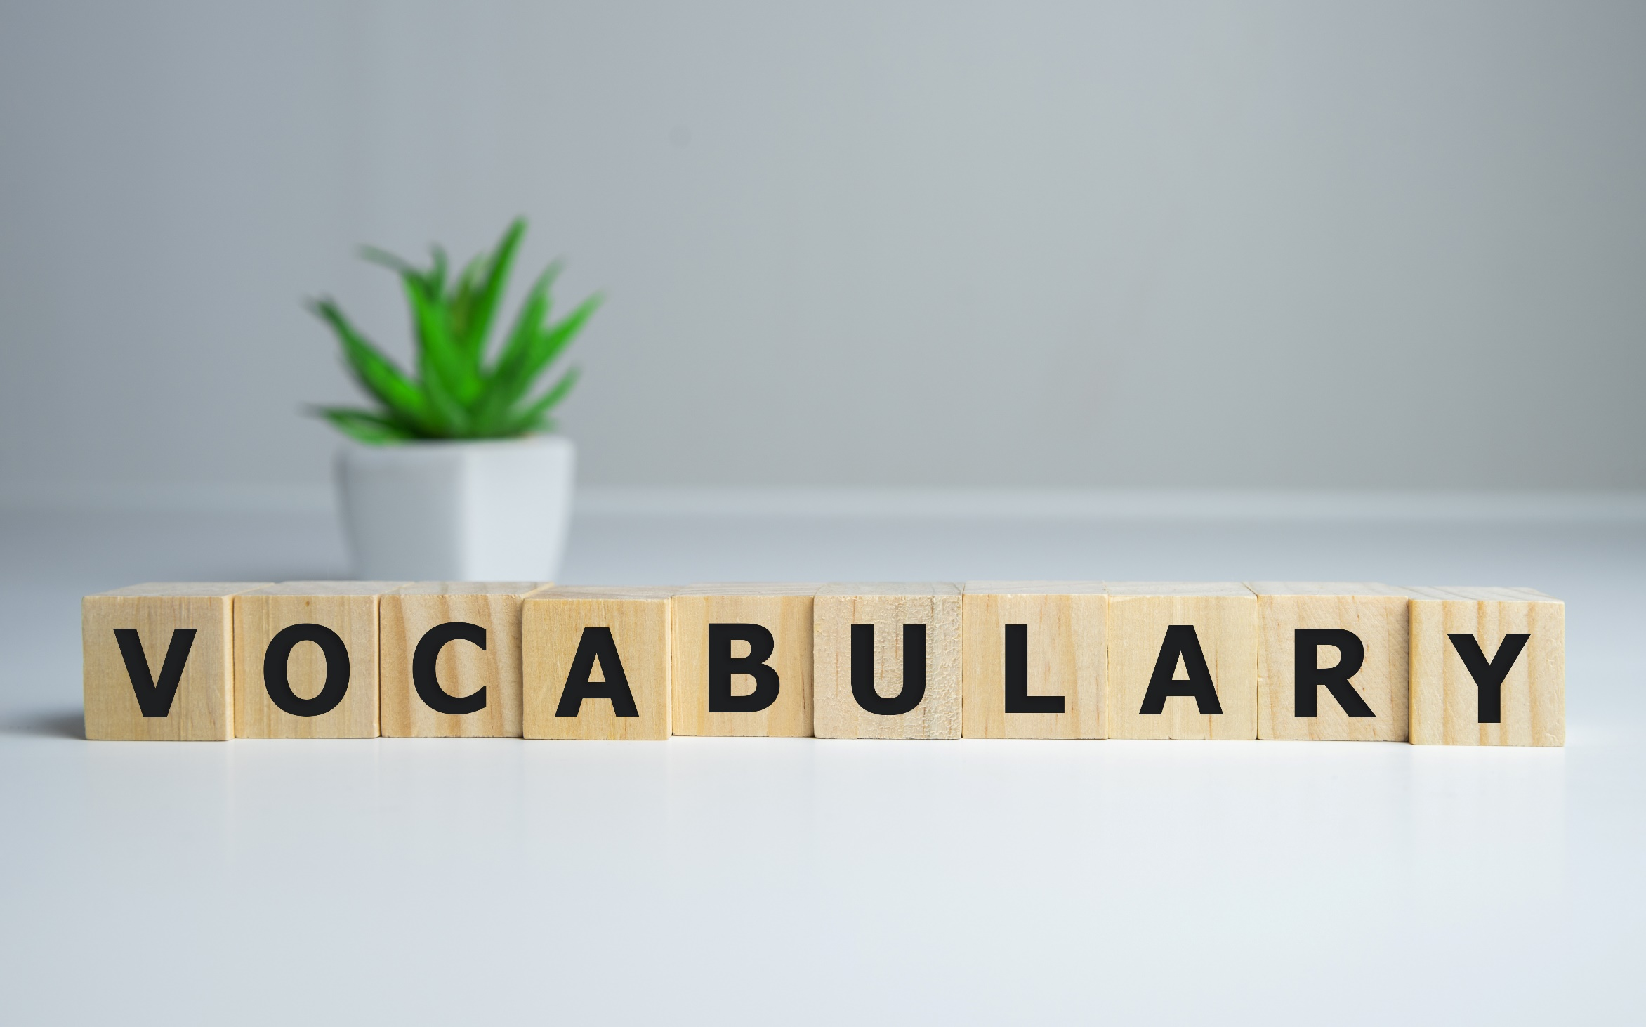


Slide 8
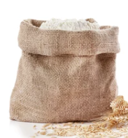


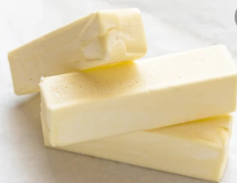
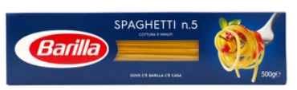
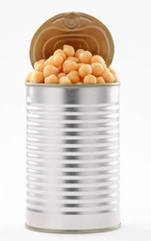
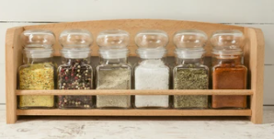
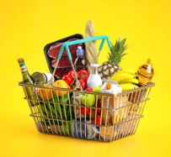
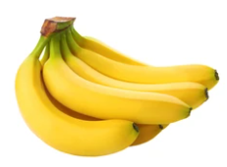
Match the words with the pictures:
can, box, carton, stick, groceries, bottle, bag, containers

Slide 9
Answer
BOTTLE
CARTON
GROCERIES
BAG
CAN

Slide 10
BOX
STICK
CONTAINERS
BUNCH

Slide 11
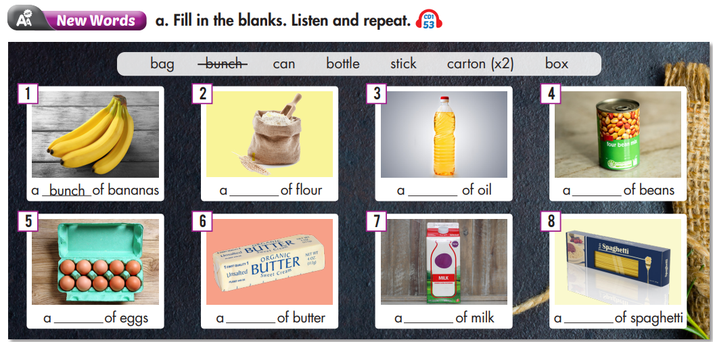

Work in pairs. Try to fill in the blanks with the words given.

Slide 12
Listen and repeat. Click each phrase to hear the sound.
A bag of flour (n) /bæɡ/ túi bột mì
A bottle of oil (n) /ˈbɑːtl/ chai, lọ dầu
A box of spaghetti (n) /bɑːks/ hộp, thùng mì ống
A bunch of bananas (n) /bʌntʃ/ bó, buồng, chùm chuối
A can of beans (n) /kæn/ lon, lọ đậu
A carton of eggs (n) /ˈkɑːrtn/ hộp (bằng bìa cứng) trứng
A stick of butter (n) /stɪk/ thanh, thỏi bơ
A carton of milk (n) /ˈkɑːrtn/ hộp (bằng bìa cứng) sữa

Slide 13
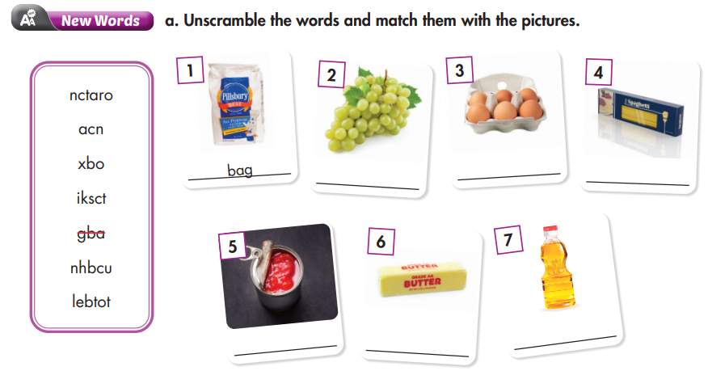
Teamwork: Take turns to come to the board, unscramble the words with correct pictures.
Extra Practice
WB p. 28

Slide 14
carton
box
bunch
stick
bottle
can

Slide 15
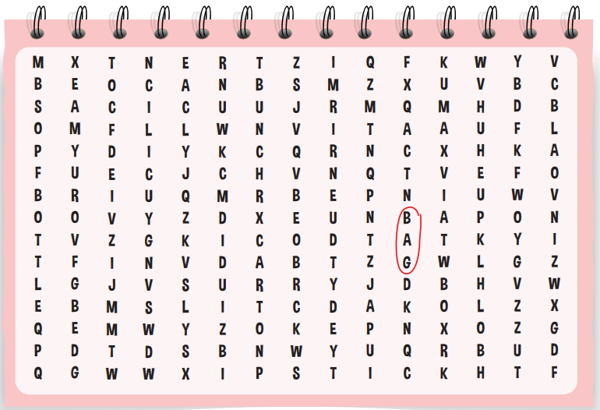
Try the word search with the words given.
Extra Practice
WB p. 28
BOX
BAG
BUNCH
STICK
CAN
BOTTLE
CARTON

Slide 16
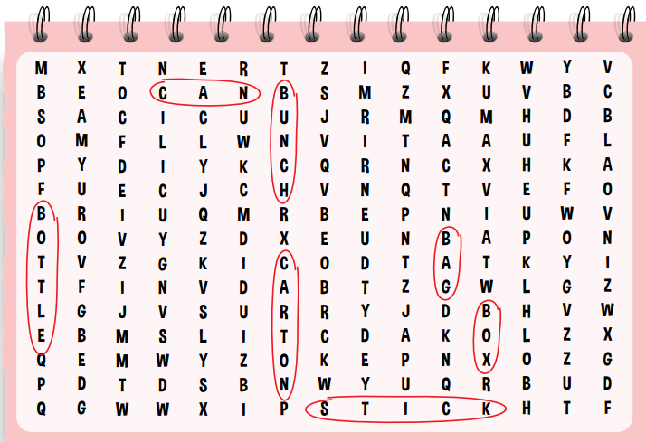
Answer

Slide 17

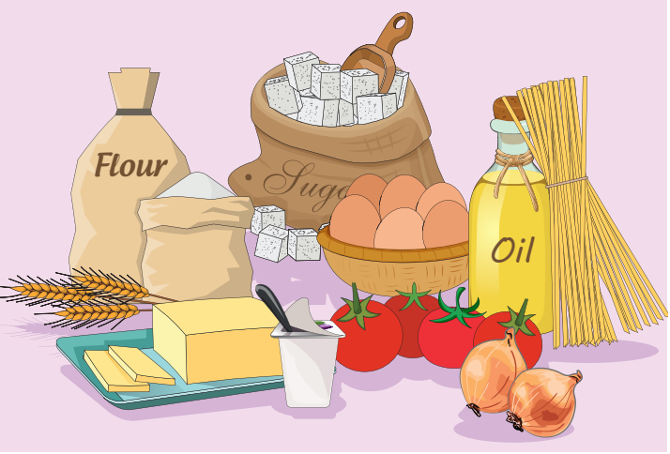

Slide 18
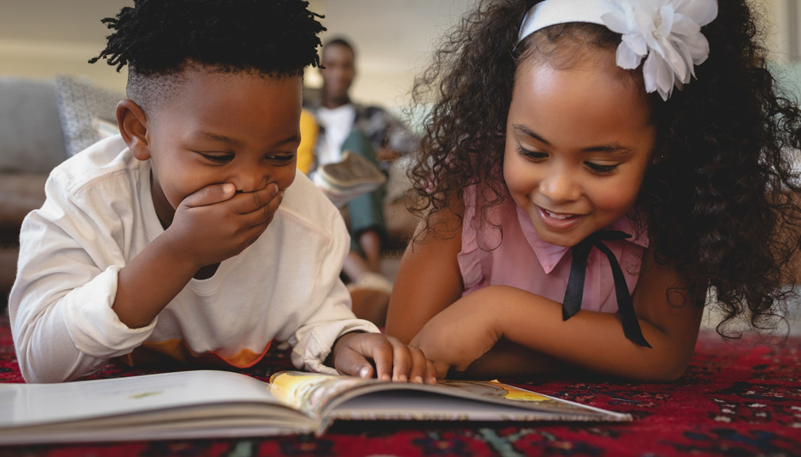
It’s reading time….

Slide 19
Pre - reading
Look at these words and phrases and try to guess what they are about.
Pete, his mom
went shopping
groceries
carton of eggs, onions
helped mom to put eggs in the fridge
a bag of chips, a bunch of bananas
put chips into the top cupboard
helped mom cook dinner.
Who are involved?
Pete & his mom.
What did his mom do?
She went shopping to buy groceries.
What did Pete do?
He helped his mom to put things into the fridge and cook dinner.

Slide 20
Scan the text and underline Pete and Pete’s mom activities.
Yesterday morning, Pete’s mom went shopping to get groceries. She got a carton of eggs, a can of tomatoes, and an onion for dinner that night. When she got home, she asked her son, Pete, to help her put the groceries away. He put the eggs in the fridge and the onion in the top cupboard. He put the tomatoes in the bottom cupboard next to the sink. Later, she went to the store to get things for lunch. She got a bunch of bananas, a bag of chips, and two sandwiches. The bananas went into the bottom cupboard, the chips into the top cupboard, and the sandwiches into the fridge. That night, Pete helped his mom cook a delicious dinner.

Slide 21
While - reading
Skim the text carefully to find out what his mom wants him to do.
a. Read the paragraph about Pete. What did his mom want him to do?
1. buy the groceries
2. put the groceries away
3. make lunch and dinner

Slide 22
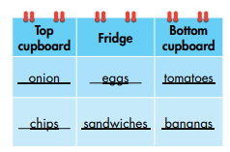
While - reading
Scan the text to get specific information.
Yesterday morning, Pete’s mom went shopping to get groceries. She got a carton of eggs, a can of tomatoes, and an onion for dinner that night. When she got home, she asked her son, Pete, to help her put the groceries away. He put the eggs in the fridge and the onion in the top cupboard. He put the tomatoes in the bottom cupboard next to the sink. Later, she went to the store to get things for lunch. She got a bunch of bananas, a bag of chips, and two sandwiches. The bananas went into the bottom cupboard, the chips into the top cupboard, and the sandwiches into the fridge. That night, Pete helped his mom cook a delicious dinner.

Slide 23

Post- reading
A CAN OF TOMATOES
A BAG OF CHIPS

Slide 24
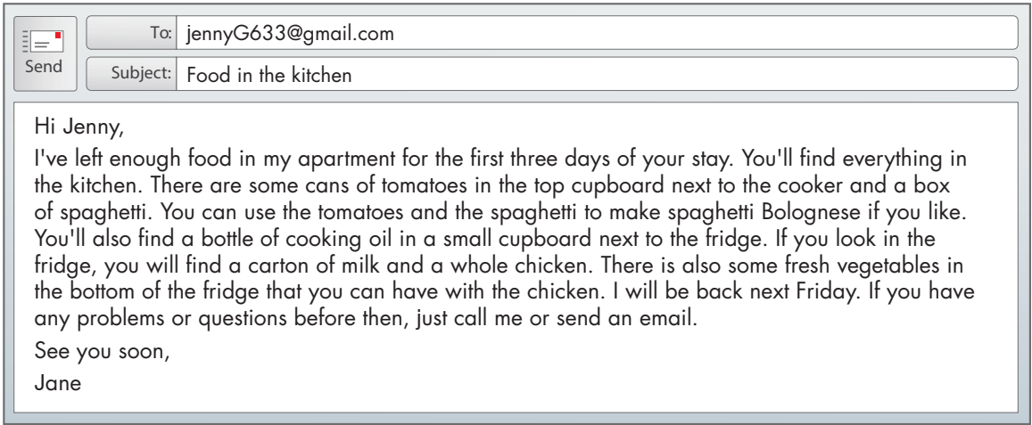
Extra Practice
WB p. 29
Reading
a. Read Jane's email to her friend and circle the correct sentence.
1. Jane will do the cooking. 2. Jenny will do the cooking
a. Read Jane's email to her friend and circle the correct sentence.
1. Jane will do the cooking. 2. Jenny will do the cooking

Slide 25
b. Now, read and answer the questions. Underline key words and phrases.
1. How many days d
How many days does Jenny have food for?
Where did Jane put the spaghetti?
How many cartons of milk does Jane have in her fridge?
When is Jane coming back?

Slide 26
Answer
How many days does Jenny have food for?
She has food for three days.
I've left enough food in my apartment for the first three days of your stay.

Slide 27
2. Where did Jane put the spaghetti?
She put the spaghetti in the top cupboard.
There are some cans of tomatoes in the top cupboard next to the cooker and a box of spaghetti.

Slide 28
3. How many cartons of milk does Jane have in her fridge?
She has a carton of milk in her fridge.
If you look in the fridge, you will find a carton of milk and a whole chicken.

Slide 29
4. When is Jane coming back?
She is coming back next Friday.
I will be back next Friday.

Slide 30

CONSOLIDATION

Slide 31
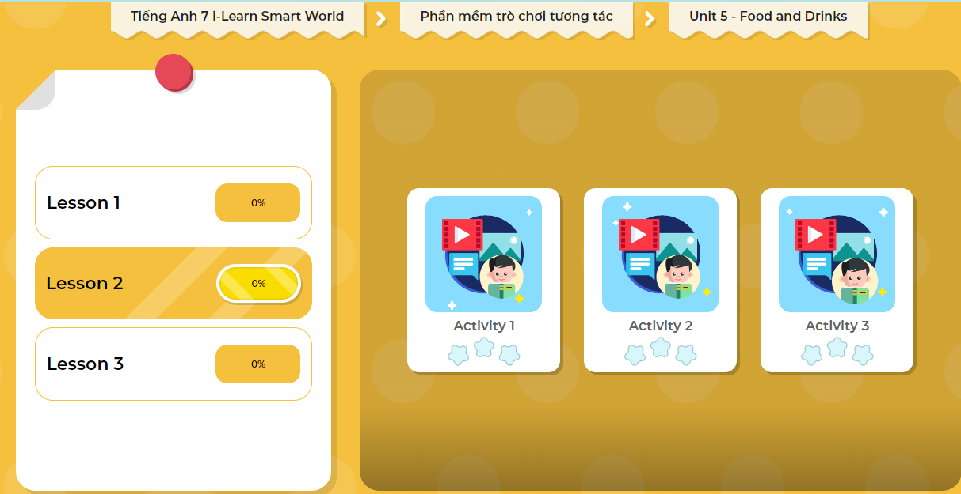
LET’S PLAY!
Click here to play the games

Slide 32
Pairwork. Write 5 sentences about what you have in your fridge. Use the vocabulary of containers you learned today. Double check your work with your friends. (7 minutes)

Slide 33
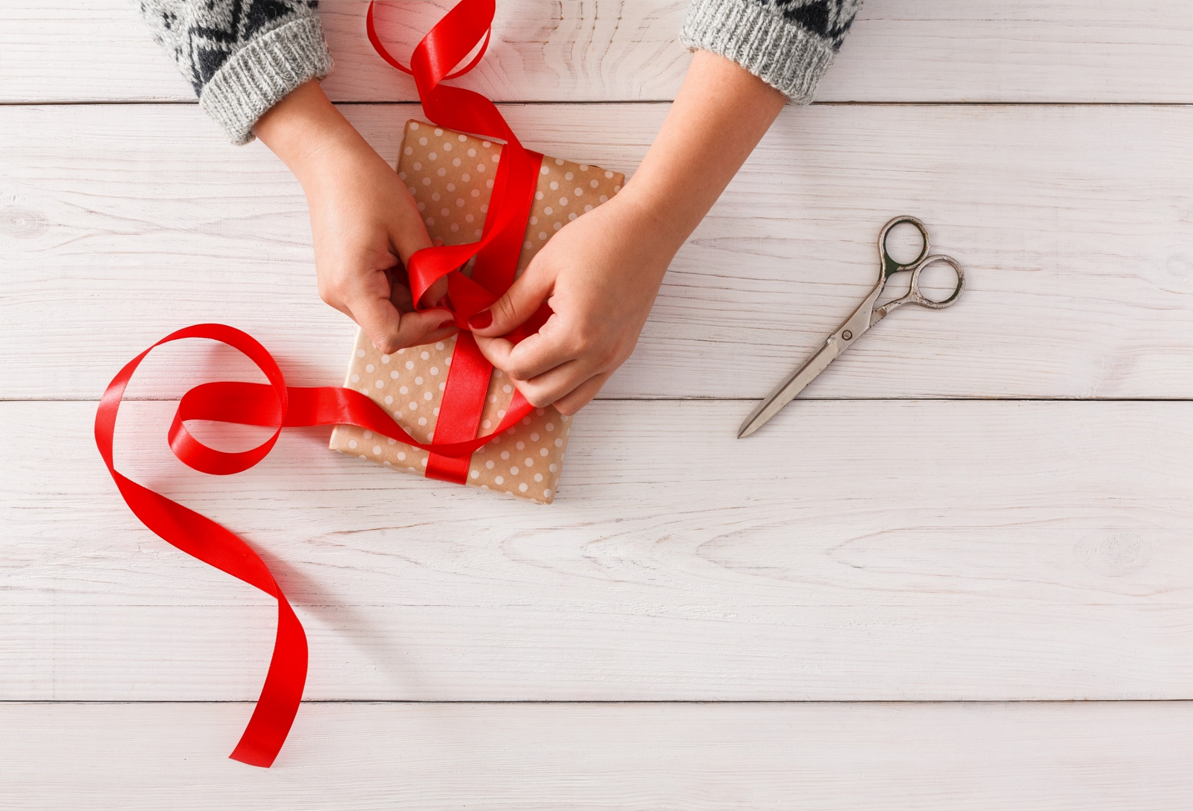
WRAP-UP

Slide 34
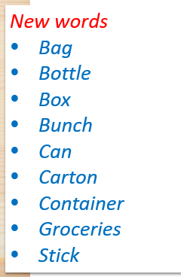
Today’s lesson

Slide 35
Today’s lesson
Reading:
Skimming and scanning for general and specific information.
Writing:
- Write about what you have in the kitchen.

Slide 36
Homework
Practice the vocabulary and make sentences using them.
Do the Reading exercise on page 29 WB.
Do the exercises in Tiếng Anh 7 i-Learn Smart World Notebook on page 30.
Prepare the next lesson (page 40 SB).
Play the consolidation games in Tiếng Anh 7 i-Learn Smart World DHA App on www.eduhome.com.vn

Slide 37
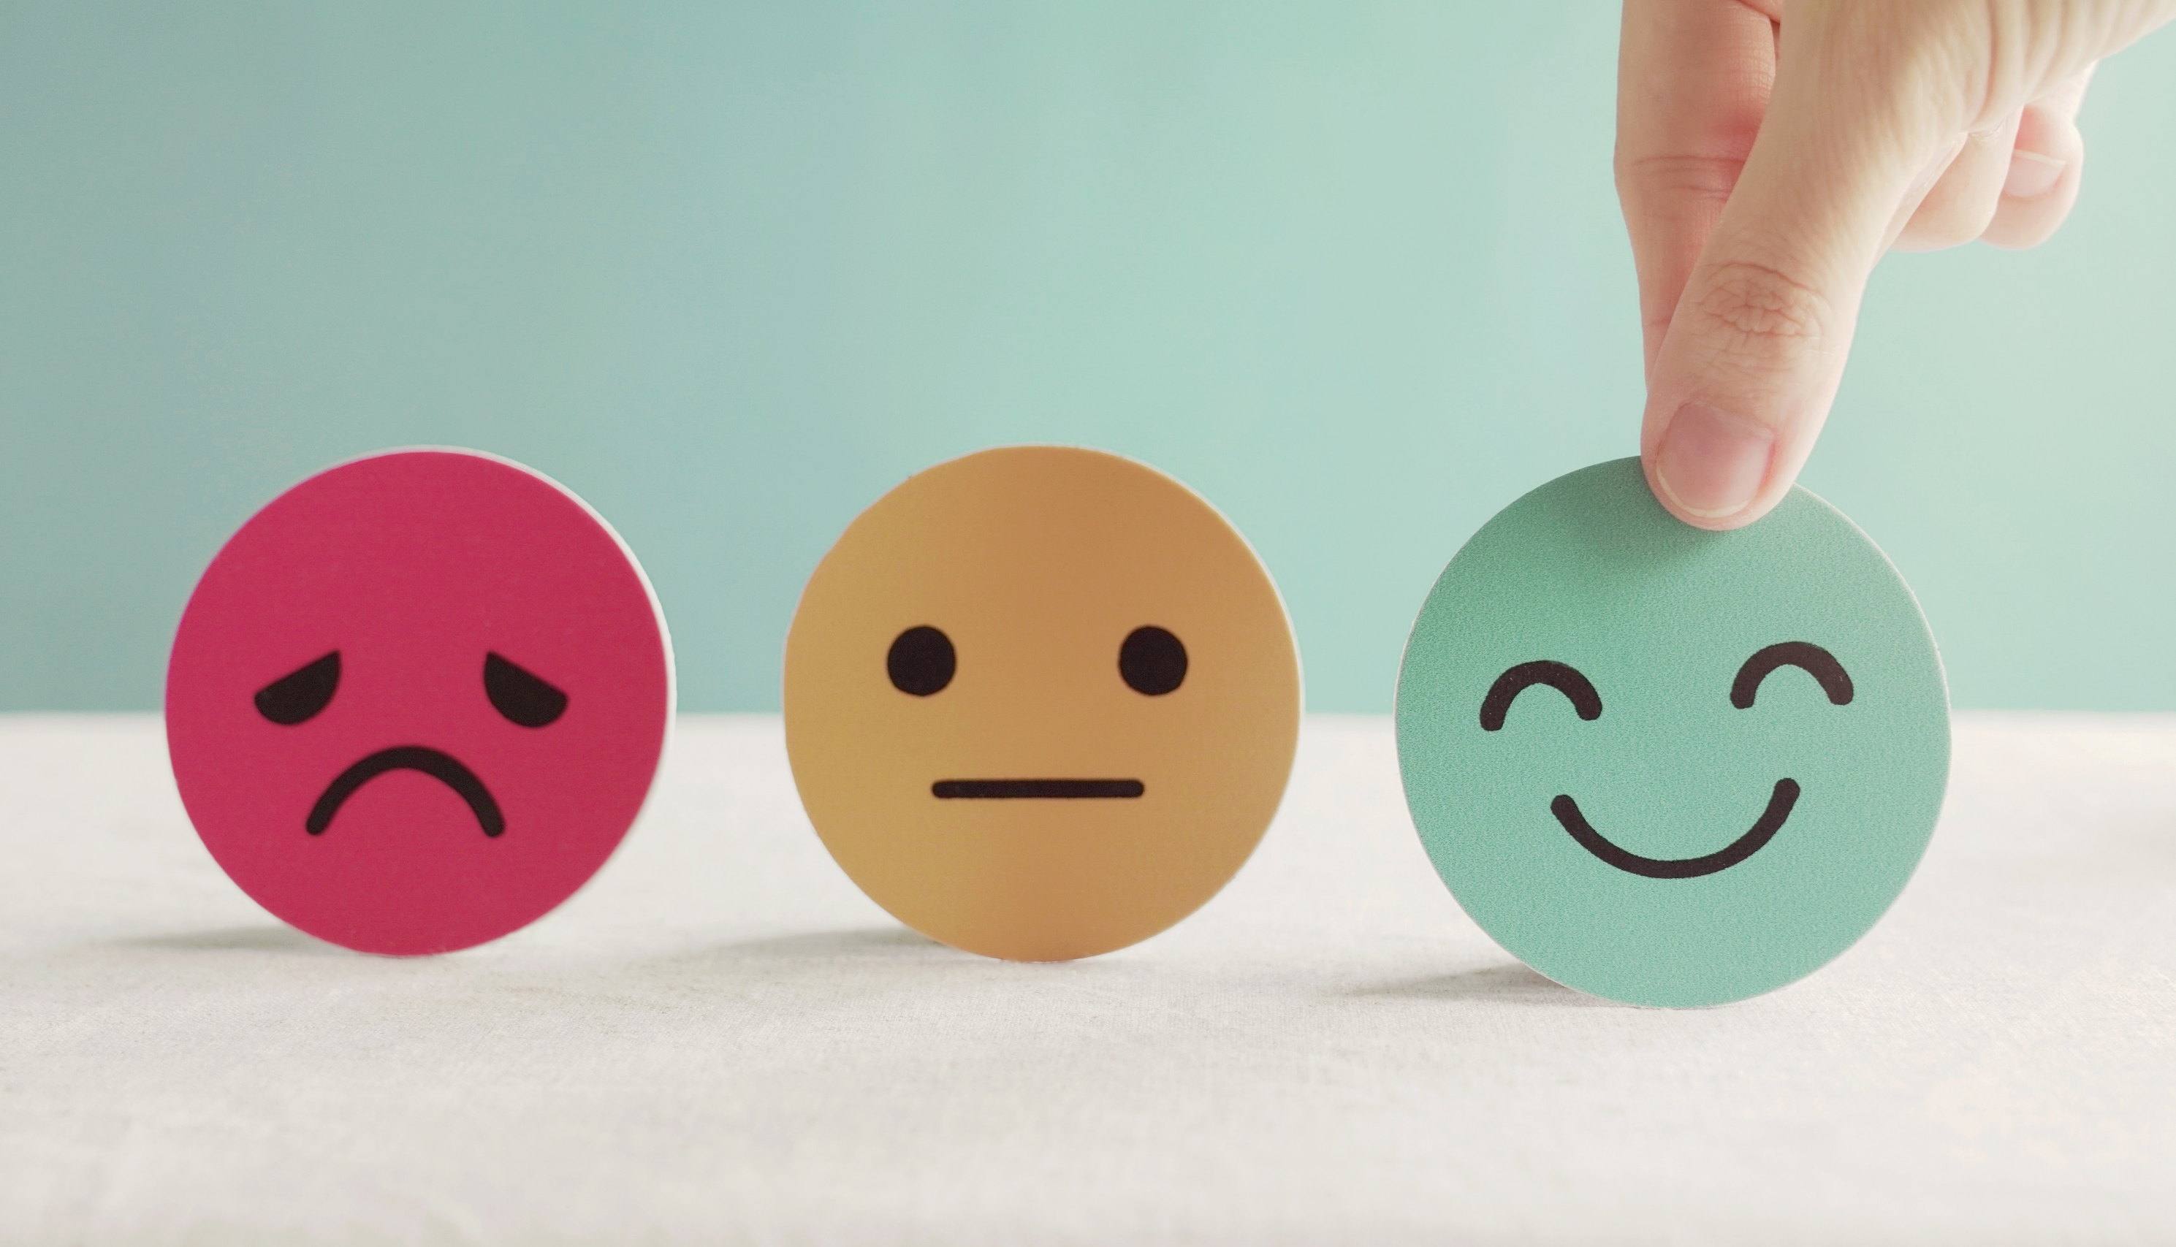
Lesson 3
Stay positive and have a nice day!

