Slide 2
Unit 6
Artificial Intelligence
LESSON 4
SPEAKING
Applications of AI in education

Slide 3
LESSON 4
SPEAKING
WARM-UP
Watch a video
- Task 1: Match each AI application with its purpose in learning.
- Vocabulary
- Task 2: Work in groups. Discuss the questions.
CONTROLLED PRACTICE
LESS-CONTROLLED PRACTICE
- Task 3: Prepare a summary of your discussion and report to the whole class.
CONSOLIDATION
- Wrap-up
- Homework

Slide 4
WARM-UP
Watch a video
- Teacher divides the class into 2 groups.
- Before playing the video, teacher asks Ss to watch carefully and try to remember as many details as possible. Ss can take notes if they want.
- Teacher shows questions one by one, Ss raise their hands and say BINGO to grab the chance to answer.
- If the answer is correct, they get one point for their team.
- The team with higher score will be the winner.

Slide 5

WARM-UP
WARM-UP

Slide 6
WARM-UP
WARM-UP
Question 1
What is the robot called?
➔ DTR (Dance Teaching by a Robot)

Slide 7
WARM-UP
WARM-UP
Question 2
Where was it invented?
➔ Japan

Slide 8
WARM-UP
WARM-UP
Question 3
For beginners, what does the robot do?
It guides the dance with low compliance,
leading the motion in the correct direction.

Slide 9
WARM-UP
WARM-UP
Question 4
Can it evaluate the partner’s performance?
➔ Yes. And it can modify its guidance based on it.

Slide 10
WARM-UP
WARM-UP
Question 5
What kind of interaction that the robot combines when it supports the skill learning process?
➔ Cognitive and physical interaction

Slide 11
CONTROLLED PRACTICE
Work in pairs. Match each AI application (1–5) with its purpose in learning (a–f). There can be multiple correct answers
1
1. speech recognition
a. support students with disabilities
2. educational robots
1. a, c
2. a, d, f
3. a, f
4. b, f
5. a, e, f
b. develop problem-solving skills
3. virtual reality
c. check pronunciation
4. AI-powered games
d. provide personalised support
5. chatbots
e. provide interactive forms of learning

Slide 12


VOCABULARY
ready-made (adj)
/ˌredi ˈmeɪd/
prepared in advance so that you can eat or use it immediately

Slide 13

VOCABULARY
feedback (n)
/ˈfiːdbæk/
advice, criticism or information about how good or useful something or somebody’s work is

Slide 14

VOCABULARY
virtual reality (n)
/ˌvɜːtʃuəl riˈæləti/
images and sounds created by a computer that seem almost real to the user, who can interact with them by using sensors

Slide 15
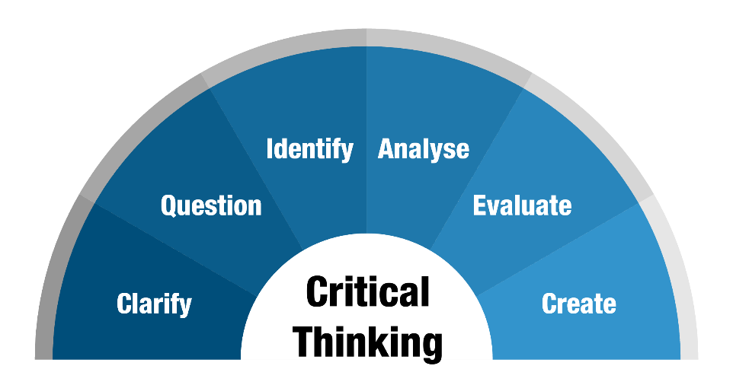
VOCABULARY
critical thinking (n)
/ˌkrɪtɪkl ˈθɪŋkɪŋ/
the process of analysing information in order to make a logical decision about the extent to which you believe something to be true or false

Slide 16
VOCABULARY
Form | Pronunciation | Meaning | Vietnamese equivalent
1. ready-made (adj) | /ˌredi ˈmeɪd/ | prepared in advance so that you can eat or use it immediately | làm sẵn
2. feedback (n) | /ˈfiːdbæk/ | advice, criticism or information about how good or useful something or somebody’s work is | nhận xét
3. virtual reality (n) | /ˌvɜːtʃuəl riˈæləti/ | images and sounds created by a computer that seem almost real to the user, who can interact with them by using sensors | thực tế ảo
4. critical thinking (n) | /ˌkrɪtɪkl ˈθɪŋkɪŋ/ | the process of analysing information in order to make a logical decision about the extent to which you believe something to be true or false | tư duy phản biện

Slide 17


CONTROLLED PRACTICE
2
Work in groups. Discuss the questions.
Questions
1. How can each application in 1 be used in education?
2. What are the advantages and disadvantages of each application?

Slide 18
LESS-CONTROLLED PRACTICE
Prepare a summary of your discussion and report to the whole class.
3
Suggested answer:
My pair want to use chatbots app at our school because it can help us understand the lessons better and provide instant support throughout the course. We can use it during and after the teachers’ lectures to clarify some confusions and querries. However, this app have some disadvantages. It can make us lazy and reduce our self-study time as we have no desire to discover the topic. All the answers will be answered and explained by the app.

Slide 19
CONSOLIDATION
1
Wrap-up
What have you learnt today?
An overview about applications of AI in education;
Vocabulary to talk about applications of AI in education.

Slide 20
CONSOLIDATION
2
Homework
- Do exercises in the workbook.
- Prepare for the next lesson – Listening.

Slide 21
Website: hoclieu.vn
Fanpage: facebook.com/www.tienganhglobalsuccess.vn

