Slide 2


Unit
9
CITIES OF THE WORLD
LESSON 6: SKILLS 2
1

Slide 3
LESSON 6: SKILLS 2
LESSON 1: GETTING STARTED
Brainstorming: Task 1
WARM-UP
Listening
Task 2: Listen and tick () T (True) or F (False).
Task 3: Listen again and f ill each gap with one word / number.
LISTENING
Writing
Task 4: Work in groups. Talk about a city in your country, using the questions below as a guide.
Task 5: Write a postcard of about 50 words about your holiday in a city. Use the information in 4.
WRITING
CONSOLIDATION
Wrap-up
Homework

Slide 4
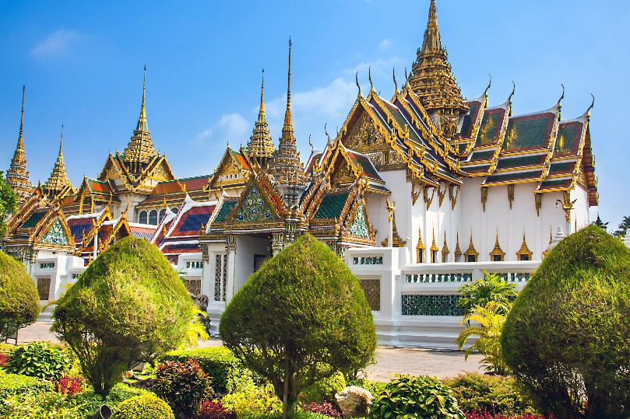
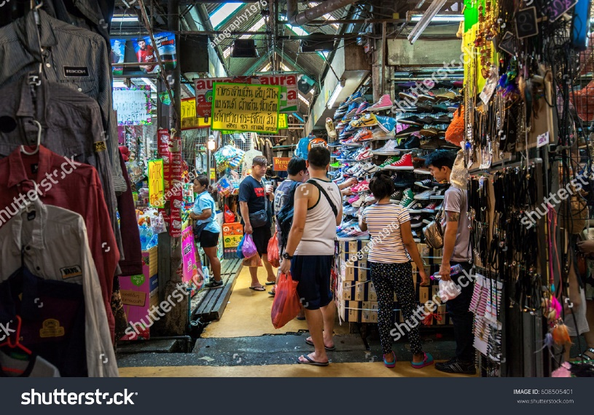
WARM-UP
Brain
-storming
What do you know about Thailand?

Slide 5
LISTENING
1
Work in groups. Discuss and answer the questions.
1.
Where is Bangkok?
2.
What is Bangkok famous for?

Slide 6

Skills 2
Listening
Thailand

Slide 7

LISTENING
2
Read the postcard and answer the questions.
 |  | T | F
1. | Bangkok is famous for palace.
2. | Things at Chatuchak market are expensive.
3. | The floating market is on the sea.
4. | You can find food stalls all around Bangkok.
✓
✓
✓
✓

Slide 8

SUGGEST
Bangkok is famous for its markets and street food.
Visit the Chatuchak, the largest weekend market in the world. There are over 15,000 stalls selling nearly everything, at cheap prices. It’s only five minutes’ walk from the station. When you visit this market, you can see part of Thai people’s life.
Another interesting type of market is the floating market on the river. Don’t forget to try street food in Bangkok. It’s easy to find food stalls all around Bangkok, serving different Thai dishes. They are really delicious.

Slide 9
SUGGEST
Bangkok is famous for its markets and street food.
Visit the Chatuchak, the largest weekend market in the world. There are over 15,000 stalls selling nearly everything, at cheap prices. It’s only five minutes’ walk from the station. When you visit this market, you can see part of Thai people’s life.
Another interesting type of market is the floating market on the river. Don’t forget to try street food in Bangkok. It’s easy to find food stalls all around Bangkok, serving different Thai dishes. They are really delicious.

Slide 10
SUGGEST
Bangkok is famous for its markets and street food.
Visit the Chatuchak, the largest weekend market in the world. There are over 15,000 stalls selling nearly everything, at cheap prices. It’s only five minutes’ walk from the station. When you visit this market, you can see part of Thai people’s life.
Another interesting type of market is the floating market on the river. Don’t forget to try street food in Bangkok. It’s easy to find food stalls all around Bangkok, serving different Thai dishes. They are really delicious.

Slide 11
SUGGEST
Bangkok is famous for its markets and street food.
Visit the Chatuchak, the largest weekend market in the world. There are over 15,000 stalls selling nearly everything, at cheap prices. It’s only five minutes’ walk from the station. When you visit this market, you can see part of Thai people’s life.
Another interesting type of market is the floating market on the river. Don’t forget to try street food in Bangkok. It’s easy to find food stalls all around Bangkok, serving different Thai dishes. They are really delicious.

Slide 12
LISTENING
3
Listen again and fill each gap with one word / number.
1.
Chatuchak market has over stalls.
15,000
2.
5
Chatuchak market is about minutes’ walk from the station.
3.
You can see part of Thai people’s at a market.
life
4.
Street food in Bangkok is .
delicious

Slide 13
AUDIO SCRIPT
Bangkok is famous for its markets and street food.
Visit the Chatuchak, the largest weekend market in the world. There are over 15,000 stalls selling nearly everything, at cheap prices. It’s only five minutes’ walk from the station. When you visit this market, you can see part of Thai people’s life.
Another interesting type of market is the floating market on the river. Don’t forget to try street food in Bangkok. It’s easy to find food stalls all around Bangkok, serving different Thai dishes. They are really delicious.

Slide 14
AUDIO SCRIPT
Bangkok is famous for its markets and street food.
Visit the Chatuchak, the largest weekend market in the world. There are over 15,000 stalls selling nearly everything, at cheap prices. It’s only five minutes’ walk from the station. When you visit this market, you can see part of Thai people’s life.
Another interesting type of market is the floating market on the river. Don’t forget to try street food in Bangkok. It’s easy to find food stalls all around Bangkok, serving different Thai dishes. They are really delicious.

Slide 15
AUDIO SCRIPT
Bangkok is famous for its markets and street food.
Visit the Chatuchak, the largest weekend market in the world. There are over 15,000 stalls selling nearly everything, at cheap prices. It’s only five minutes’ walk from the station. When you visit this market, you can see part of Thai people’s life.
Another interesting type of market is the floating market on the river. Don’t forget to try street food in Bangkok. It’s easy to find food stalls all around Bangkok, serving different Thai dishes. They are really delicious.

Slide 16
AUDIO SCRIPT
Bangkok is famous for its markets and street food.
Visit the Chatuchak, the largest weekend market in the world. There are over 15,000 stalls selling nearly everything, at cheap prices. It’s only five minutes’ walk from the station. When you visit this market, you can see part of Thai people’s life.
Another interesting type of market is the floating market on the river. Don’t forget to try street food in Bangkok. It’s easy to find food stalls all around Bangkok, serving different Thai dishes. They are really delicious.

Slide 17
AUDIO SCRIPT
Bangkok is famous for its markets and street food.
Visit the Chatuchak, the largest weekend market in the world. There are over 15,000 stalls selling nearly everything, at cheap prices. It’s only five minutes’ walk from the station. When you visit this market, you can see part of Thai people’s life.
Another interesting type of market is the floating market on the river. Don’t forget to try street food in Bangkok. It’s easy to find food stalls all around Bangkok, serving different Thai dishes. They are really delicious.

Slide 18
Skills 2
Writing

Slide 19
WRITING
4
Work in groups. Talk about a city in your country, using the questions below as a guide.
What city is it?
What is it like? (the weather, the people, the food)
What can you see and do there?

Slide 20

WRITING
5
Write a postcard of about 50 words about your holiday in a city. Use the information in 4.
Dear Mum and Dad,
To:
Love,
Trang

Slide 21

CONSOLIDATION
1
Wrap-up
What have we learnt in this lesson?
Listen for specific information about Thailand
Write a postcard about your holiday

Slide 22

CONSOLIDATION
2
Homework
Rewrite the postcard on the notebook.

Slide 23

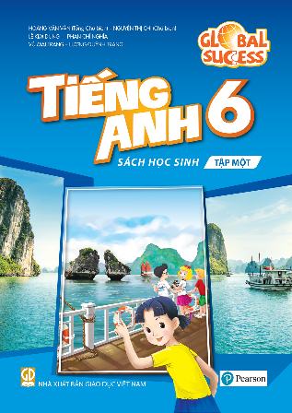

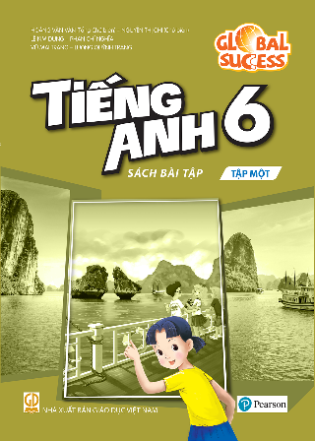
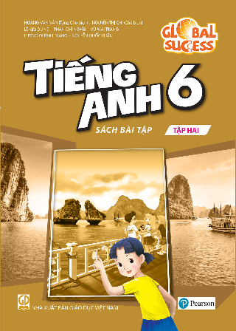
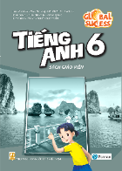
Website: hoclieu.vn
Fanpage: facebook.com/www.tienganhglobalsuccess.vn/

