Slide 1
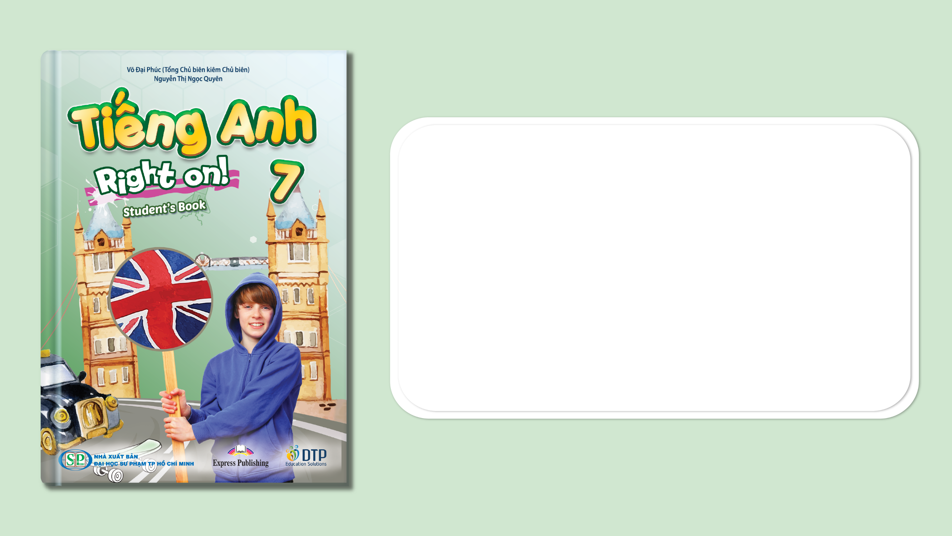
Unit 3: Arts and Music
Lesson: Overview
Pages 44 & 45

Slide 2
Lesson Outline
Warm-up
Vocabulary
Listening
Consolidation
Wrap-up

Slide 3
Objectives
By the end of this lesson, students will be able to…
- get an overview of Unit 3.
- practise and learn vocabularies for festivals and activities: exhibition, folk festival, performance, premiere, second-hand.
- oractise listening specific information.

Slide 4

WARM-UP

Slide 5

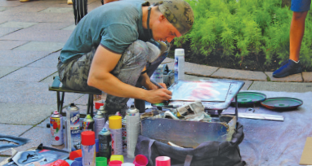
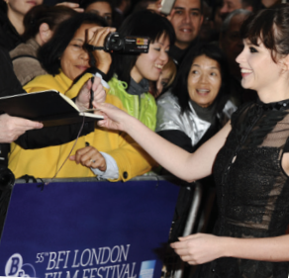
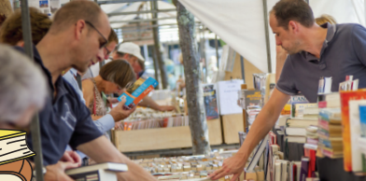
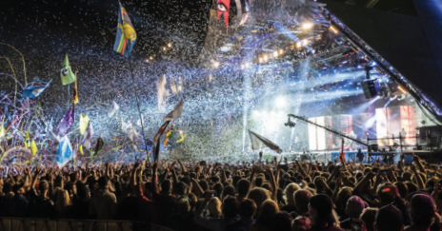
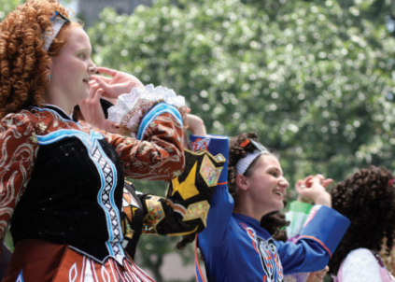
Work in pairs.
Match each picture with its correct name.
1
2
3
The London Film Festival
4
5
Edinburgh Art Festival
The Hay Festival
Glastonbury Festival
The Dalriada Festival

Slide 6
ANSWER
1
Edinburgh Art Festival

Slide 7
ANSWER
2
The London Film Festival

Slide 8
ANSWER
3
The Hay Festival

Slide 9
ANSWER
4
Glastonbury Festival

Slide 10
ANSWER
5
The Dalriada Festival

Slide 11
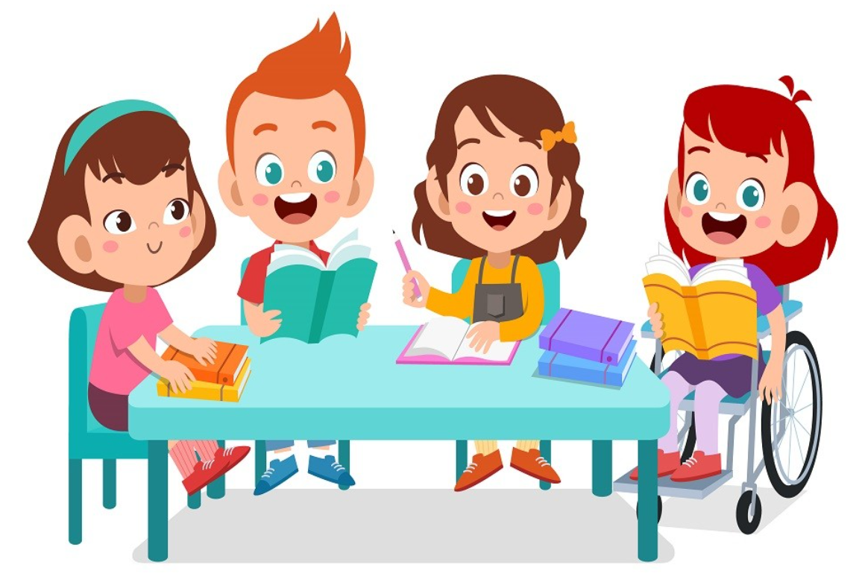
It’s time to learn …

Slide 12

New words
……..
…….
…….
……..

Slide 13

Listen and repeat. Click each phrase to hear the sound.
watch film premieres (v. phr) /wɑtʃ fɪlm ˈpremieərz/ xem buổi công chiếu phim
find second-hand books (v. phr) /faɪnd ˌsekənd ˈhænd bʊks/ tìm sách cũ
see live performances of popular groups (v. phr) /si: laiv pəˈfɔ:mənsiz əv ˈpɒpjələr ɡru:ps/ xem buổi biểu diễn trực tiếp của những nhóm nổi tiếng
see traditional dance performances (v. phr) /si: trəˈdɪʃənəl dæns pəˈfɔ:mənsiz/ xem buổi biểu diễn múa truyền thống
see art exhibitions (v. phr) /si: ɑ:rt ˌeksɪˈbɪʃən/ xem triển lãm nghệ thuật
Notes:
GV click vào từng cụm nghe âm thanh

Slide 14
Look at the IPA and the meaning of each word to read out the word.
/wɑtʃ fɪlm ˈpremieərz/ xem buổi công chiếu phim
/faɪnd ˌsekənd ˈhænd bʊks/ tìm sách cũ
/si: laiv pəˈfɔ:mənsiz əv ˈpɒpjələr ɡru:ps/ xem buổi biểu diễn trực tiếp của những nhóm nổi tiếng
/si: trəˈdɪʃənəl dæns pəˈfɔ:mənsiz/ xem buổi biểu diễn múa truyền thống
/si: ɑ:rt ˌeksɪˈbɪʃən/ xem triển lãm nghệ thuật
Notes:
GV click vào từng cụm nghe âm thanh

Slide 15
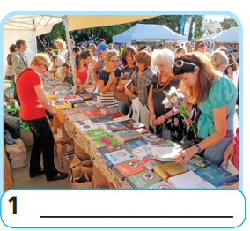
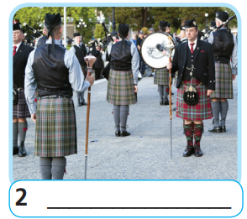
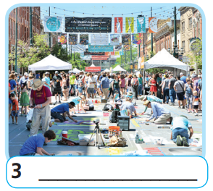
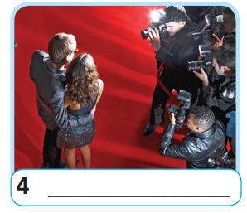
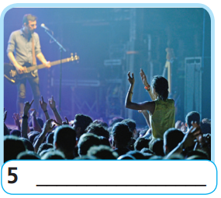
Extra Practice
WB, page 26
Label the pictures using the names of festivals below.
• music festival
• book festival
• folk festival
• flm festival
• art festival

Slide 16
Extra Practice
WB, page 26
Answer
book festival
folk festival
art festival
film festival
music festival

Slide 17

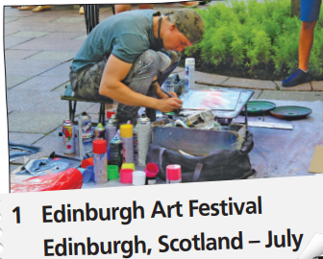
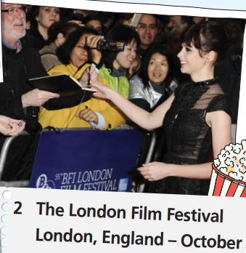
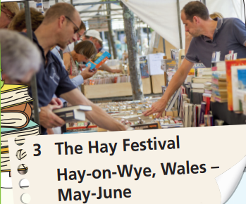
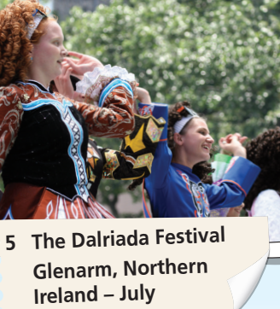
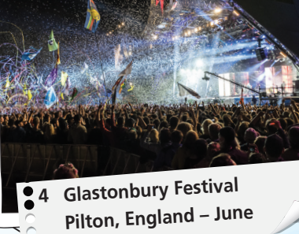
Work in pairs.
Which of the festivals in the pictures is a book festival?
folk festival? film festival? art festival? music festival?

Slide 18
Answer
1. Edinburgh Art Festival is an art festival.
2. The London Film Festival is a film festival.
3. The Hay Festival is a book festival.
4. Glastonbury Festival is a music festival.
5. The Dalriada Festival is a folk festival.

Slide 19
Work in pairs.
Listen. Which of the activities in the list can you do at the
festivals in the pictures?
• watch film premieres
• see traditional dance performances
• find second-hand books
• see art exhibitions
• see live performances of popular groups

Slide 20
Example
• watch film premieres
• see traditional dance performances
• find second-hand books
• see art exhibitions
• see live performances of popular groups
At Edinburgh Art Festival, you can see art exhibitions.

Slide 21
Write in your notebook
1. At the London Film Festival, you can watch film premieres.
2. At the Hay Festival, you can find second-hand books.
3. At Glastonbury Festival, you can see live performances of popular groups.
4. At the Dalriada Festival, you can see traditional dance performances.

Slide 22
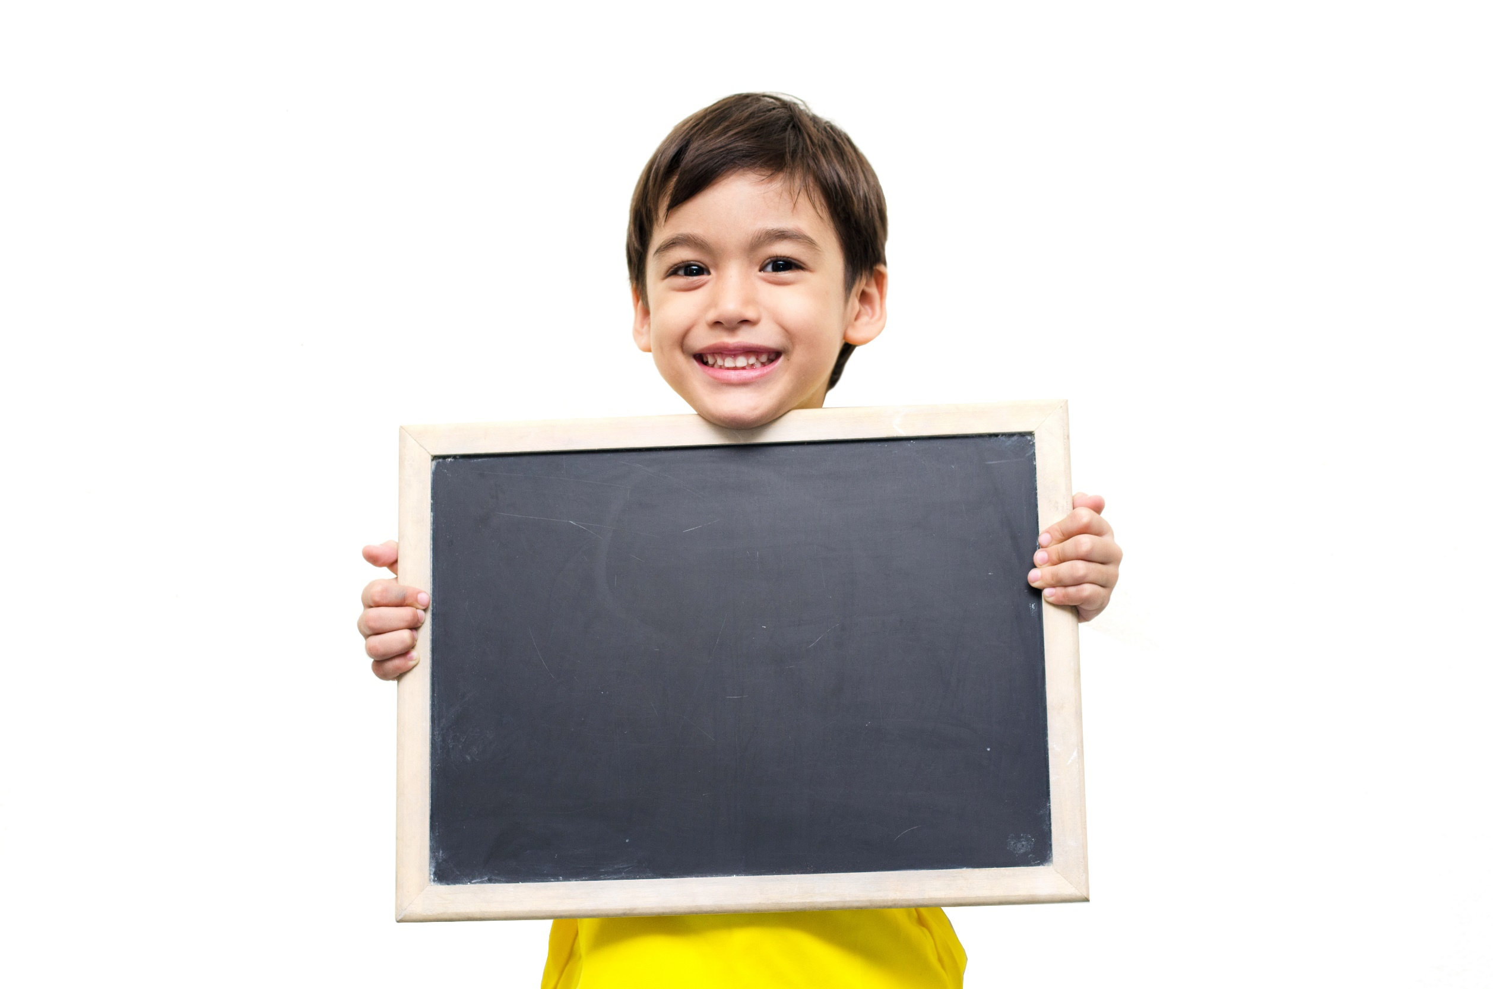
Listening

Slide 23
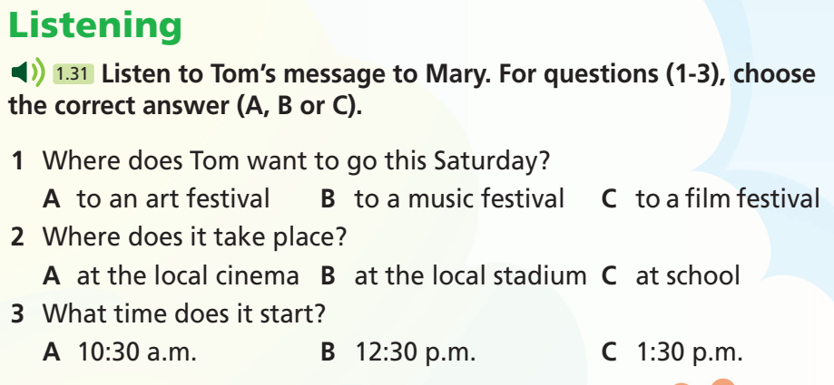
Pre - listening
To whom does Tom message?
- Mary.
What are you going to do?
- Listen and choose the correct answer.

Slide 24
Pre - listening
Read the instruction quickly. Underline the key words.
a. Listen to Tom’s message to Mary. For questions (1-3), choose
the correct answer (A, B or C).

Slide 25
While - listening
Now listen and choose the correct answer.  FIRST TIME
Listen to Tom’s message to Mary. For questions (1-3), choose
the correct answer (A, B or C).
☞ YOUR ANSWER?
1. Where does Tom want to go this Saturday?
A. to an art festival B. to a music festival C. to a film festival
2. Where does it take place?
A. at the local cinema B. at the local stadium C. at school
3 What time does it start?
A. 10:30 a.m. B. 12:30 p.m. C. 1:30 p.m.
☞ WHY?

Slide 26
While - listening
Now listen again and check.  SECOND TIME
While you are listening, focus on what Tom messages Mary.
What are you doing this Saturday? I’m going to a film festival.
☞ THE ANSWER IS …
C. to a film festival.

Slide 27
While - listening
Now listen again and check.  SECOND TIME
While you are listening, focus on what Tom messages Mary.
It’s at the local stadium, just down the road from our school, so we can walk there.
☞ THE ANSWER IS …
B. at the local stadium.

Slide 28
While - listening
Now listen again and check.  SECOND TIME
While you are listening, focus on what Tom messages Mary.
The first film starts at 10:30 a.m.
☞ THE ANSWER IS …
A. 10:30 a.m.

Slide 29
While - listening
Now listen again and check.  THIRD TIME
What are you doing this Saturday? I’m going to a film festival.
1. Tom wants to go to a film festival this Saturday.
It’s at the local stadium, just down the road from our school, so we can walk there.
2. It take place at the local stadium.
The first film starts at 10:30 a.m.
3. It starts at 10.30 a.m.

Slide 30
Post - listening
Extra Practice
Listen again and check if the statements are Right or Wrong.
1. Tom thought the music festival at the Arts Centre last weekend was great. 2. The film festival is at the local stadium, just down the road from their school, so they can cycle there. 3. It’s free, but they need to book the tickets online. 4. There’s a break for lunch between 12:00 and 1:30.

Slide 31
Post - listening
Answer
Extra Practice
1. Tom thought the music festival at the Arts Centre last weekend was great.
Right
Did you enjoy the music festival at the Arts Centre last weekend? I thought it was great!
2. The film festival is at the local stadium, just down the road from their school, so they can cycle there.
Wrong
It’s at the local stadium, just down the road from our school, so we can walk there.

Slide 32
Post - listening
Answer keys
Extra Practice
3. It’s free, but they need to book the tickets online.
Right
It’s free, but we need to book the tickets online.
4. There’s a break for lunch between 12:00 and 1:30.
Wrong
The first film starts at 10:30 a.m. and there’s a break for lunch between 12:30 and 1:30.

Slide 33
Audio Scripts
Hi, Mary! It’s Tom. Did you enjoy the music festival at the Arts Centre last weekend? I thought it was great! What are you doing this Saturday? I’m going to a film festival. Do you fancy coming with me? It’s at the local stadium, just down the road from our school, so we can walk there. It’s free, but we need to book the tickets online, so let me know if you want to come. The first film starts at 10:30 a.m. and there’s a break for lunch between 12:30 and 1:30.
Call me back and let’s talk! Bye!

Slide 34
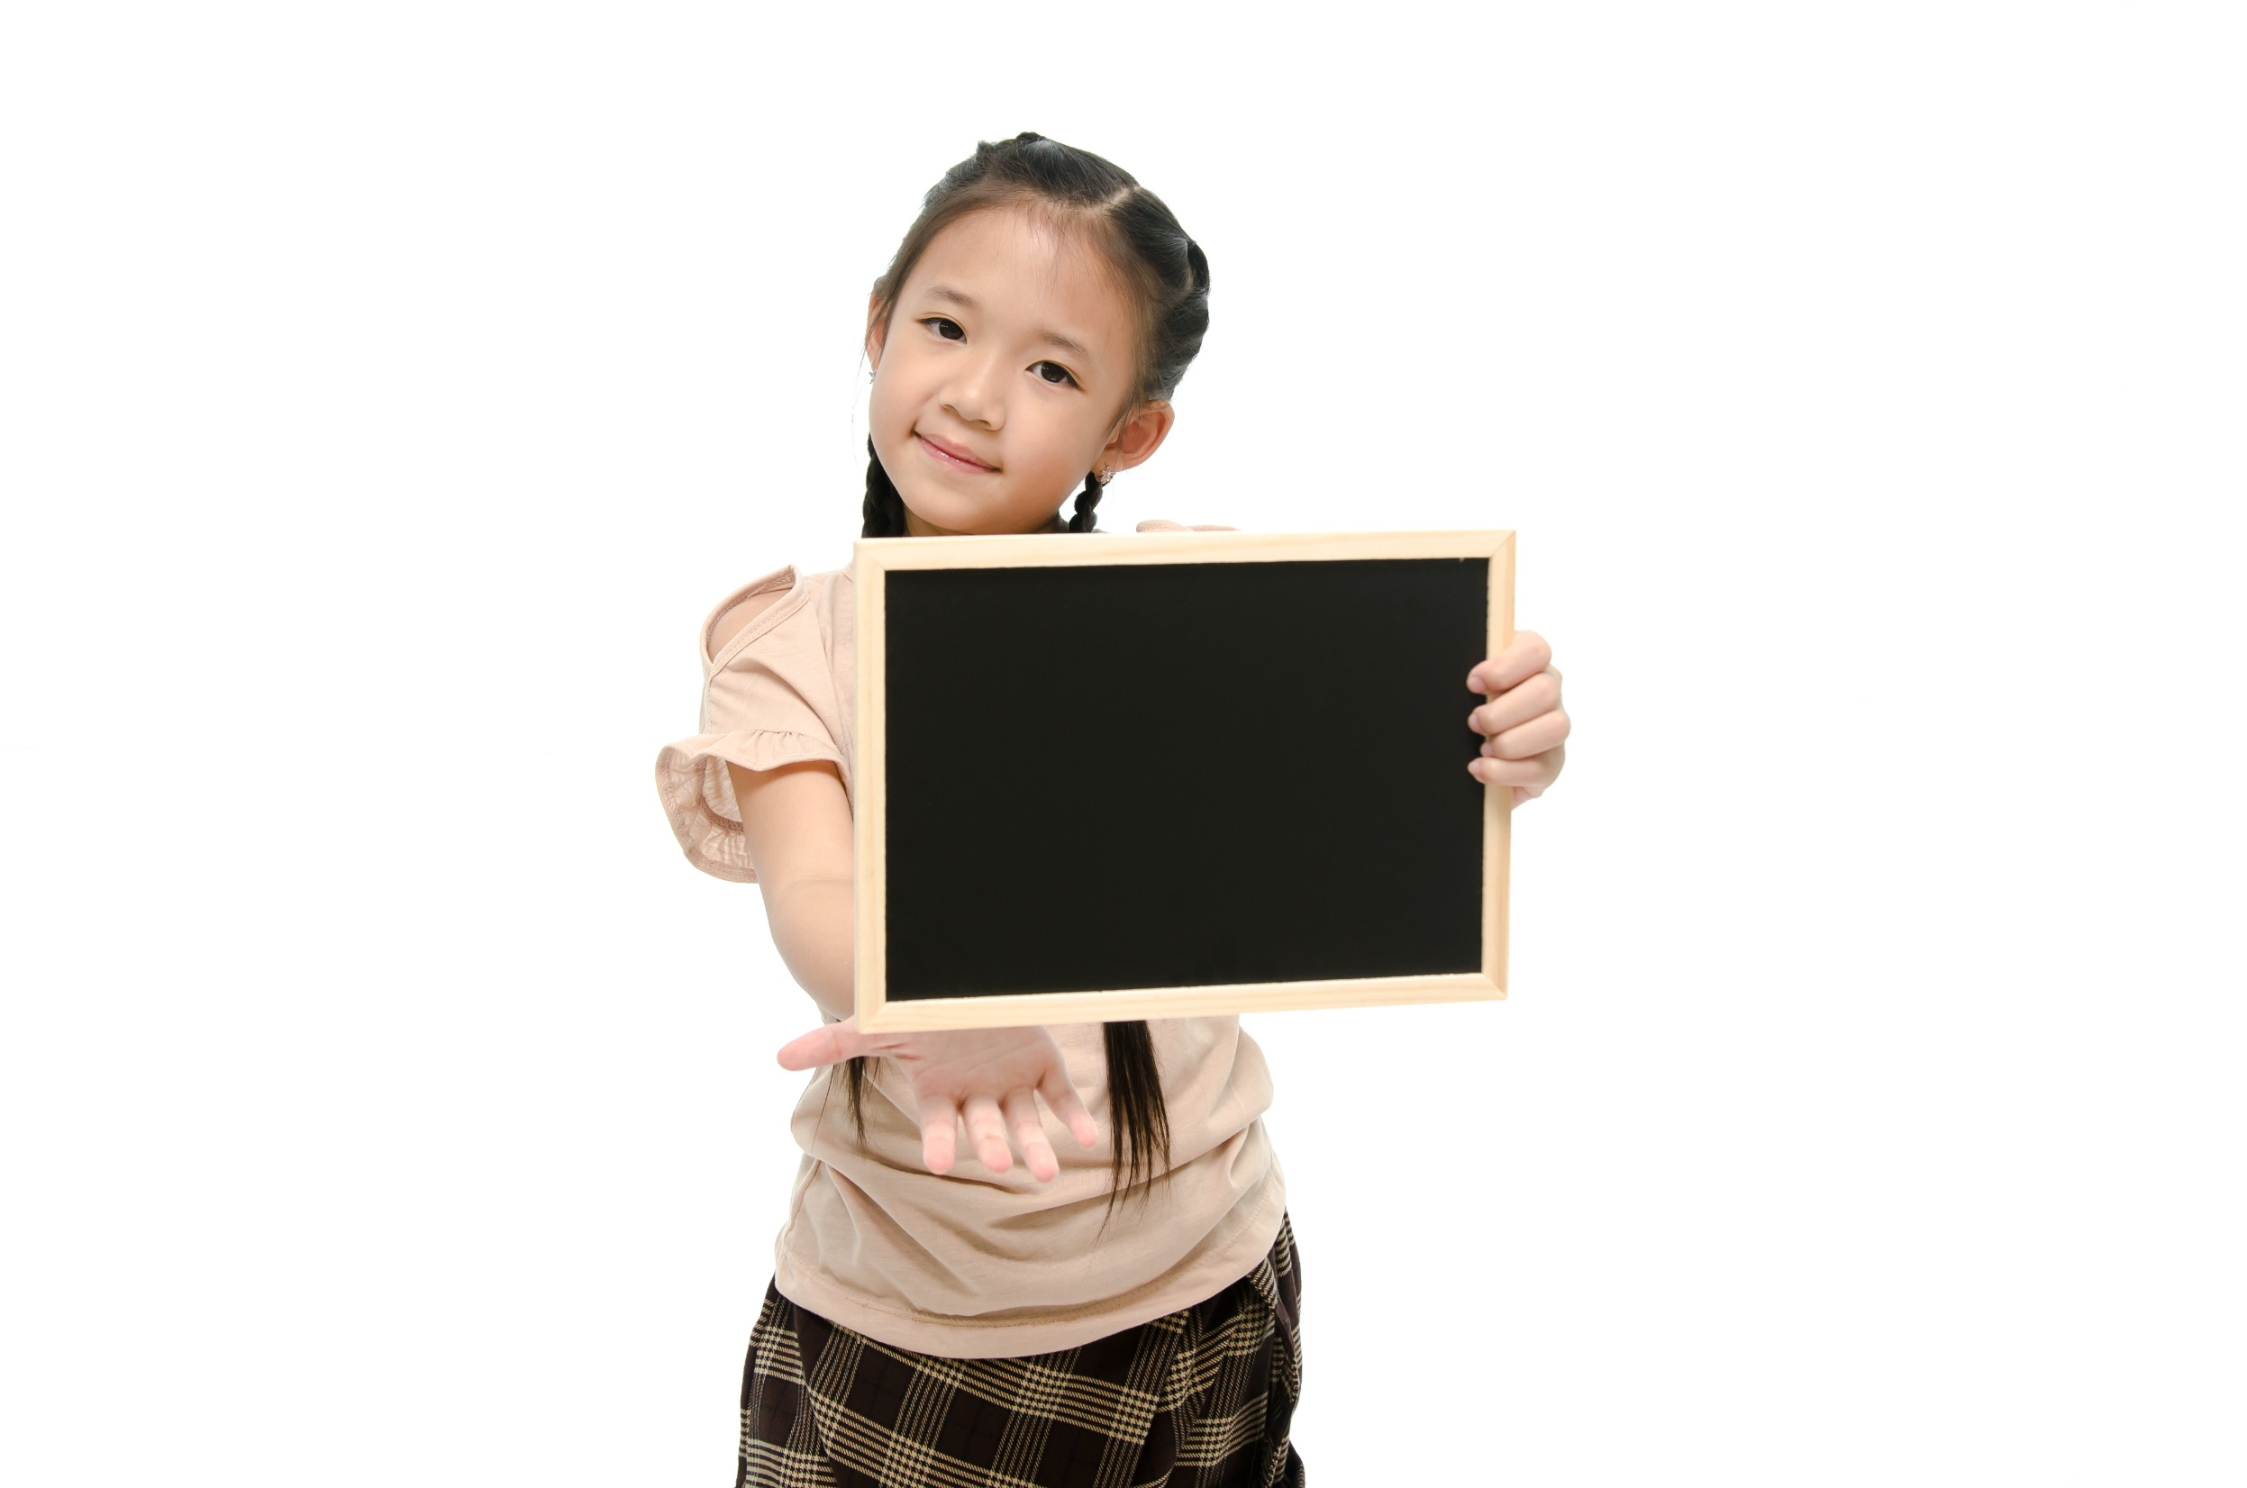
Speaking

Slide 35

Pre - Speaking
Work in pairs.
A friend wants to attend one of the festivals in the pictures. Suggest one to him/her. Use your answers in Exercises 1 and 2 to give him/her information about it as in the example.
What does your friend want?
→ Attend one of the festivals.
What are you going to do?
→ Suggest and give information.

Slide 36
STUDENT A
STUDENT B
Do you fancy going to Edinburgh Art Festival?
What kind of festival is it?
It’s an art festival.
Where and when does it take place?
It takes place in Edinburgh in Scotland in July.
What can you do there?
You can see art exhibitions.
You can count me in.

Slide 37

While - Speaking
Work in pairs.
Make similar conversations with the information below.

Slide 38
Name | Kind | When and Where? | What to do?
The London Film Festival | Film Festival | London, England – October | watch film premieres
The Hay Festival | Book Festival | Hay-on-Wye, Wales – May-June | find second-hand books
Glastonbury Festival | Music Festival | Pilton, England – June | see live performances of popular group
The Dalriada Festival Glenarm | Folk festival | Northern Ireland – July | see traditional dance performances

Slide 39
Post - Speaking
In groups, discuss the about your favorite festival.
You can begin with:
I like… festival best because…

Slide 40

CONSOLIDATION

Slide 41
Write a paragraph about your favourite festival.
Write about 60-80 words.

Slide 42

WRAP-UP

Slide 43
Today’s lesson
Vocabularies
exhibition
folk festival
performance
premiere
second-hand
Listening: Practise listening specifc information.
Speaking: Talk about your favorite festival.

Slide 44
Homework
Practise the vocabularies and make sentences using them.
Do the exercises in TA 7 Right on WB (page 26).
Do the exercises in TA 7 Right on Notebook on (pages 18 & 19).
Prepare the next lesson (page 46 SB).

Slide 45
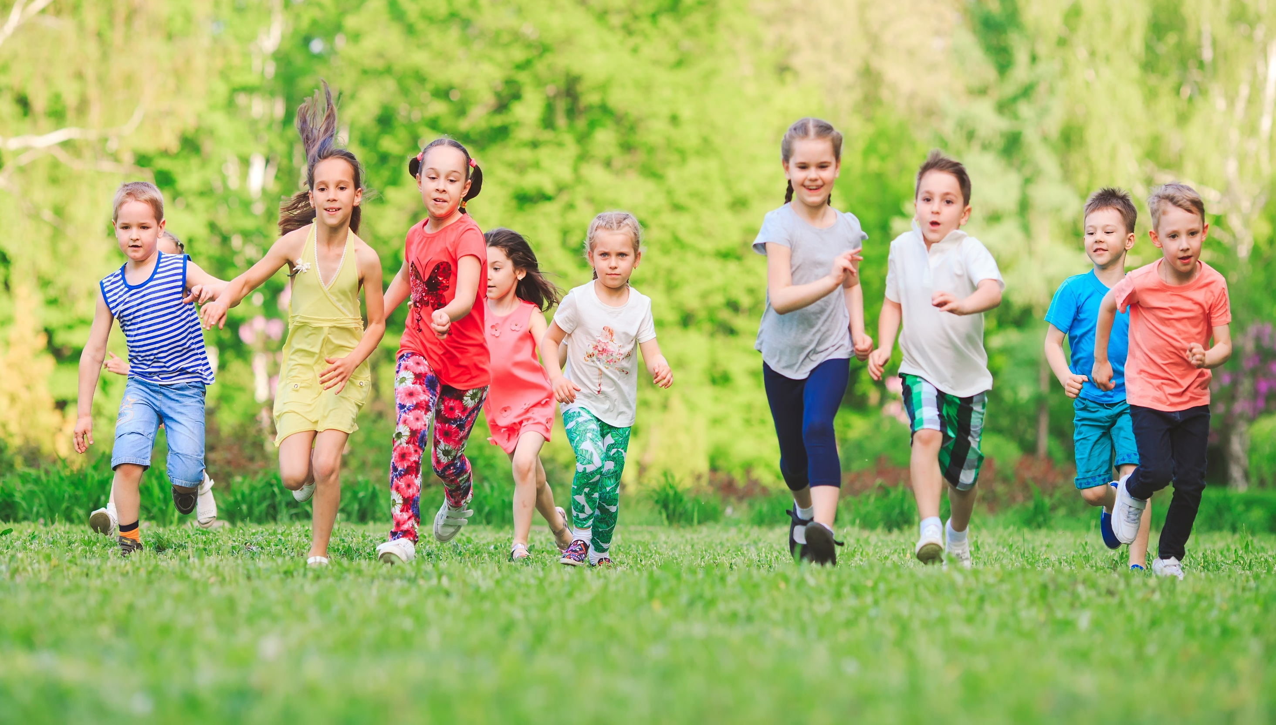
Have a nice day!

