Slide 1

WELCOME TO MY CLASS
Good morning Everybody

Slide 2
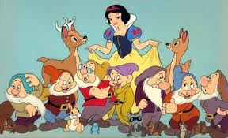
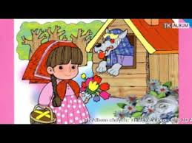
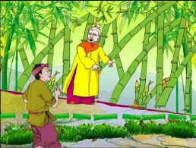
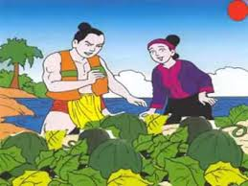
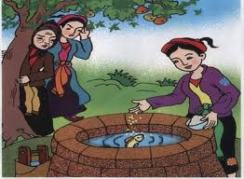

* WARM UP: PELMANISM
1
2
3
4
5
The story of Tam and Cam
The Hundred-knot Bamboo Tree
Snow white and seven Dwarfs
The story of watermelon
Little Red Riding Hood
A
B
C
D
E
1
2
3
4
5

Slide 3
Date
UNIT SIX
FOLK TALES
Period 45
A CLOSER LOOK 1

Slide 4
I. NEW WORDS
- An ogre
: yêu tinh
- A knight
: hiệp sĩ
- Evil (adj)
: xấu xa
- Cunning (adj)
: xảo quyệt
- Fierce (adj)
: hung dữ
- A witch (adj)
: phù thủy
- Woodcutter (n)
: Tiều phu, người đốn củi

Slide 5
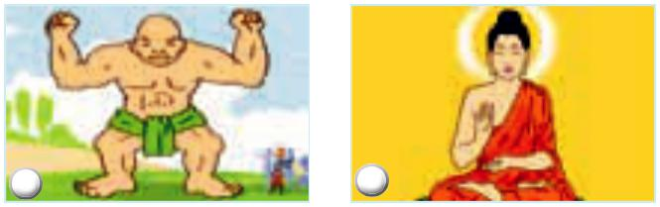
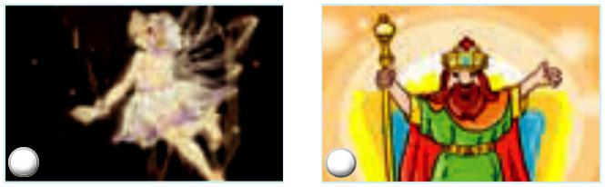
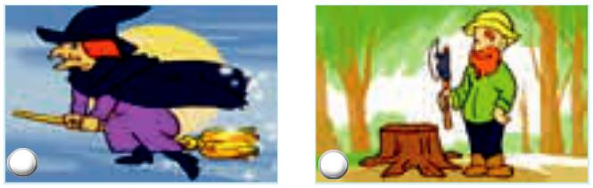
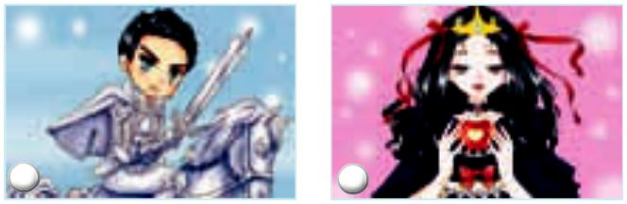
II. VOCABULARY
1. Match the characters with the pictures. (Ex. 1/ p. 60)
A. woodcutter
B. emperor
C. Buddha
D. knight
E. fairy
F. princess
G. giant
H. witch
1
2
3
4
5
6
7
8

Slide 6
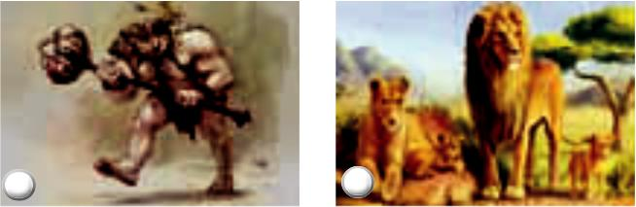
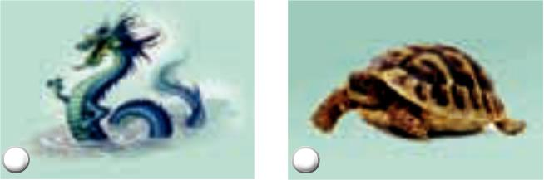

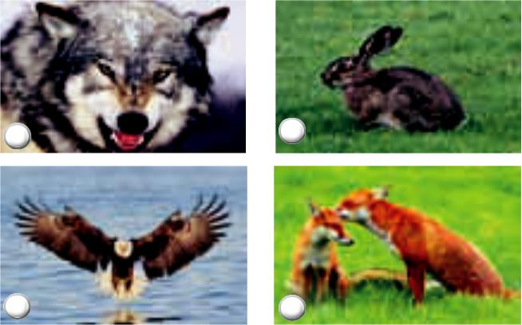
2. Match the creatures with the pictures. (Ex. 2/ p. 60)
A. dragon B. wolf C. hare D. fox
E. tortoise F. lion G. ogre H. eagle
1
2
3
4
g. ogre
f. lion
a. dragon
e. tortoise
5
6
7
8
d. fox
c. hare
h. eagle
b. wolf

Slide 7
3. Put the adjectives into the correct columns. (Ex. a/ p. 60)
cheerful | generous | greedy | mean
evil | cunning | wicked | kind
fierce | cruel | brave
Positive |  | Negative
cheerful
generous
brave
kind
cruel mean
evil greedy
wicked fierce
cunning

Slide 8
4. Now use these adjectives to describe some characters in one of your favourite folk tales. (Ex. 3b p. 60)
There’s a wolf in Little Red Riding Hood. He’s cunning and wicked.
* Example:
There is a fairy in Cinderella.
She is kind.
There is a prince in Snow White and Seven Drafts.
He is brave.

Slide 9

III. PRONUNCIATION
Intonation in exclamatory sentences
1. Listen and repeat. (Ex. 4/ p. 60)
1. What a colourful hat she is wearing!
2. What a time we’ve had today!
3. What beautiful eyes she has!
4. What a nice day it is!
5. What good news it is!
REMEMBER!
We use falling intonation for exclamatory sentences.

Slide 10
2. Practise these sentences. Then listen and repeat.
(Ex. 5/ p. 60)
What a beautiful princess she is!
What brave knights they are!
What a big nose the wolf has!
What a fierce ogre it is!
What a handsome prince he is!

Slide 11
IV. AT HOME
Learn by heart new words.
Practise pronunciation.
Do Exercises A1, A2 / p. 44 in workbook.
Be ready for A CLOSER LOOK 2.

Slide 12




The bye bye song
Bye, bye.
See you tomorrow.
Bye, bye.
See you tomorrow.
Bye, bye.
See you tomorrow.
Bye, bye. Bye, bye.
The bye bye
song
Notes:
12

