Slide 1
TRÒ CHƠI Ô CHỮ
1
G
O
O
D
1
2
H
A
P
P
Y
2
3
O
P
P
O
S
I
T
E
3
4
H
O
T
4
5
E
A
S
T
5
6
H
I
G
H
6
7
T
H
I
N
7
8
H
E
A
L
T
H
Y
8

Slide 2
1
What is the opposite of bad?
Back

Slide 3
2
What is the opposite of sad?
Back

Slide 4
3
Happy is the … of sad?
Back

Slide 5
4
What is the opposite of cold?
Back

Slide 6
5
What is the opposite of west?
Back

Slide 7
6
What is the opposite of low?
Back

Slide 8
7
What is the opposite of thick?
Back

Slide 9
8
What is the opposite of sad?
Back

Slide 11
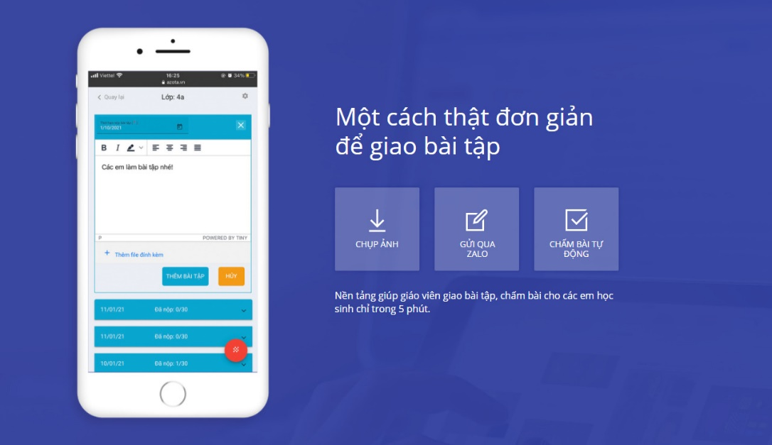
gioithieu.azota.vn

