Slide 1


Slide 2
REVIEW 1 (UNIT 1-3)
Unit
FAMILY LIFE
LESSON 3
SKILLS (2)
Reading and Writing

Slide 3
LESSON 3
SKILLS (2)
WARM-UP
Brainstorming
Task 1. Match the headings with the paragraphs
Task 2. True or False
READING
WRITING
Write an opinion essay on the given topic.
CONSOLIDATION
Wrap-up
Homework

Slide 4
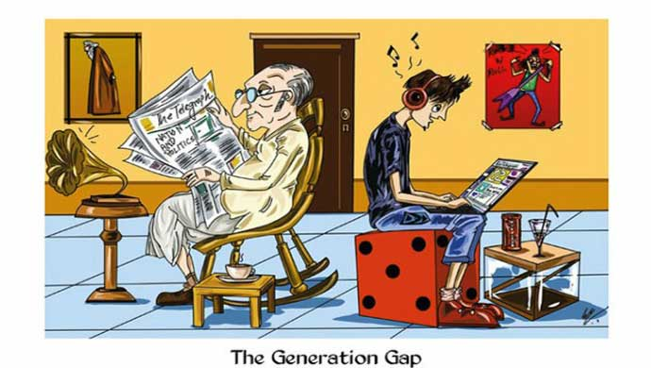
WHAT CAN YOU SEE IN THE PICTURE?
Generation gap

Slide 5
BRAINSTORMING
lack of time for each other
parents impose decisions on children
differences in interests
Where does generation gap come from?
differences in habits
compare children with others
differences in viewpoints

Slide 6
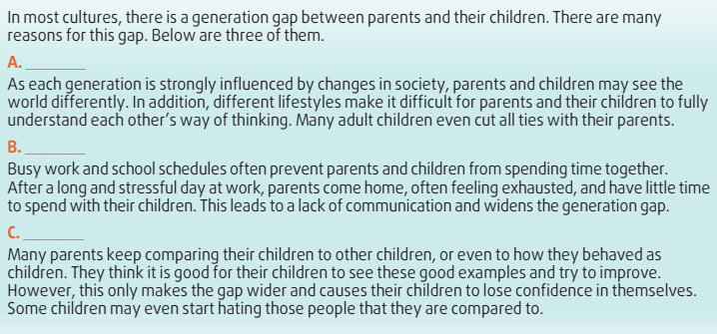
READING
1
Match the headings with the paragraphs.
Lack of understanding
Lack of interaction
Comparing to others

Slide 7

READING
2
True or False.
 | T | F
1. Three reasons for the generation gap between parents and children are mentioned in the text.
2. Changes in society help parents and children get closer to each other.
3. Despite their busy schedules, all parents and children spend a lot of time together.
4. Parents don't have enough time for their children because they work long hours.
5. Many parents believe that comparing their children to others is good for them.

Slide 8
WRITING
Write an opinion essay on the following topic. You may use the ideas in the reading to help you.
Sample answer:
Many parents compare their own childhood with their children’s experiences because they want to teach them good behaviour. In my opinion, parents should not make such a comparison for two reasons.
Firstly, parents and their children belong to different generations. Parents experienced different social changes and grew up in different economic conditions. These changes and conditions have formed their points of views and behaviour. However, many social norms have changed over the last decades. Therefore, it may be difficult to apply them to their children’s life nowadays.
In addition, when children are compared to their parents, they may lose their confidence because they may think that they are not good enough. As a result, many of them will believe that their parents don’t believe in their abilities and become afraid of living independently.
In conclusion, parents shouldn’t compare their life experiences with their children’s experiences because of generational differences and the negative emotional feelings that this comparison may cause to their children.

Slide 9
CONSOLIDATION
1
Wrap-up
What have you learnt today?
Practice the skills reading for main ideas and specific information;
Develop develop writing skills on the given topic.

Slide 10
CONSOLIDATION
2
Homework
Do exercises in the workbook.
Prepare for Unit 4 – Lesson 1.

Slide 11

Website: hoclieu.vn
Fanpage: facebook.com/www.tienganhglobalsuccess.vn
Website: hoclieu.vn
Fanpage: facebook.com/sachmem.vn/

