Slide 1
Unit 4 For A Better Community
Lesson 8: LOOKING BACK AND PROJECT

Slide 2
Unit
1
1
FAMILY LIFE
Family Life
Unit
OBJECTIVES
By the end of the lesson, students will be able to:
Review the vocabulary and grammar of Unit 4;
Apply what they have learnt (vocabulary and grammar) into practice through a project

Slide 3
Table of contents
01
02
03
Warm-up
Looking back
Project
04
Consolidation

Slide 4
01
Warm-up
Brainstorming

Slide 5
WARM-UP
Brainstorming
List two-syllable words with the same spelling but different stress

Slide 6
02
Looking back

Slide 7
PRONUNCIATION
Listen and mark the stressed syllables in the words in bold. Then practise saying the sentences.
1. We hope that the number of volunteers will increase this year.
2. When will you present your report about the volunteer project?
3. I always keep a record of visitors’ donations.
4. We still import too many products that can be made in our country.

Slide 8
PRONUNCIATION
Listen and mark the stressed syllables in the words in bold. Then practise saying the sentences.
1. We hope that the number of volunteers will in'crease this year.
2. When will you pre'sent your report about the volunteer project?
3. I always keep a 'record of visitors’ donations.
4. We still im'port too many products that can be made in our country.

Slide 10
VOCABULARY
GAME
Choose the right option.

Slide 11
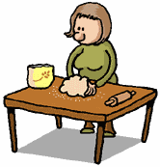
There are (end) __________ opportunities for teenagers to volunteer these days.
endless
GREAT
end
endless
endlessly

Slide 12
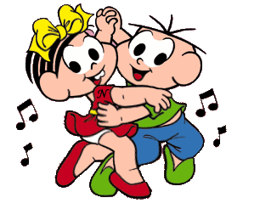
We were very (excite) __________ to help children organise afterschool activities.
excited
GREAT
excited
excite
exciting

Slide 13
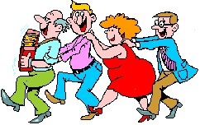
The local people were really (help) __________. They supported us all the time we stayed there.
helpful
GREAT
help
helpfully
helpful

Slide 14
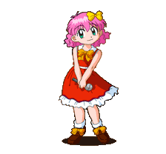
We need more (volunteer) __________ for our community projects.
volunteers
GREAT
volunteerss
volunteers
volunteer

Slide 15
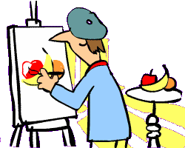
Our charity groups received generous (donate) __________ from the local people.
donations
GREAT
donate
donated
donations

Slide 16
GRAMMAR
Complete the sentences using the correct forms of the verbs in brackets. Use the past simple or past continuous.
1. I first (meet) __________ Lan while we (work) _____________ as volunteers.
2. While we (walk) ______________ home, we (see) __________ a girl crying near a bus stop.
3. Kim (notice) __________ the poverty of the area while she (deliver) _____________ free meals to old people.
4. When I (arrive) __________ at the community centre, a guest speaker (give) __________ a speech.
met
were working
were walking,
saw
noticed
was delivering
arrived
was giving

Slide 17
03
Project

Slide 18
PROJECT
Your presentation should include:
• What is the volunteer project about?
• What are the aims of the project?
• Where is it carried out?
• Who takes part in the project?
• What are the main activities of the project?
• Who will benefit from the project?

Slide 19
04
Consolidation

Slide 20
CONSOLIDATION
1
Wrap-up
Review the vocabulary and grammar of Unit 4;
Apply what they have learnt (vocabulary and grammar) into practice through a project

Slide 21
CONSOLIDATION
2
Homework
Prepare for the next lesson: Getting started
Do exercises in the workbook

Slide 22
SEE YOU NEXT TIME !!

