Slide 2
Unit 7
The world of mass media
LESSON 3
READING
Digital media vs. traditional media

Slide 3
LESSON 3
READING
WARM-UP
Board race
PRE-READING
Task 1: Discuss the questions.
- Task 2: Match each word with its meaning.
- Task 3: Decide the person who raises the opinion.
- Task 4: Choose the correct answers.
WHILE-READING
POST-READING
Task 5: Discussion.
CONSOLIDATION
- Wrap-up
- Homework

Slide 4
WARM-UP
BOARD RACE
- Work as 2 groups.
- Take turns to write all traditional and digital media forms in 2 minutes
- If the answer is correct ➔ one point.
- The group with higher score will be the winner.

Slide 5

WARM-UP
BOARD RACE

Slide 6
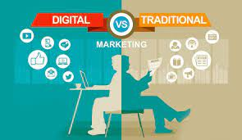
PRE-READING
1
Work in pairs. Read the first section of the article. discuss the following questions.
Do you think that digital media can replace traditional media?
Why/Why not?

Slide 7


PRE-READING
convenient (adj)
/kənˈviːniənt/
useful, easy or quick to do; not causing problems

Slide 8

PRE-READING
flexible (adj)
/ˈfleksəbl/
able to change to suit new conditions or situations

Slide 9
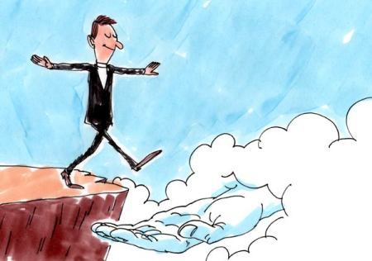
PRE-READING
reliable (adj)
/rɪˈlaɪəbl/
that can be trusted to do something well; that you can rely on

Slide 10
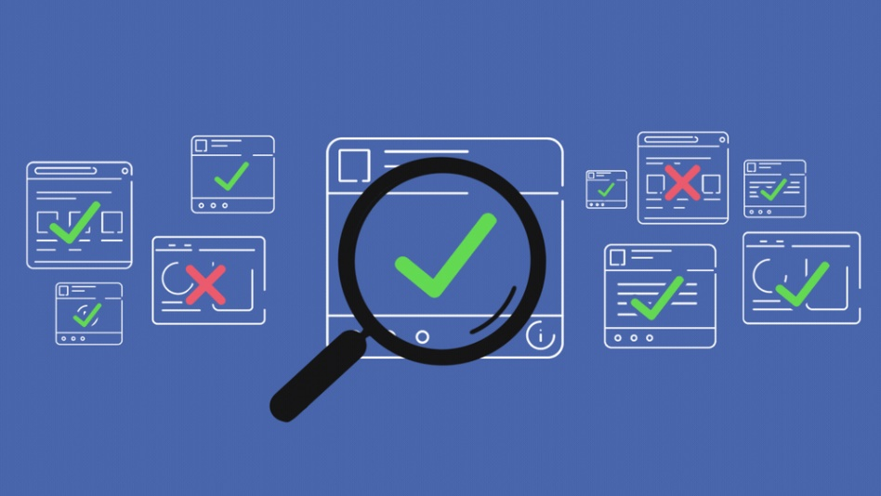
PRE-READING
fact-check (v)
/ˈfækt tʃek/
to investigate an issue in order to check that the facts are given correctly

Slide 11
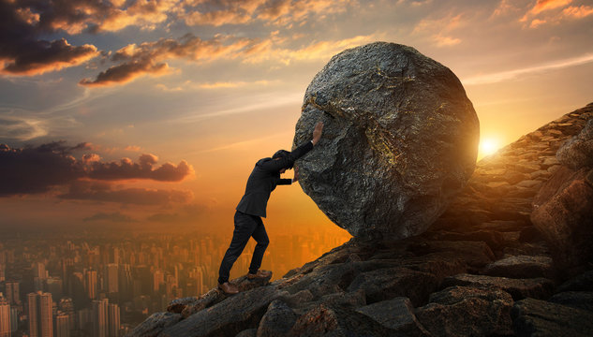
PRE-READING
struggle (v)
/ˈstrʌɡl/
to try very hard to do something when it is difficult or when there are a lot of problems

Slide 12
PRE-READING
Form | Pronunciation | Meaning | Vietnamese equivalent
1. convenient (adj) | /kənˈviːniənt/ | useful, easy or quick to do; not causing problems | tiện lợi
2. flexible (adj) | /ˈfleksəbl/ | able to change to suit new conditions or situations | linh hoạt
3. reliable (adj) | /rɪˈlaɪəbl/ | that can be trusted to do something well; that you can rely on | đáng tin cậy
4. fact-check (v) | /ˈfækt tʃek/ | to investigate an issue in order to check that the facts are given correctly | xác minh tính chính xác
5. struggle (v) | /ˈstrʌɡl/ | to try very hard to do something when it is difficult or when there are a lot of problems | vật lộn

Slide 13
WHILE-READING
Read the article. Match the highlighted words with their meanings.
2
DEBATE CORNER
Digital media is any form of media that is created, viewed, and distributed via electronic devices. Examples of digital media include websites, social media, videos, video games, digital advertising, software, and electronic books. With the development of technology and smart devices in recent years, digital media saw a sharp rise. This raises the question of whether digital media will replace traditional media such as printed newspapers, broadcast TV, and radio. Below are two opinion pieces sent to our Debate Corner this week.

Slide 14
WHILE-READING
Read the article. Match the highlighted words with their meanings.
2
Nowadays, it is much easier and more convenient to access information via digital media. Most digital content is also freely accessible. All it takes is a few clicks, and you can read the latest news, watch videos, or see online adverts. In addition, digital media forms are more interactive. For example, customers can provide instant feedback, which can be used to solve any problems. In return, almost every organisation can reach its target customers easily via digital media. Furthermore, digital media is more flexible since information can be updated easily and frequently. By contrast, articles in printed newspapers or adverts on TV cannot be changed immediately. With more than 75 million social media users in Viet Nam and the number is increasing, it will not be long before traditional media becomes a thing of the past.
Minh Quang

Slide 15
WHILE-READING
Read the article. Match the highlighted words with their meanings.
2
Digital media is very convenient, but its strengths are also its own weaknesses. Since anyone with access to computers and the Internet can post or share information online, it raises the question of how credible it is. On the other hand, traditional media offers information from reliable sources that are fact-checked. Moreover, let us not forget that digital media relies on the Internet and smart devices to work well. There are still remote or disadvantaged areas in Viet Nam where access to technology is limited or too expensive. Many people also still struggle with technology. So although digital media is on the rise, traditional media such as printed newspapers, broadcast TV, and radio is here to stay.
Pham Hoa

Slide 16
WHILE-READING
Read the article. Match the highlighted words with their meanings.
2
1
distributed
that can be trusted or believed
a
that allows information to be passed continuously and in both directions between different devices or users
2
accessible
b
3
interactive
c
that can be reached, used, seen, etc.
credible
given to a large number of people
4
d

Slide 17
WHILE-READING
3
Read the article again. Write Q next to Quang’s opinion, H next to Hoa’s opinion, and N if it is not their opinion.
1. Digital media will replace traditional media in our country soon. | __________
2. Digital media will replace traditional media, but that won’t be soon. | __________
3. Traditional media will become more accessible in the future. | __________
4. Both traditional and digital media will be in use in the future. | __________
5. The future is uncertain for both traditional and digital media. | __________
Q
N
N
H
N

Slide 18
WHILE-READING
4
Read the article again. Choose the correct answers.
1. What are the three main reasons that Quang gives to support his view?
(Circle THREE correct choices)
A. All digital media content is free to use.
B. Digital media can be accessed easily.
C. Information on digital media can be updated many times.
D. Users can interact with content and post opinions on digital media.
E. Customers are more flexible online.
2. Why does Quang mention the fact that many organisations can reach its customers via digital media?
A. To prove that advertisements on digital media are highly accessible.
B. To suggest that customers can interact well on digital media.
C. To show that digital media allows interaction between both sides.
D. To prove that digital media forms are easier to use than traditional ones.

Slide 19
WHILE-READING
4
Read the article again. Choose the correct answers.
3. What are the three main reasons that Hoa gives to support her view?
(Circle THREE correct choices)
A. Information on digital media cannot always be trusted.
B. The government only supports the use of traditional media.
C. People in areas with limited access to technology still use traditional media.
D. Not everyone is comfortable with technology.
E. Traditional media forms are friendlier to users than digital ones.
4. Why does Hoa say ‛here to stay’ in her opinion piece?
A. To show that digital media will only continue to be used in her country.
B. To confirm her opinion that traditional media has become a part of life and will continue to be popular.
C. To emphasise that printed newspapers can easily be sent to remote places.
D. To state her opinion that digital media is on the rise.

Slide 20
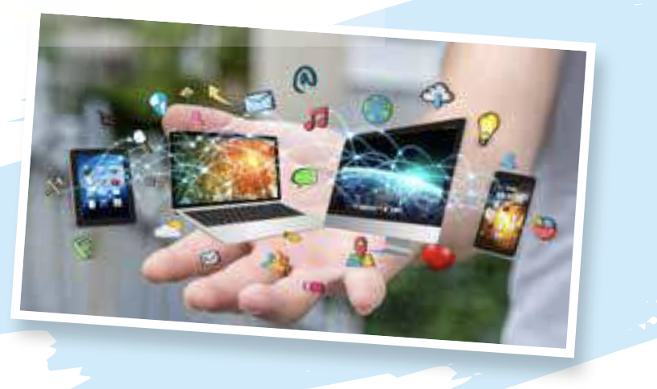
WHILE-READING
5
Work in pairs. Discuss the following questions.
After reading the article, who do you agree with, Hoa or Quang? Why?

Slide 21
POST-READING
5
Work in pairs. Discuss the following question.
After reading the article, who do you agree with, Hoa or Quang? Why?
Suggested answers:
I personally agree with Hoa. Digital media is very powerful, but not without limitations. They are not always reliable, have limited access in certain areas and not always easy to use for many people. Therefore, I believe that people will continue to combine different sources of information or types of media to take full advantage of each type.

Slide 22
CONSOLIDATION
1
Wrap-up
What have you learnt today?
Some lexical items about traditional and digital media
Reading skills for general ideas and for specific information about traditional and digital media

Slide 23
CONSOLIDATION
2
Homework
Do exercises in the workbook.
Prepare for Lesson 4.

Slide 24
Website: hoclieu.vn
Fanpage: facebook.com/www.tienganhglobalsuccess.vn

