Slide 1
KEY ENGLISH TEST 1
SPEAKING TEST 1

Slide 2
KET SPEAKING
Time allowed - 8-10 minutes
Normally you will do the speaking test with another candidate. The two of you will meet two examiners. One of the examiners will talk to you, the other does not particpate in the conversations.
There are two parts to the speaking test:
Speaking part 1: short questions and answers between you and the examiner
Speaking part 2: the examiner gives you some information or a card with some ideas for questions. You have to talk with the other candidate and ask or answer questions.
Scoring The Speaking section is worth 25% of the total score for the exam.
How to prepare for KET Speaking
Speak as much as you can, with your friends
Practise asking and asnwering questions about daily life
Practise giving information about yourself

Slide 3
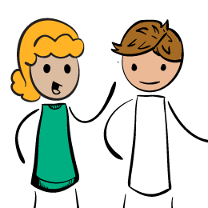
Part 1: Student – examiner interaction
Section 1: The examiner will ask you:
Your name
Where you come from
Provide full-sentence answers

Slide 4
Part 1: Student – examiner interaction
Section 2: You will be asked some questions that require longer answers. For example:
Why you like something
Details about a hobby,…
Popular topic:
Music Sport Cinema and TV reading
Traveling work shopping future plans
Past experience family personal interests education

Slide 5
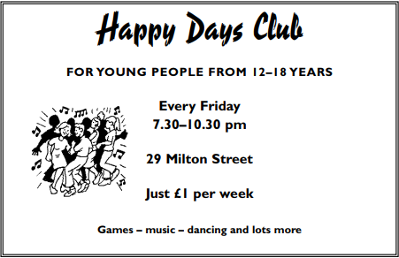
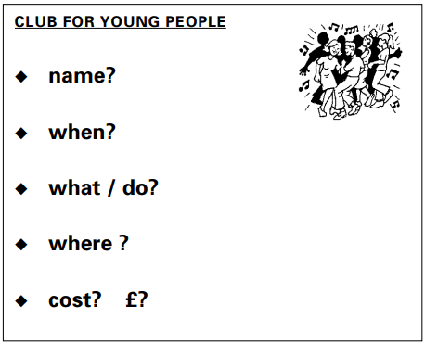
Part 2: Student – student interaction
Ask and answer questions based on the cue cards
For example:
Do not just read from the cards.Answer in full sentences
Pay attention to the grammar

Slide 6
SPEAKING PART 1

Slide 7
Part 1:
What is your name? What is your surname? How can you spell your name/ your surname?
Where do you come from?
Do you work or study?
Do you like studying English?
What are your hobbies and interest?
Tell me about your family

Slide 8
1. What is your name/surname? How can you spell your name/surname?
My name is…../ I’m …..
It is spelled/spelt…. / That is….
For example: Q: What is your name?
A: My name is Sam
Q: What is your surname? How do you spell it?
A: My surname is Gally. That is G-A-L-L-Y

Slide 9
Where do you come from?
I come from….
(add more details)
Ex: I come from Thai Binh. It is in the North of Vietnam.
I am working as …. (add more details)
Do you work or study?
I am studying in grade…, (name of school) primary/ secondary/ high school/university
Ex: I am studying in grade 6, An Le secondary school./ I am working as a teacher at An Le secondary school.

Slide 10
Do you like learning English?
Yes/ No (add reasons)
Ex: Yes, because it is very interesting
I like /love/ am fond of/ am a big fan of + Ving (hobbies/ interests)
What are your hobbies or interests?
Ex: I love cooking and I always cook for my family

Slide 11
FAMILY
The answer should be at least 3 sentences
Helpful outline and vocabulary
Single parent family
Nuclear family
Extended family
Family
Types of family
Members of family
Family relationship
Family activities
Going out for lunch/dinner
Watching TV
Playing board games
Shopping
Grandparents
Mother
Father
Brothers/sisters/siblings
Close-knit family
Get on well with each other

Slide 12
SPEAKING PART 2

Slide 13
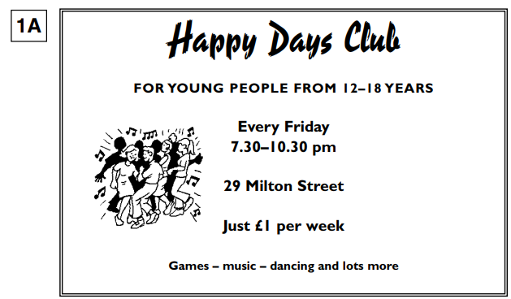
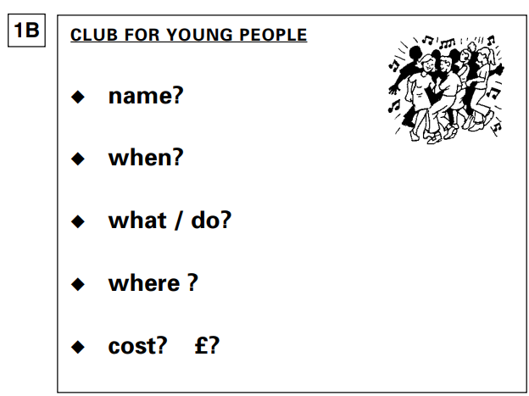
Asking and answering questions using these prompt cards

Slide 14
Possible answers
1. What is the name of the club? | Happy Days Club
2. When does it open? | It opens from 7.30 to 10.30 pm every Friday
3. What can people do there? | People can play games, listen to music, dance and lots more
4. Where is the club? | It is at 29 Milton Street
5. How much does it cost? | It costs just £1 a/per week
On Milton street
At + 29 Milton Street
Can you think of other questions or other ways to ask for information?

Slide 15
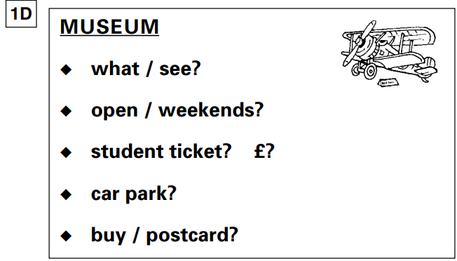
What can I see in the museum?
Is it open on weekends/ at the weekends?
How much is a student ticket?
Is there a car park?
Can I buy a postcard there?
Can you think of other questions or other ways to ask for information?

