Slide 1

Unit 7: Education
Review
Pages 102 &103

Slide 2






LESSON OUTLINE
Consolidation

Slide 3

By the end of this lesson, students will be able to…
review vocabularies and grammar points.
describing and identifying personal belongings.
comparing different types of transportation.
practice listening, reading, and speaking skills.

Slide 4
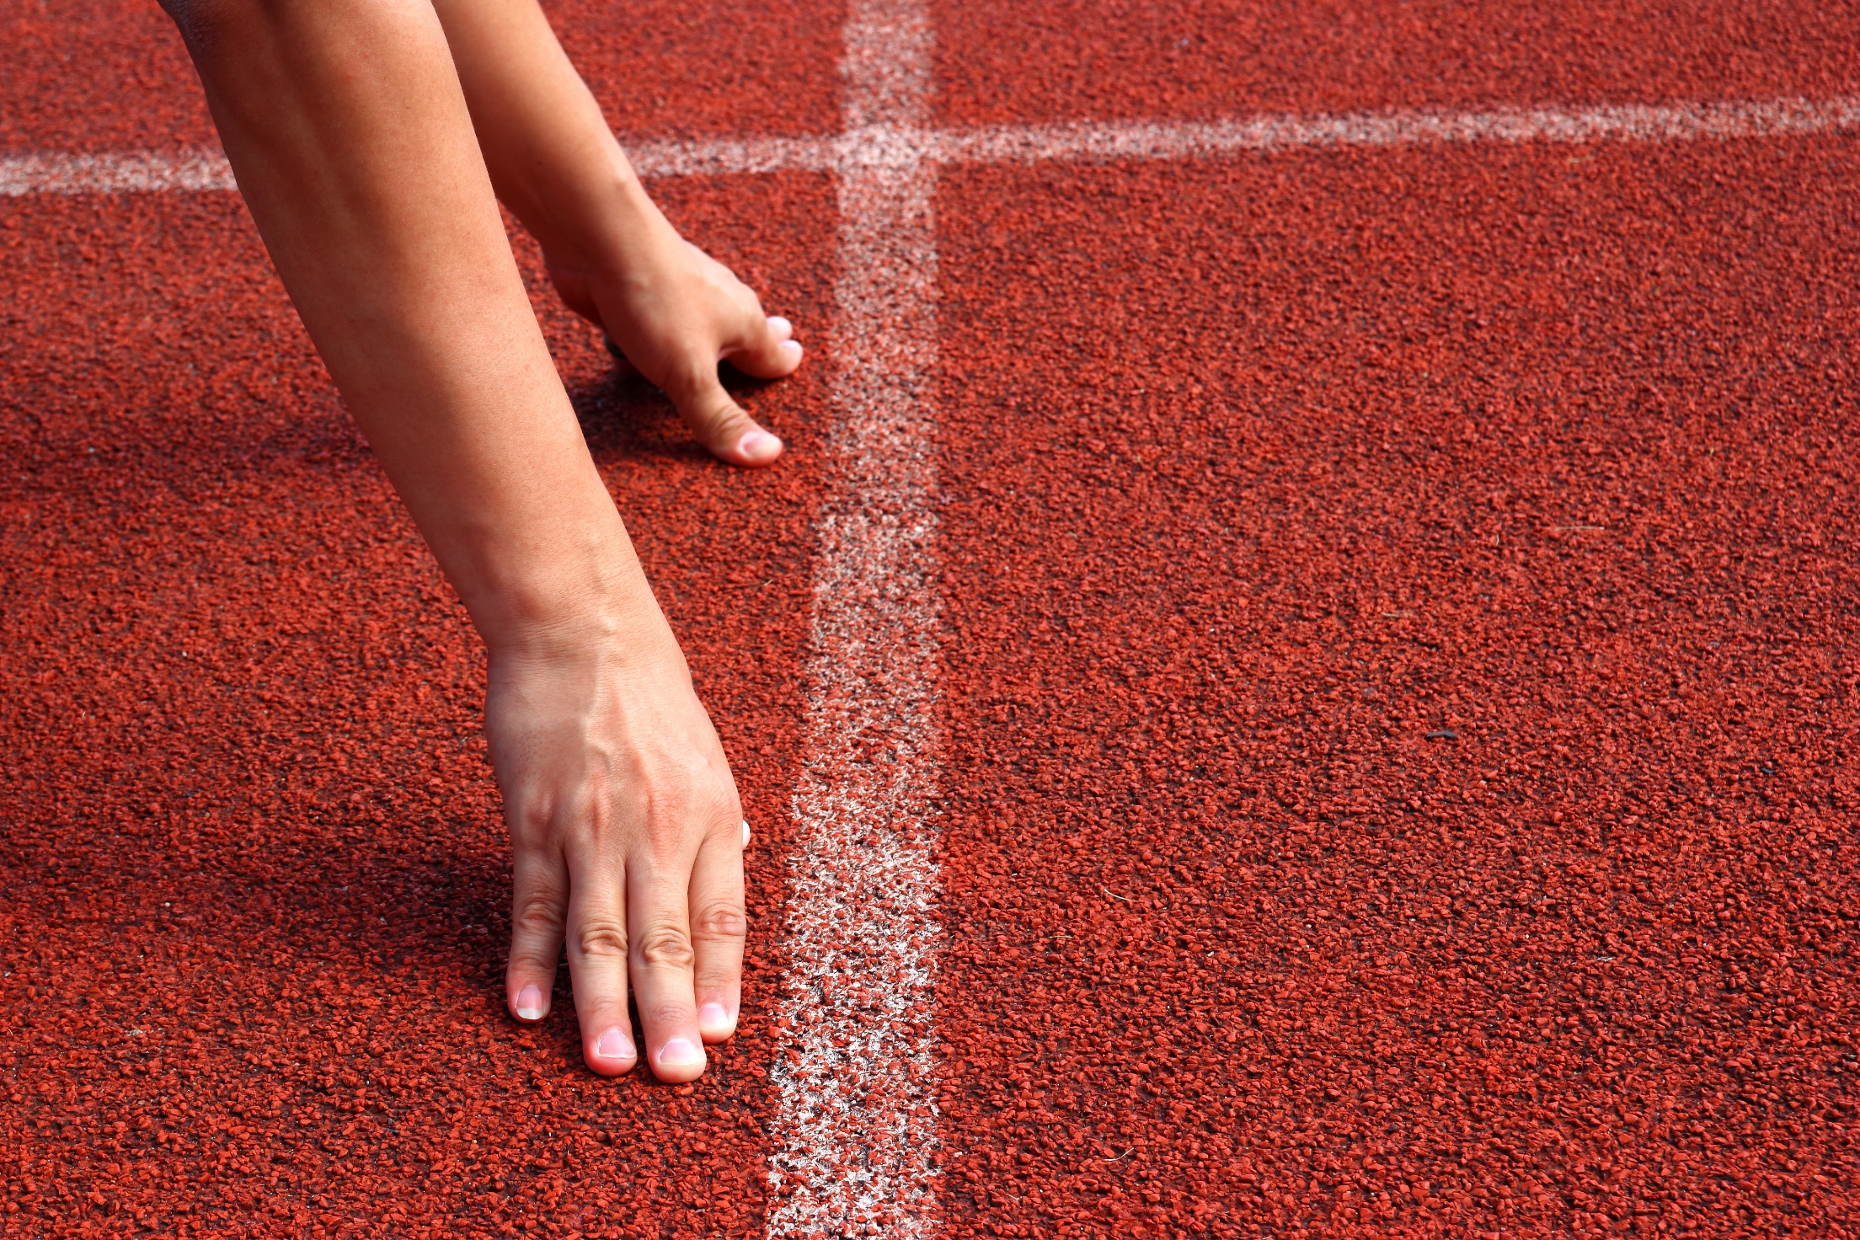
WARM-UP

Slide 5

Work in pairs. Take turn to talk about what you have/are wearing today. Then report things that your partner has/is wearing today.
A: Today, I have a new black watch and I am wearing an old blue pair of sandals.
B: Today, I have an old dark blue bag and I am wearing a white T-shirt.

Slide 6
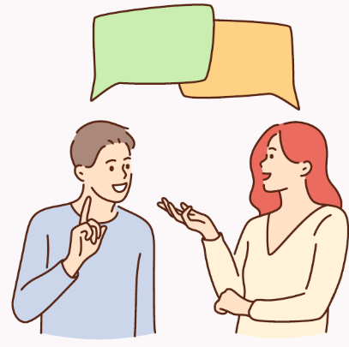
Report about your partner.
My name is…. My partner is…. He/ She has …………….. with him/ her today. He/ She is wearing…….

Slide 7

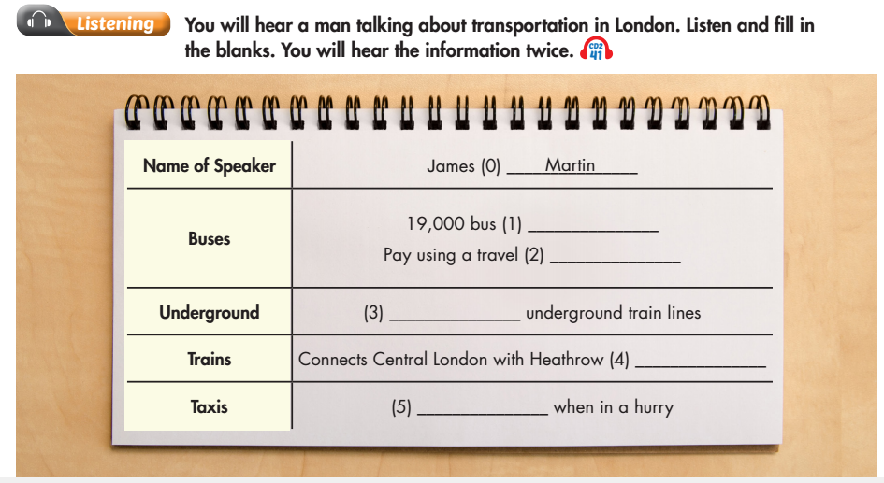
Click on the icon to hear the sound

Slide 8
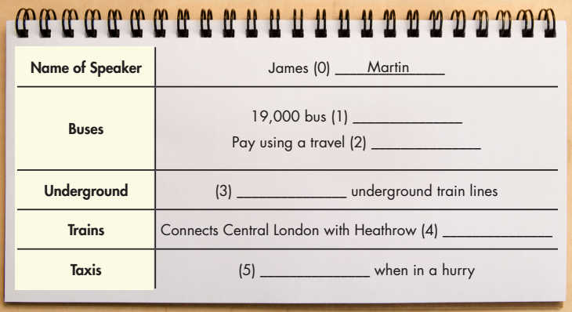
Try to guess what you should fill in the blanks.
Before - listening
Bus stop? Bus station?

Slide 9
Try to guess what you should fill in the blanks.
Before - listening
A noun phrase with “travel”?

Slide 10
Try to guess what you should fill in the blanks.
Before - listening
A number? how many?

Slide 11
Try to guess what you should fill in the blanks.
Before - listening
A name? a place?

Slide 12
Try to guess what you should fill in the blanks.
Before - listening
Good point?

Slide 13

While - listening
☞ FIRST TIME
☞ YOUR ANSWER?
Click on the icon to hear the sound

Slide 14
While - listening
Now listen again and check.  SECOND TIME
Click on the icon to hear the sound
stops
card
11/eleven
Airport
convenient

Slide 15
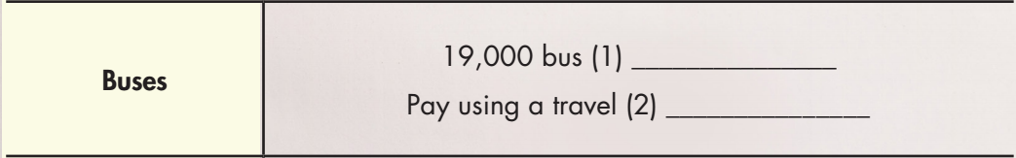
While - listening
Now listen again and check.  SECOND TIME
Click on the icon to hear the sound
stops
card
Buses aren't as fast as the subway, but there are over nineteen thousand bus stops in London. You
can pay for tickets using a London travel card.

Slide 16
While - listening
Now listen again and check.  SECOND TIME
Click on the icon to hear the sound
11/eleven
The subway in London is called the Underground. There are eleven underground train lines covering over four hundred kilometers of track with two hundred and seventy stations.

Slide 17
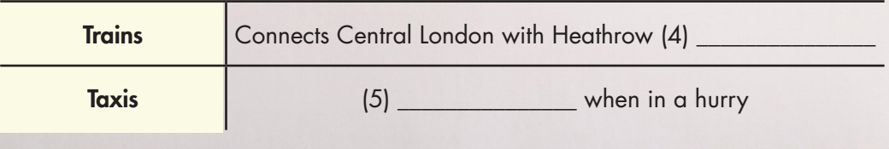
While - listening
Now listen again and check.  SECOND TIME
Click on the icon to hear the sound
Airport
convenient
Also, there is a large train network with special lines connecting
central London with Heathrow Airport. The trains are as fast as the underground but not as cheap. Finally, there are taxis. You can see these famous black taxis all over London. Taxis are very expensive, but they are convenient if you are in a hurry.

Slide 18
Audio scripts
M: My name's James Martin and I'm going to tell you about the transportation in London. There are even hundred bus routes covering all of London. Buses aren't as fast as the subway, but there are over nineteen thousand bus stops in London. You can pay for tickets using a London travel card. The subway in London is called the Underground. There are eleven underground train lines covering over four hundred kilometers of track with two hundred and seventy stations. It's really fast. Also, there is a large train network with special lines connecting central London with Heathrow Airport. The trains are as fast as the underground but not as cheap. Finally, there are taxis. You can see these famous black taxis all over London. Taxis are very expensive, but they are convenient if you are in a hurry.

Slide 19
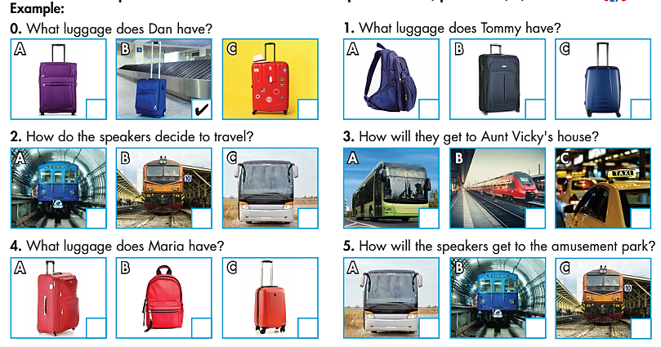
Extra Practice
WB, page 68
Click on the icon to hear the sound

Slide 20
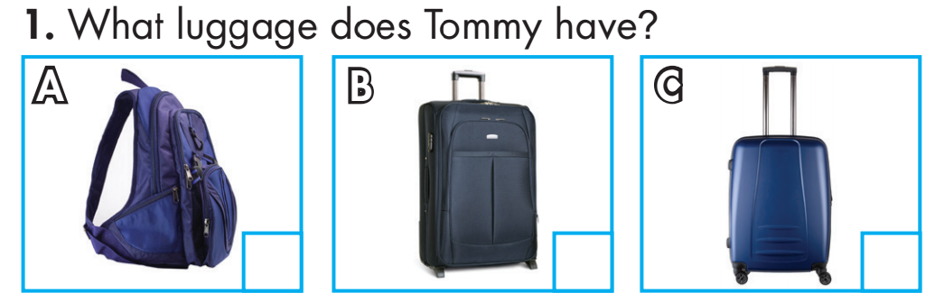

Click on the icon to hear the sound
1.
G: What luggage do you have, Tommy? Is it the blue backpack?
B: Mine's a dark blue suitcase, Rachel.
G: Is this yours?
B: No, mine's a small suitcase.
G: Ah! Here it is!

Slide 21
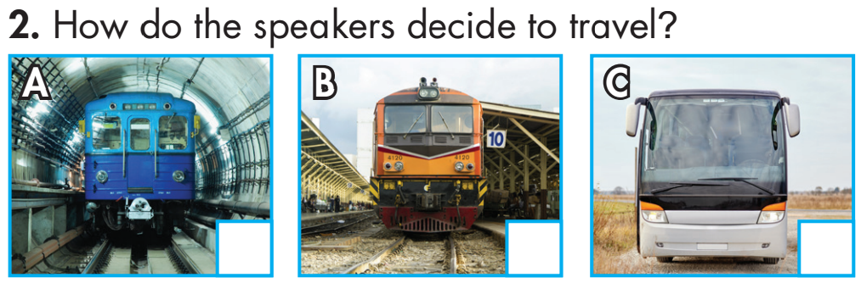
Click on the icon to hear the sound
2.
W: Let's go to the city mall today.
M: Good idea. How are we going to get there?
W: We could take the bus.
M: Hmm. The bus isn't as frequent as the subway.
W: Yeah… and the subway is cheaper than the train.
M: OK. Let's take the subway, then.
W: Sure.

Slide 22
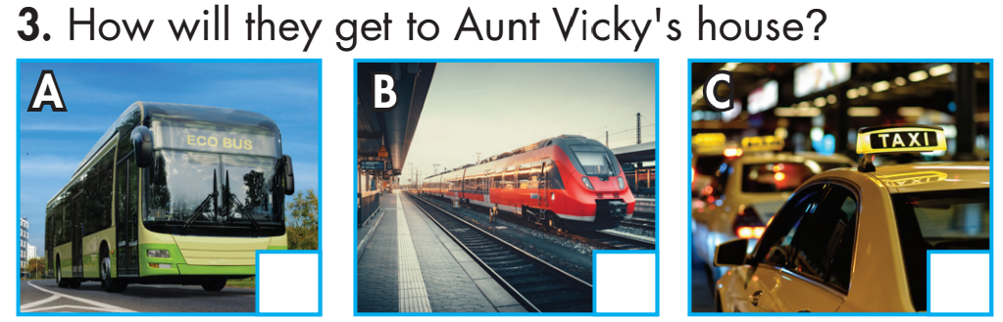
Click on the icon to hear the sound
3.
W: I'm visiting Aunt Vicky this Sunday. Do you want to go with me?
B: Sure! I miss her.
W: My car's broken so we're going to take the bus there.
B: Oh, Mom. Buses are cheap but always full. Can we go by taxi?
W: Taxis are expensive. Let's take the train. It's comfortable and fast.
B: Sounds great!

Slide 23
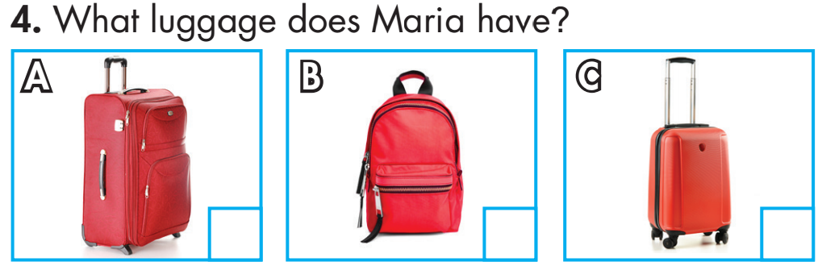
Click on the icon to hear the sound
4.
G: Here's your red backpack, Carl.
B: Thanks. What luggage do you have, Maria?
G: Mine's a red suitcase.
B: Is this yours? The small red suitcase?
G: No, it's not. Mine's bigger than that.
B: Oh, right. Look, there it is!
G: That's it!

Slide 24
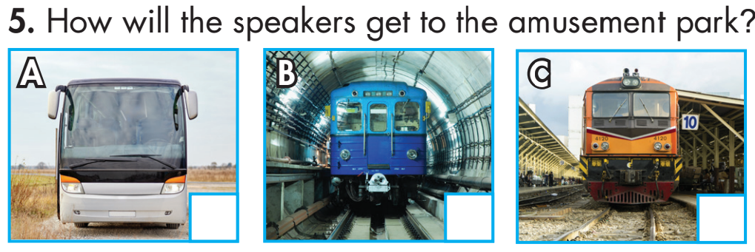
Click on the icon to hear the sound
5.
B: So, how are we getting to the amusement park?
G: Well, we can't take the subway. It doesn't go there. We could take the bus or the train.
B: Hmm. Well, the bus isn't as comfortable as the train.
G: Yeah, but it's a lot cheaper.
G: That's true. Let's take the bus, then.
B: OK. Sounds good.

Slide 25

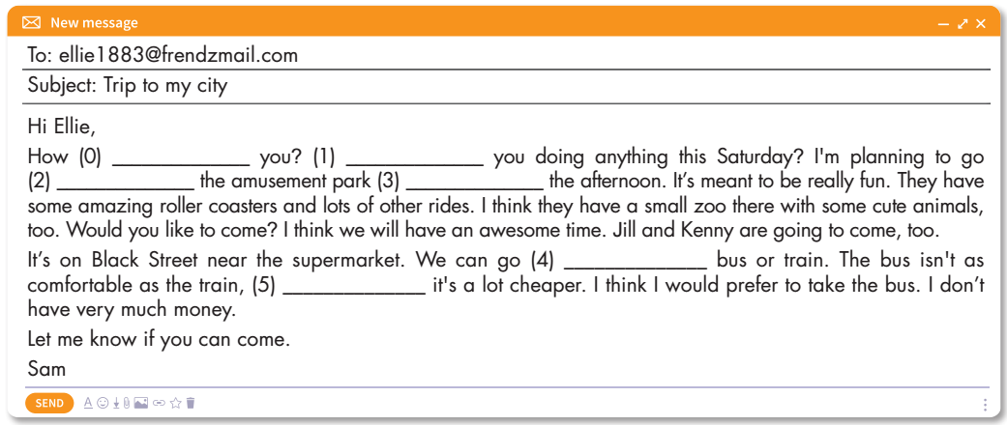
are
to
in
by
but

Slide 26
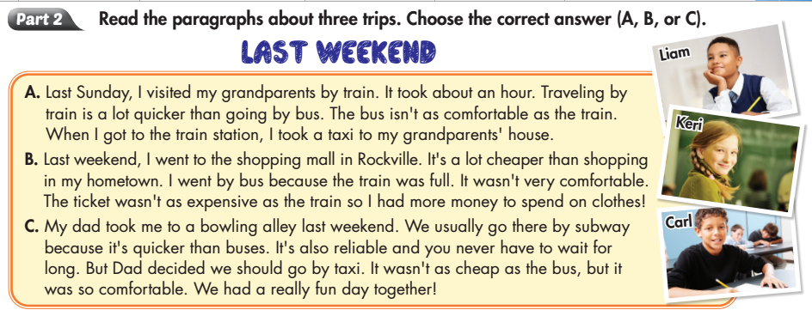
Extra Practice
WB, page 68

Slide 27
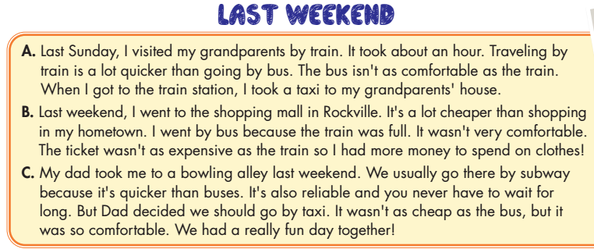


Liam
Keri
Carl

Slide 28

Liam
Keri
Carl

Slide 29
Liam
Keri
Carl

Slide 30
Liam
Keri
Carl

Slide 31
Liam
Keri
Carl

Slide 32
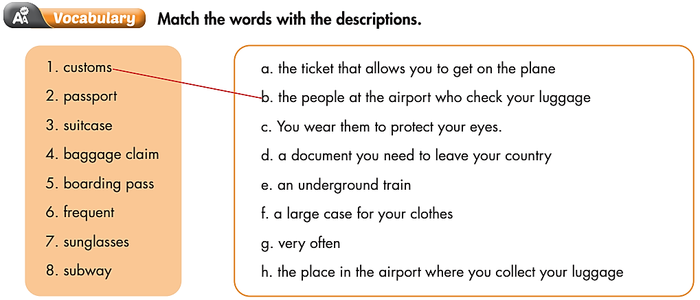

Slide 33

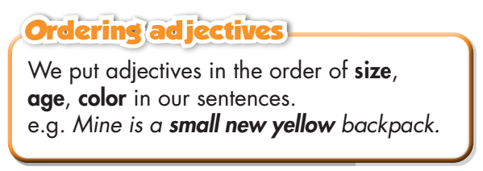
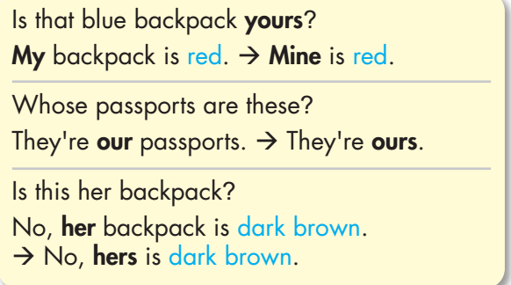
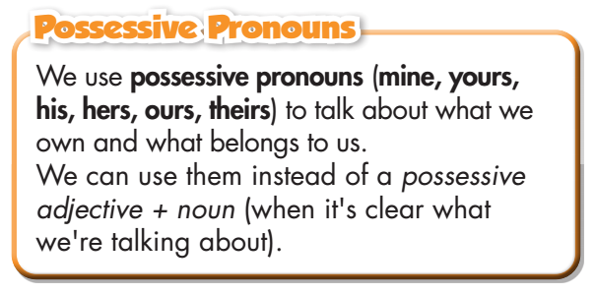

Slide 34
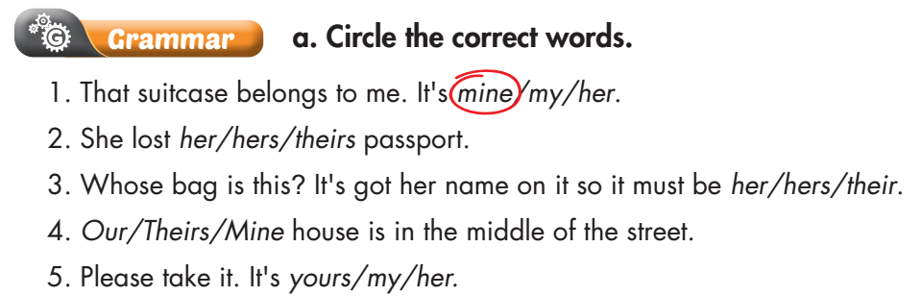

Slide 35
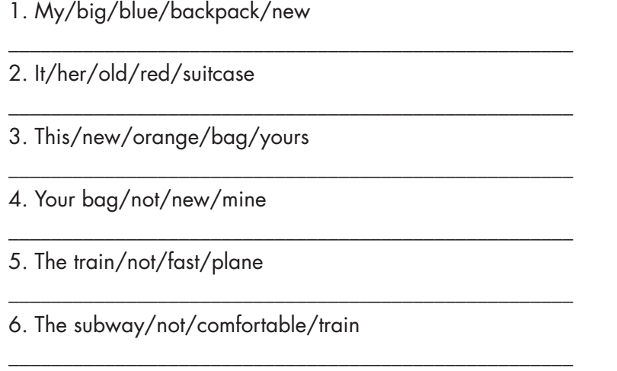
My big blue backpack is new.
It is her old red suitcase.
This new orange bag is yours.
Your bag is not as new as mine.
The train is not as fast as the plane.
The subway is not as comfortable as the train.

Slide 36

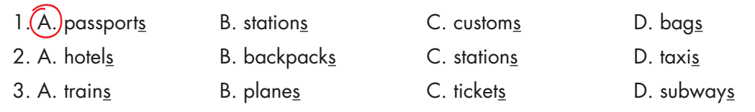

Slide 37
A. passports B. stations C. customs D. bags
2. A. hotels B. backpacks C. stations D. taxis
3. A. trains B. planes C. tickets D. subways

Slide 38
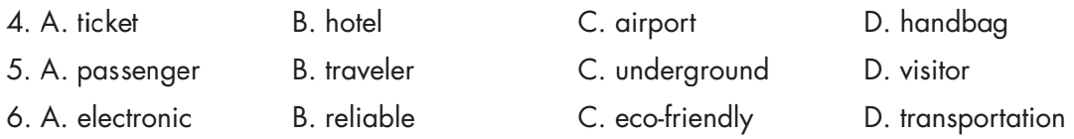
b. Circle the word that differs from the other three in the position of primary stress in each of the following questions.

Slide 39
b. Circle the word that differs from the other three in the position of primary stress in each of the following questions.
4. A. ticket B. hotel C. airport D. handbag
5. A. passenger B. traveler C. underground D. visitor
6. A. electronic B. reliable C. eco-friendly D. transportation
/ˈtɪkɪt/
/hoʊˈtel/
/ˈerpɔːrt/
/ˈhændbæɡ/
/ˈpæsɪndʒər/
/ˈtrævələr/
/ˌʌndərˈɡraʊnd/
/ˈvɪzɪtər/
/ɪˌlekˈtrɑːnɪk/
/rɪˈlaɪəbl/
/ˌiːkəʊ ˈfrendli/
/ˌtrænspərˈteɪʃn/

Slide 40

CONSOLIDATION

Slide 41
Work in groups: Compare 2 types of transportation that you usually see in the place you live.
Which one is more comfortable?
Which one is faster?
Which one is cheaper?
Which one is more convenient?
Which one is suitable for you?

Slide 42

WRAP-UP

Slide 43
Today’s lesson
- Review vocabularies and grammar points in Unit 7.
Describe and identify personal belongings.
Compare different types of transportation.
Practice listening, reading, and speaking skills.

Slide 44
Homework
Review all vocabularies and grammar points in Unit 7.
Practice presenting about transportation.
Play the consolidation games in Tiếng Anh 7 i-Learn Smart World DHA App on www.eduhome.com.vn.
Prepare the next lesson (page 60 SB).

Slide 45

Lesson 3
Stay positive and have a nice day!

