Slide 1

Unit 3: Arts and music
Lesson: Right on!
Page 57

Slide 2
Lesson Outline
Warm-up
Project
Consolidation
Wrap-up

Slide 3
Objectives
By the end of this lesson, students will be able to…
- prepare a poster and give a presentation about a traditional musical instrument.
- to talk about the value of music appreciation.
- test/consolidate vocabulary and grammar learnt throughout the unit.
- to practise everyday English.

Slide 4

WARM-UP

Slide 5

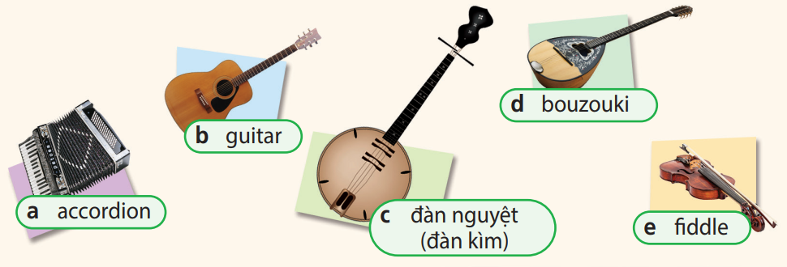
Work in pairs.
Match the pictures with their correct names
- accordion
- đàn nguyệt (đàn kìm)
- fiddle
- bouzouki
- guitar

Slide 6
Answer keys
bouzouki
guitar
accordion
đàn nguyệt
(đàn kìm)
fiddle

Slide 7

It’s time to learn …

Slide 8

Presentation

Slide 9
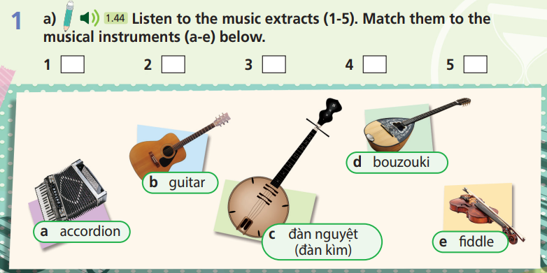
How many musical instruments are there?
Five.
What are you going to do?
Match musical extracts to musical instruments.

Slide 10


1 a) Listen to the music extracts (1-5). Match them to the musical instruments (a-e) below.
b
e
a
d
c

Slide 11


1 b) Listen again and match the countries (1-5) to their traditional musical instruments (a-e).
What are number 1-5?
Name of countries.
What are you going to do?
Match instruments to countries.

Slide 12
1 b) Listen again and match the countries (1-5) to their traditional musical instruments (a-e).
b
d
e
a
c

Slide 13

Practice

Slide 14

2 Work in groups. Collect information about a traditional musical instrument in your country or other countries under the headings name, type, description and other facts. Create a poster.
What information are you going to find out?
A traditional musical instrument.
What are you going to do with it?
Collect information with headings name, type, description and other facts, and then create a poster.
How to collect information?
Research online.

Slide 15
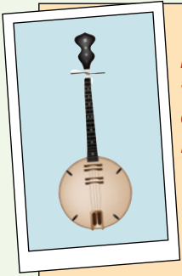
Suggested Answer
Name: đàn nguyệt (đàn kìm) Type: string instrument Description: a two-stringed instrument, look like a guitar Other facts: The instrument’s Vietnamese name, đàn nguyệt, means “moon string instrument.”

Slide 16

3 Give a presentation about a traditional musical instrument.
“Where words fail, music speaks,” said Hans Christian Andersen. Look at this picture. Do you know what this instrument is? It’s the đàn nguyệt, a traditional Vietnamese string instrument.
The đàn nguyệt is a two-stringed instrument and it looks like a guitar.
To play the đàn nguyệt, you need to pluck the strings with a small plectrum or guitar pick. This takes a lot of skills because it only has two strings!
Let’s listen to an extract. ... Isn’t that beautiful?
The đàn nguyệt name means “moon string instrument”.
The đàn nguyệt is a wonderful instrument to listen to. What do you think?

Slide 17

Production

Slide 18
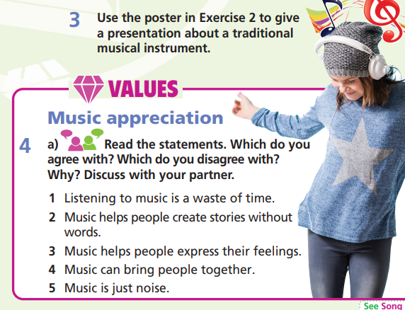
How many statements are there?
→ Five.
What are you going to do?
→ Discuss with our partner.

Slide 19

Music appreciation
4 a) Read the statements. Which do you agree with? Which do you disagree with? Why? Discuss with your partner.
1. Listening to music is a waste of time.
2. Music helps people create stories without words.
3. Music helps people express their feelings.
4. Music can bring people together.
5. Music is just noise.

Slide 20
To express
Agreeing
- That’s right!
- Absolutely!
- Exactly!
- Me too!
- Yes, I agree!
- I totally agree!
- I couldn’t agree more!
- I see exactly what you mean!
- You're right. That's a good point.
Disagreeing
I don’t agree!
I totally disagree!
Absolutely not!
That’s not right!
I’m not sure about that.

Slide 21
STUDENT A
STUDENT B
I completely disagree that listening to music is a waste of time and that music is just noise. I don’t know what I’d do if I didn’t have music.
I agree. I think that music can bring people together. I mean, that’s why people go to concerts.
Music defnitely helps people express their feelings. I can cry if I hear a sad song, but a dance song can make me feel energetic and happy.
Yeah, me too.

Slide 22

4 b) Choose a piece of music. Draw a picture or think of a story. Present it to the class.
Music is a part of our culture, tradition and life. It plays an important role in refreshing our mind and soul. I often listen to music and one of the songs that I love is “Wind of Change”. “Wind of Change” is considered one of the best rock music of all time and it is a ballad by the German music band ‘Scorpion’.
This song speaks about the hope in a time of dense tension and possibility of war and casualty. It represents the inner cry of people for peace and harmony.
I love this song - it is simple but powerful, inspires and motivates me and gives me hope.

Slide 23

CONSOLIDATION

Slide 24
Write a paragraph about your favourite piece of music (60-80 words) by answering the following questions.
What’s its name?
Who wrote it?
What’s it about?
Why do you love it?

Slide 25

WRAP-UP

Slide 26
Lesson 3
Today’s lesson
- Develop research skills.
- Develop public speaking skills.

Slide 27
Homework
Design own homemade musical instruments. Present them to class.
Prepare the next lesson (page 58 SB).

Slide 28
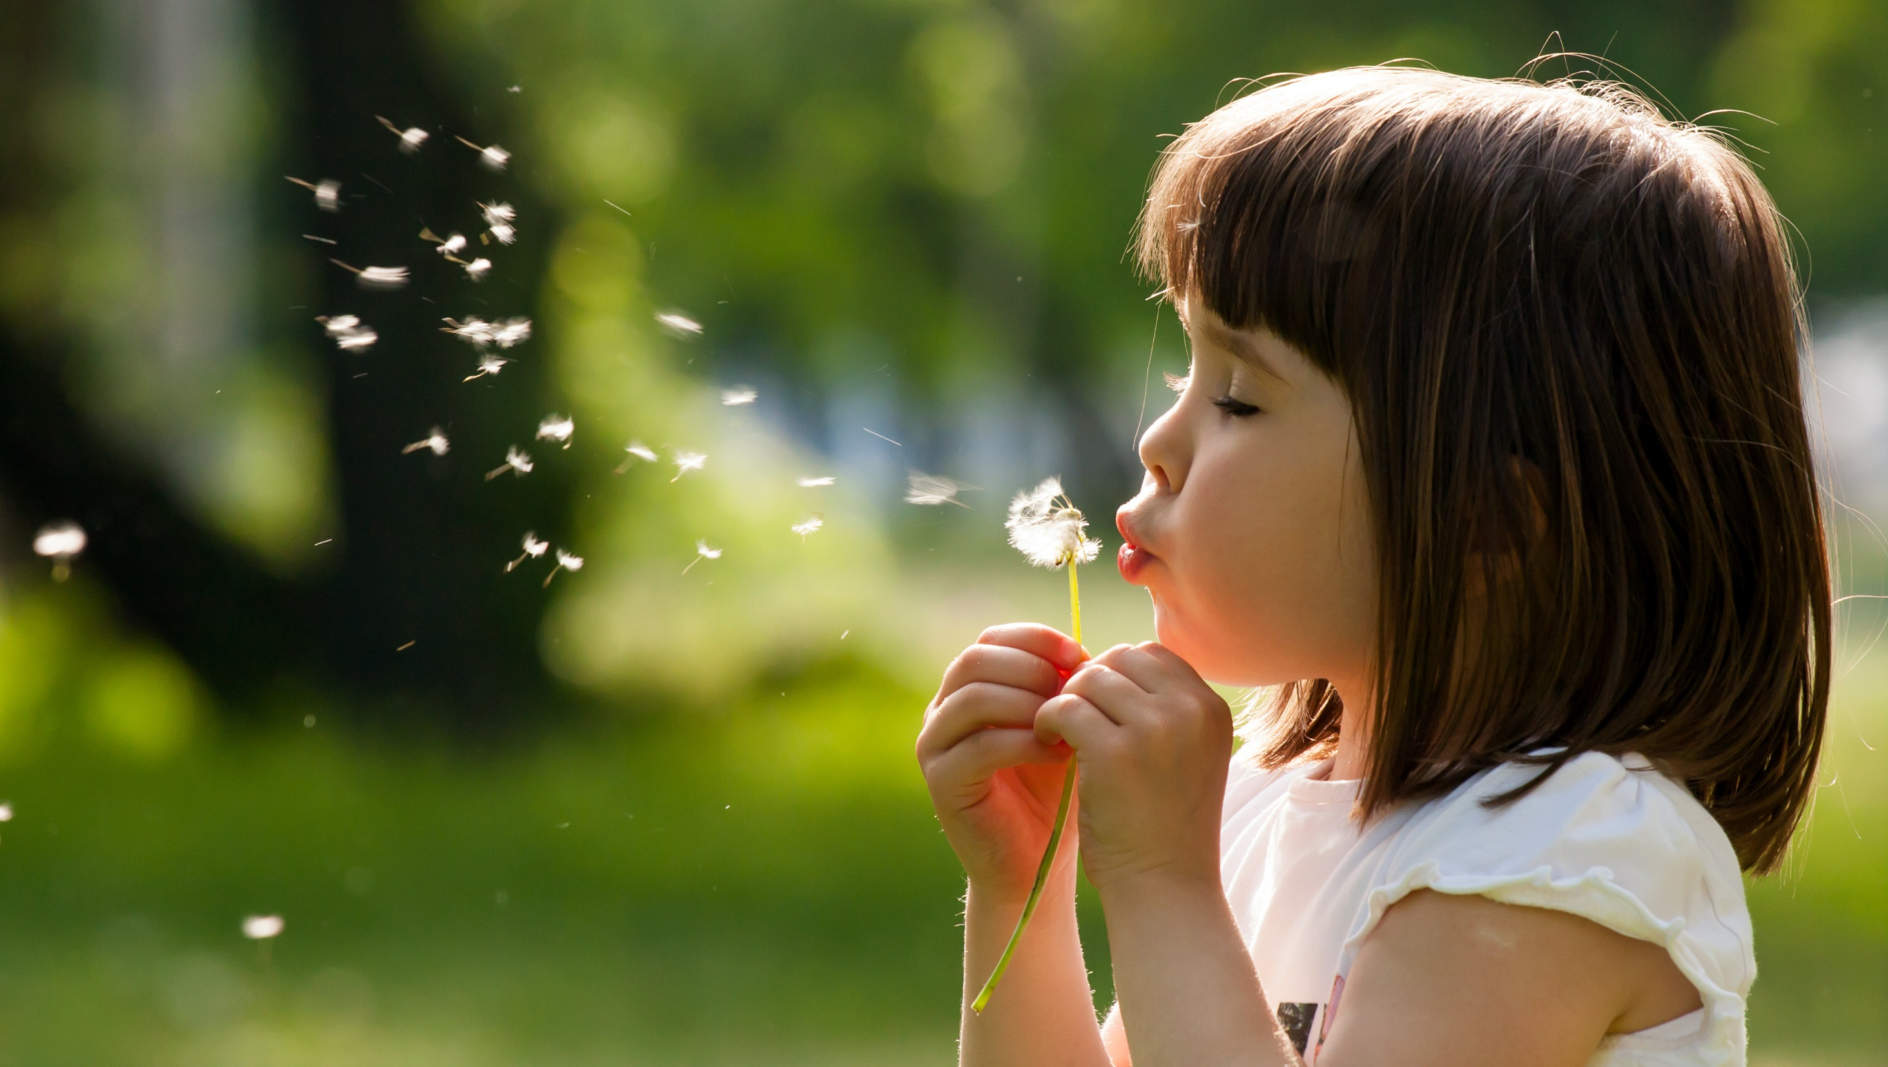
Enjoy your day!

