Slide 1


Slide 2

Unit
9
NATURAL DISASTERS
LESSON 2: A CLOSER LOOK 1
VOCABULARY
PRONUNCIATION
Unit
HOBBIES

Slide 3
LESSON 2: A CLOSER LOOK 1
WARM-UP
Game: Kim’s game
Vocabulary
Task 1: In column B, write the noun forms of the verbs in column A.
Task 2: Write a word or phrase from the box under the correct picture.
Task 3: Fill in each blank with a word or phrase from the box.
VOCABULARY
Task 4: Listen and repeat the words. Pay attention to the word stress.
Task 5: Listen and repeat the sentences. Mark the stress in the underlined words.
PRONUNCIATION
CONSOLIDATION
Wrap-up
Homework

Slide 4
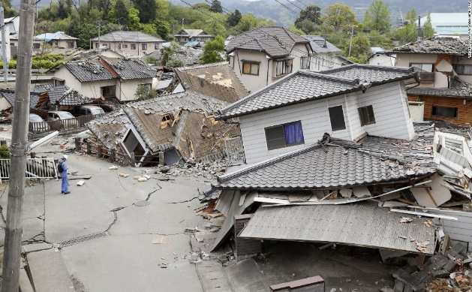
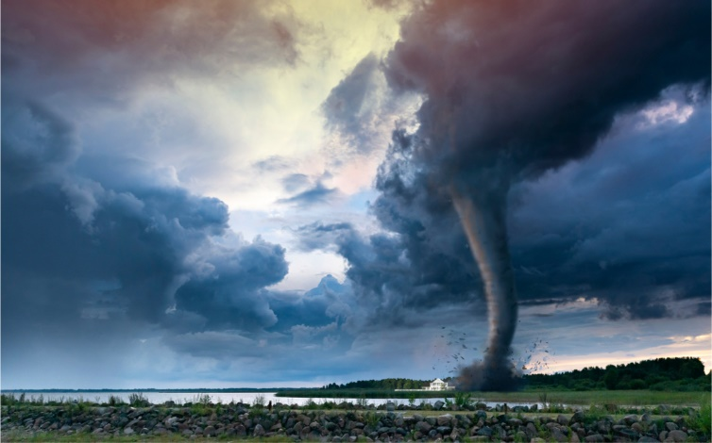
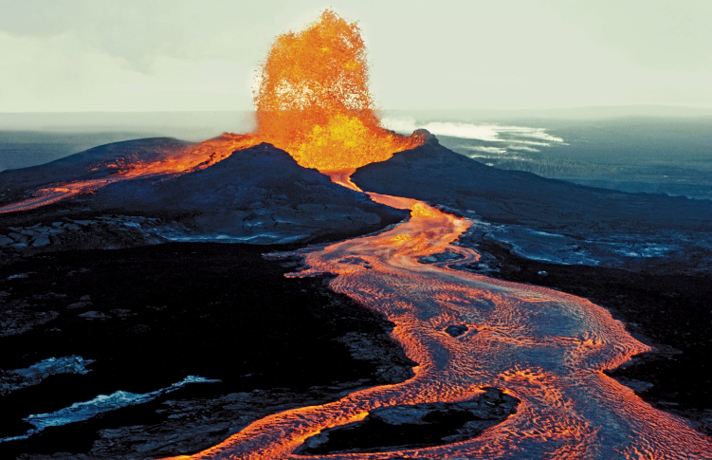
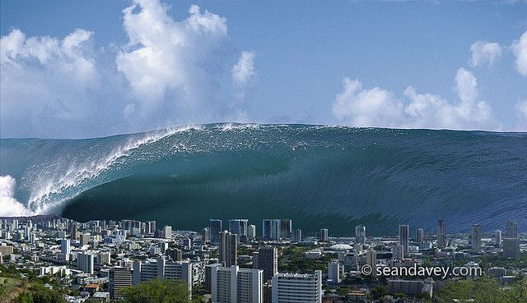
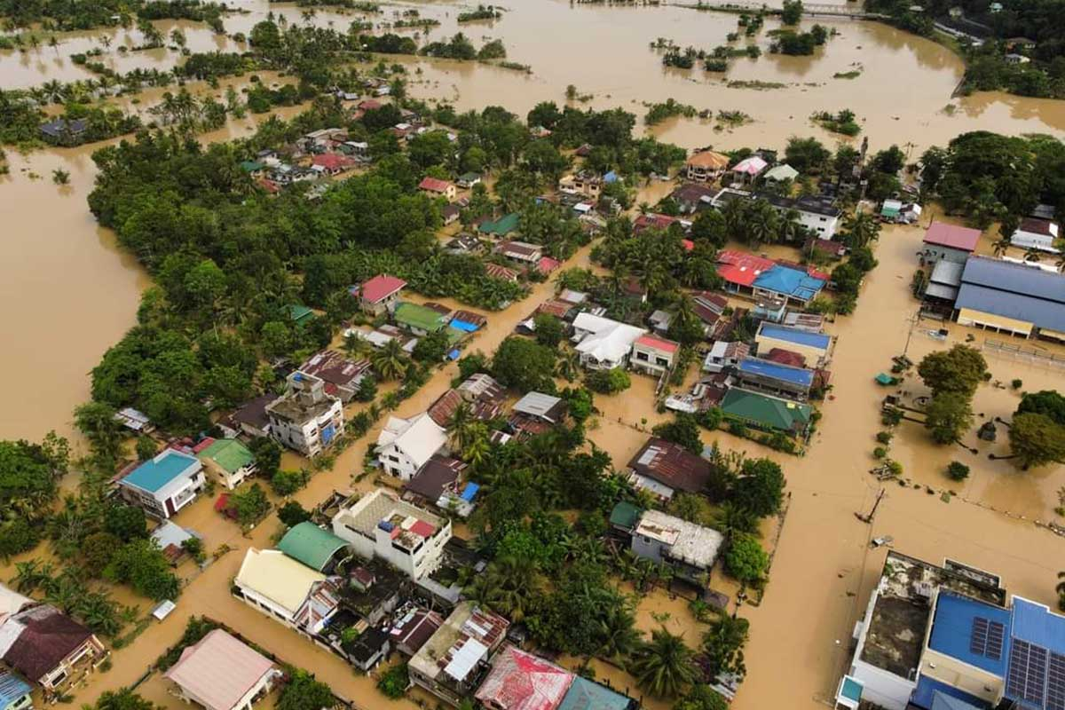
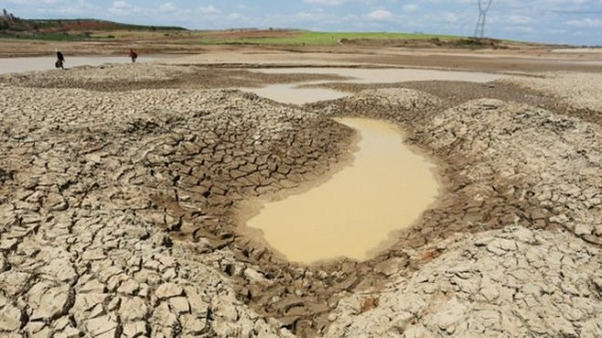
WARM-UP

Slide 5


WARM-UP
Earthquake
Tornado
Volcano
Tidal wave/ tsunami
Flood
Drought

Slide 6
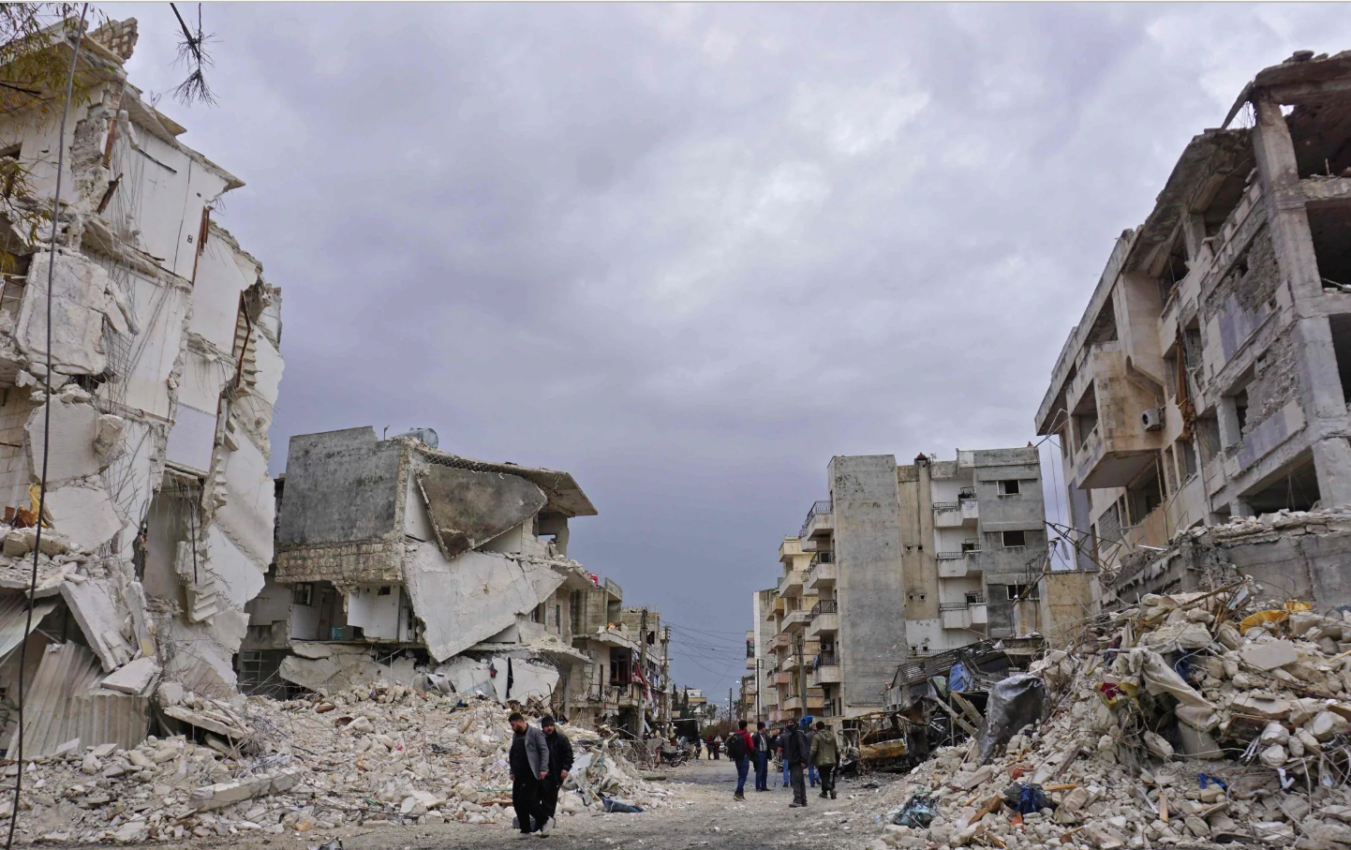

VOCABULARY
destroy (v)
/dɪˈstrɔɪ/
phá hủy

Slide 7
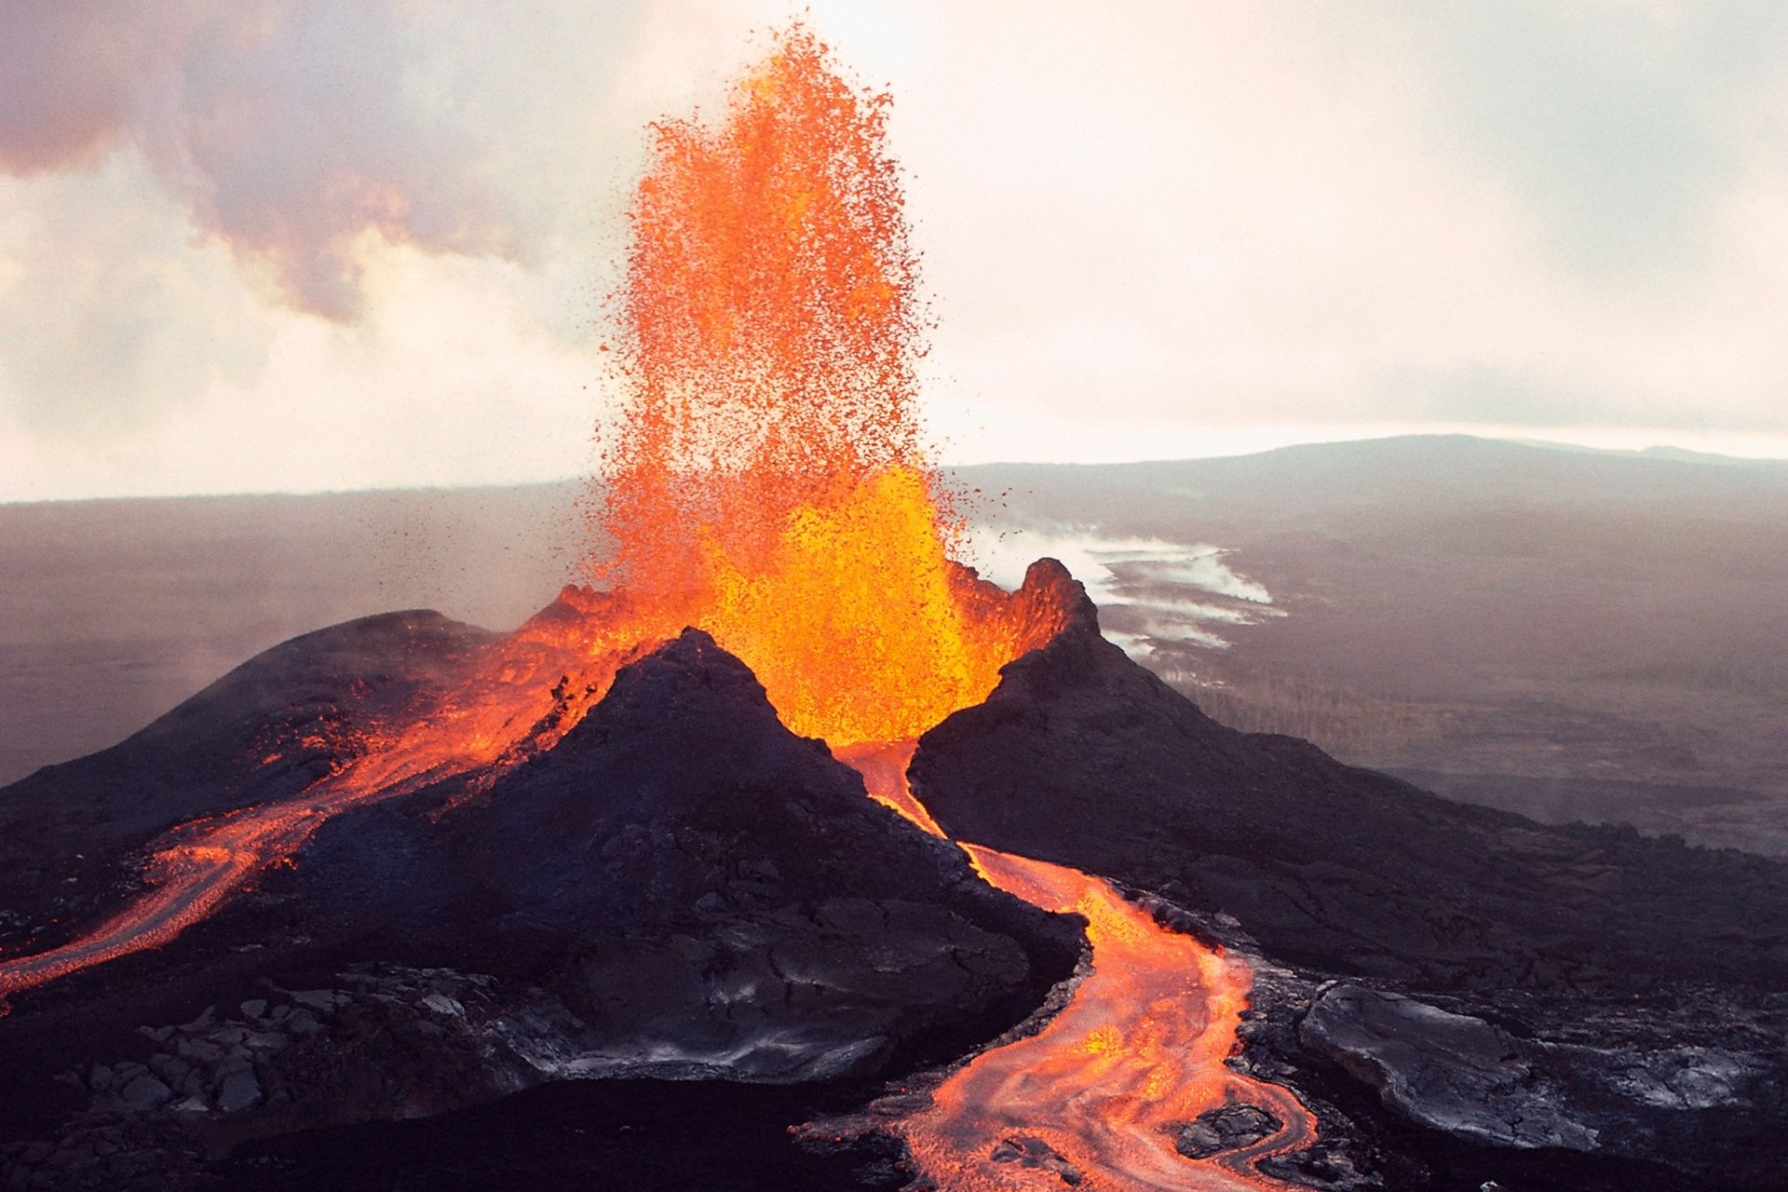
VOCABULARY
erupt (v)
/ɪˈrʌpt/
phun trào

Slide 8

VOCABULARY
predict (v)
/prɪˈdɪkt/
dự đoán

Slide 9
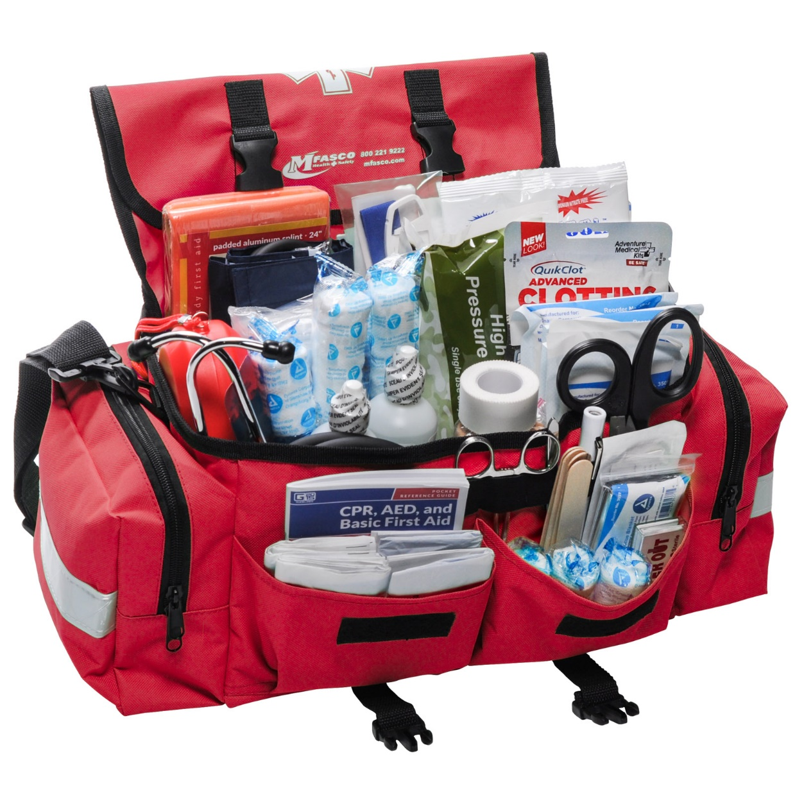
VOCABULARY
emergency kit (n)
/ɪˈmɜːdʒənsi kit/
bộ dụng cụ dùng trong trường hợp khẩn cấp

Slide 10
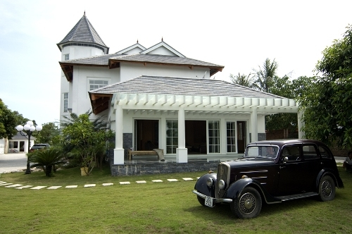
VOCABULARY
property (n)
/ˈprɒpəti/
của cải, nhà cửa

Slide 11
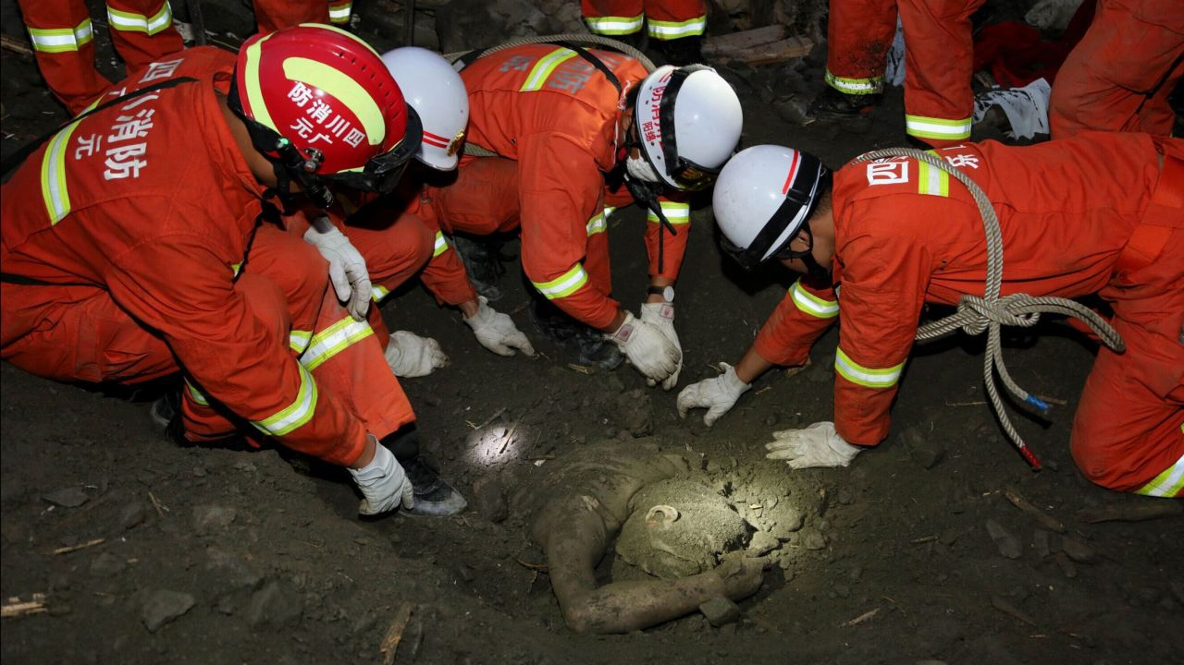
VOCABULARY
rescue worker (n)
/ˈreskjuːˈwɜːkər /
nhân viên cứu hộ

Slide 12
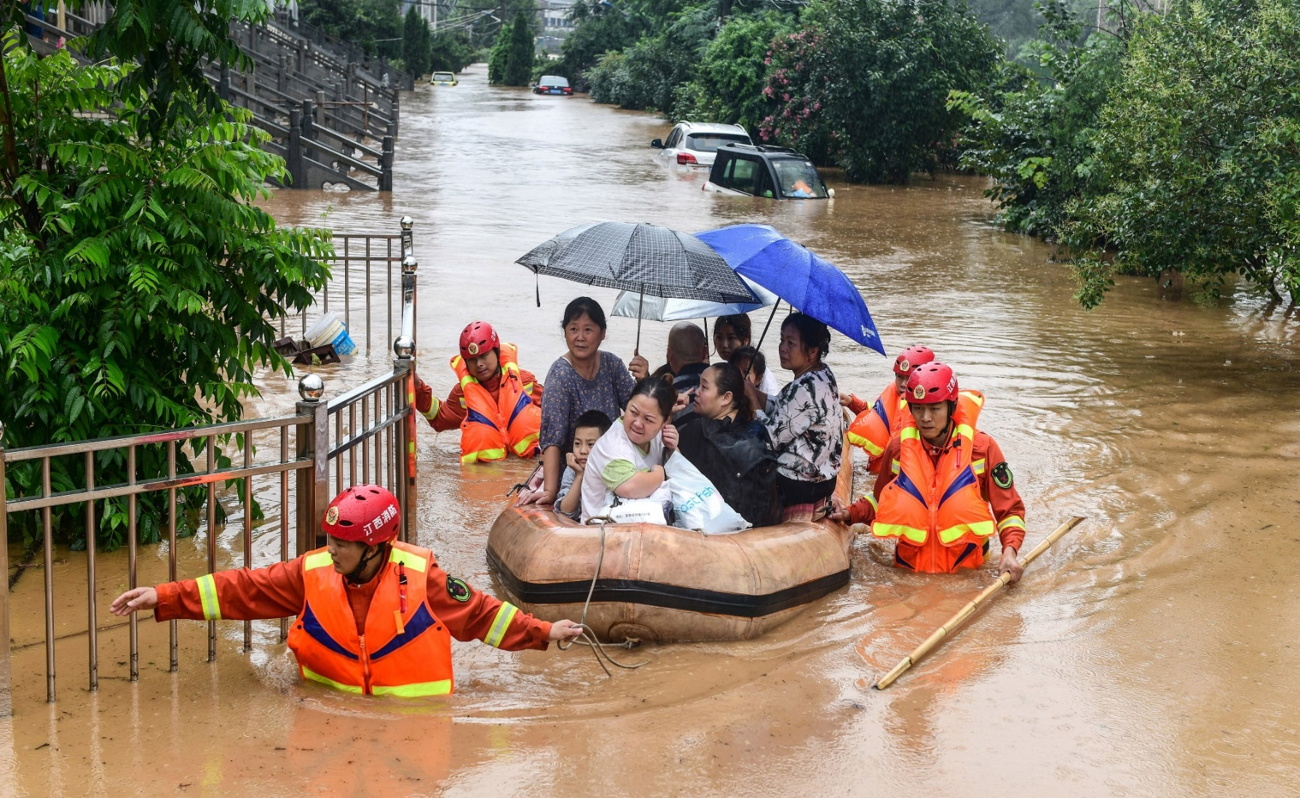
VOCABULARY
victim (n)
/ˈvɪktɪm/
nạn nhân

Slide 13
VOCABULARY
New words | Pronunciation | Meaning
1. destroy (v) | /dɪˈstrɔɪ/ | phá hủy
2. erupt (v) | /ɪˈrʌpt/ | phun trào
3. predict (v) | /prɪˈdɪkt/ | dự đoán
4. emergency kit | /ɪˈmɜːdʒənsikit/ | bộ dụng cụ dùng trong trường hợp khẩn cấp
5. property (n) | /ˈprɒpəti/ | của cải, nhà cửa
6. rescue worker | /ˈreskjuːˈwɜːkər / | nhân viên cứu hộ
7. victim (n) | /ˈˈvɪktɪm/ | nạn nhân

Slide 14
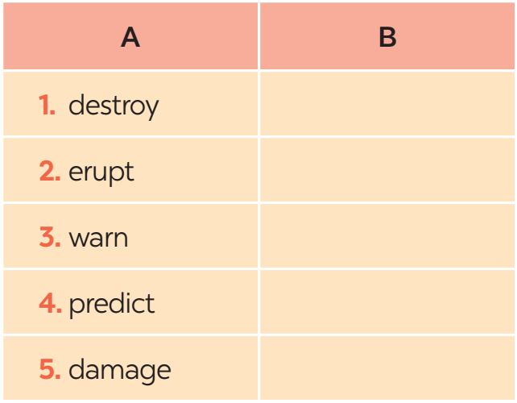
VOCABULARY
1
In column B, write the noun forms of the verbs in column A.
destruction
eruption
warning
prediction
damage

Slide 15

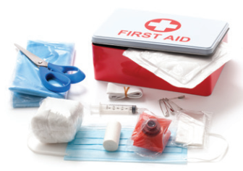

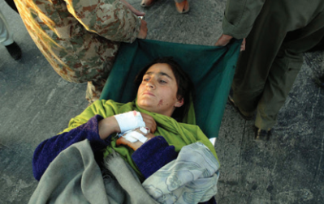
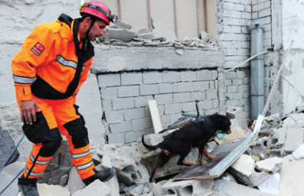
VOCABULARY
2
Write a word or phrase from the box under the correct picture.
emergency kit victim rescue worker property whistle
whistle
emergency kit
1. ____________
2. _____________
3. _____________
property
5. _____________
victim
rescue worker
4. _____________

Slide 16
VOCABULARY
3
Fill in each blank with a word or phrase from the box.
warning predict property damage emergency kit
1. Natural disasters can cause serious ________ to human life.
2. Local authorities gave a flood ________ yesterday, so today people are moving to safer places.
3. To prepare for a natural disaster, we should make a(n) ___________.
4. It’s hard to believe that we cannot _______ when earthquakes will happen.
5. They lost all of their ________ because of the volcanic eruption.
damage
warning
emergency kit
predict
property

Slide 17
PRONUNCIATION
4
Listen and repeat the words. Pay attention to the word stress.
musical dangerous
national humorous
practical poisonous
personal marvellous

Slide 18
PRONUNCIATION
5
Listen and repeat the sentences. Mark the stress in the underlined words.
‘
1. The flood victims are collecting their personal property.
2. Avoid dangerous places, such as windows or bookcases, during an earthquake.
3. There are numerous tropical storms in this area every year.
4. Some natural disasters, such as landslides, usually happen in mountainous areas.
5. She gave us practical tips about treating poisonous wastes.
‘
‘
‘
‘
‘
‘
‘

Slide 19
CONSOLIDATION
1
Wrap-up
VOCABULARY
PRONUNCIATION

Slide 20

CONSOLIDATION
2
Homework
- Learn the new words by heart .
- Do exercises in the workbook.
- Prepare for Lesson 3 - A closer look 2.

Slide 21

Website: hoclieu.vn
Fanpage: facebook.com/tienganhglobalsuccess.vn/

