Slide 1


Slide 2

Unit
10
1
Unit
FAMILY LIFE
ECOTOURISM
LESSON 1
GETTING STARTED
An eco-friendly fieldtrip to Phong Nha Cave

Slide 3

Unit
1
1
FAMILY LIFE
Family Life
Unit
OBJECTIVES
Gain an overview about the topic ecotourism
Use words and phrases related to ecotourism

Slide 4
LESSON 1
GETTING STARTED
WARM-UP
Brainstorming
PRESENTATION
Vocabulary
Task 1: Listen and read.
Task 2: Correct the mistakes.
Task 3: Put each phrase into the correct column.
Task 4: Complete these sentences from Task 1.
PRACTICE
CONSOLIDATION
Wrap-up
Homework

Slide 5
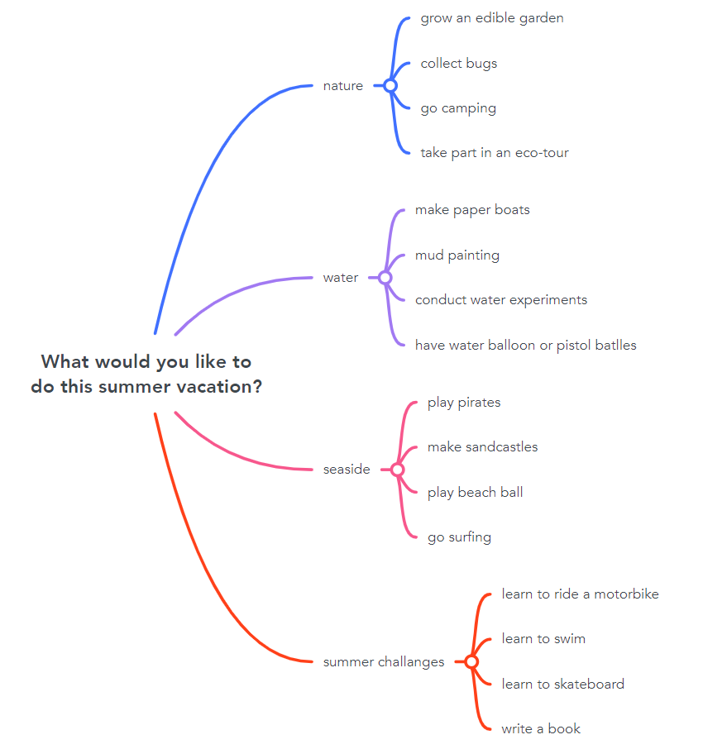
WARM-UP
What would you like to do this summer vacation?
summer challenges

Slide 6
LESSON 1
GETTING STARTED
WARM-UP
Brainstorming
PRESENTATION
Vocabulary

Slide 7
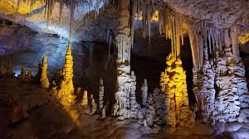

PRESENTATION
stalactite (n)
/ˈstæləktaɪt/
piece of rock hanging down from the roof of a cave

Slide 8

PRESENTATION
fieldtrip (n)
/ˈfiːldˌtrɪp/
a visit made by students to study something away from their school or college

Slide 9
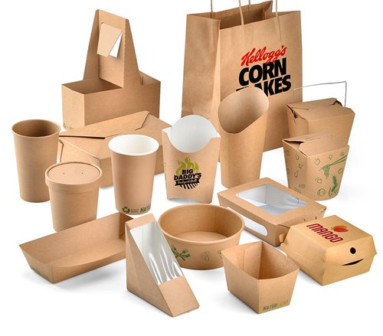
PRESENTATION
packaging (n)
/ˈpækɪdʒɪŋ/
the materials in which objects are wrapped before being sold

Slide 10
PRESENTATION
New words | Pronunciation | Meaning
stalactite (n) | /ˈstæləktaɪt/ | piece of rock hanging down from the roof of a cave
fieldtrip (n) | /ˈfiːldˌtrɪp/ | a visit made by students to study something away from their school or college
packaging (n) | /ˈpækɪdʒɪŋ/ | the materials in which objects are wrapped before being sold

Slide 11
LESSON 1
GETTING STARTED
WARM-UP
Brainstorming
PRESENTATION
Vocabulary
Task 1: Listen and read.
Task 2: Correct the mistakes.
Task 3: Put each phrase into the correct column.
Task 4: Complete these sentences from Task 1.
PRACTICE

Slide 12
PRACTICE
1
Listen and read.
An eco-friendly fieldtrip to Phong Nha Cave
Ms Hoa: Listen, everyone! this year, we’re going on a fieldtrip to Phong Nha Cave, a tourist attraction in Quang Binh Province.
Class: Hooray!
Nam: I hope I can find some small pieces of stalactites. If I add some to my rock collection, it will be the best at school.
Mai: I’ll buy a lot of snacks to share. We'll have fun!
Ms Hoa: We will have fun, but in a different way. this time, the fieldtrip is going to be eco-friendly.
Nam: Ms Hoa, what’s an eco-friendly fieldtrip?
Ms Hoa: Going on an eco-friendly fieldtrip means we’ll enjoy, explore and learn about the place, but in a way that will not damage it. So, Nam, I’m afraid you can’t take any stalactites because it takes hundreds or sometimes thousands of years for them to form.

Slide 13
PRACTICE
1
Listen and read.
An eco-friendly fieldtrip to Phong Nha Cave
Nam: Wow! I didn’t know that. I won’t even touch them, I promise.
Mai: But can we bring snacks?
Ms Hoa: Yes, but if I were you, I wouldn’t bring too many snacks. We don’t want to leave litter behind and damage the environment.
Mai: I agree. I’ll also try to bring snacks with less packaging.
Ms Hoa: that’s a good idea. Let’s hope our fieldtrip will be a fun educational experience for everyone.

Slide 14
PRACTICE
PRACTICE
2
Read the conversation again. Then find and correct a mistake in each sentence below.
1. On an eco-friendly fieldtrip, tourists enjoy, explore and damage the environment.
2. Nam will take pieces of stalactites because they take a long time to form.
3. Mai will bring snacks with a lot of packaging on the trip.
but not
(OR: On an eco-friendly fieldtrip, tourists enjoy, explore and damage the environment. → protect/ learn about)
→ will not / won’t
→ will not / won’t (OR: Mai will bring snacks with a lot of packaging on the trip. → less)

Slide 15
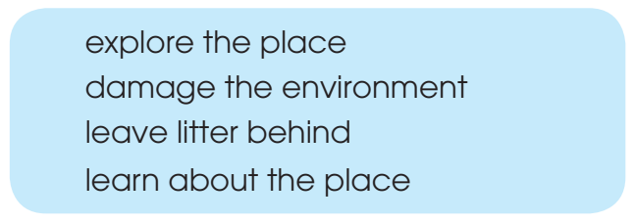
PRACTICE
3
Put each phrase into the correct column.
Dos | Don’ts
explore the place
damage the environment
learn about the place
leave litter behind

Slide 16
PRACTICE
4
Complete these sentences from Task 1.
1. Nam says, ‛If I ___________ some to my rock collection, it ___________ the best at school!’
2. Ms Hoa says, ‛If I ___________ you, I ___________ bring too many snacks’.
add
will be
were
wouldn’t

Slide 17
LESSON 1
GETTING STARTED
WARM-UP
Brainstorming
PRESENTATION
Vocabulary
Task 1: Listen and read.
Task 2: Correct the mistakes.
Task 3: Put each phrase into the correct column.
Task 4: Complete these sentences from Task 1.
PRACTICE
CONSOLIDATION
Wrap-up
Homework

Slide 18
CONSOLIDATION
1
Wrap-up
Gain an overview about the topic ecotourism
Use words and phrases related to ecotourism

Slide 19
CONSOLIDATION
2
Homework
Choose a local tourist attraction and find information about it.
Exercises in the workbook
Project preparation

Slide 20

Website: hoclieu.vn
Fanpage: facebook.com/tienganhglobalsuccess.vn/

