Slide 1
Gender Equality
Unit 6
Lesson 1: Getting Started
Equal job opportunities

Slide 2
OBJECTIVES
Gain an overview about the topic Gender Equality
Identify and use words and phrases related to the topic Gender Equality
Identify and use the passive voice with modals

Slide 3
Table of contents
01
02
Warm-up
Presentation
03
04
Practice
Consolidation

Slide 4
01
Warm-up
Game: Charades

Slide 5
WARM - UP
Charades – Rules:
Play in two teams.
Each team sends one student to the board, facing the class. You MUST NOT turn around!
When a word appears on the screen, students on the board must describe the word to the guessers of your team. No talking! Gestures only!
Whoever guesses the correct word faster wins 1 point.
Both teams change the guessers after each word.

Slide 6
Surgeon

Slide 7
Pilot

Slide 8
Firefighter

Slide 9
Nurse

Slide 10
Teacher

Slide 11
02
Introduction

Slide 12
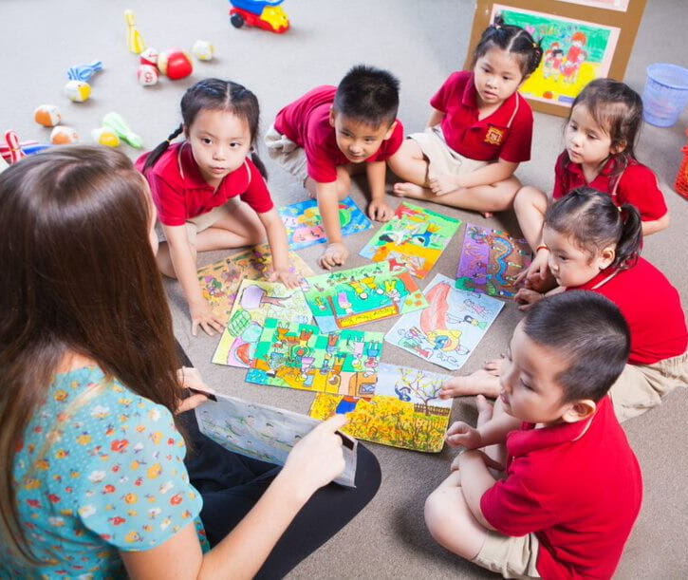
PRESENTATION
PRESENTATION
kindergarten (n)
/ˈkɪndəɡɑː(r)tn/
a school for children between the ages of about three and five

Slide 13
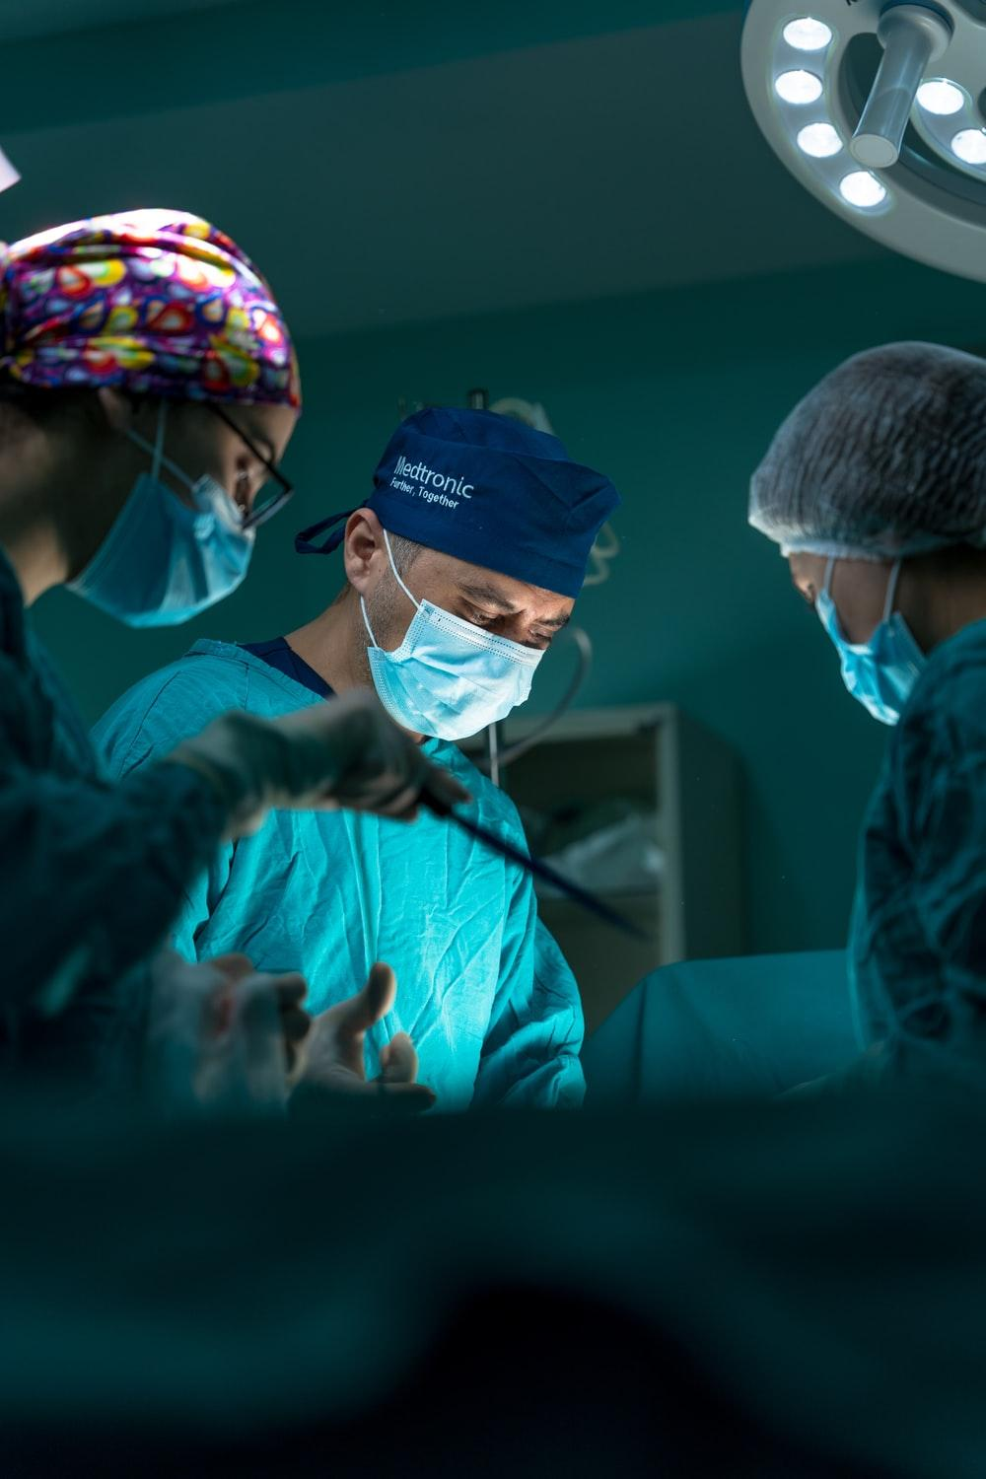
PRESENTATION
surgeon (n)
/ˈsɜː(r)dʒən/
a doctor who is trained to perform surgery

Slide 14
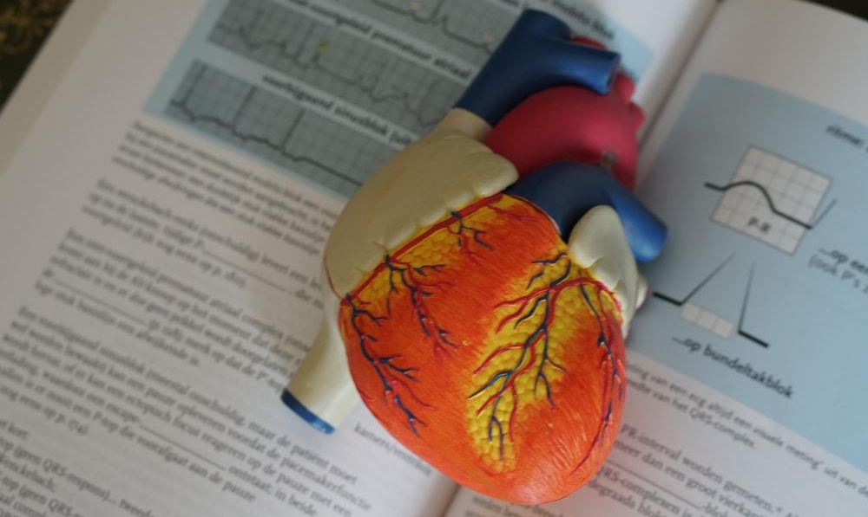
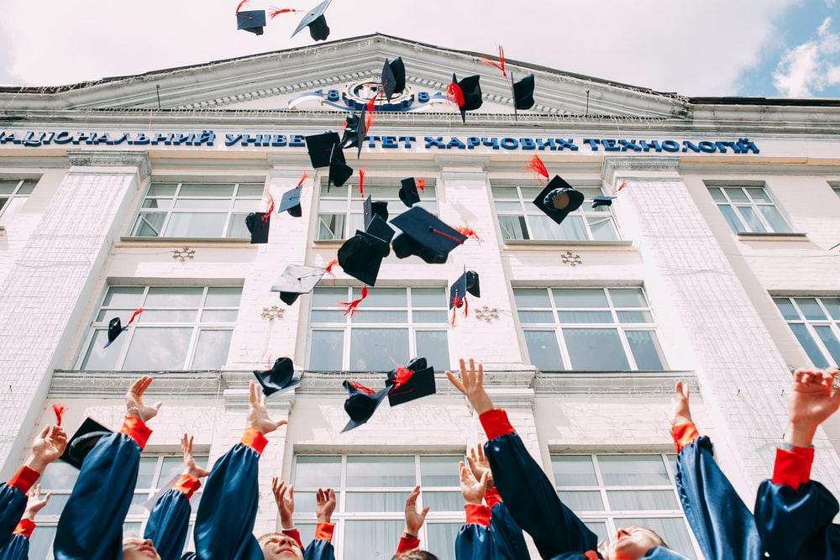
PRESENTATION
medical school (n)
/ˈmedɪkl skuːl/
a college or a department of a university where students study to obtain a degree in medicine

Slide 15
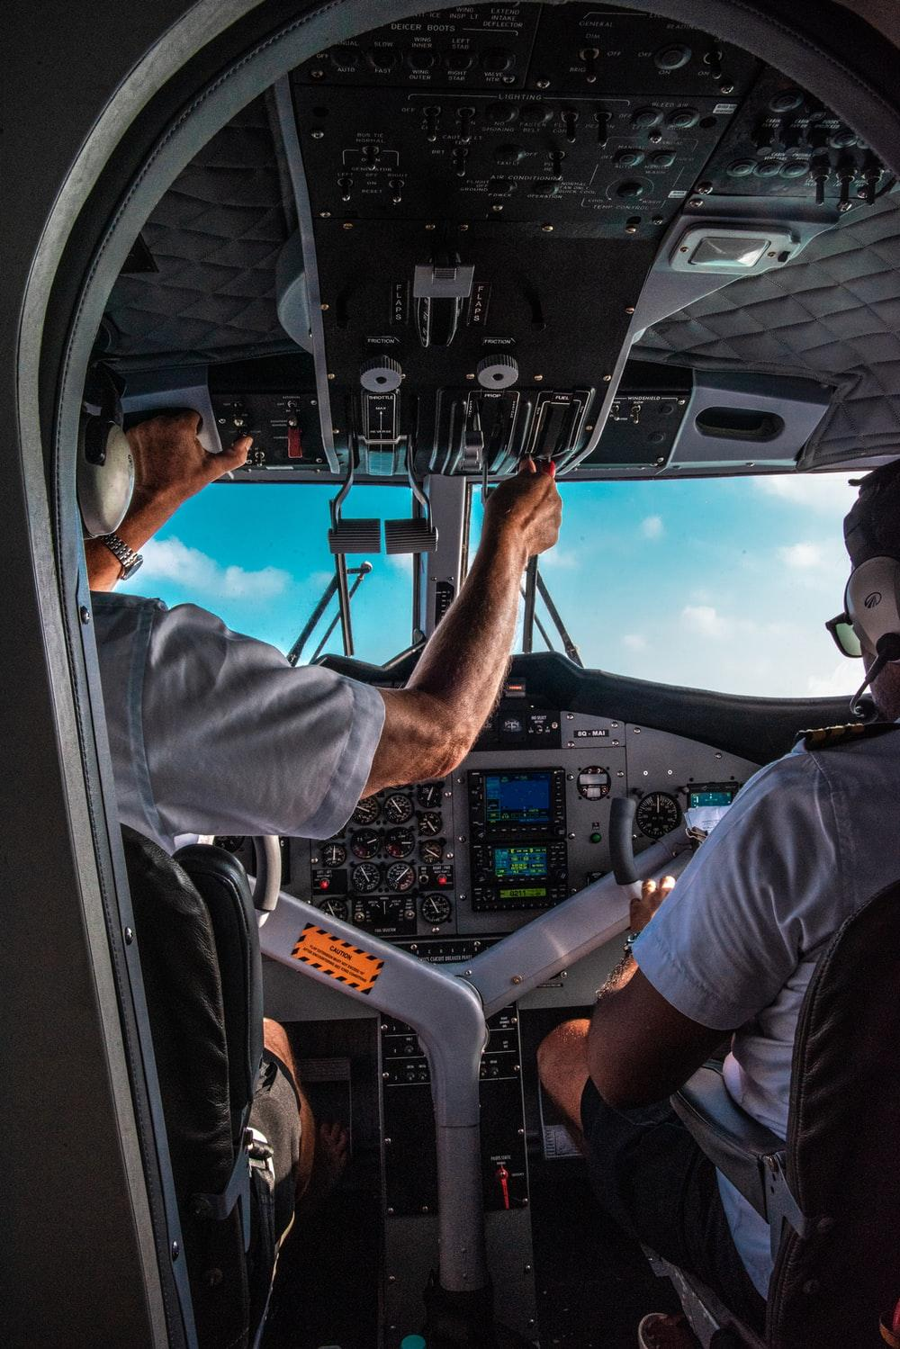
PRESENTATION
pilot (n)
/ˈpaɪlət/
a person who operates the controls of an aircraft, especially as a job

Slide 16
PRESENTATION
New words | Pronunciation | Meaning
kindergarten (n) | /ˈkɪndəɡɑː(r)tn/ | a school for children between the ages of about two and five
surgeon (n) | /ˈsɜː(r)dʒən/ | a doctor who is trained to perform surgery
medical school (n) | /ˈmedɪkl skuːl/ | a college or a department of a university where students study to obtain a degree in medicine
pilot (n) | /ˈpaɪlət/ | a person who operates the controls of an aircraft, especially as a job

Slide 17
03
Practice

Slide 18
PRACTICE
PRACTICE
1
Listen and read.
Equal job opportunities
At an international summer camp: Lan is talking with Mark and Linda about jobs.
Lan: It’s great to have another week full of activities and trips at the camp.
Mark: Oh, yeah. I like the trip to the kindergarten most. The kids were adorable and the teachers were great. I think I’ll be a kindergarten teacher.
Lan: That’s fantastic. My cousin works at a kindergarten and the children love being in his class. By the way, what do you want to be in the future, Linda?
Linda: Oh, I’ve always wanted to be a surgeon, so I’ll go to medical school. What about you, Lan?

Slide 19
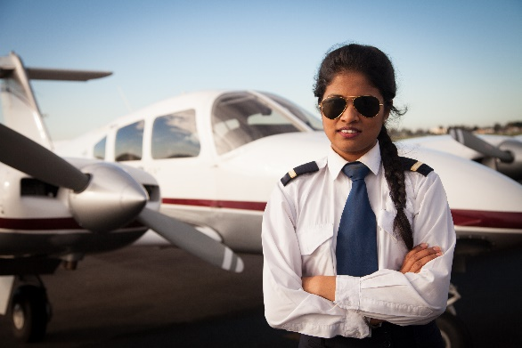
PRACTICE
1
Listen and read.
Equal job opportunities
Lan: Me? My dream is to become an airline pilot. That’s why I’m focusing on maths and physics, and exercising more to improve my fitness.
Linda: Cool! I hope your dream will come true. In some countries girls may not be allowed to be pilots.
Lan: That’s true, Linda. We’re lucky to live in a country where boys and girls are encouraged to do the jobs they want.
Mark: I couldn’t agree more. Girls mustn’t be kept home in today’s world. Boys and girls should be treated equally and given the same job opportunities.

Slide 20
PRACTICE
PRACTICE
2
Read the conversation again and tick (✓) T (True) or F (False).
 |  | T | F
1. | Linda would like to be a kindergarten teacher.
2. | Lan wants to be a teacher of maths and physics in the future.
3. | Mark says that girls mustn’t be kept home in today’s world.
✔
✔
✔

Slide 23
Choose the words to make meaningful phrase
opportunities
school
equally
GREAT!
NEXT
treated

Slide 24
Choose the words to make meaningful phrase
school
opportunities
equally
GREAT!
NEXT
medical

Slide 25
Choose the words to make meaningful phrase
school
equally
opportunities
GREAT!
job

Slide 26
PRACTICE
4
Complete the summary below. Use the verb phrases from the conversation in activity 1.
Three students are talking about future jobs. While Mark wants to work as a kindergarten teacher, Linda wants to be a surgeon. Lan dreams to be an airline pilot. Linda says that in some countries girls (1)_________________ to be pilots. Mark thinks girls (2)______________ home in today’s world. He says that boys and girls (3) ________________ equally and given the same job opportunities.
may not be allowed
mustn’t be kept
should be treated

Slide 27
04
Consolidation

Slide 28
CONSOLIDATION
1
Wrap-up
Some words and phrases related to Gender Equality
Reading for specific information
Scanning skills.

Slide 29
CONSOLIDATION
2
Homework
Do exercises in the workbook
Project preparation.

Slide 30
SEE YOU NEXT TIME !!

