Slide 1

Unit 6: Be green
Lesson 6f: Skills
Page 104

Slide 2
Lesson Outline
Warm-up
Reading
Consolidation
Wrap-up

Slide 3
Objectives
By the end of this lesson, students will be able to…
- listen and read for specific information.
- read for key information.
- enrich vocabulary related to the topic: set up, valley, spot.

Slide 4

WARM-UP

Slide 5
Choose the word whose underlined part is pronounced differently from that of the others. Practise saying them.
1. A. canteens B. projects C. photos D. problems
/kænˈtiːnz/ /ˈprɒdʒekts/ /ˈfəʊtəʊz/ /ˈprɒbləmz/
2. A. boots B. noon C. food D. foot
/buːts/ /nuːn/ /fuːd/ /fʊt/
3. A. joined B. picked C. stayed D. cleared
/dʒɔɪnd/ /pɪkt/ /steɪd/ /klɪərd/

Slide 6


Listen to the sounds and answer the questions.
Where are you?
I am probably in ….
2. What can you see?
I can see…
3. How do you feel?
I feel…
The zoo?
The park?
The countryside?
The forest?
The river?
The waterfalls?
The trees?
The mountains?
The birds?
The tigers?
Relaxed?
Happy?
Excited?

Slide 7
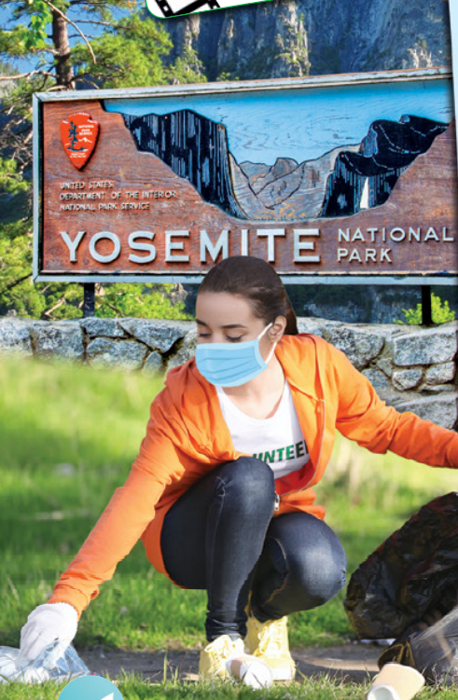
Work in groups of 3-4. Answer the questions.
What can you do there?
What tasks can volunteers do when they visit Yosemite National Park?
Go camping?
Go hiking?
Go trekking?
Go climbing?
Picking up litter

Slide 8

It’s time to learn …

Slide 9
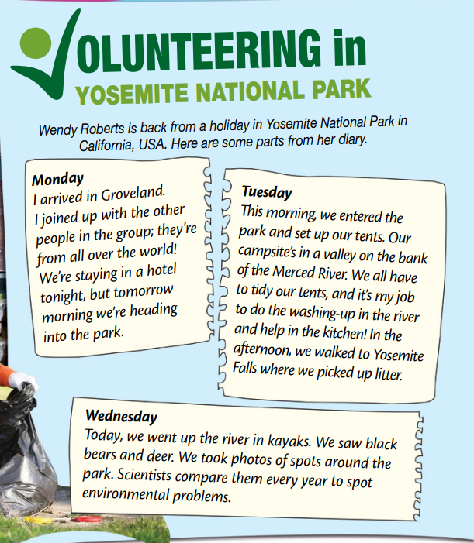
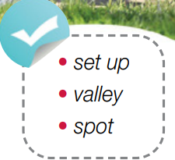
Pre-reading
Find these words in the text, try to guess what are their meanings.

Slide 10
Vocabulary
Listen and repeat.
set up (tents) /ˈset ʌp/ (v. phr) dựng (lều)
valley /ˈvæli/ (n) thung lũng
spot /spɑːt/ (v) nhìn thấy, phát hiện spot /spɑːt/ (n) nơi, điểm
volunteer /ˌvɒlənˈtɪə(r)/ (v)/(n) tình nguyện / tình nguyện viên

Slide 11
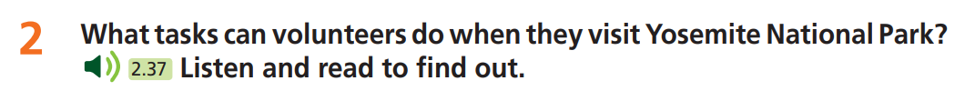
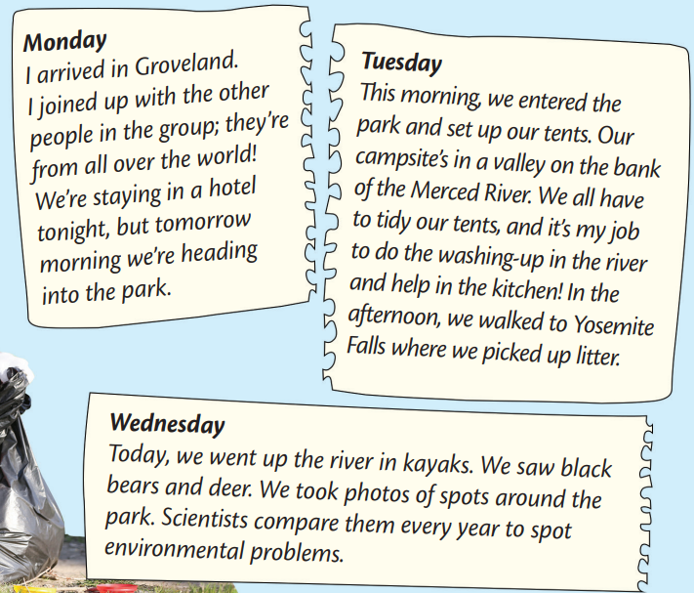
While-reading
The volunteers can:
The volunteers can tidy their tents, do the washing-up, help in the kitchen and pick up litter.
The volunteers can take photographs and scientists compare them every year to spot environmental problems in Yosemite National Park.

Slide 12
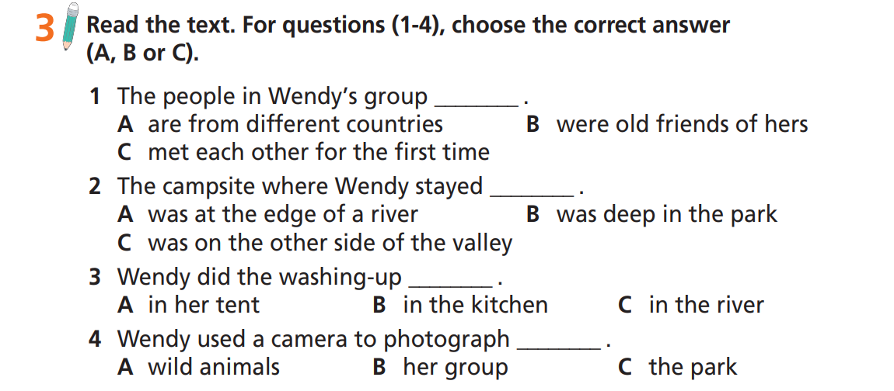
Read the task and underline the key words.

Slide 13
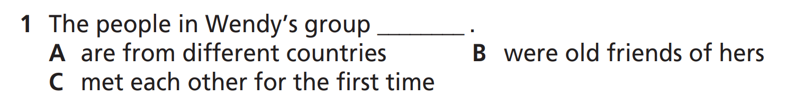
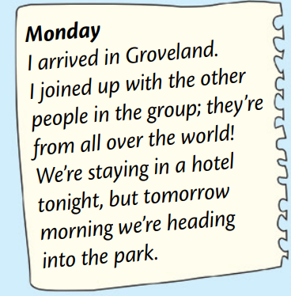
Now, read the text again and check the answers.

Slide 14
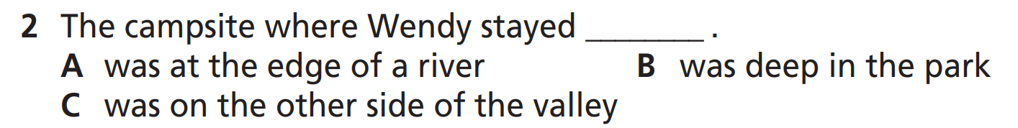
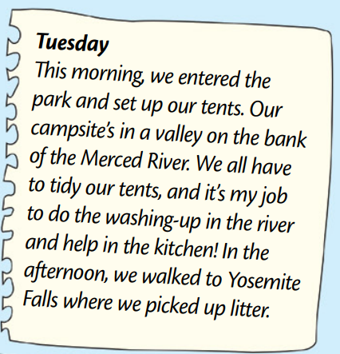
Now, read the text again and check the answers.

Slide 15
Now, read the text again and check the answers.

Slide 16
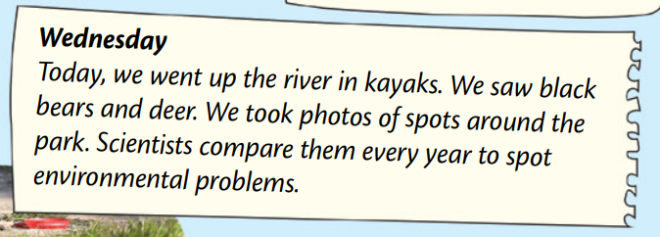
Now, read the text again and check the answers.

Slide 17
Extra Task
Read the text again and decide if the statements are RIGHT (R), WRONG (W) OR DOESN’T SAY (DS)
First, underline the key words.
1. Wendy stayed in a tent in the park on her first day.
2. Wendy spent 2 days in Yosemite National Park.
3. The volunteers picked up the litter along the river.
4. There is too much plastic in the valley on the bank of the Merced River.
5. Wendy helps scientists spot the environmental problems.

Slide 18
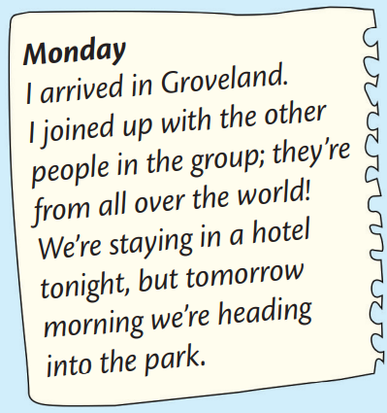
Extra Task
Read the text again and decide if the statements are RIGHT (R), WRONG (W) OR DOESN’T SAY (DS)
1. Wendy stayed in a tent in the park on her first day.
F

Slide 19
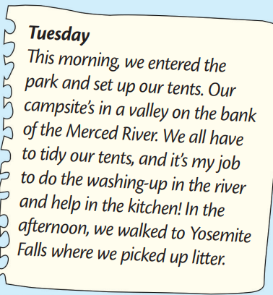
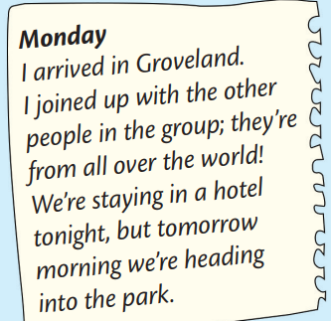
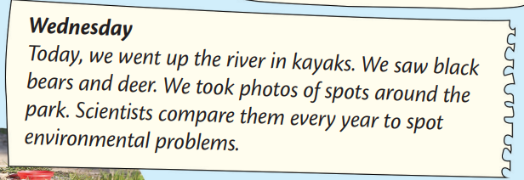
Extra Task
Read the text again and decide if the statements are RIGHT (R), WRONG (W) OR DOESN’T SAY (DS)
2. Wendy spent 2 days in Yosemite National Park
T

Slide 20
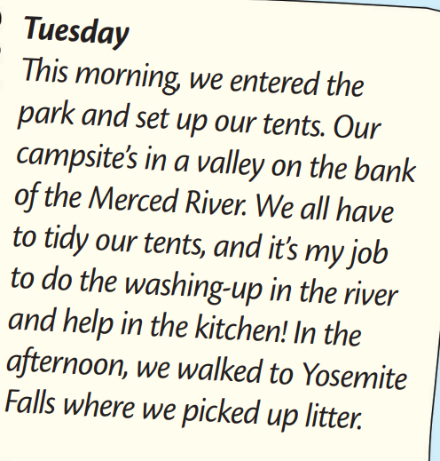
Extra Task
Read the text again and decide if the statements are RIGHT (R), WRONG (W) OR DOESN’T SAY (DS)
3. The volunteers picked up the litter along the river.
F

Slide 21
Extra Task
Read the text again and decide if the statements are RIGHT (R), WRONG (W) OR DOESN’T SAY (DS)
4. There is too much plastic in the valley on the bank of the Merced River.
DS

Slide 22
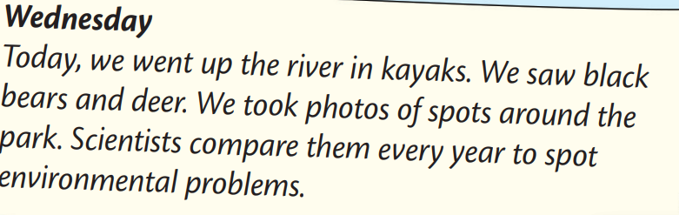
Extra Task
Read the text again and decide if the statements are RIGHT (R), WRONG (W) OR DOESN’T SAY (DS)
5. Wendy helps scientists spot the environmental problems.
T

Slide 23

Post-reading
First, discuss with your partner the meaning of “eco-teen”.
Notes: eco-teen is a teenager who does volunteer work and activities to help protect the environment.
You can answer they following questions:
Is she doing any volunteer activities? What are they?
Suggested answer:
Wendy is an eco-teen because she is on a volunteering holiday. She is staying in a national park and helping to do the washing-up, pick up litter and take photographs for scientists.

Slide 24

CONSOLIDATION

Slide 25
Are you an eco-teen? Write a paragraph (at least 40 words) to explain how you are an eco-teen or what you’ll do to become an eco-teen.
Are you doing any volunteer eco-activities?
If not, what will you do to become an eco-teen?

Slide 26

WRAP-UP

Slide 27
Today’s lesson
Vocabularies
valley
spot
set up (tent)
Reading
Listen and read for specific information.
Read for key information.

Slide 28
Homework
Practise the vocabularies; and make sentences using them.
Do the exercises in TA 7 Right on WB (page 53).
Prepare the next lesson (page 105 SB).
Do Unit 6 Test 1 in Bài Tập Bổ Trợ TA 7 Right on (pp. 50 & 51).

Slide 29

Enjoy your day!

