Slide 1


Slide 2

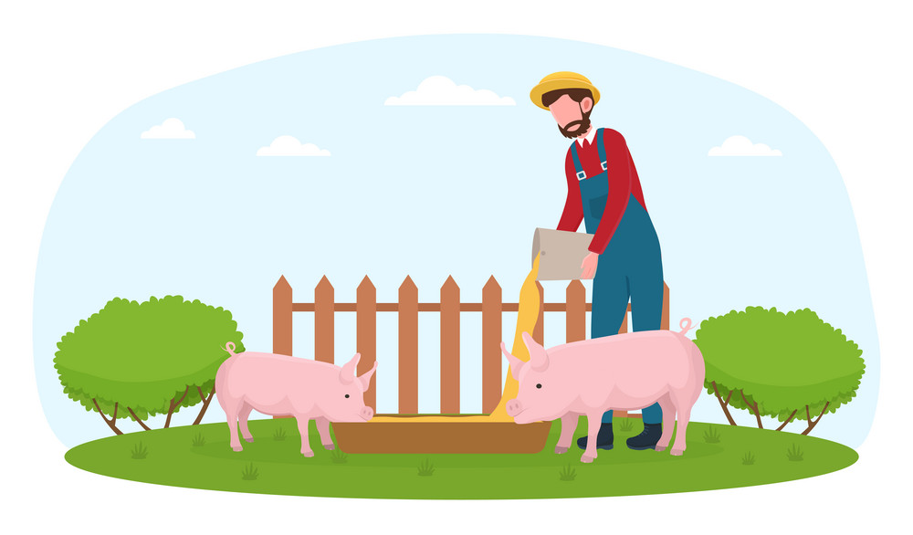
Unit
2
LIFE IN THE COUNTRYSIDE
LESSON 3: A CLOSER LOOK 2

Slide 3
LESSON 3: A CLOSER LOOK 2
WARM-UP
Making comparison
PRESENTATION
Comparative adverbs
Task 1: Write the comparative forms of the adverbs in the table below.
Task 2: Complete the sentences with the comparative forms of the adverbs in brackets.
Task 3: Complete the sentences with suitable comparative forms of the adverbs from the box.
Task 4: Read the situations and complete the sentences using the comparative forms.
PRACTICE
PRODUCTION
Task 5: Work in pairs. Ask and answer to find out who…
CONSOLIDATION
Wrap-up
Homework

Slide 4
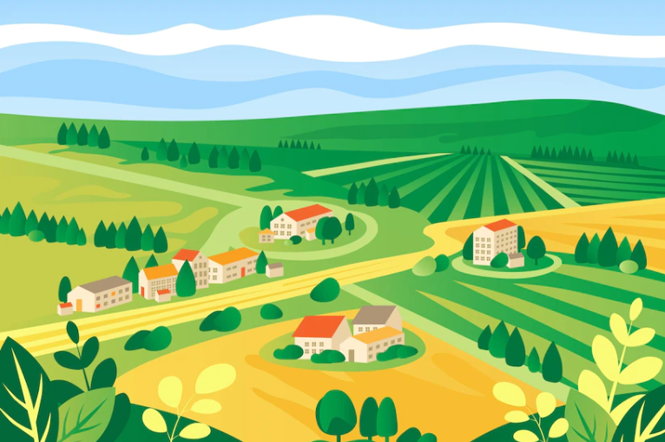

WARM-UP
MAKING
COMPARISON

Slide 5
PRESENTATION
– For most adverbs (often with two or more syllables), we make comparative forms by adding more.
Example:
slowly → more slowly
carefully → more carefully
– For adverbs that have the same forms as adjectives like fast, hard, soon, etc., we make comparative forms by adding -er.
Example:
fast → faster
hard → harder
– Some irregular adverbs:
well → better
badly → worse

Slide 6
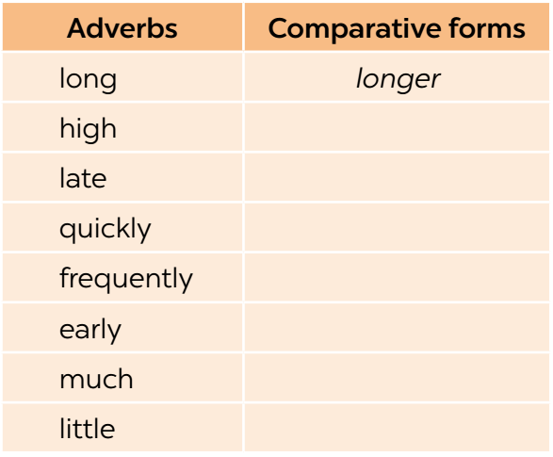
PRACTICE
1
Write the comparative forms of the adverbs in the table below.
higher
later
more quickly
more frequently
earlier
more
less

Slide 7
PRACTICE
2
Complete the sentences with the comparative forms of the adverbs in brackets.
1. Mai dances (beautifully) _______________ than Hoa does.
2. Please write (clearly) _____________. I can’t read it.
3. Life in the city seems to move (fast) _____ than that in the countryside.
4. If you want to get better marks, you must work much (hard) ______.
5. Today it’s raining (heavily) ____________ than it was yesterday.
more beautifully
more clearly
faster
harder
more heavily

Slide 8
PRACTICE
3
Complete the sentences with suitable comparative forms of the adverbs from the box.
early soundly fast carefully quietly
1. After his accident last month, he is driving _____________ now.
2. A horse can run ______ than a buffalo.
3. You’re too loud. Can you speak a bit ____________?
4. After working hard all day on the farm, we slept ____________ than ever before.
5. The farmers started harvesting their crops ______ than expected.
more carefully
faster
more quietly
more soundly
earlier

Slide 9
PRACTICE
4
Read the situations and complete the sentences using the comparative forms of the adverbs in brackets.
1. The red car can run 200 km/h while the black car can run 160 km/h.
 The red car can run _______________________. (fast)
2. Nick can jump 1.5 m high while Tom can jump only 1.3 m.
 Nick can jump ___________________. (high)
faster than the black car
higher than Tom (can)

Slide 10
PRACTICE
3. Mai and hoa both did well on the exam. Hoa got 80% of the answers correct and Mai got 90%.
Mai did ___________________________. (well)
4. My dad expected the workers to arrive at 7 a.m., but they arrived at 6:30 a.m.
The workers arrived __________________________. (early)
5. The buses run every 15 minutes. The trains run every 30 minutes.
 The buses run ____________________________. (frequently)
better on the exam than Hoa
earlier than my dad expected
more frequently than the trains

Slide 11
PRODUCTION
5
Work in pairs. Ask and answer to find out who:
– can run faster
– can jump higher
– stays up later at night
– gets up earlier in the morning
Example:
A: How fast can you run?
B: I can run 15 kilometres an hour.
A: OK, you can run faster than me.
Report your results to the class.

Slide 12
CONSOLIDATION
1
Wrap-up
What have we learnt in this lesson?
How to use the comparative forms of adverbs

Slide 13

CONSOLIDATION
2
Homework
Do exercises in the workbook.

Slide 14

Website: hoclieu.vn
Fanpage: facebook.com/www.tienganhglobalsuccess.vn/

