Slide 1


Slide 2
Unit
7
Education options for school-leavers
Unit
FAMILY LIFE
COMMUNICATION AND CULTURE / CLIL
LESSON 7

Slide 3
LESSON 7
COMMUNICATION AND CULTURE / CLIL
WARM-UP
Watch a video
Task 1: Listen and complete the conversation with the expressions in the box. Then practise it in pairs.
Task 2: Make similar conversation.
COMMUNICATION
CLIL
Task 1: Read the text and complete the table below with information from the text. Use no more than TWO words or a number in each gap.
EXTRA ACTIVITY
Task 2. Work in groups. Discuss the similarities and differences between education after leaving school in Viet Nam and in the UK.
Wrap-up
Homework
CONSOLIDATION

Slide 4
WARM-UP
Watch a video and answer the questions
1. How many people are there in the conversation?
2. What is the man doing?

Slide 5
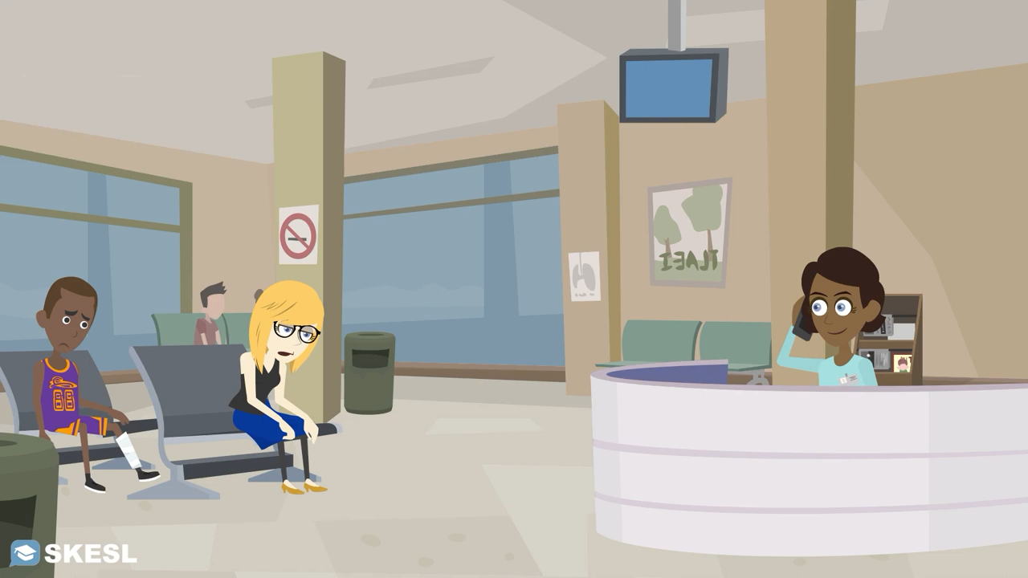
WARM-UP
Watch a video and answer the questions

Slide 6
WARM-UP
Watch a video and answer the questions
1. How many people are there in the conversation?
2. What is the man doing?
-> There are two people in the conversation.
-> The man is calling to make an appointment with the doctor.

Slide 7
EVERYDAY ENGLISH
1
Listen and complete the conversation with the expressions in the box. Then practise it in pairs.
A. suit you B. shall I come C. I have another appointment D. could I meet you
D
Lan: Ms Ha, (1) ________ on Thursday afternoon? I would like your advice on how to prepare for my university entrance exam next year.
Ms Ha: Sorry, (2) ________ at that time. But I’m free on Saturday morning.
Lan: That would be good for me. What time (3) ________ to see you?
Ms Ha: Would 9 o’clock (4) ________?
Lan: Yes, sounds good. Thank you, Ms Ha.
Ms Ha: OK, then. See you on Saturday in the staffroom.
C
B
A

Slide 8
EVERYDAY ENGLISH
Useful expressions
Making an appointment | Giving a positive response
• Will you be available on/at …? • I’d like to make/arrange an appointment with you on/at … • Would … suit you/be OK for you? • When’s convenient for you? | • All right, I’ll see you then. • OK, I’ll see you (next week) (at around 3 p.m.).
 | Giving a negative response and proposing another time/date
 | • Sorry, I’ve got another appointment at that time. How about …? • I’m afraid I can’t make it at that time. Are you free on/at …?

Slide 9
EVERYDAY ENGLISH
2
Work in pairs. Use the model in 1 to make similar conversations for these situations. One of you is Student A, the other is Student B. Use the expressions below to help you.
Student A, a secondary school student, makes an appointment to see Student B, a university representative, to ask for advice on his/her education plans after leaving school. Student B can't make the suggested day/time and proposes another day/time.
Student B, a secondary school student, makes an appointment to see Student A, a career advisor, to ask for advice on vocational courses. Student A can't make the suggested day/ time and proposes another day/time.

Slide 10
CULTURE
1
Read the text and complete the table below with information from the text. Use no more than TWO words or a number in each gap.
UK education after secondary school
Age at end of formal education | • 16 in the UK • stay until the age of (1) ________ in full-time education or do training in England
Vocational education | • lasts up to three years • also called career education or (2) _________________ • some students still go on to (3) _______________
Sixth form | • lasts two years • Students study subjects •Grades are used to apply for (4) _______________.
University education | Students study to get a (5) _______________, a master’s degree, or a doctorate.
18
technical education
higher education
university courses
bachelor’s degree

Slide 11

CULTURE
2
Work in groups. Discuss the similarities and differences between education after leaving school in Viet Nam and in the UK.

Slide 12
CULTURE
2
Work in groups. Discuss the similarities and differences between education after leaving school in Viet Nam and in the UK.
Suggested answers:
Similarities
Both systems provide vocational education after secondary school
Differences:
In Viet Nam, students leave secondary school at 18. Then they can start university immediately.
In some parts of the UK, students can leave school at 16.

Slide 13
CONSOLIDATION
1
Wrap-up
What have you learnt today?
The similarities and differences between education after leaving school in Viet Nam and in the UK.
Review expressions for making an appointment

Slide 14
CONSOLIDATION
2
Homework
Do exercises in the workbook.
Prepare for Lesson 8 - Unit 7.

Slide 15

Website: hoclieu.vn
Fanpage: facebook.com/sachmem.vn/

