Slide 1


Slide 2

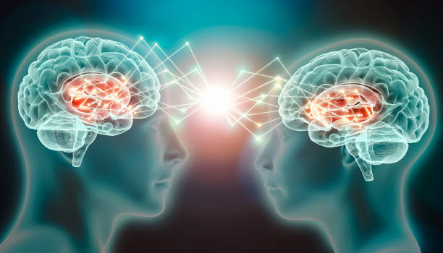
Unit
10
COMMUNICATION IN THE FUTURE
LESSON 5: SKILLS 1
1

Slide 3
LESSON 5: SKILLS 1
WARM-UP
Task 1: List as many ways of communication as you can.
*Vocabulary
Task 2: Read an interview with Minh and Tom. Tick the speaker of each sentence.
Task 3: Read the interview again. Choose the correct answer A, B, or C.
READING
SPEAKING
Task 4:. Read the ideas about online calls. Put the ideas in the correct column.
Task 5: Choose a way of communication and discuss its advantages and disadvantages. Report your answers to the class.
CONSOLIDATION
Wrap-up
Homework

Slide 4
WARM-UP
1
Work in pairs. List as many ways of communication as you can.
Example: meeting face to face, sending letters, chatting online, etc….
COMMUNICATION

Slide 5

READING
telepathy (n)
/təˈlepəθi/
thần giao cách cảm

Slide 6
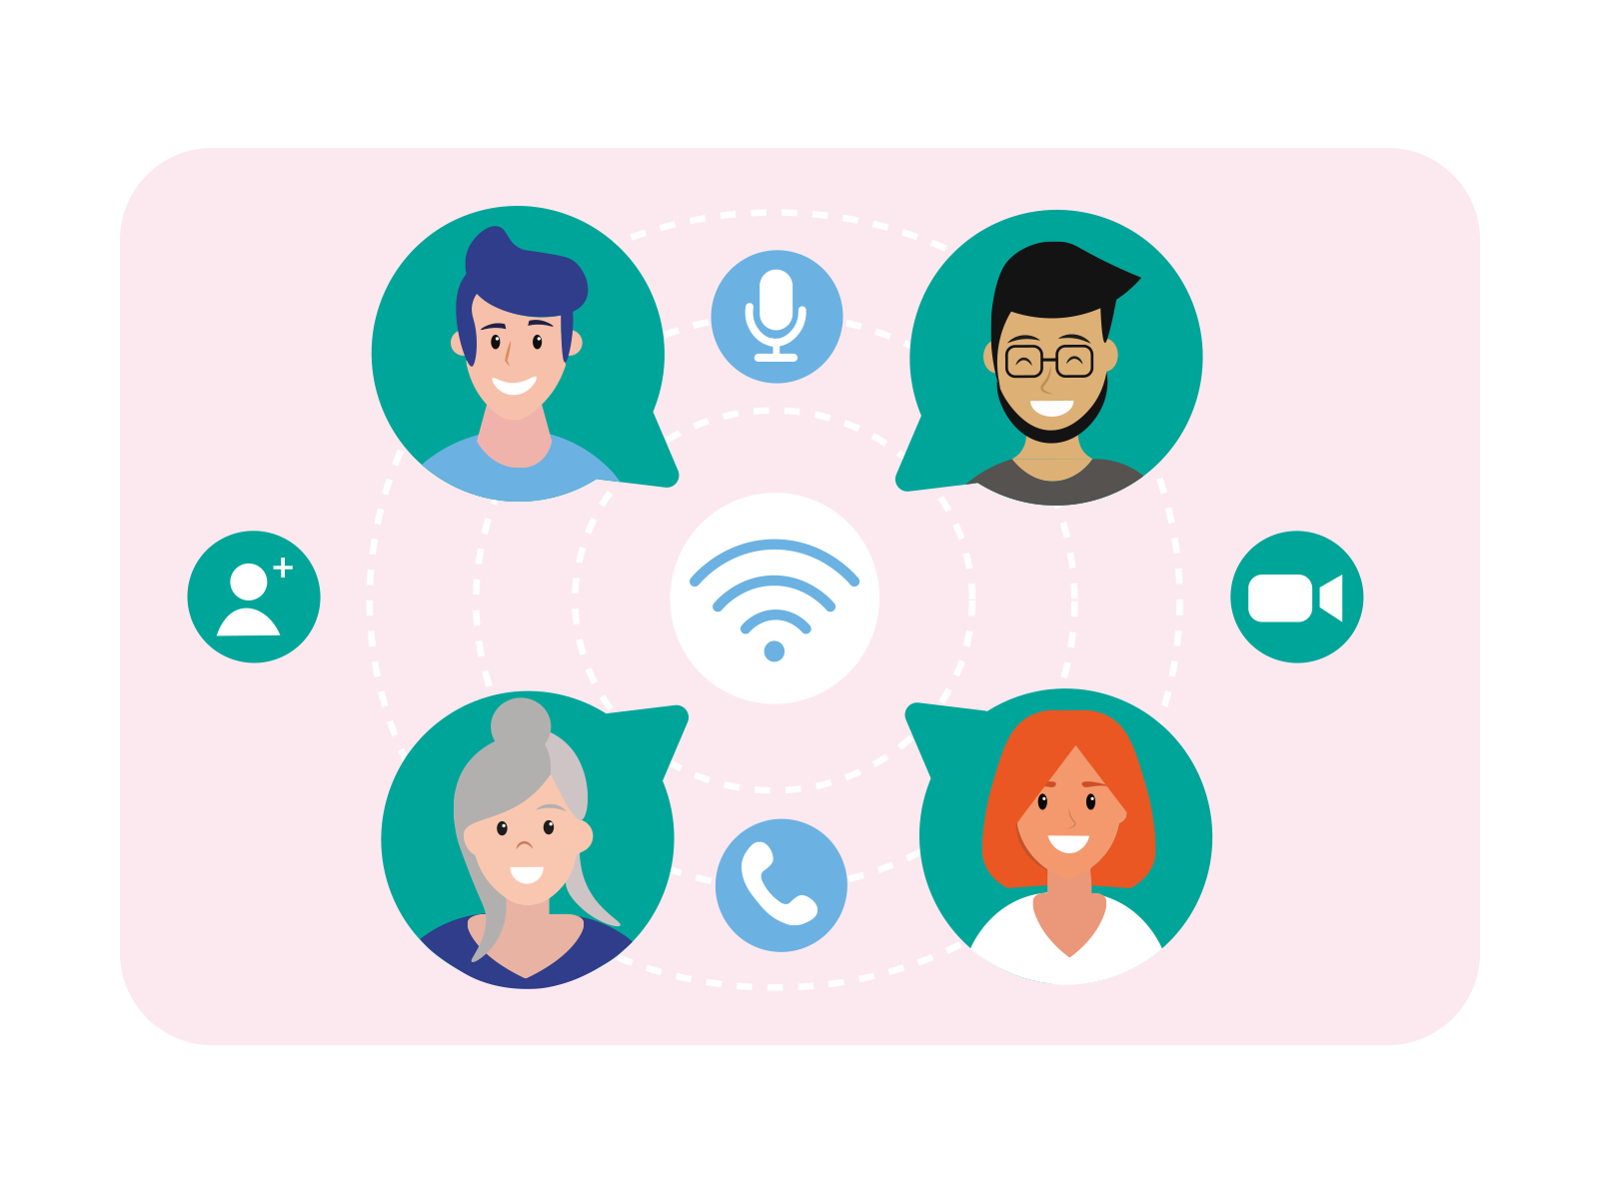
READING
keep in contact (v)
/kiːp ɪn kənˈtækt/
giữ liên lạc

Slide 7

READING
thought (n)
/θɔːt/
suy nghĩ

Slide 8
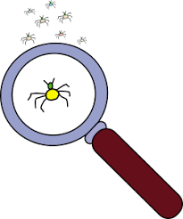
READING
tiny (a)
/ˈtaɪni/
nhỏ bé

Slide 9
READING
New words | Pronunciation | Meaning
1. telepathy (n) | /təˈlepəθi/ | thần giao cách cảm
2. keep in contact (v) | /kiːp ɪn kənˈtækt/ | giữ liên lạc
3. thought (n) | /θɔːt/ | suy nghĩ
4. tiny (a) | /ˈtaɪni/ | nhỏ bé

Slide 10

READING
2
Read an interview with two students, Minh and Tom. Then tick the speaker of each sentence.
Who says that…? | Minh | Tom
1. he sends voice messages to friends
2. he calls his friends by using the Internet
3. everyone will be able to use telepathy in the future
4. people need a small device to send their thoughts to others
5. bad people can make use of telepathy to harm others

Slide 11
READING
3
Read the interview again. Choose the correct answer A, B, or C.
1. What is the interview mainly about?
A. One way of future communication.
B. Voice chats and online calls.
C. Problems of telepathy.
2. Which way of communication below is NOT mentioned in the interview?
A. Meeting face to face
B. Writing an email
C. Telepathy

Slide 12
READING
3
Read the interview again. Choose the correct answer A, B, or C.
3. According to Tom, telepathy means ______.
A. making phone calls via the Internet
B. talking on tiny devices
C. communicating by thoughts
4. The MC says that ______.
A. telepathy is perfect
B. not all people can do telepathy
C. she disagrees with Minh’s opinion

Slide 13
READING
3
Read the interview again. Choose the correct answer A, B, or C.
5. What does the MC think may be a problem with telepathy?
A. People won’t want to meet each other.
B. Telepathy devices can be expensive.
C. Some people won’t want to talk anymore.

Slide 14
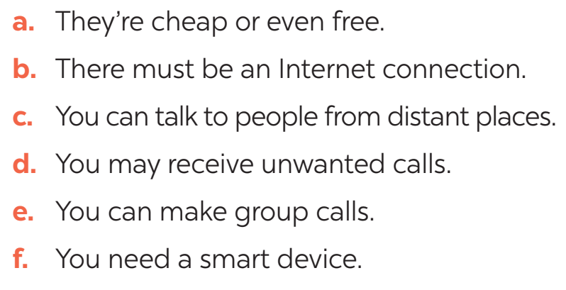
SPEAKING
4
Work in pairs. Read the following ideas about online calls. Put the ideas in the correct column.
Advantages | Disadvantages
a
b
c
d
e
f

Slide 15

SPEAKING
5
Work in groups. Choose a way of communication and discuss its advantages and disadvantages. Then report your answers to the class.
- To start a talk about advantages and disadvantages:
+ I think there are both advantages and disadvantages of online calls.
- To introduce the advantages:
+ In terms of the advantages / good points, ...
+... can be beneficial in many ways. First, ...
- To introduce the disadvantages:
+ However, ... has some drawbacks. For example, ...

Slide 16

CONSOLIDATION
1
Wrap-up
What have we learnt in this lesson?
read about telepathy
talk about future communication

Slide 17

CONSOLIDATION
2
Homework
Do exercise in the workbook.

Slide 18

Website: hoclieu.vn
Fanpage: facebook.com/tienganhglobalsuccess.vn/

