Slide 2

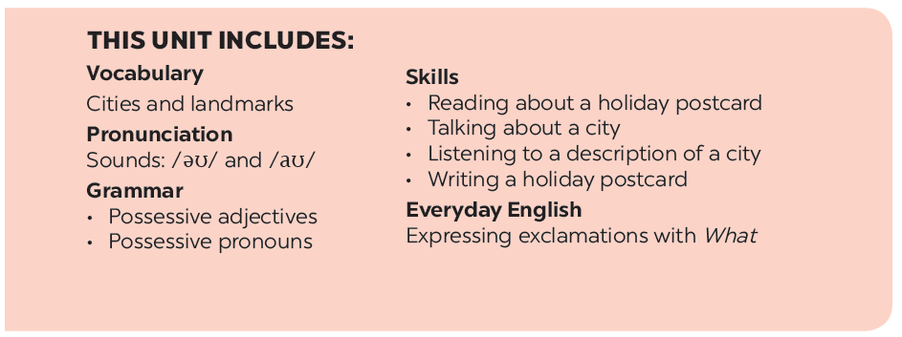

Slide 3







Vocabulary
Pronunciation
/əʊ/ and /aʊ/
Fill each box with an adjective.
Listen and write the words in the correct column. Then listen and repeat.
Complete the sentences with the words in 1.
Listen and repeat. Pay attention to the underlined words.
Write the words / phrases below under the correct pictures.

Slide 4


Fill each box with an adjective.
Vocabulary
rainy
old
exciting
old
city
delicious
delicious
tasty
friendly
food
exciting
friendly
helpful
sunny
people
tasty
rainy
sunny
helpful
weather

Slide 5

Complete the sentences with the words in 1.
Vocabulary
1.
- What’s the weather like in Sydney in summer?
sunny
- It’s and dry.
I love the buildings in Edinburgh. I feel that they can tell stories.
2.
old
There are so many things to do in New York. It’s very .
3.
exciting
4.
The people in my city are and helpful.
friendly
5.
Ha Noi is famous for its street food.
delicious / tasty

Slide 6

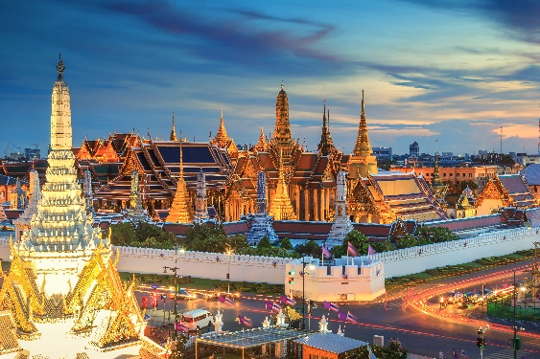
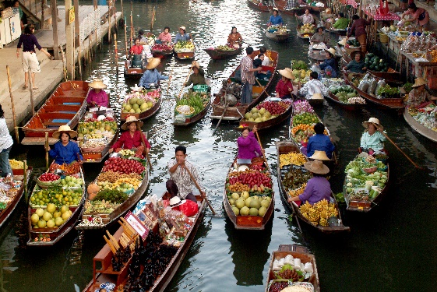
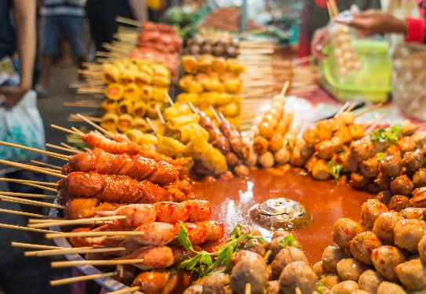
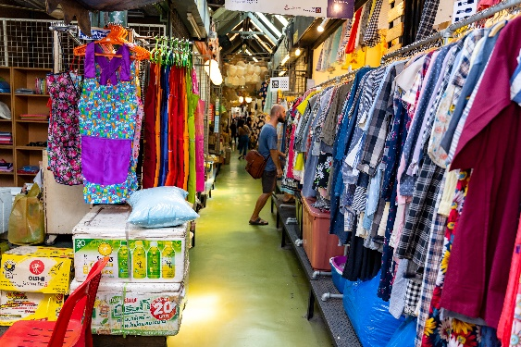
Write the words / phrases below under the correct pictures.
Vocabulary
stall
street food
palace
floating market
1.
palace
2.
floating market
3.
street food
4.
stall

Slide 7


Listen and write the words in the correct column. Then listen and repeat.
Pronunciation
/əʊ/ and /aʊ/
boat
house
town
tower
postcard
crowded
coast
pagoda
/əʊ/
/aʊ/
boat
house
postcard
crowded
coast
town
pagoda
tower

Slide 8

Listen and repeat. Pay attention to the underlined words.
Pronunciation
/əʊ/ and /aʊ/
1.
The town is crowded at the weekend.
2.
There’s lots of snow in Tokyo in winter.
3.
It’s very cold on the boat.
4.
He’s running aroud the house.

Slide 9






Website: hoclieu.vn
Fanpage: facebook.com/www.tienganhglobalsuccess.vn/

