Slide 1



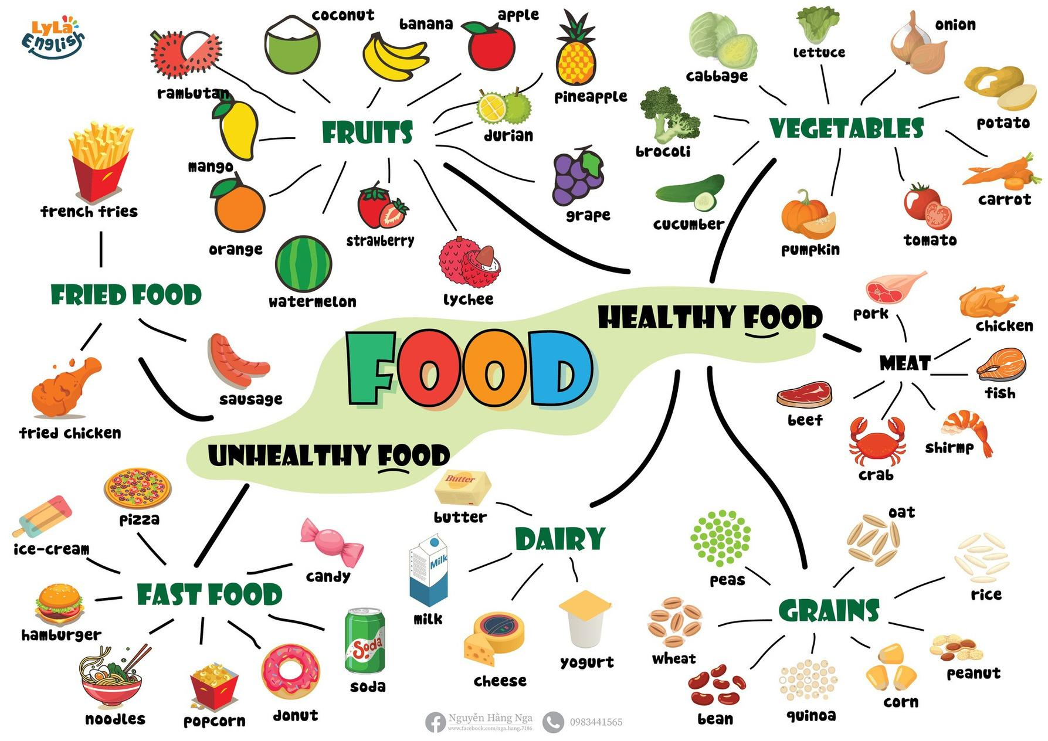


Slide 2

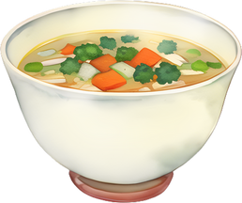

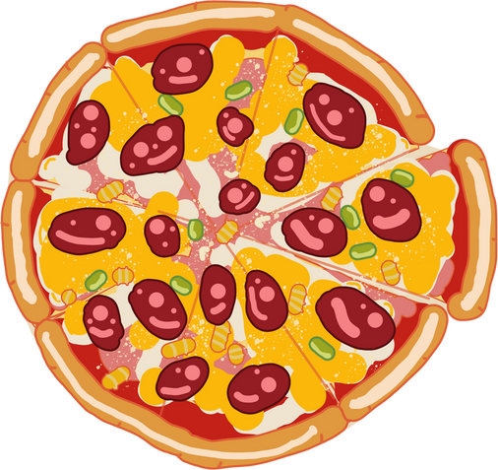




I. QUESTION
1. What do you eat for breakfast/ lunch/ dinner?
I eat...
2. What food do you like?/ what is your favorite food?
It’s ...
3. What shape is the pizza?
It’s ...
4. Is soda good for your health?
No/Yes...
5. Can you tell me some healthy food/ unhealthy food?

Slide 3






II. VOCABULARY
sandwich:...........................................................
noodles:.............................................................
bread:...............................................................
sticky rice:.........................................................

Slide 4


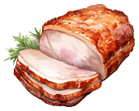


II. VOCABULARY
pork:...........................................................
rice:.............................................................
soup:...............................................................
broccoli:.........................................................

Slide 5

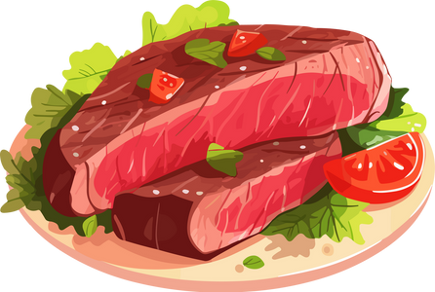
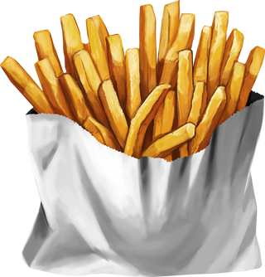
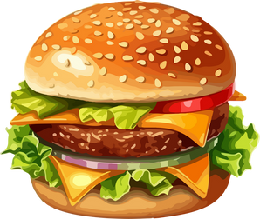
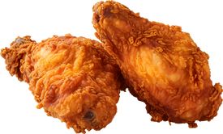

II. VOCABULARY
beef:...........................................................
french fries:.................................................
hamburger:.................................................
fried chicken:..............................................
soda:...........................................................

Slide 6






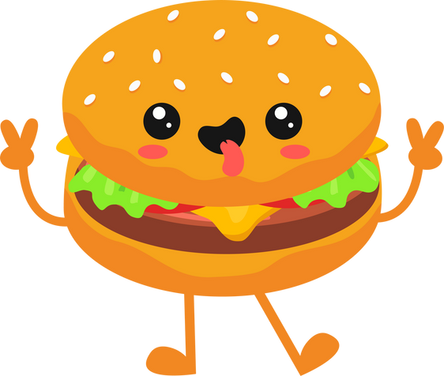
III. EXERCISES
1. Look at the picture and circle:
Soup Pork
Sausage
Orange Banana Carrot
Milk Beef
Orange
Butter
Cheese
Hamburger
Donut
Coca
Pizza chicken
Milk
Candy

Slide 7





III. EXERCISE:
2. Color the HEALTHY FOOD:

Slide 8

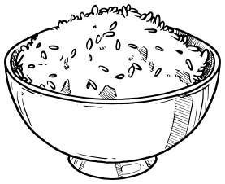


III. EXERCISE:
3. Color the UNHEALTHY FOOD:

Slide 9


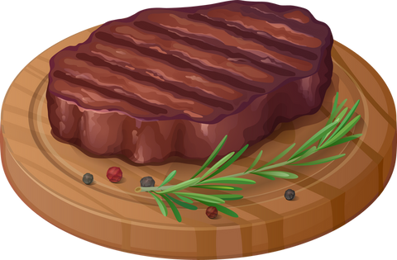

III. EXERCISE:
4. Look and match:
tomato
fried chicken
soup candy
sausage pork

Slide 10






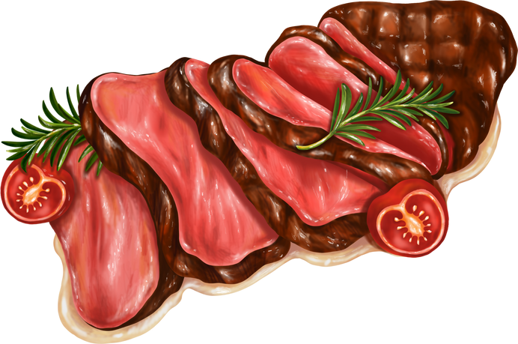

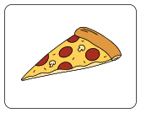

III. EXERCISE:
5. Choose the correct answer:
Healthy Unhealthy
Healthy
Unhealthy
Healthy
Unhealthy
Healthy
Unhealthy
Healthy Unhealthy
Healthy Unhealthy

Slide 11



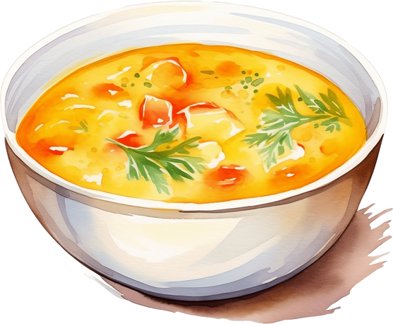

III. EXERCISE:
6. Reorder the words:
c/b/b/a/e/g/a .....
e/e/f/b .....
h/m/a/b/r/u/r/e/g .....
e/b/r/d/a .....
s/p/u/o .....

Slide 12





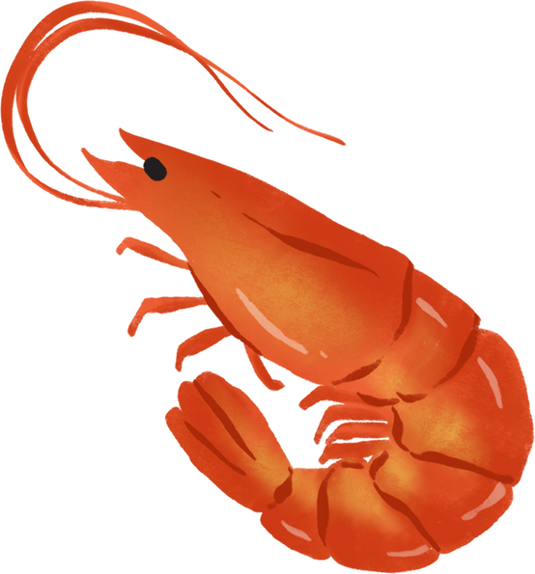
III. EXERCISE:
7. Find half:

Slide 13

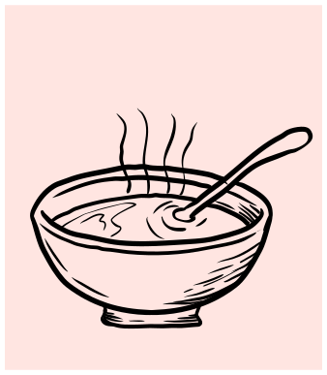
III. EXERCISE:
8. Guess the word:
....
....
....

